Slide 1

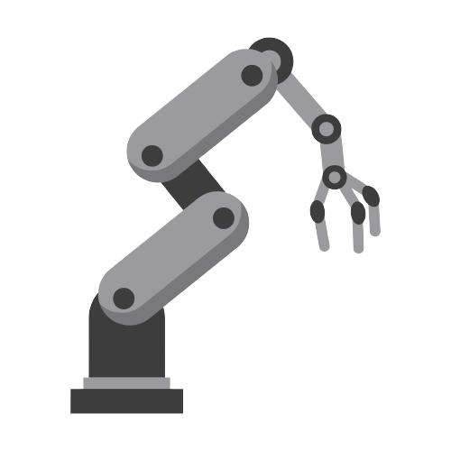

The
Robotics
By team Bulgaria

Slide 2

What are robotics

Slide 3
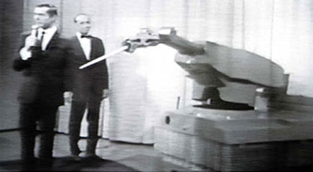
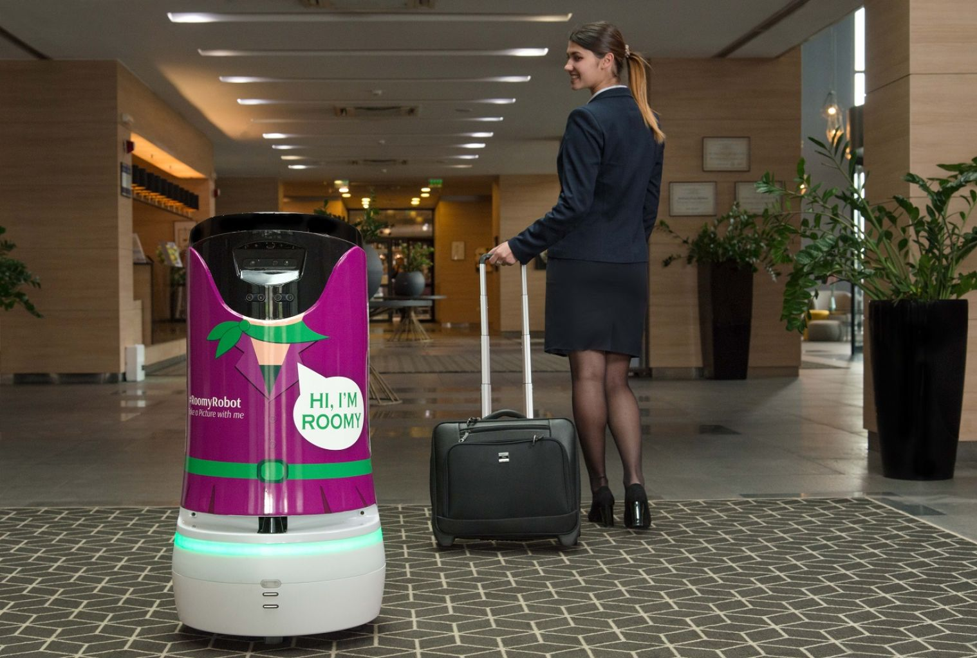
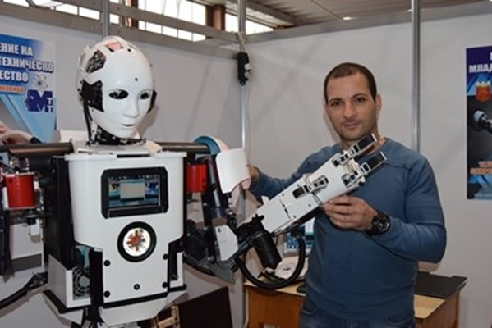
History
BEGINNINGS
CUrrent trends
The future
3000BC - first instance
400BC, 1557, 1700, 19th, 20th century
1950s, George C. Devol –Unimate
1958, Stanford Research
Institute – Wobbly the robot
Robotic Process Automation (RPA)
The Smart Factory
Robotics as a Service (RaaS)
Cobots and other multipurpose robots
Rise of delivery robots
Decreased carbon footprint
Artificial Intelligence (AI)
Actions and thinking like humans
Computer Vision
Manipulation
Motion control
Language processing
World perception

Slide 4
History
BEGINNINGS
3000BC - first instance
400BC, 1557, 1700, 19th, 20th century
1950s, George C. Devol –Unimate
1958, Stanford Research
Institute – Wobbly the robot

Slide 5
History
CUrrent trends
Robotic Process Automation (RPA)
The Smart Factory
Robotics as a Service (RaaS)
Cobots and other multipurpose robots
Rise of delivery robots
Decreased carbon footprint

Slide 6
History
The future
Artificial Intelligence (AI)
Actions and thinking like humans
Computer Vision
Manipulation
Motion control
Language processing
World perception

Slide 7
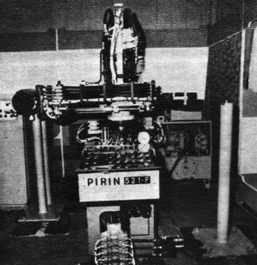
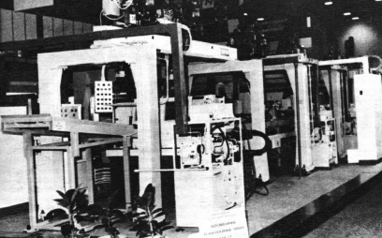
Robotics in Bulgaria
1971 – first robot in Bulgaria, family name "Pirin"
Automation and robotics companies
Company distributors/representatives for robot manufacturers
Robotics schools for young and old
PARA – Professional Association for Robotics and Automation
The first Bulgarian collaborative robot

Slide 8

Our Contribution

Slide 9
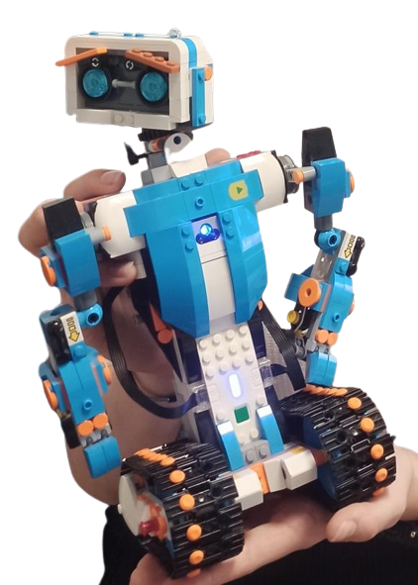
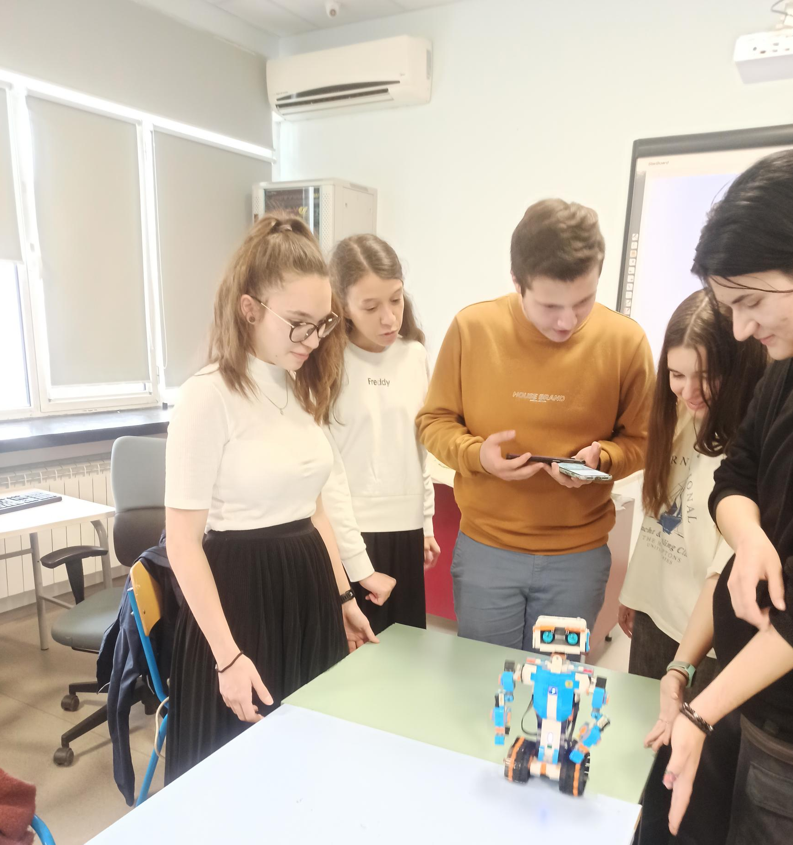
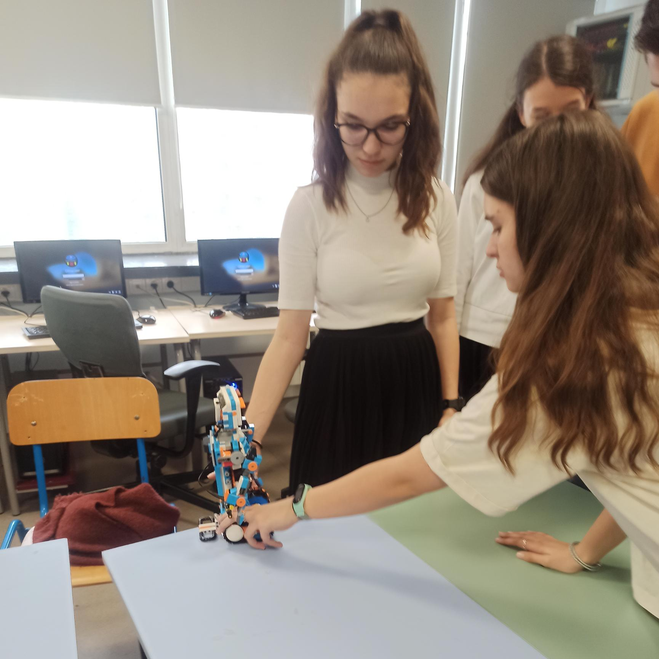
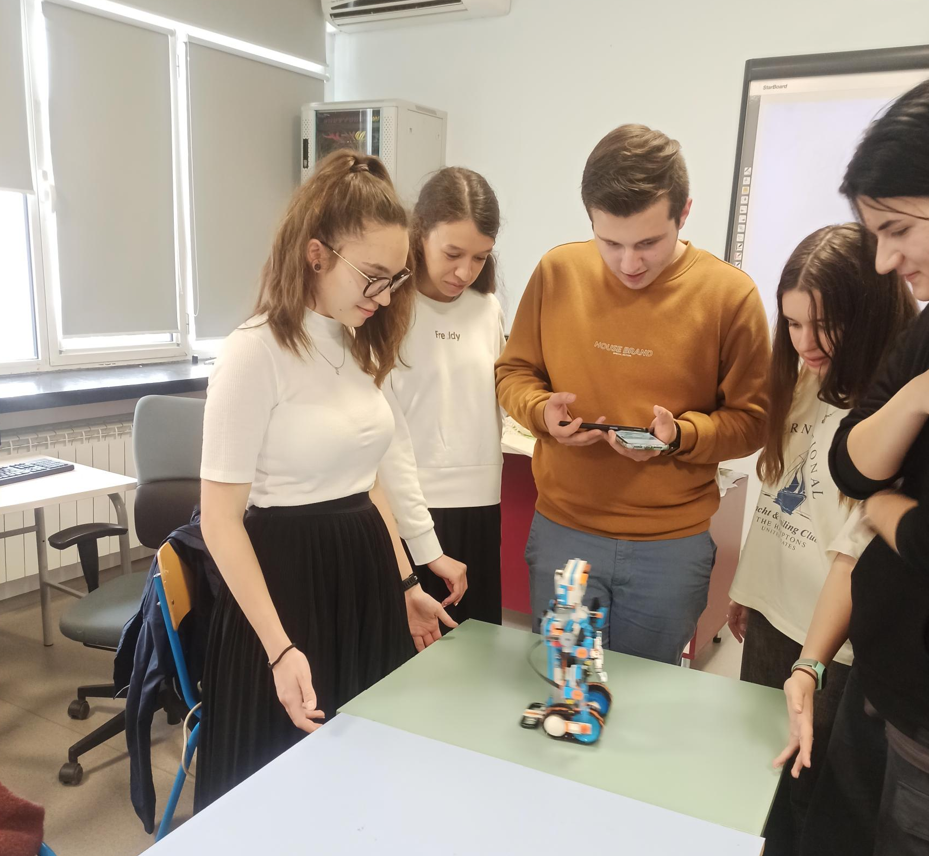
Our robot – SHREK!

Slide 10
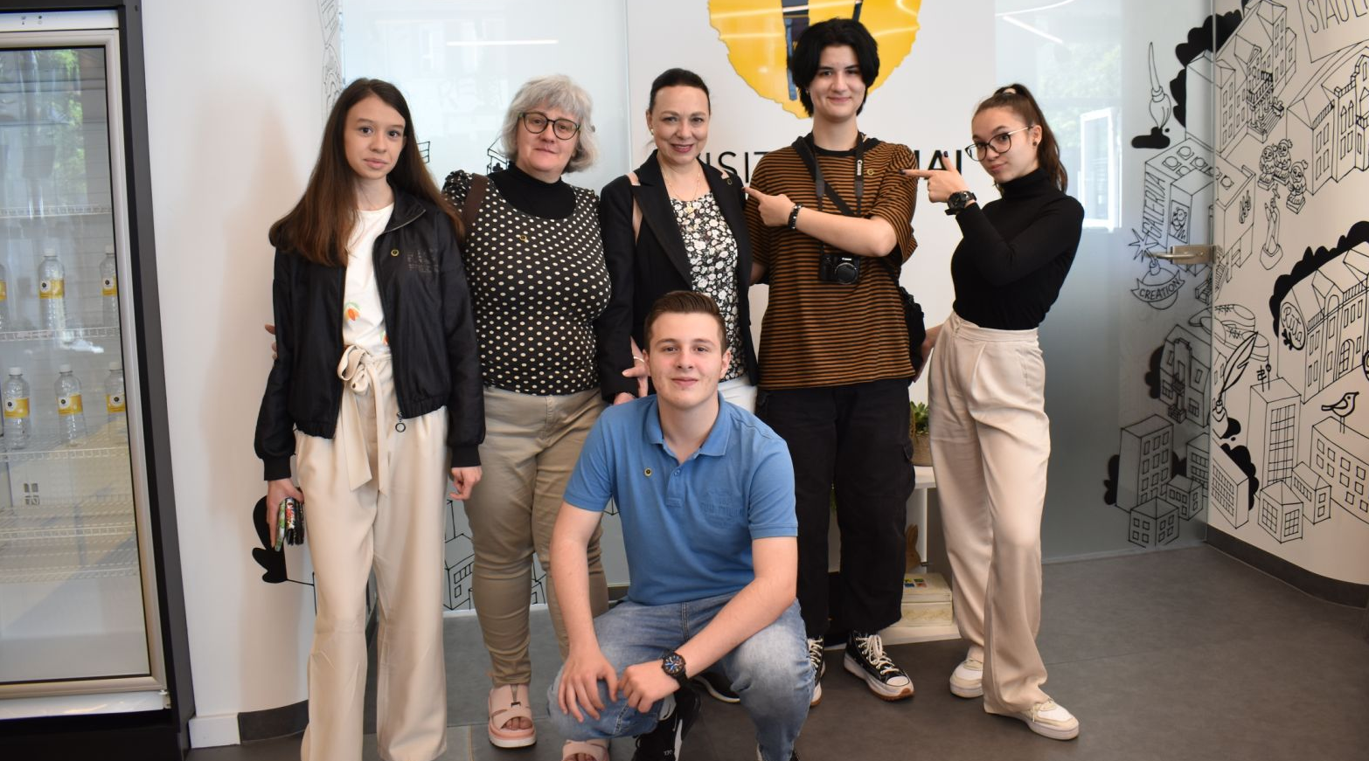


Thank you for the attention

