Slide 1

Coding and Programing
Team Bulgaria

Slide 2
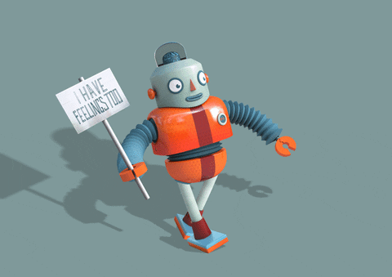
In the episode you will see:
The meaning of coding and programing
The difference between programing and coding
Programming languages and their features
Interesting facts for the history of programming
The future of programing and the future of programming in the EU
AI like a threat to the programmers and not only
Conclusion
Pretty Little Games

Slide 3


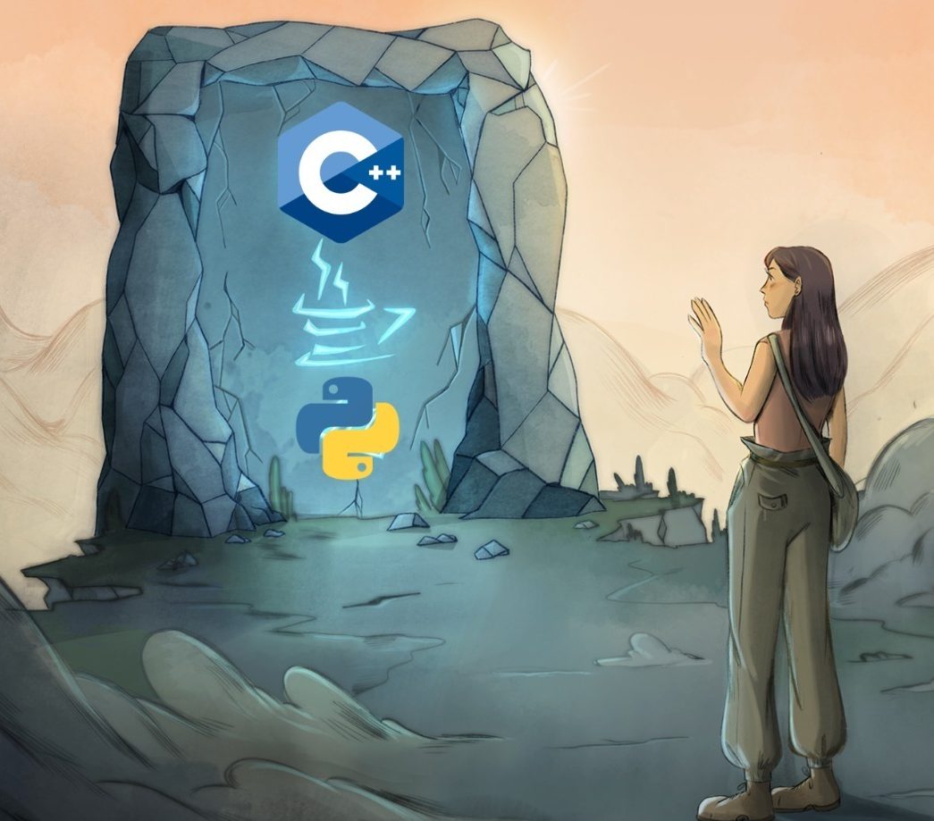
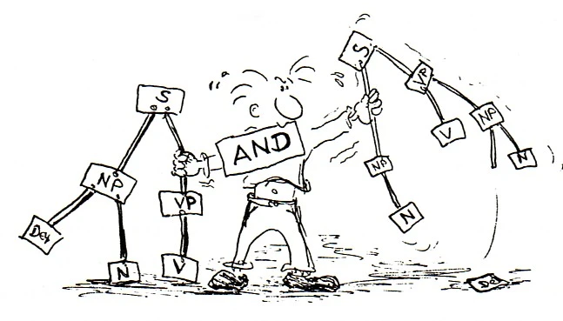
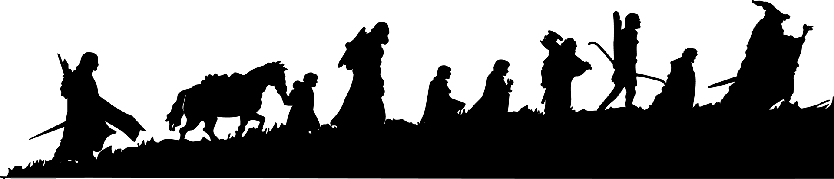
Language
Java
Python
PHP
C++
Ruby

Slide 4

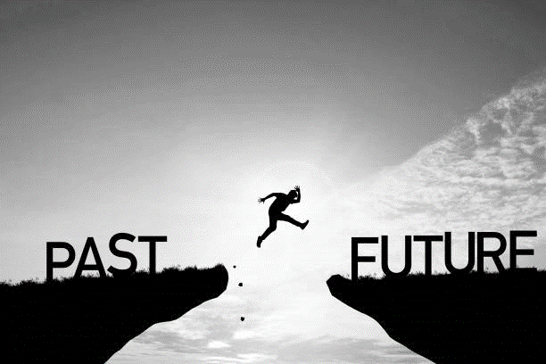

Sequel
Digital single market
Accessibility in Software Development
Low-Code and No-Code Platforms

Slide 5


Ethical Issues in Programming

Slide 6
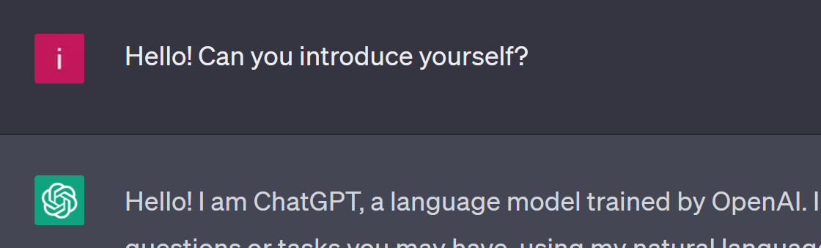

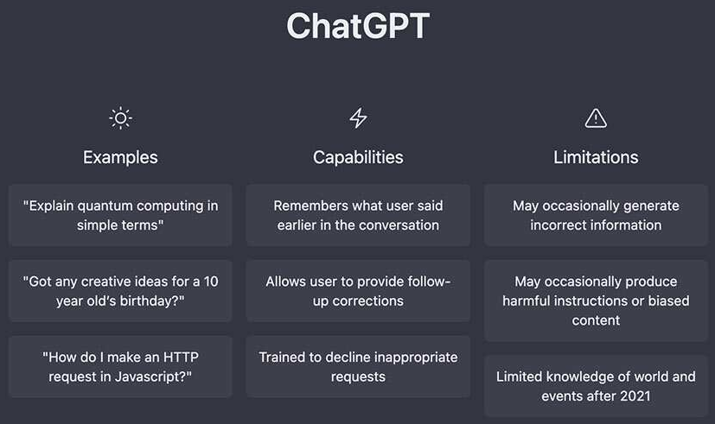
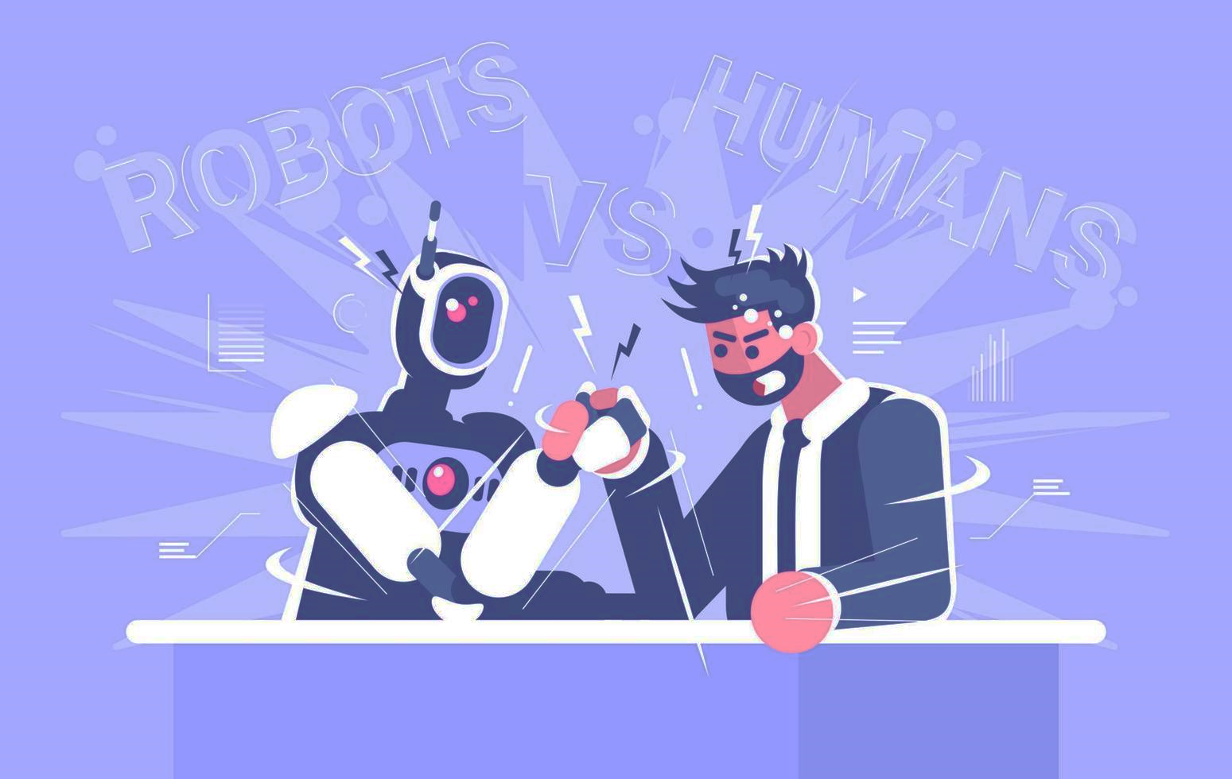
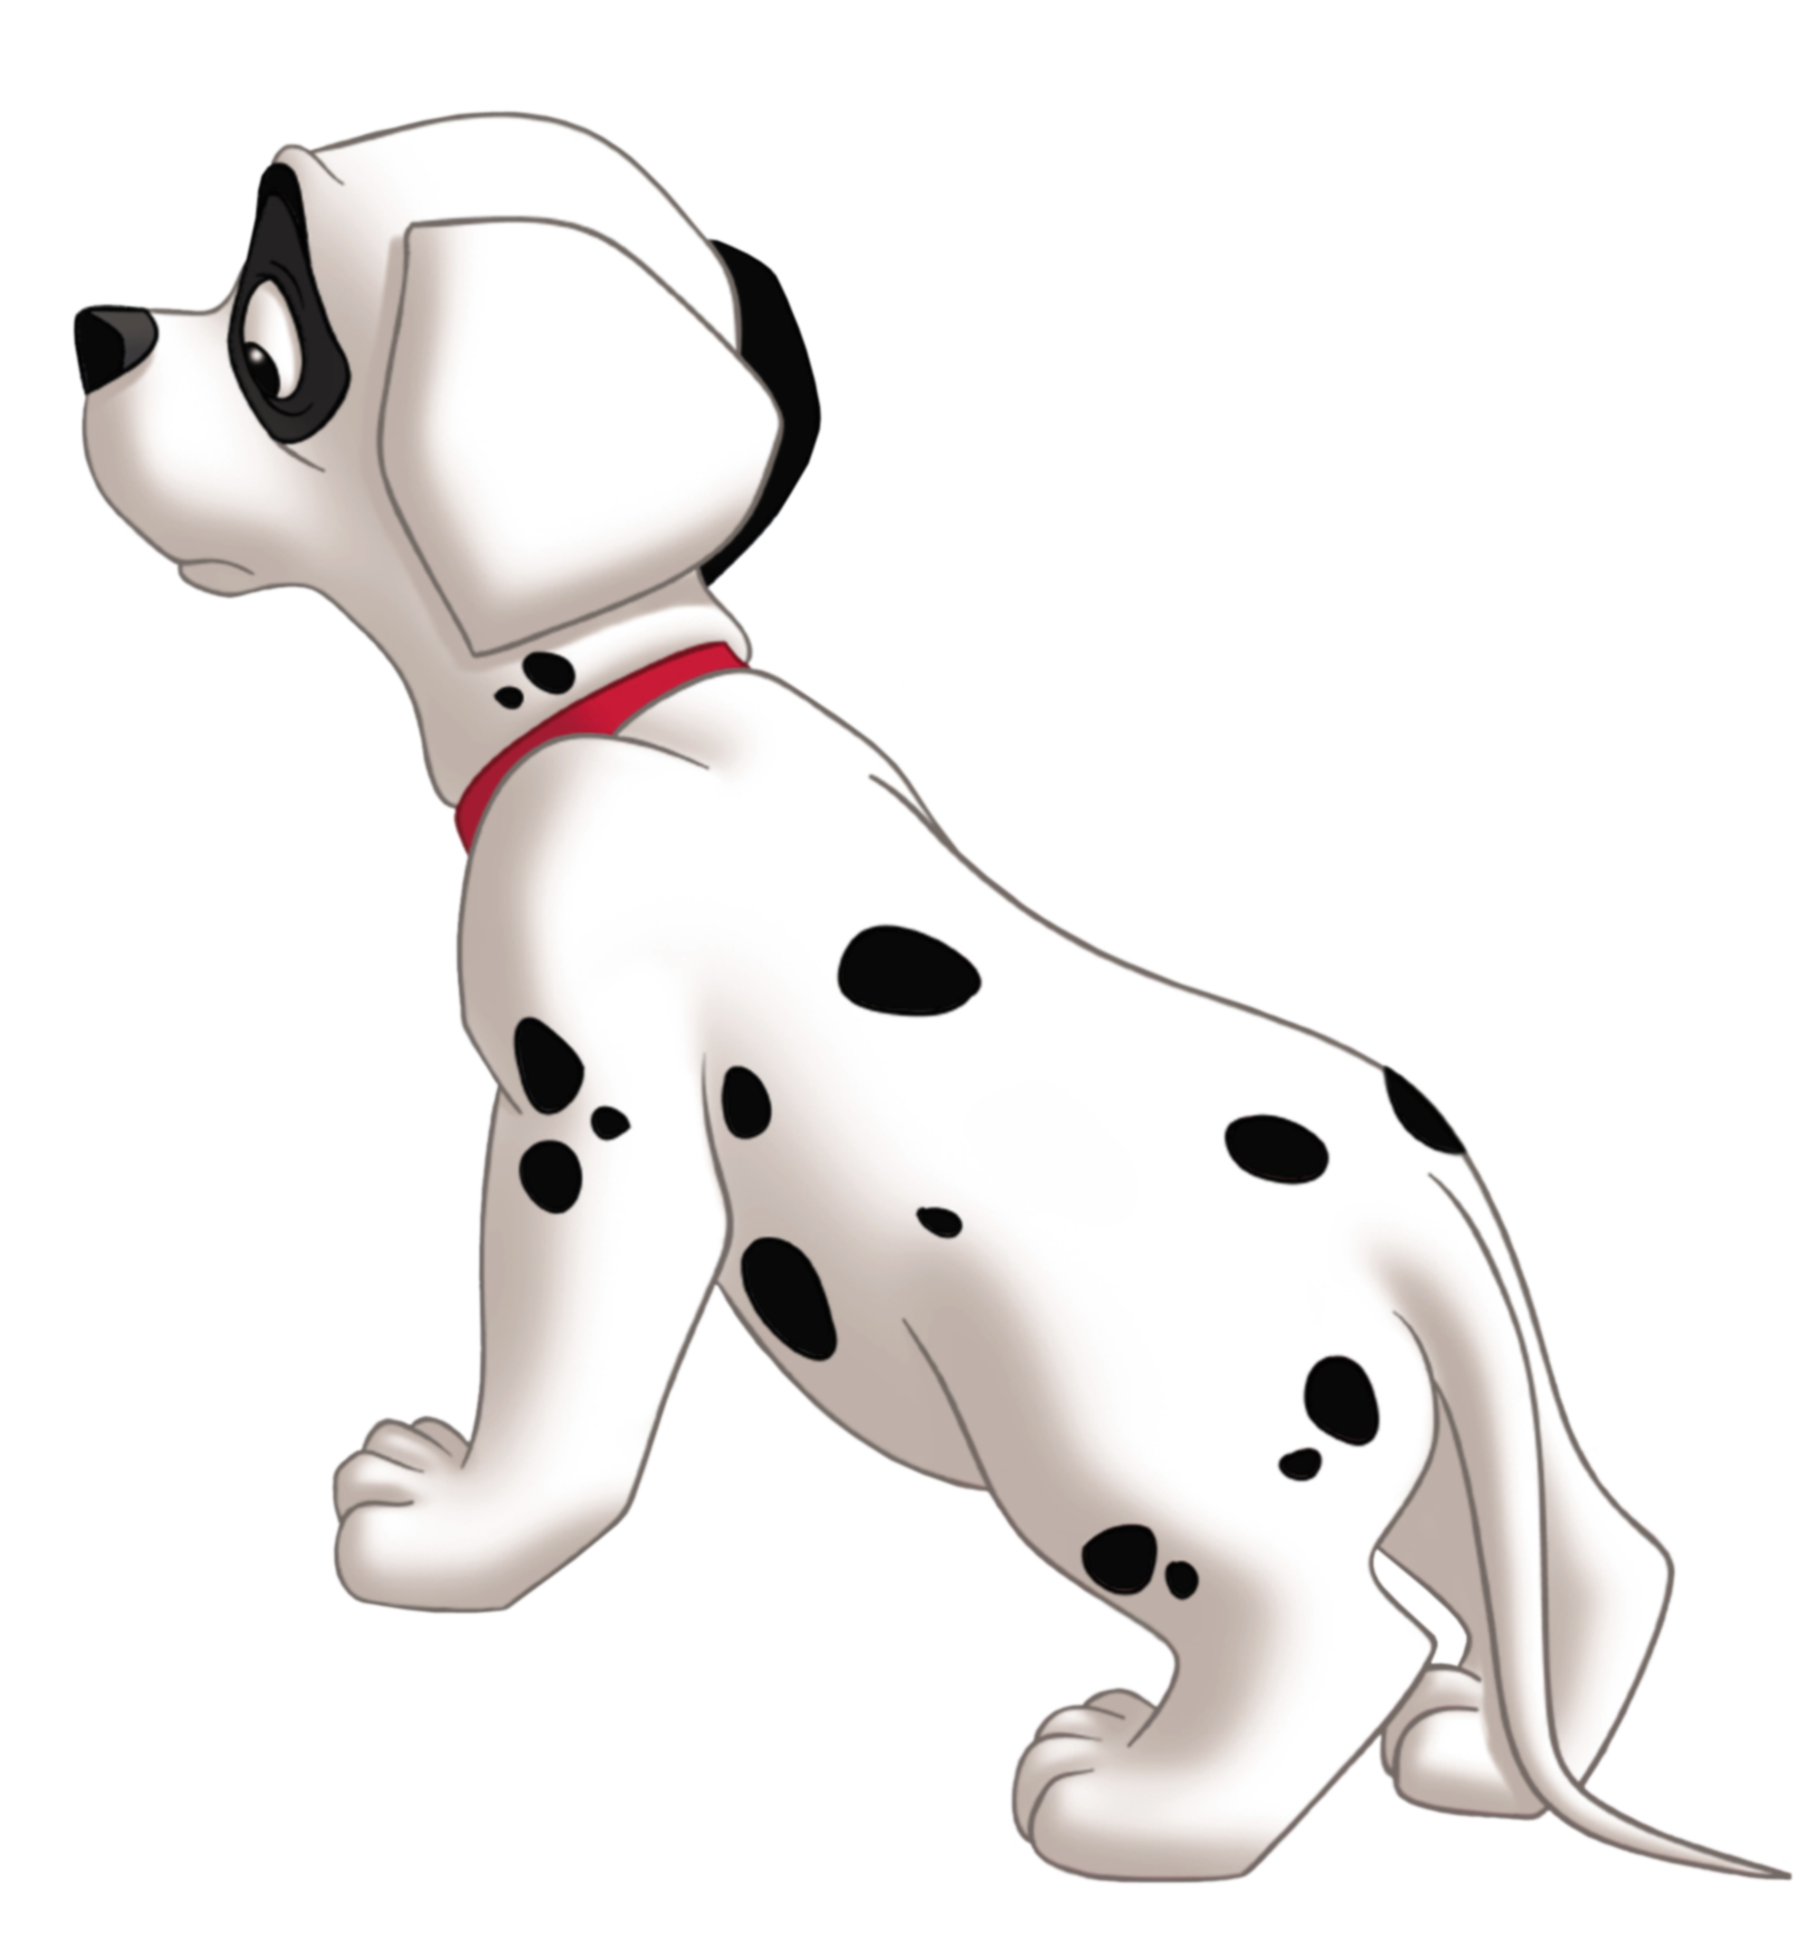
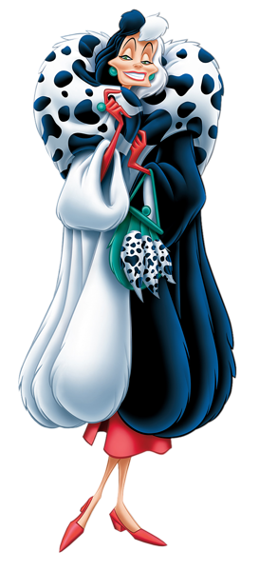

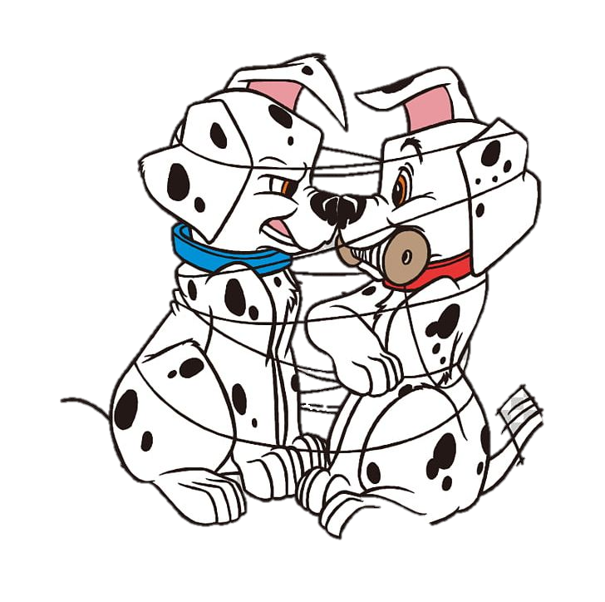
BG
AI-s

Slide 7


Slide 8



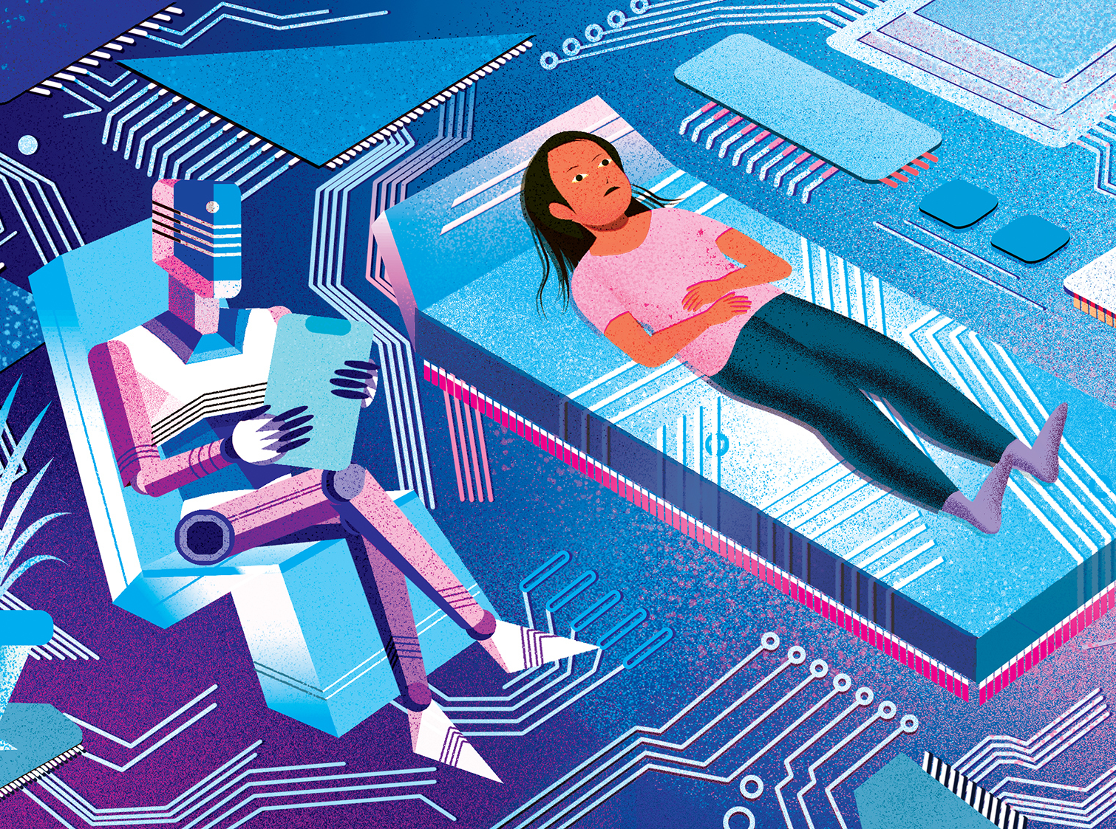
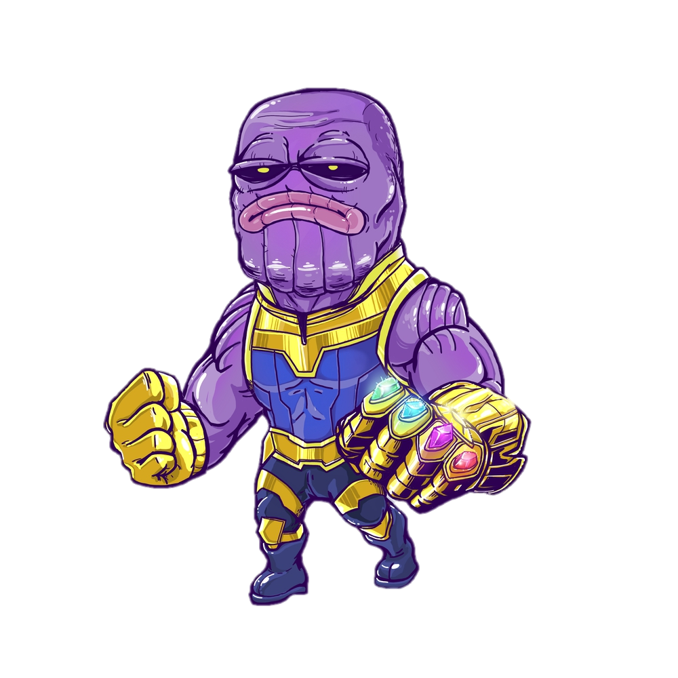
ARRATIONS
Programing
Coding

Slide 9

Pretty Little Games

Slide 10
1. What's the name of the machine on which was the first code written?
2. For which AI tool Eva talked?
3. Which are the languages I talked about?
4. What type of platform is Google sites?
5.What did John Atanasov make?

Slide 11

Thank you for your attention!

