Slide 1
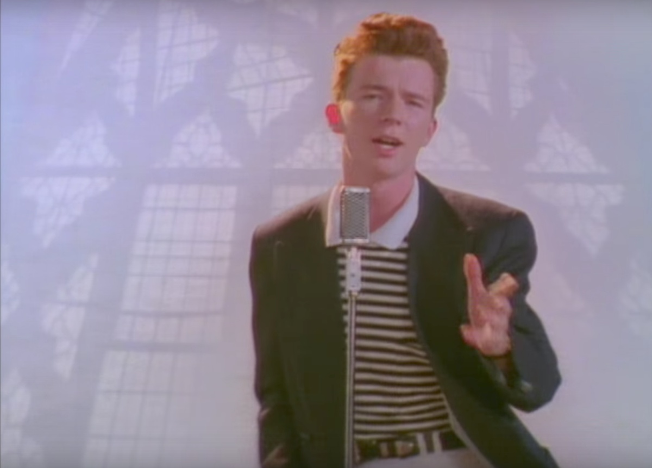
József Attila (Attila József/Joseph)
Made by Tamás Ézsiás

Slide 2

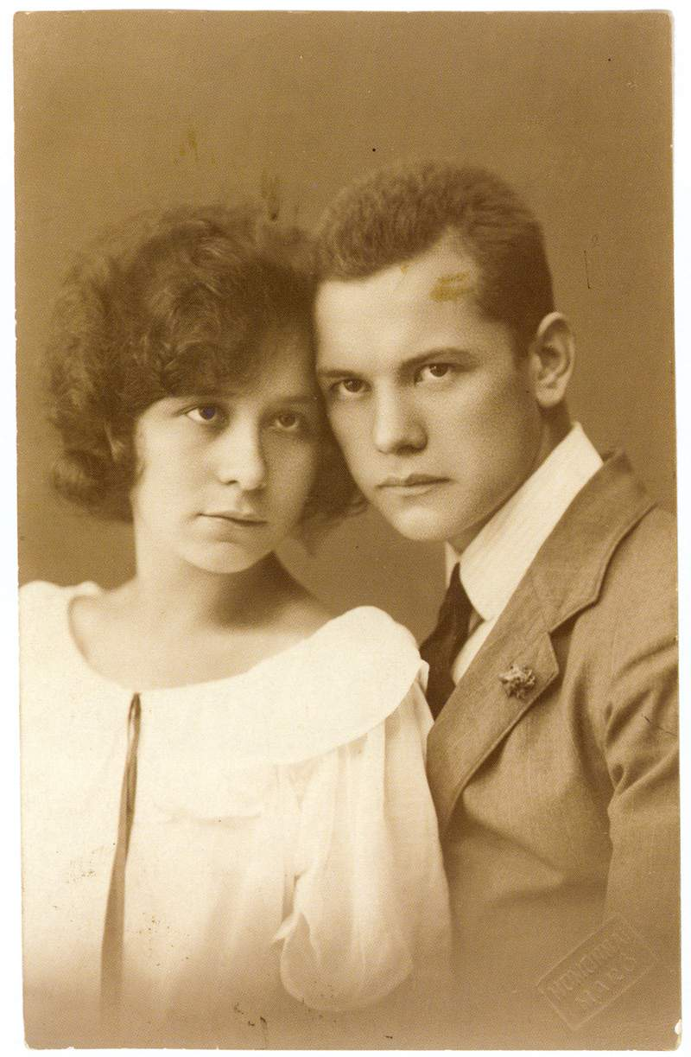
Birth and stuff
He was born on april 11, 1905 in Ferencváros (District 9 of Budapest)
He was born as a 6th child but 3 of his sibling has Died before he even born
His dad left when he was 3 and went to Romania. So he was left with his mother and siblings and after sometime when their Mother could not produce the need for normal life she gave Attila and his sister Etelka to a Children Protection Service (In 1910)
His foster Parents decided that the name Attila does not exist (Just as Romania) so they called him Steve/István
Etelka and Attila

Slide 3
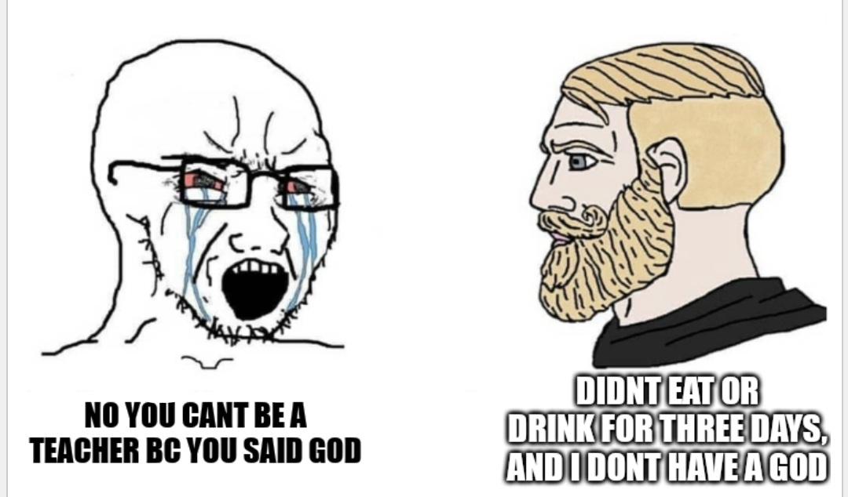
Adulthood (kinda)
After going around the country he came back to Budapest and oddly enough met Mátyás Rákosi (One of the leaders/faces of the socialist era) then he joined the Socialist Worker Party (wich is nice).
In 1925 he joined the University of Wienna but nothing extra happened
Almost forgot to mention that he wanted to be a teacher someday but after writing about not having a god and stuff like that he was kind of banned from the Teaching career

Slide 4

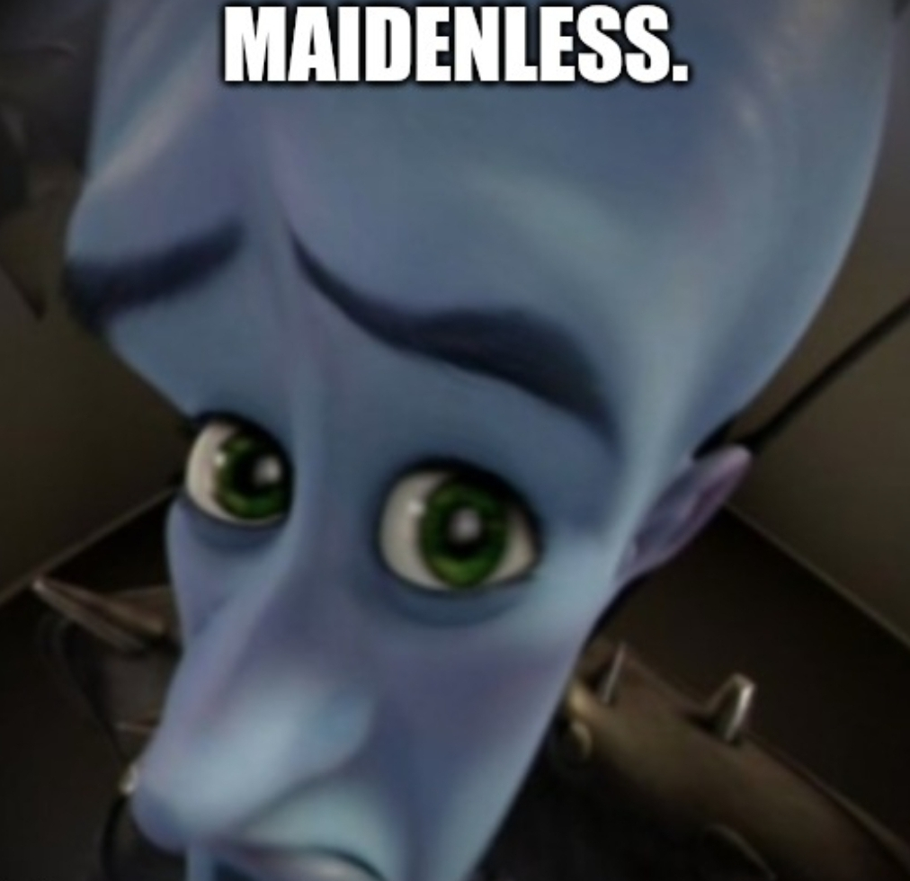
Love life

Slide 5
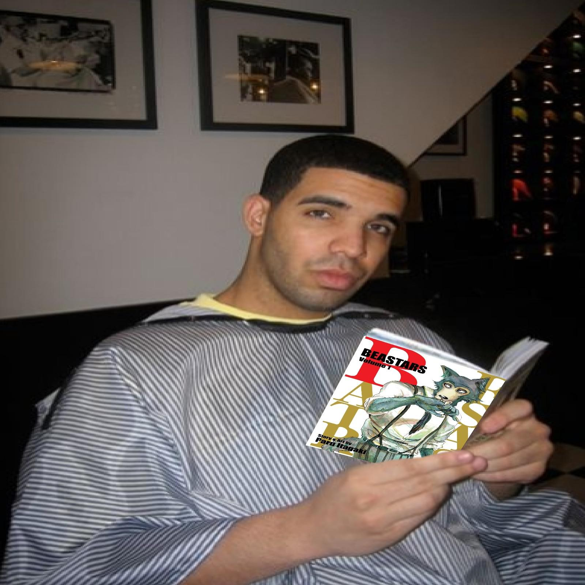
His poetry
Here are some of the work of his from different years
Later (1937)
Talks about a dead person who cared for him and will take him to the afterlife (Most likely its his mom)
WorkerDeath (1922)
Descirbes a death of a worker
And the future after the incident
Corpse on the street (1932)
Describes an of course fictional tale of someone that jumped from a high place and died plus questions the conditions around the incident
Lullaby (1935)
What could it be? Hmm
There is a pattern between his poetry, what could it be? Oh yes...
tshell
WorkerDeath
A worker dies by decapitation
and describes the future after that

Slide 6
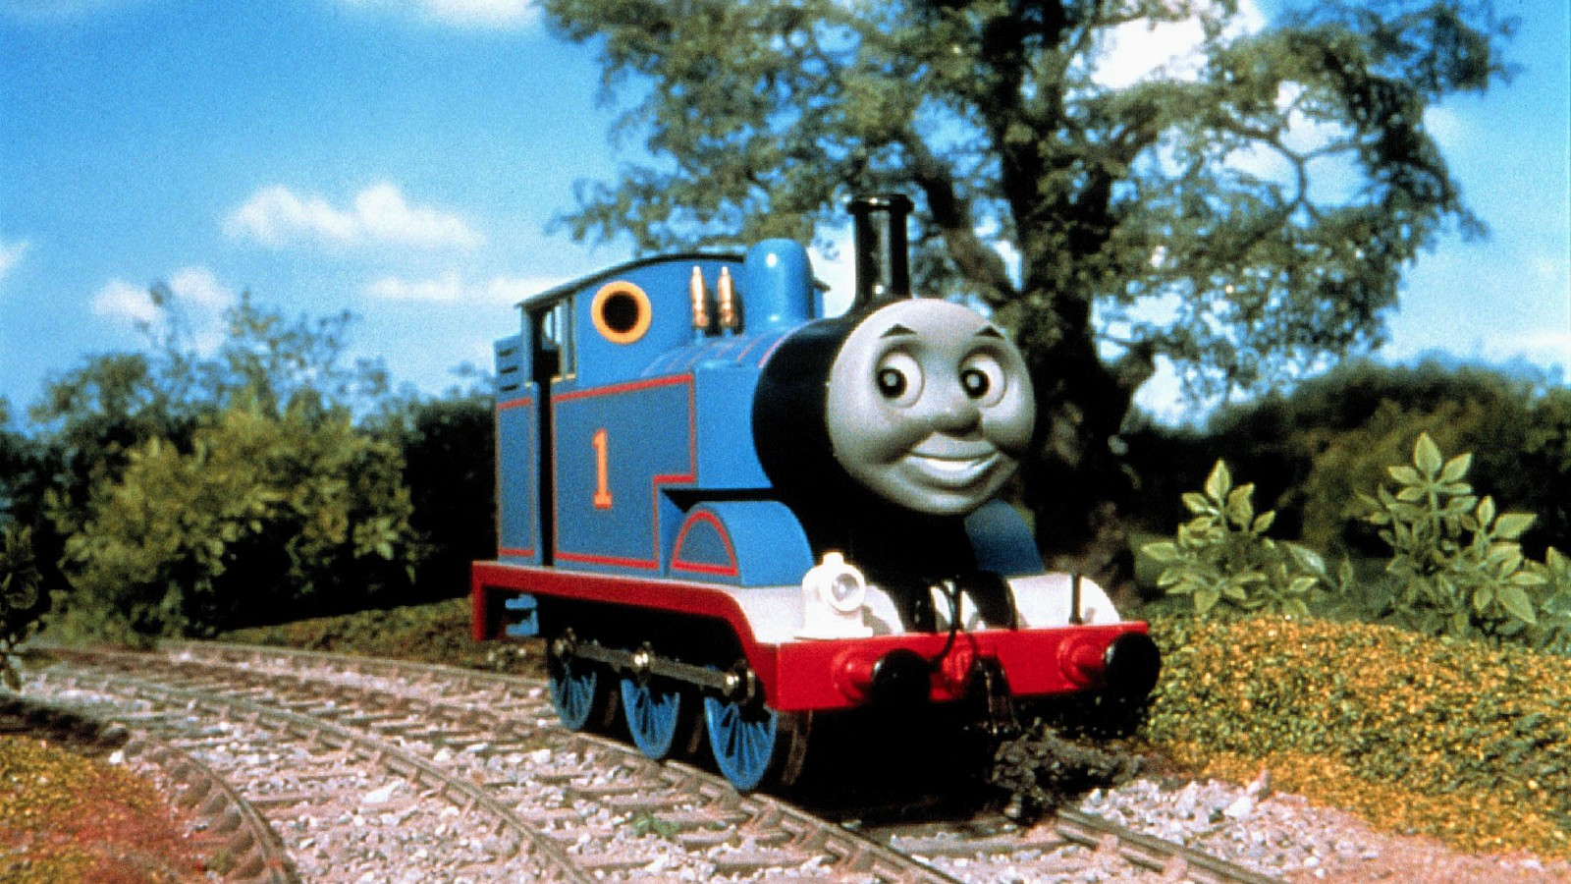
Death
He died by suicide in Balatonszárszó (Oddly enough he wrote a poem about the place)
Many people guesses the true cause of death because suicide is just an assumption
But the fact is that he was hit by a train, as a lonely mentally ill and short lived man at the age of 32

Slide 7

K
K

