Slide 1
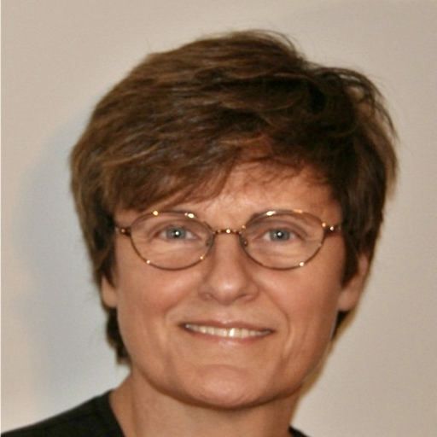
A Hungarian Woman in STEAM
Hungarian students’ presentation
May 2022

Slide 2
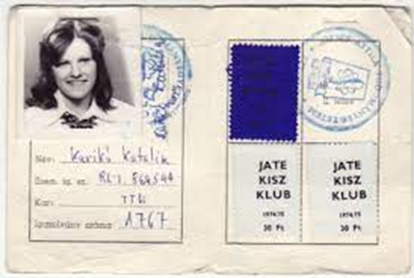
Primary school years
Curiosity, the ability to think and the desire to learn about the world were already present in Kati Karikó, when the father would show his daughter the heart or intestines when butchering a pig as something interesting. To observe among plants, trees, flowers, animals, to draw certain conclusions: this is what the landscape and the countryside gave to all of this, and at the same time the curiosity about their functioning and vegetation. The school can give fulfillment to this interest, if this encounter is lucky. In the case of Kati Karikó, this is exactly what happened, both in primary and secondary school.

Slide 3
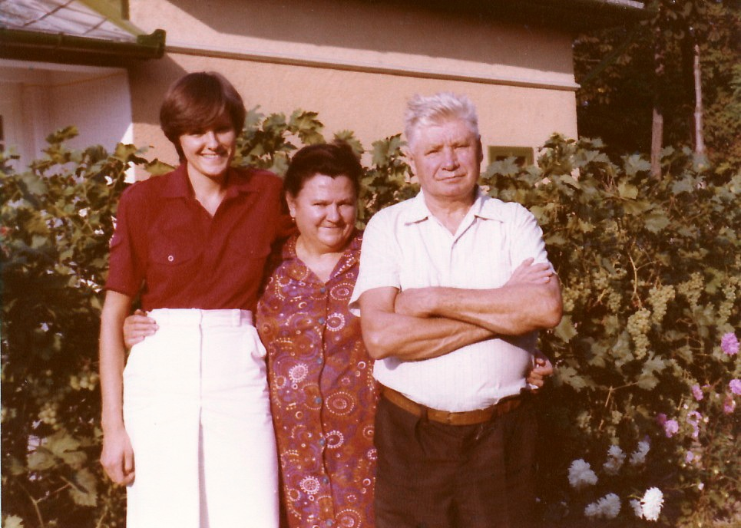
High school years
Her school years had a great impact on the development of her attitude and thinking. Their demonstrations in biology, chemistry and physics classes played a role in this (for example: making crystals and then trying it at home, hanging a thread in salt solution), as well as their regular trips to the pharmacy and arboretum

Slide 4
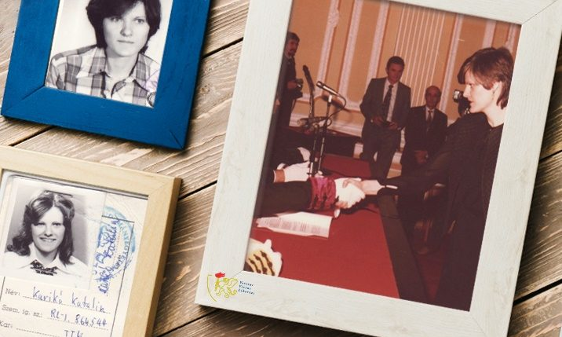
University years in Szeged
In Szeged, at the then Attila József University, she graduated in biology. She received an academic scholarship and was invited to work at the Biological Research Center in Szeged, where she joined the RNA team.

Slide 5
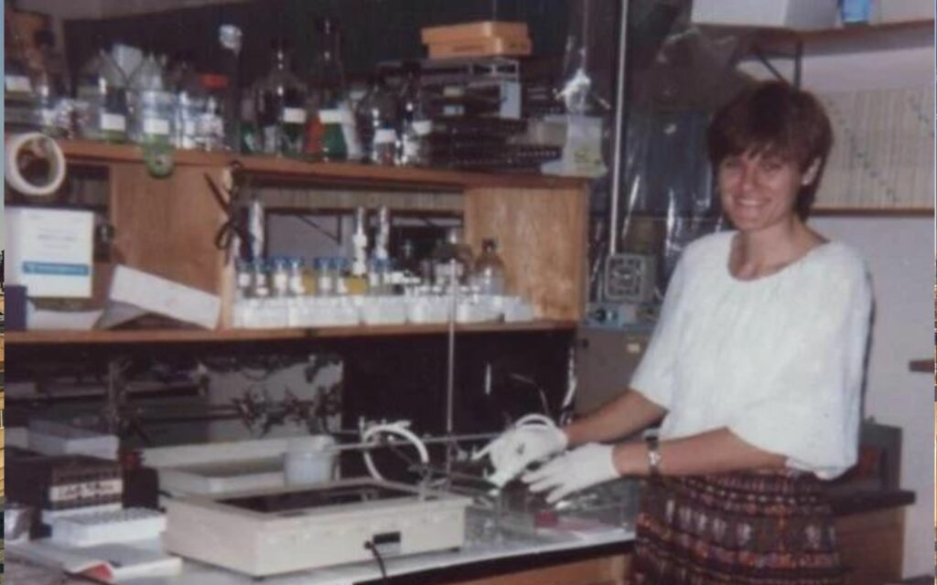
USA Pennsylvania
a few years later she moved to the University of Pennsylvania, where she has researched for 24 years. In 2004, she and a colleague, Drew Weissmann, registered a patent for the therapeutic use of mRNA containing modified nucleosides. This patent was purchased in 2011 by BioNTech and Moderna. In 2014, Katalin Karikó became the vice president of the German company BioNTech

Slide 6
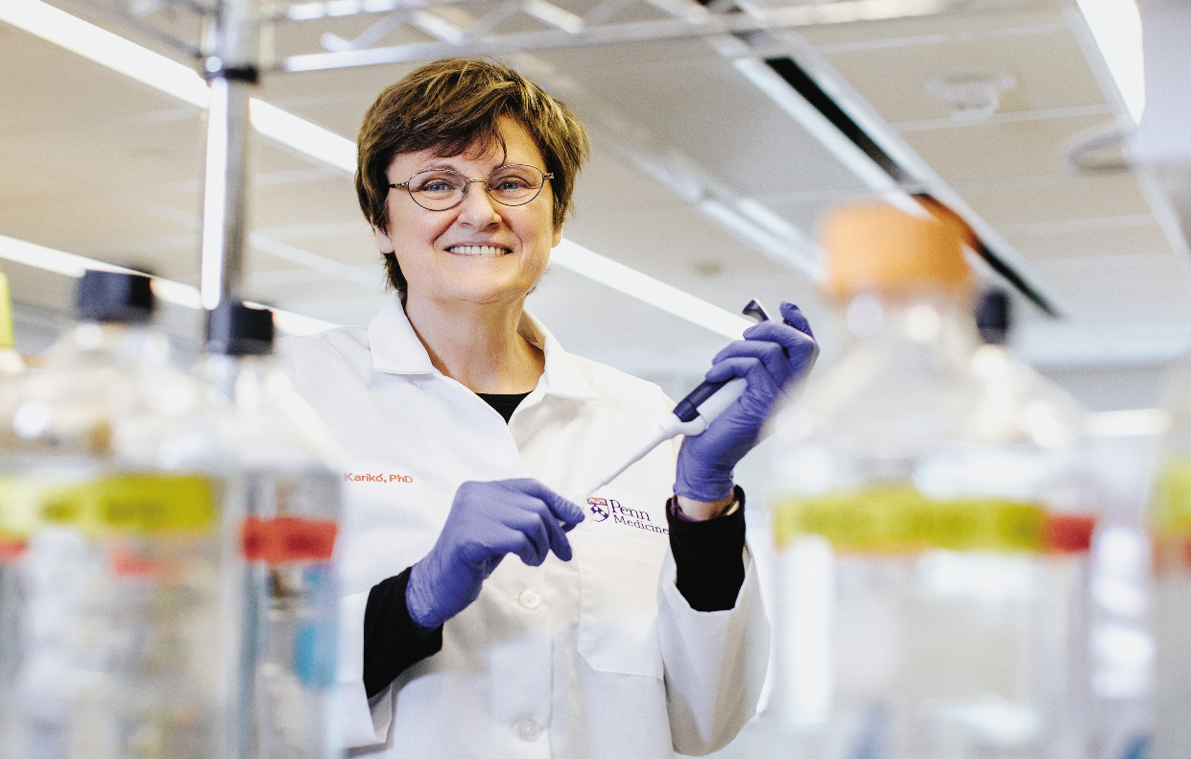
COVID-19
. In 2018, together with the pharmaceutical company Pfizer, they began to develop a vaccine based on this technology, which is also why testing of the vaccine began a few months after the appearance of the coronavirus, and its widespread use at the beginning of December 2019.
In 2020, Katalin Karikó's name was suddenly known to everyone. The majority of Hungarians were proud that a native of our country - even if she did not work here for most of her life - contributed to the development of vaccination.

Slide 7
Thank you for your attention!

