Slide 1
IT professions
made by Hungarian STEAM Group in budapest
May 2023

Slide 2
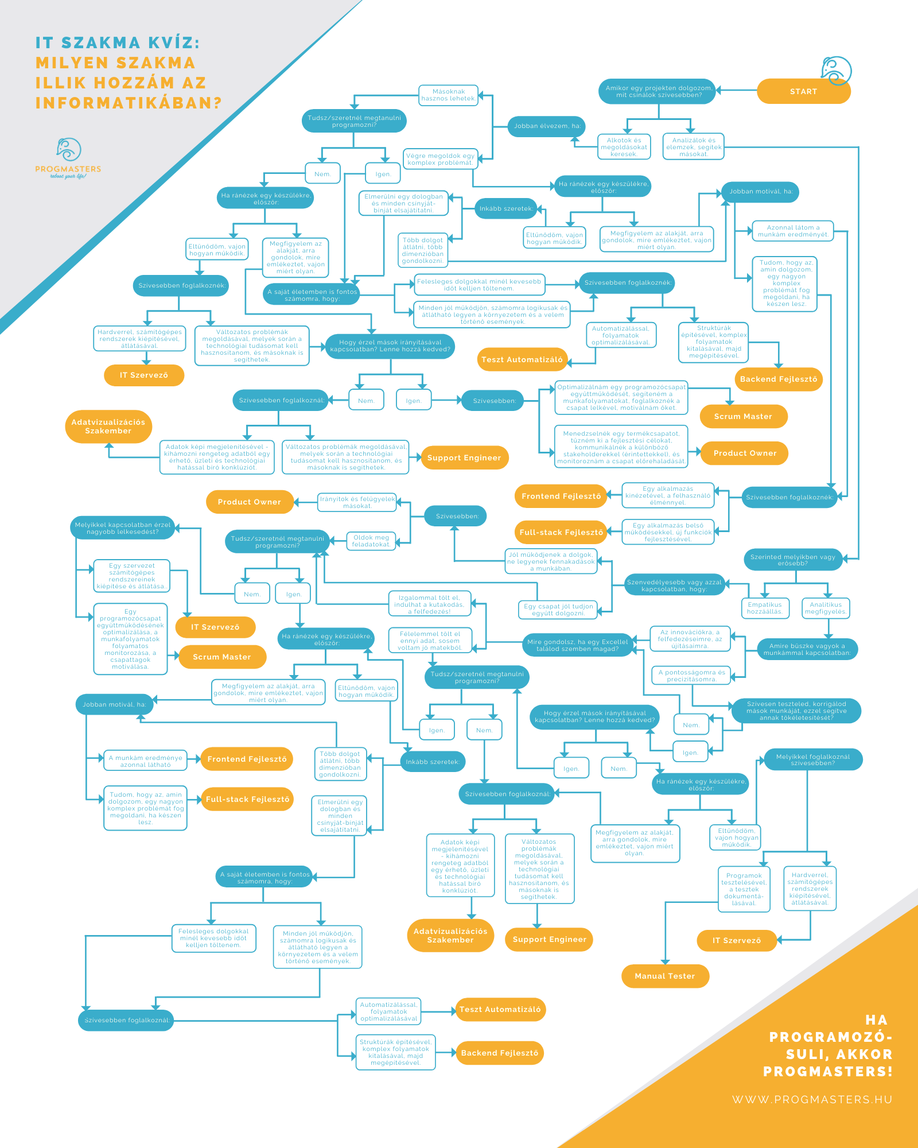

Slide 3

IT Coordinator
The task of the information organizer is computer-supported information planning, as well as the modernization and improvement of the system.

Slide 4

Data Analyst / Data Visualisation Expert
Although the positions of Data Scientist and Data Analyst overlap to some extent and are often referred to as synonyms for each other, a somewhat sharp dividing line can be drawn between the two: while the data miner "kneads" the data, looks for correlations, the data analyst processes and interprets them, sets up models up.

Slide 5

Data Scientist/Analyst
With the help of various statistical and mathematical relationships, the data scientist looks for (miner) hidden relationships in this large data set, which, in the best case, the organization can turn into a profitable conclusion.

Slide 6

Product Owner / Product Manager
The product owner is responsible for the market performance of the product and its development in one person.

Slide 7

Scrum master
The task of the Scrum Master is to ensure the implementation of the agile organizational culture in the team and in as many areas of the organization as possible.
Agile organizations should be created where teams are working on some complex, creative result. An agile team is therefore a highly motivated team that is given autonomy to carry out and organize their work. In the Scrum model, the work of such teams can be organized efficiently and relatively predictably.

Slide 8

Test Automation Engineer
Test automation engineers write automated tests to run in the background every time a new feature or piece of code is added to a piece of software. This way, manual rounds can be minimized and new code can be avoided causing errors elsewhere and having to retest everything manually.

Slide 9
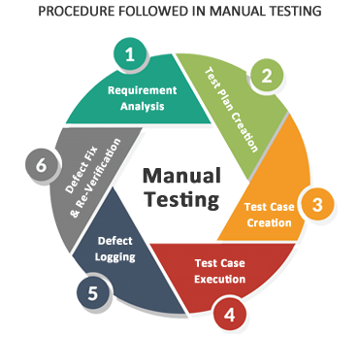
QA / Manual Tester
The task of the software tester is to test the written program. Depending on the mode, you can run manual and automated tests. During manual, i.e. manual testing, the testing colleague goes through the parts to be tested in great detail and systematically, and in this way can spot errors that an automated test run by an algorithm would not necessarily detect.

Slide 10
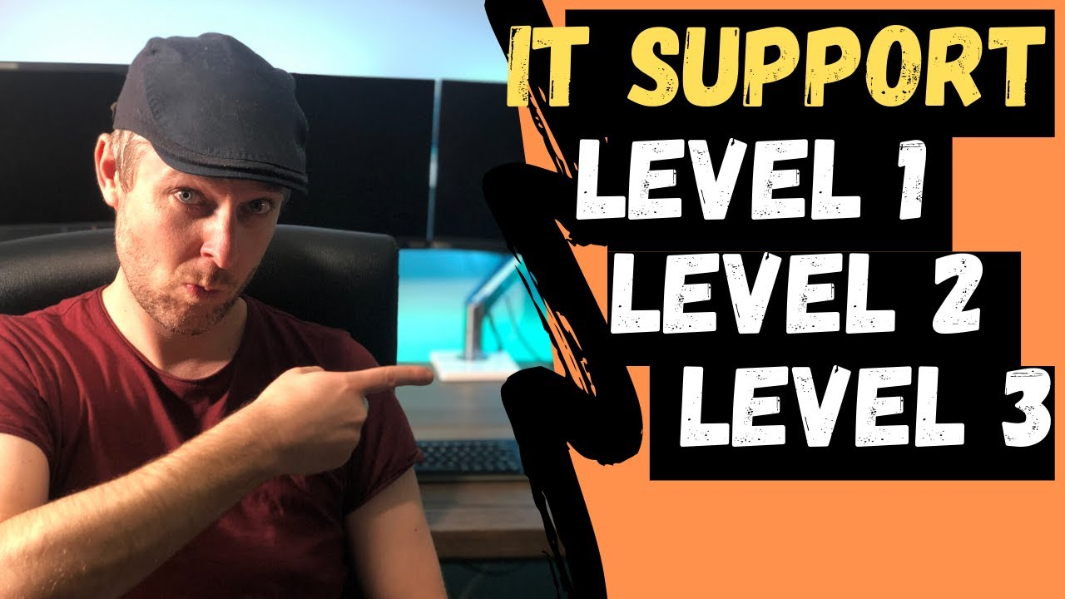
Support engineer (Level 2, Level 3)
Support engineers are the vanguard of customer support. They help the customer to solve all technical problems ranging from simple to very complex.

Slide 11
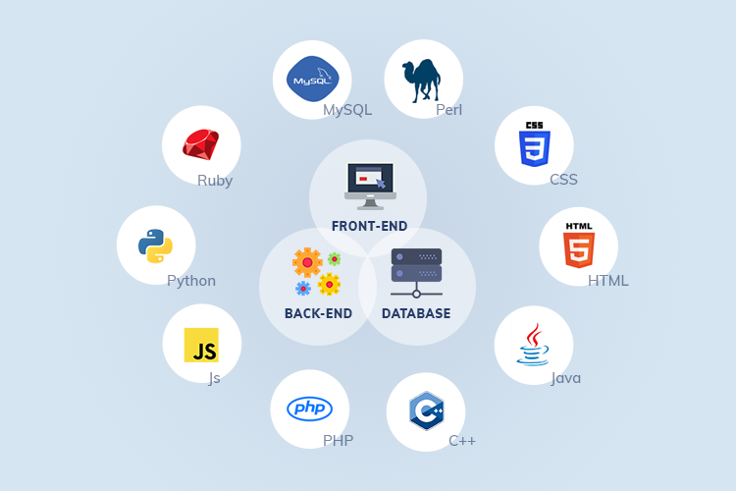

Full-stack Developer
A full-stack developer is a technological expert who must know the technological background of user interfaces, the business logic system (the system running in the background) and the database layer.

Slide 12

Backend Developer
The backend developer deals with the interior of the program, the real internal structure of the functions.

Slide 13

Frontend Developer
The frontend programmer deals with the appearance of the program: it visually shows the information / functions produced by the backend.

Slide 14

Multimedia- developer,
Webdesigner
Among the computer tasks, it is the more creative, expressive, and spectacular part: such as image editing, video recording, design, photography, website making, development.

Slide 15

Medical operator
Administrative, computer operator and software operator activities in healthcare institutions

Slide 16
And IT specialists are still needed in many areas…
Thank you for your attention!

