Slide 1
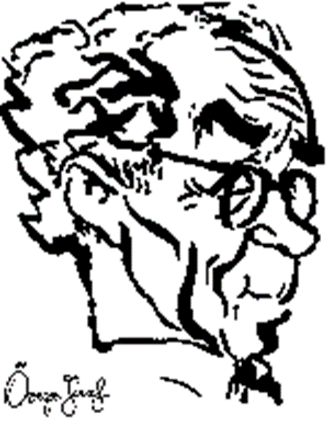
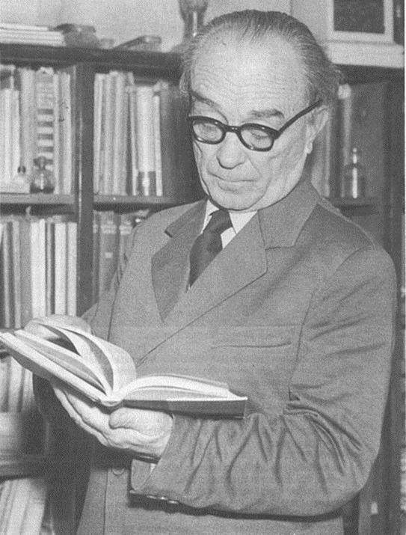
JÓZSEF ÖVEGES
1895-1979
PROFESSOR, PHYSICIST, PIARIST PRIEST

Slide 2
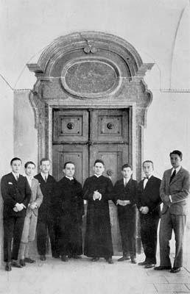
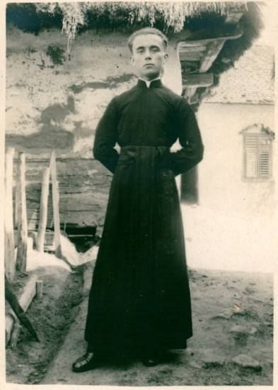
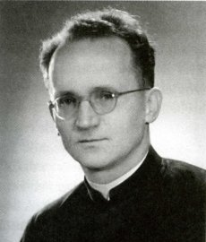
THE MONK
In addition to religious life, he undertook, as a Piarist, to take special care of children’s education.

Slide 3
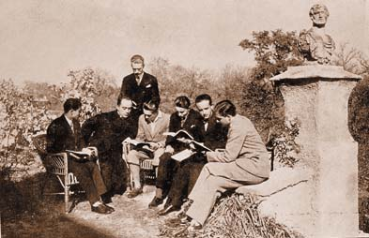
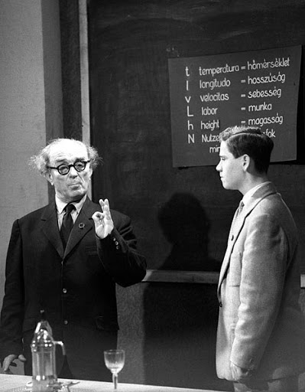
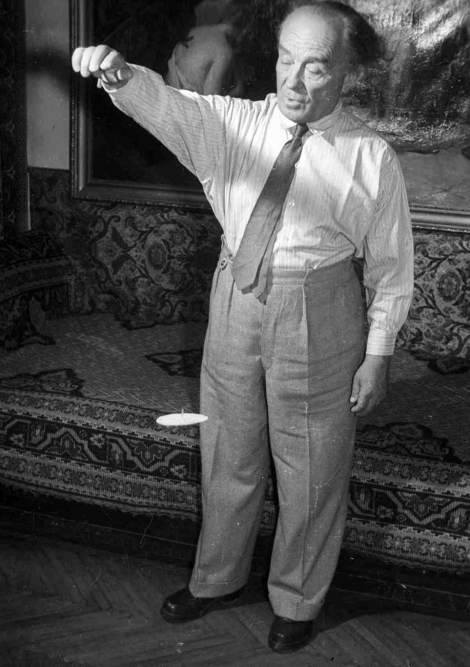
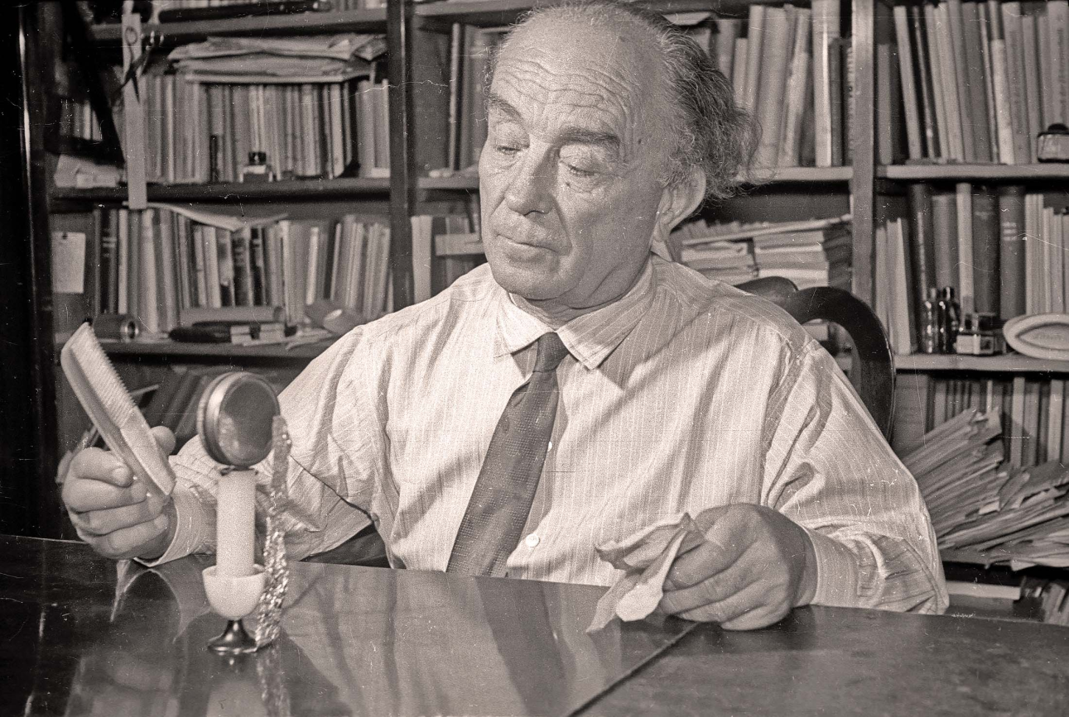
THE PROFESSOR, THE TEACHER
He began his career in Szeged as a Piarist high school teacher. After coming to Budapest to the Technical University, he taught physics and future physics teachers on the Pedagogical College.
He practiced all his experiments at home too.

Slide 4
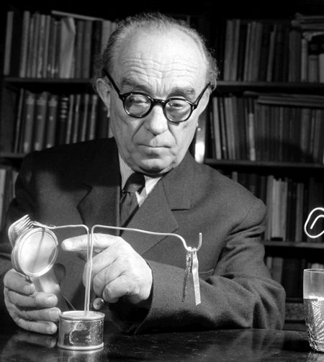
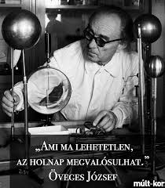
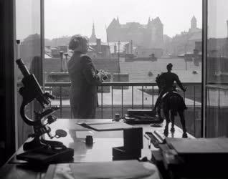
THE PHYSICIST
József Öveges was one of the first winners of the Kossuth Prize, founded in 1948. In 1962 he received the Bugát Commemorative Medal, and in 1976 he was awarded for the first time the prize founded by the Eötvös Loránd Physical Society, the Prometheus Medal for the dissemination of physical knowledge.

Slide 5
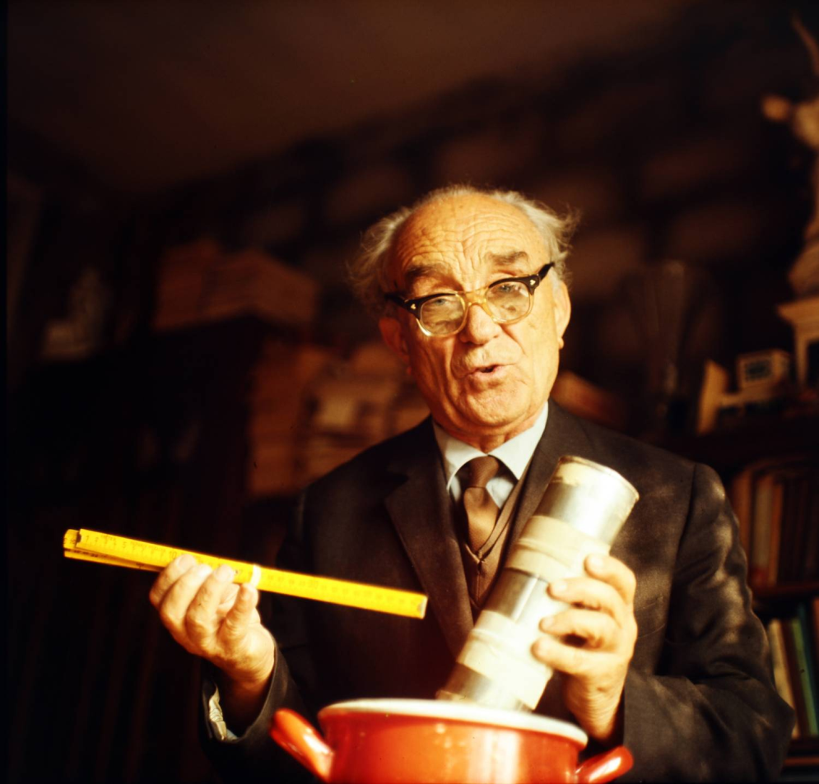
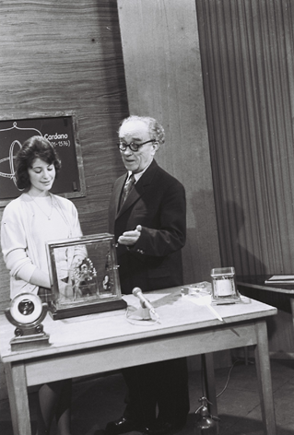
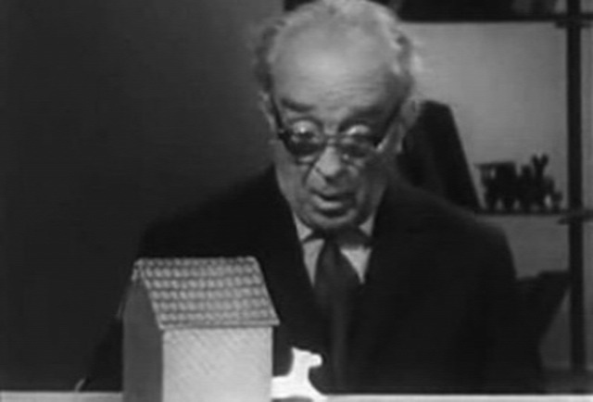
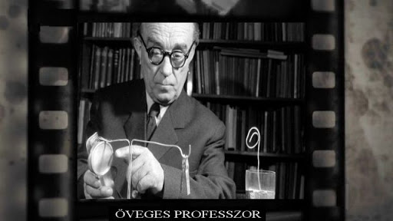

IN THE MEDIA
In Hungarian Television's 100 Questions, 100 Answers program, he taught the whole country about the beauty of physics. His creed: "What is impossible today is possible tomorrow!"

Slide 6
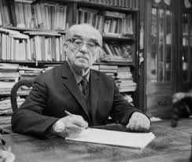






SOME OF HIS BOOKS
He promoted his first book by urging people, "Sell your umbrella and buy József Öveges' book of weather forecast!" He is the author of more than 30 books, some of his works are used as textbooks in education.

Slide 7

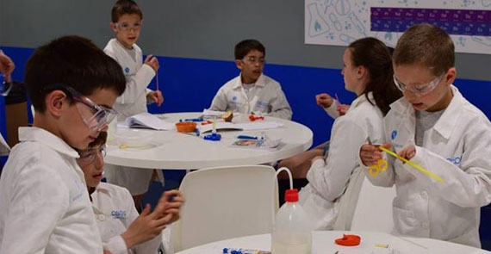
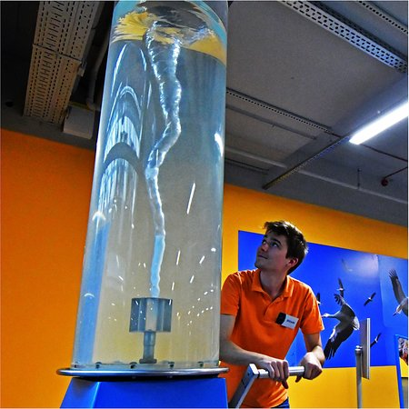
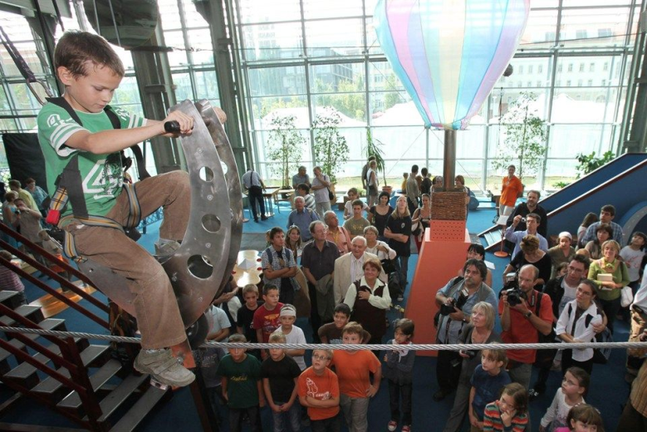
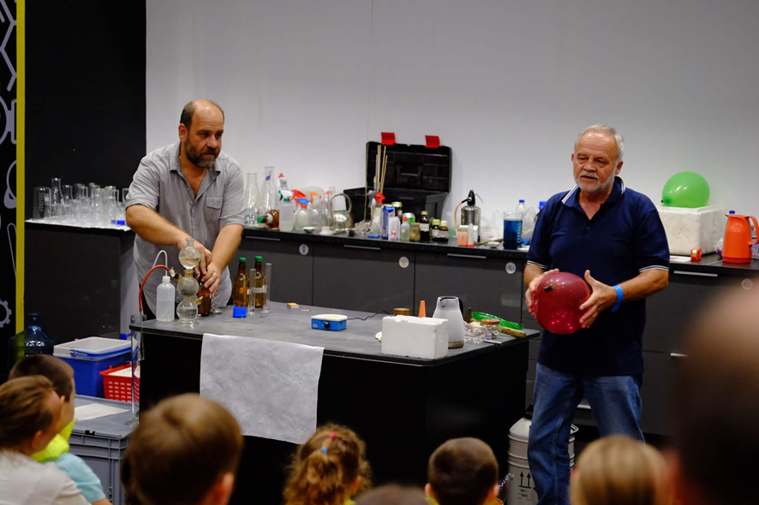
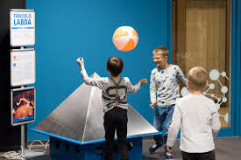
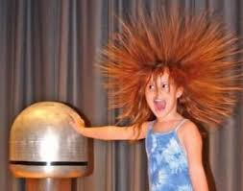
HIS MEMORY
A place where children, young people, parents learn about the laws of physics in a funny way - the professor's dream is realized by the Palace of Miracles..

