Slide 1

Robotics

Slide 2

What is robotics?
Robotics is a branch of engineering that involves the conception, design, manufacture and operation of robots. The objective of the robotics field is to create intelligent machines that can assist humans in a variety of ways.
Robotics can take on a number of forms. A robot may resemble a human, or it may be in the form of a robotic application, such as robotic process automation (RPA), which simulates how humans engage with software to perform repetitive, rules-based tasks.

Slide 3
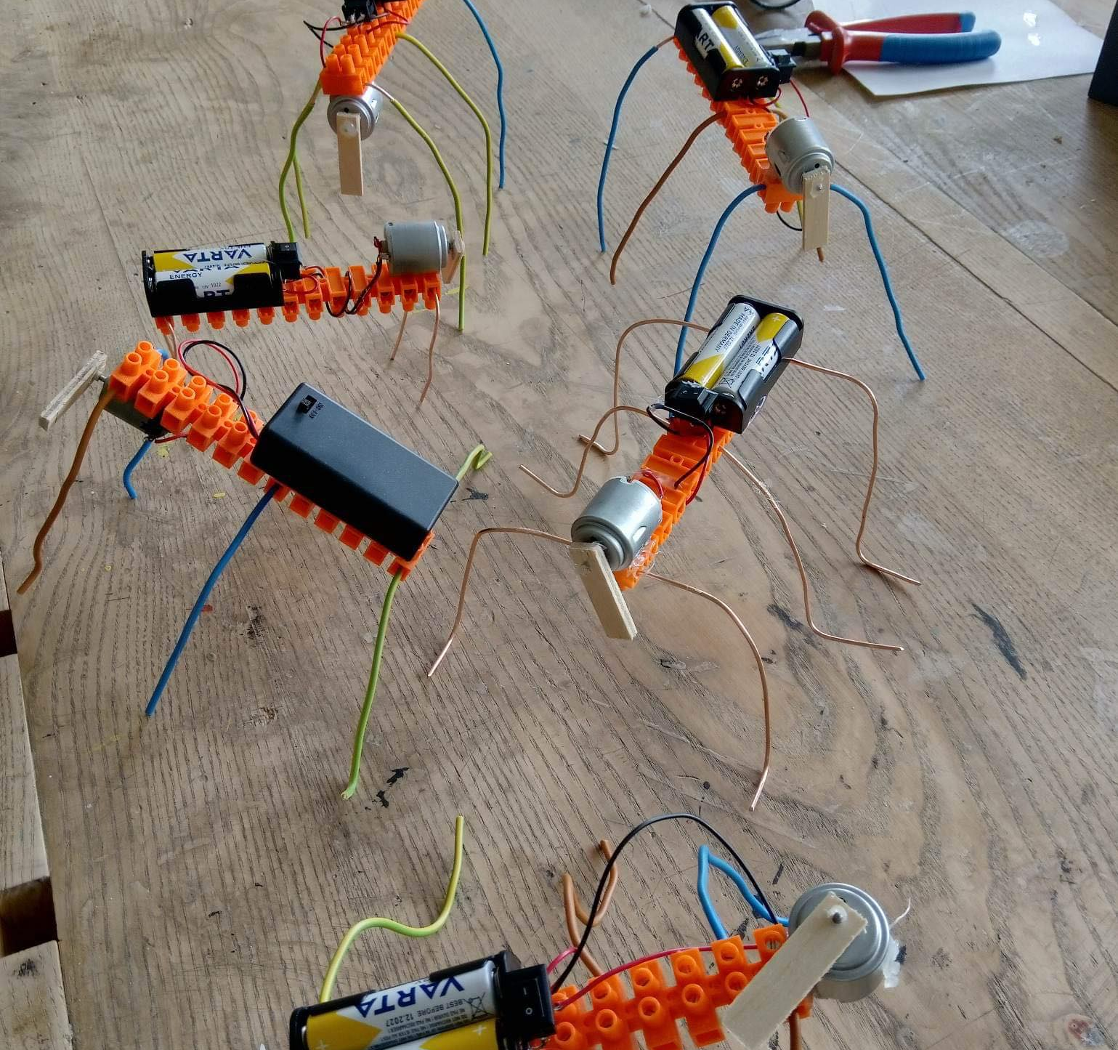
These are the robots we made, but how did we make them?

Slide 4
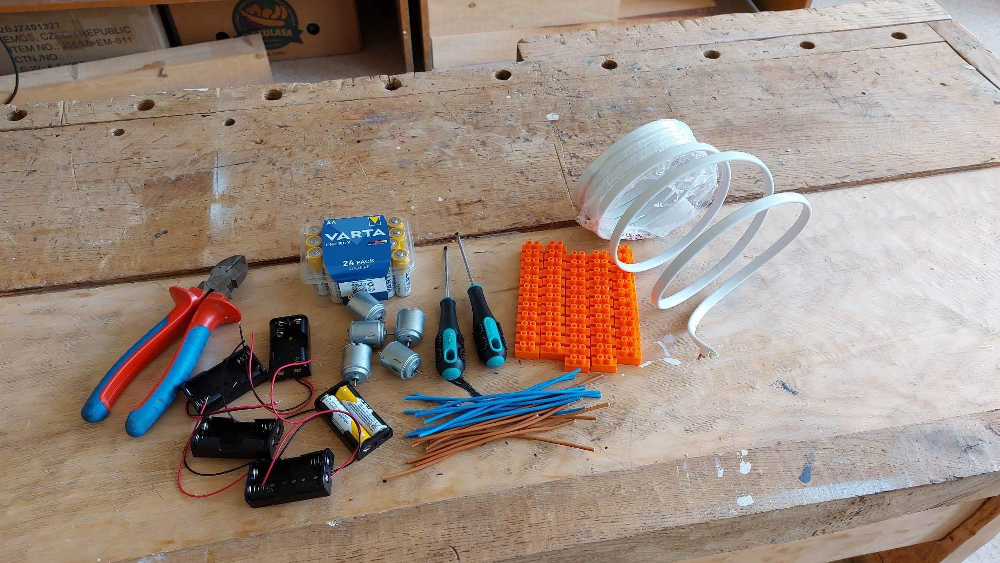
The material we used

Slide 5

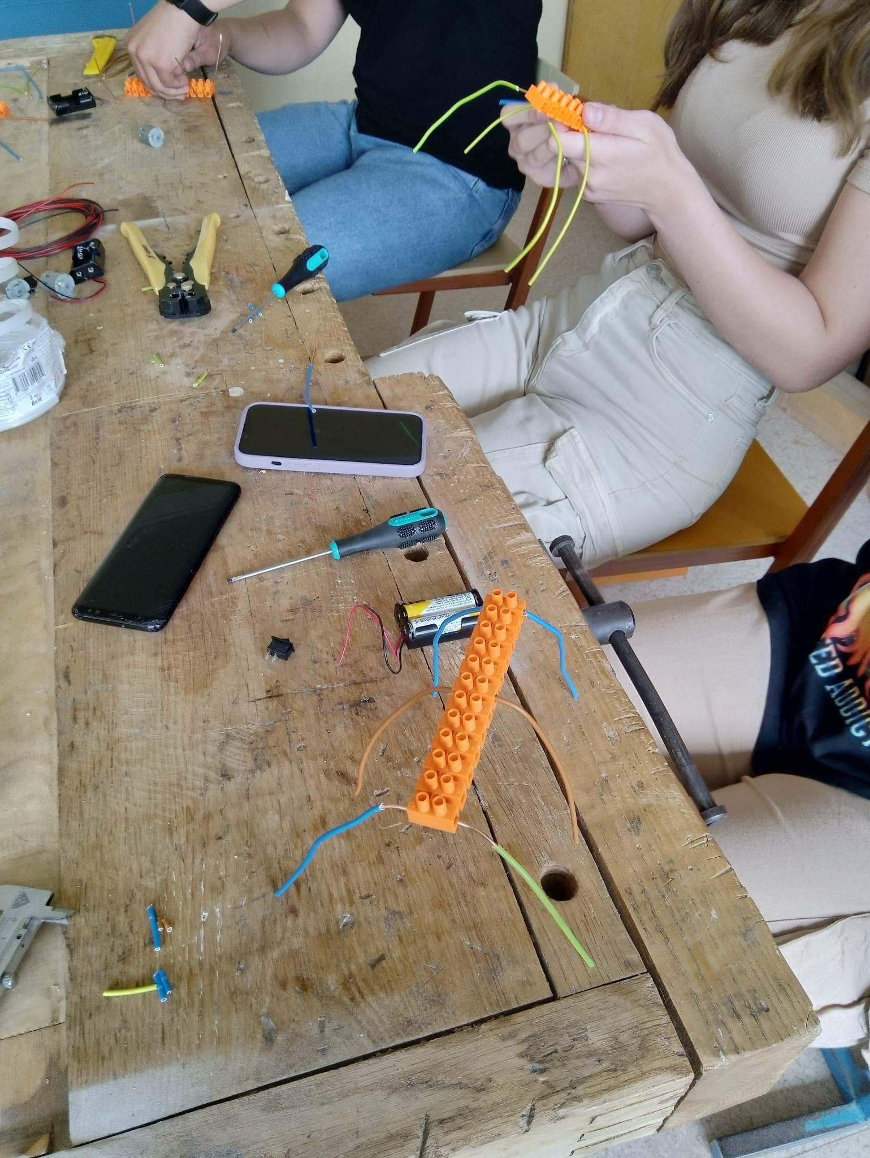
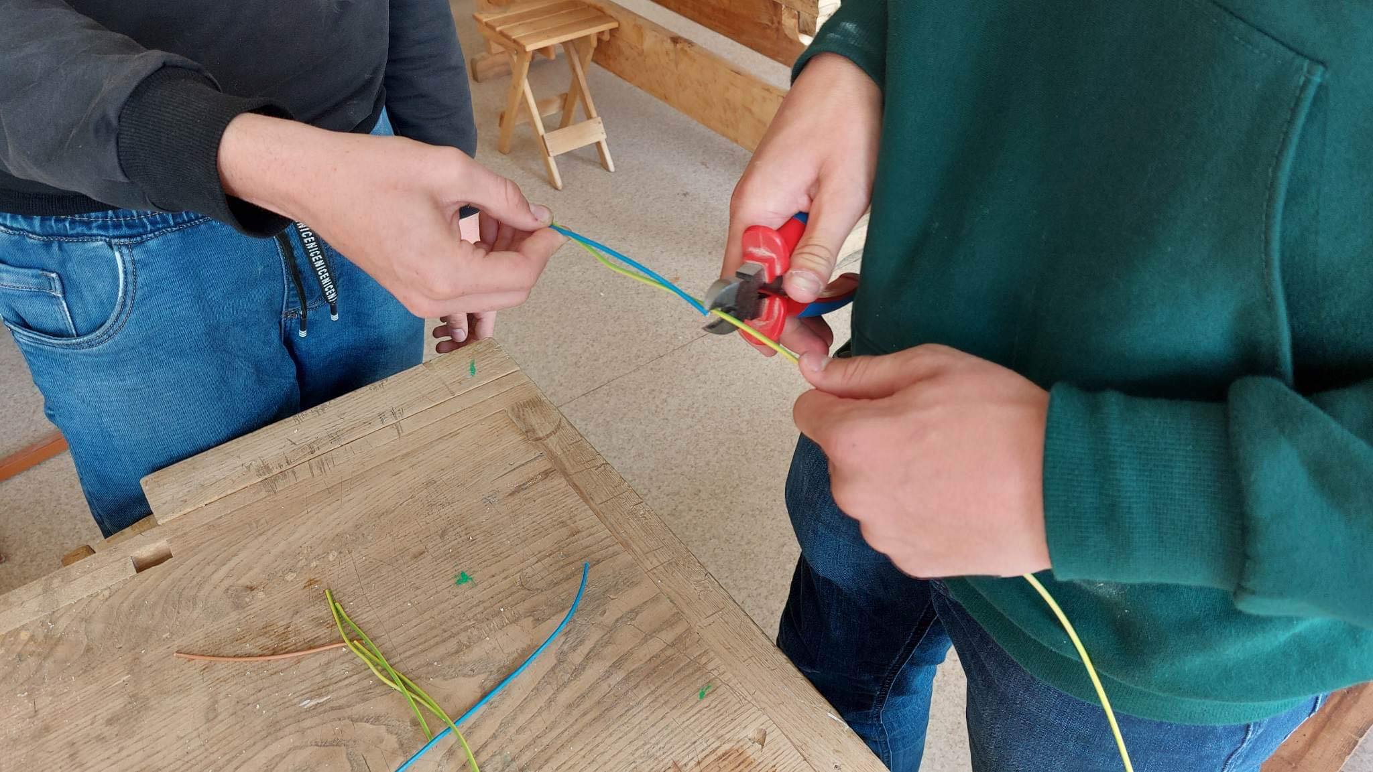
THE PROCESS

Slide 6
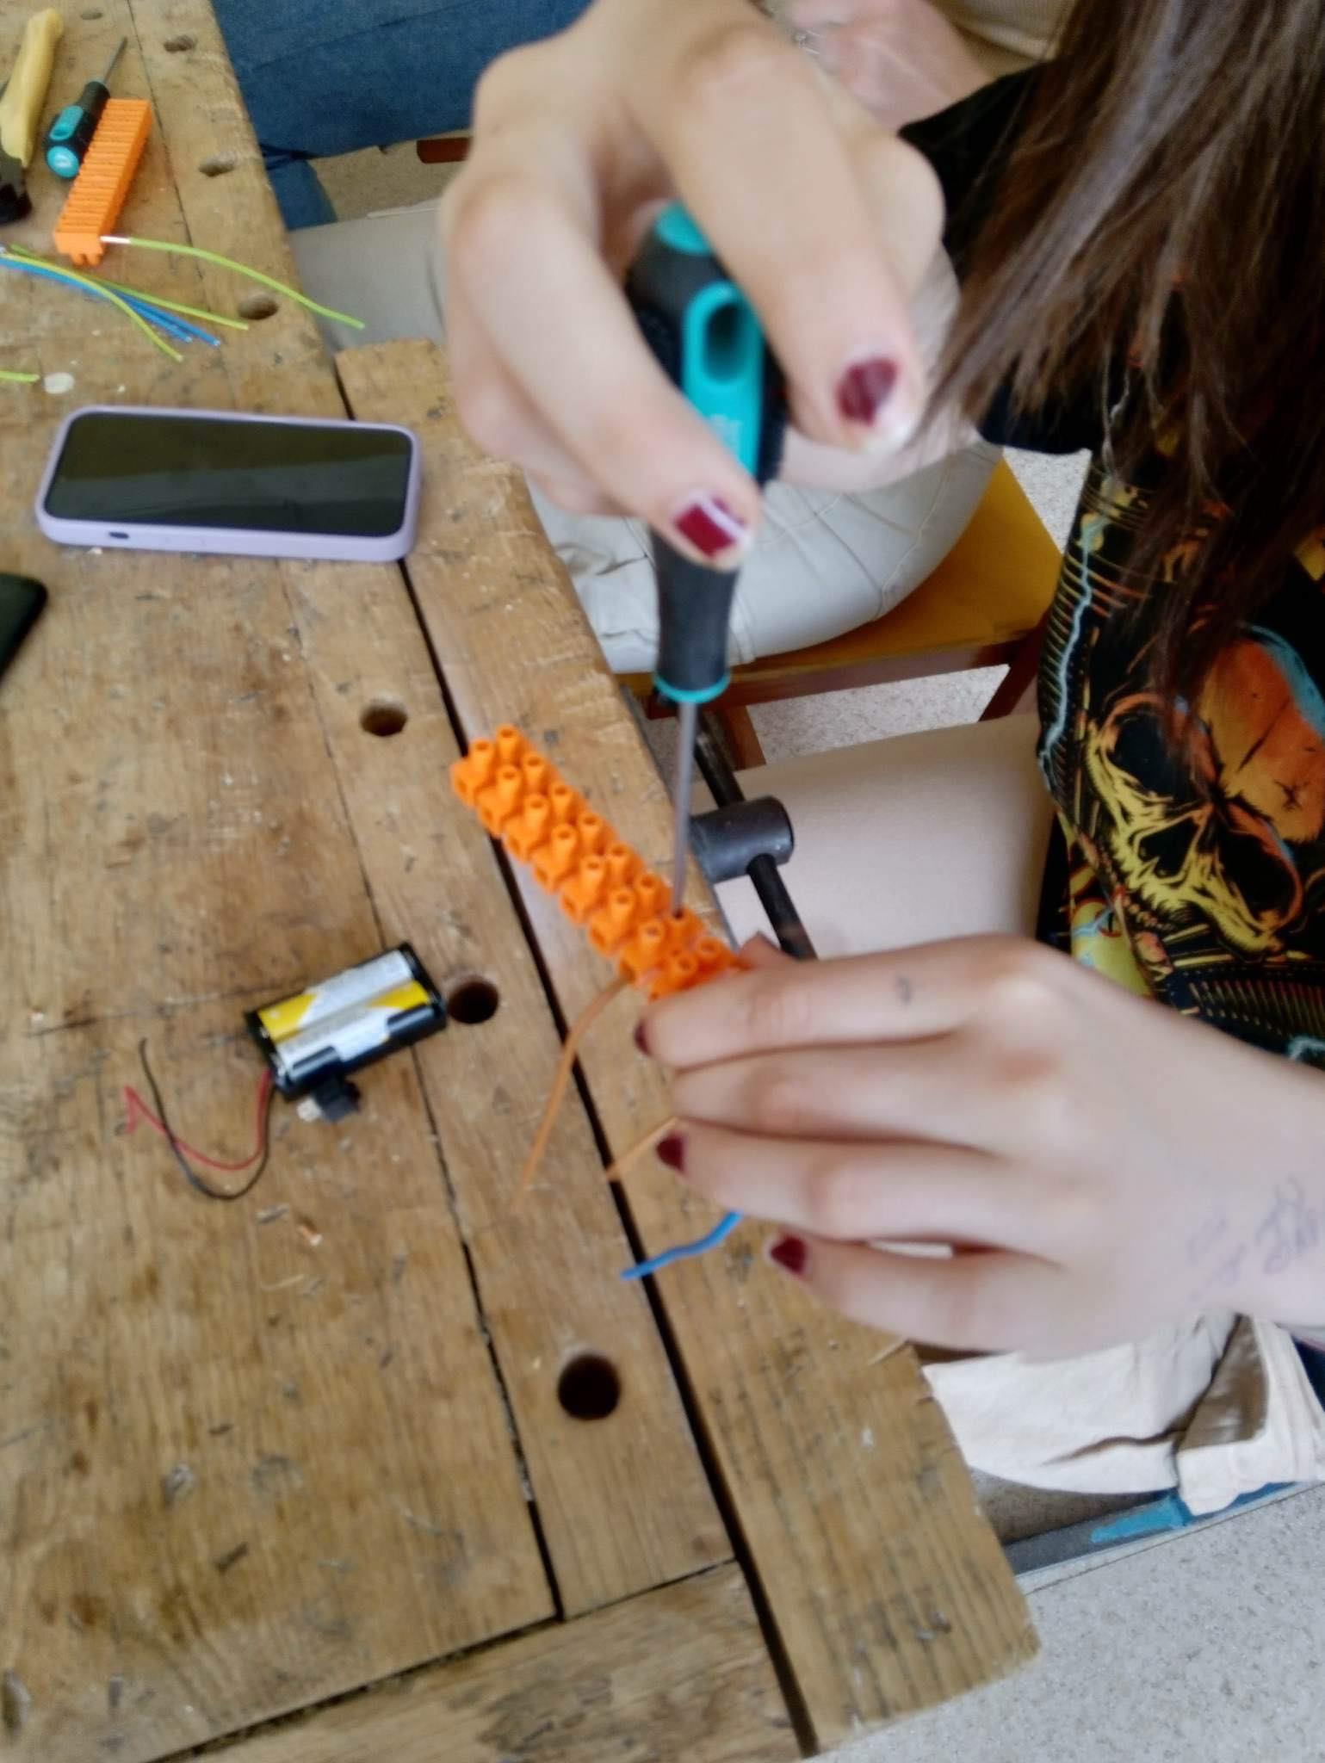
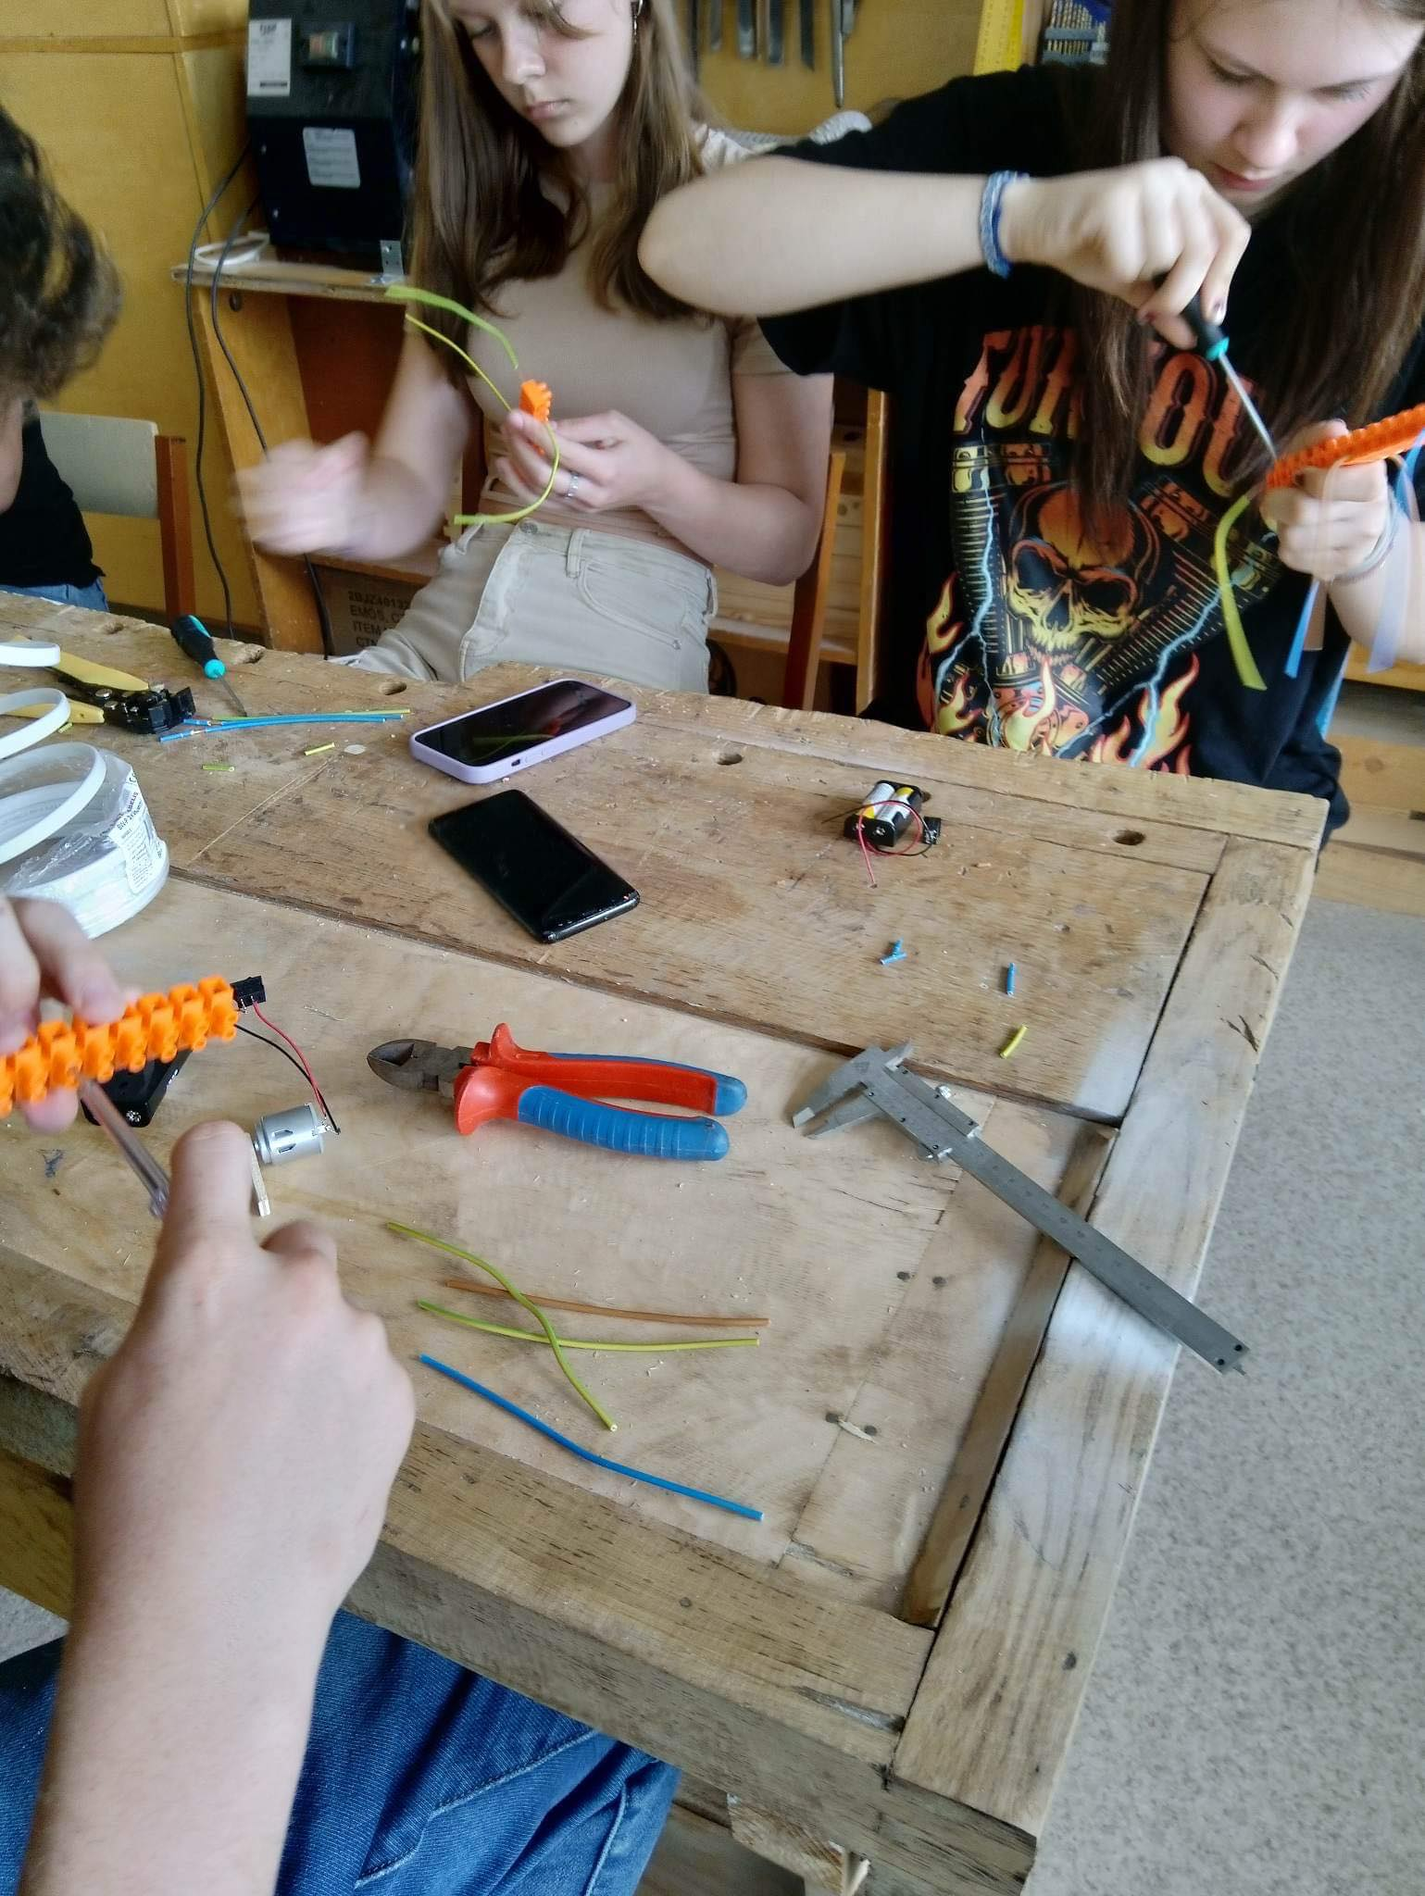

Slide 7
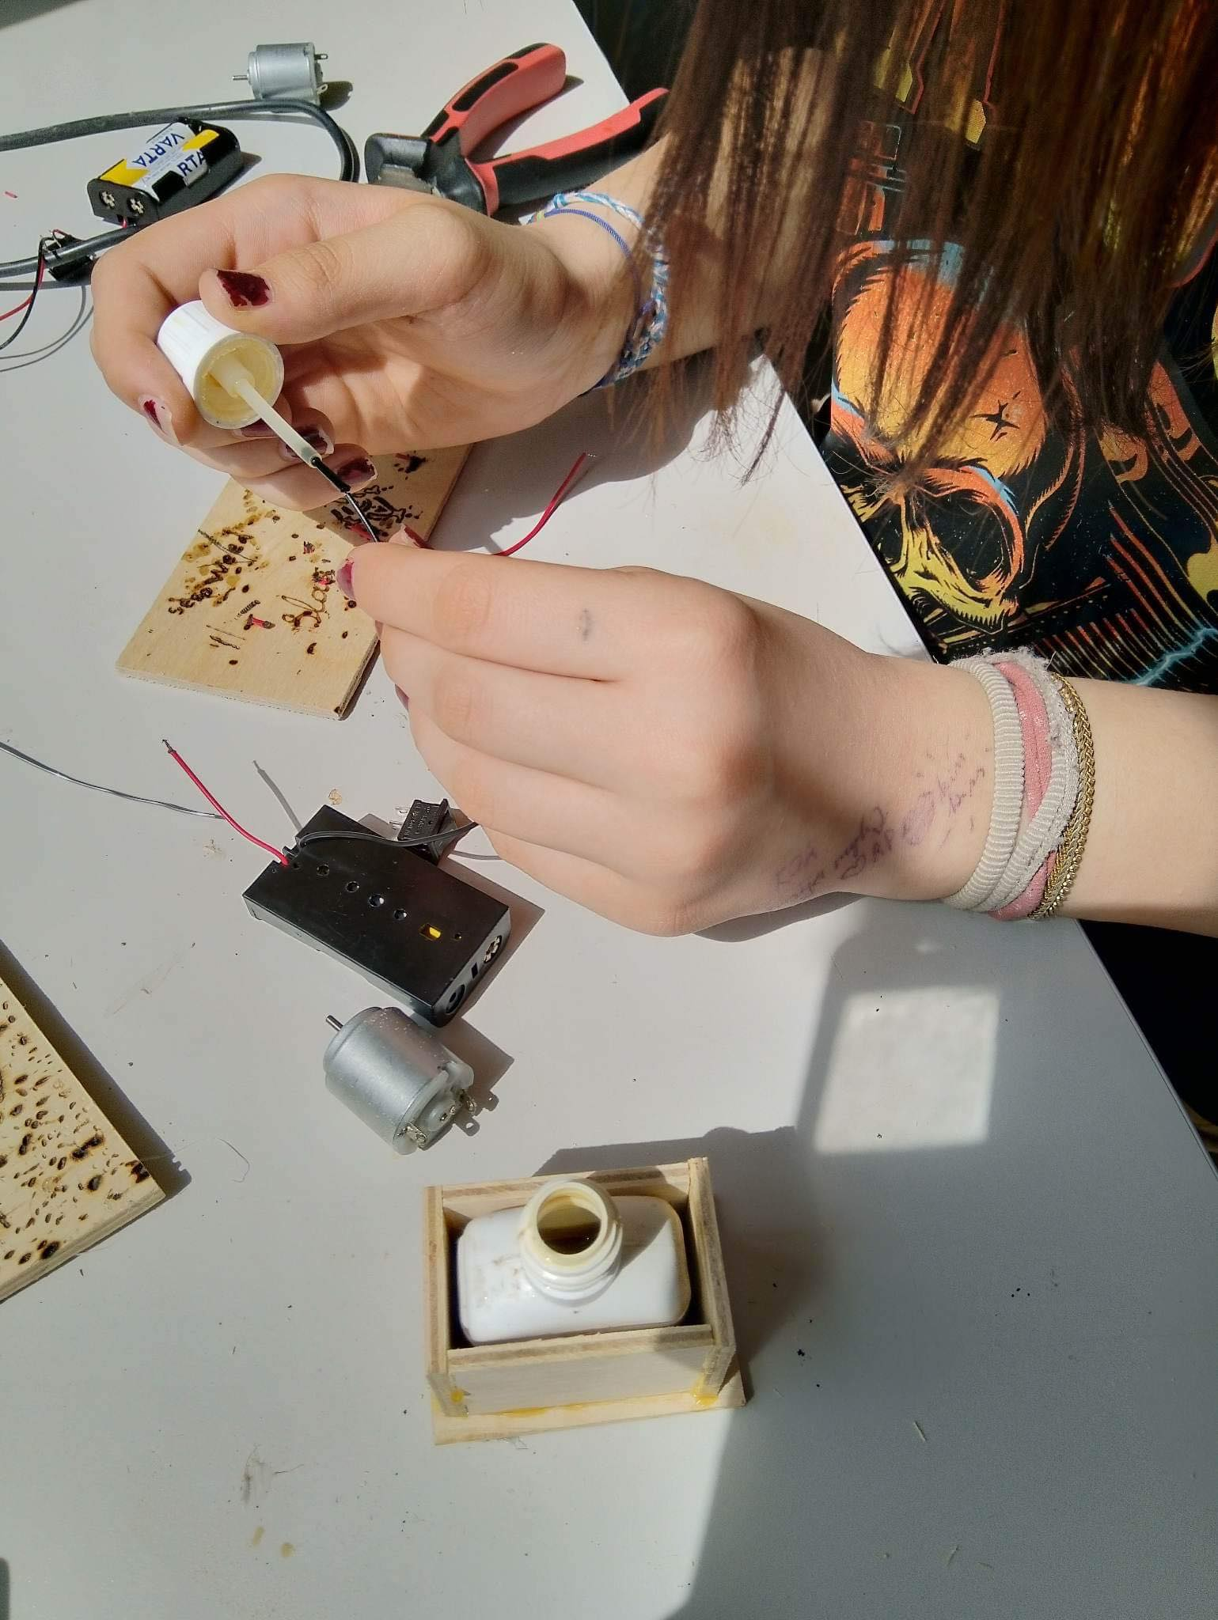
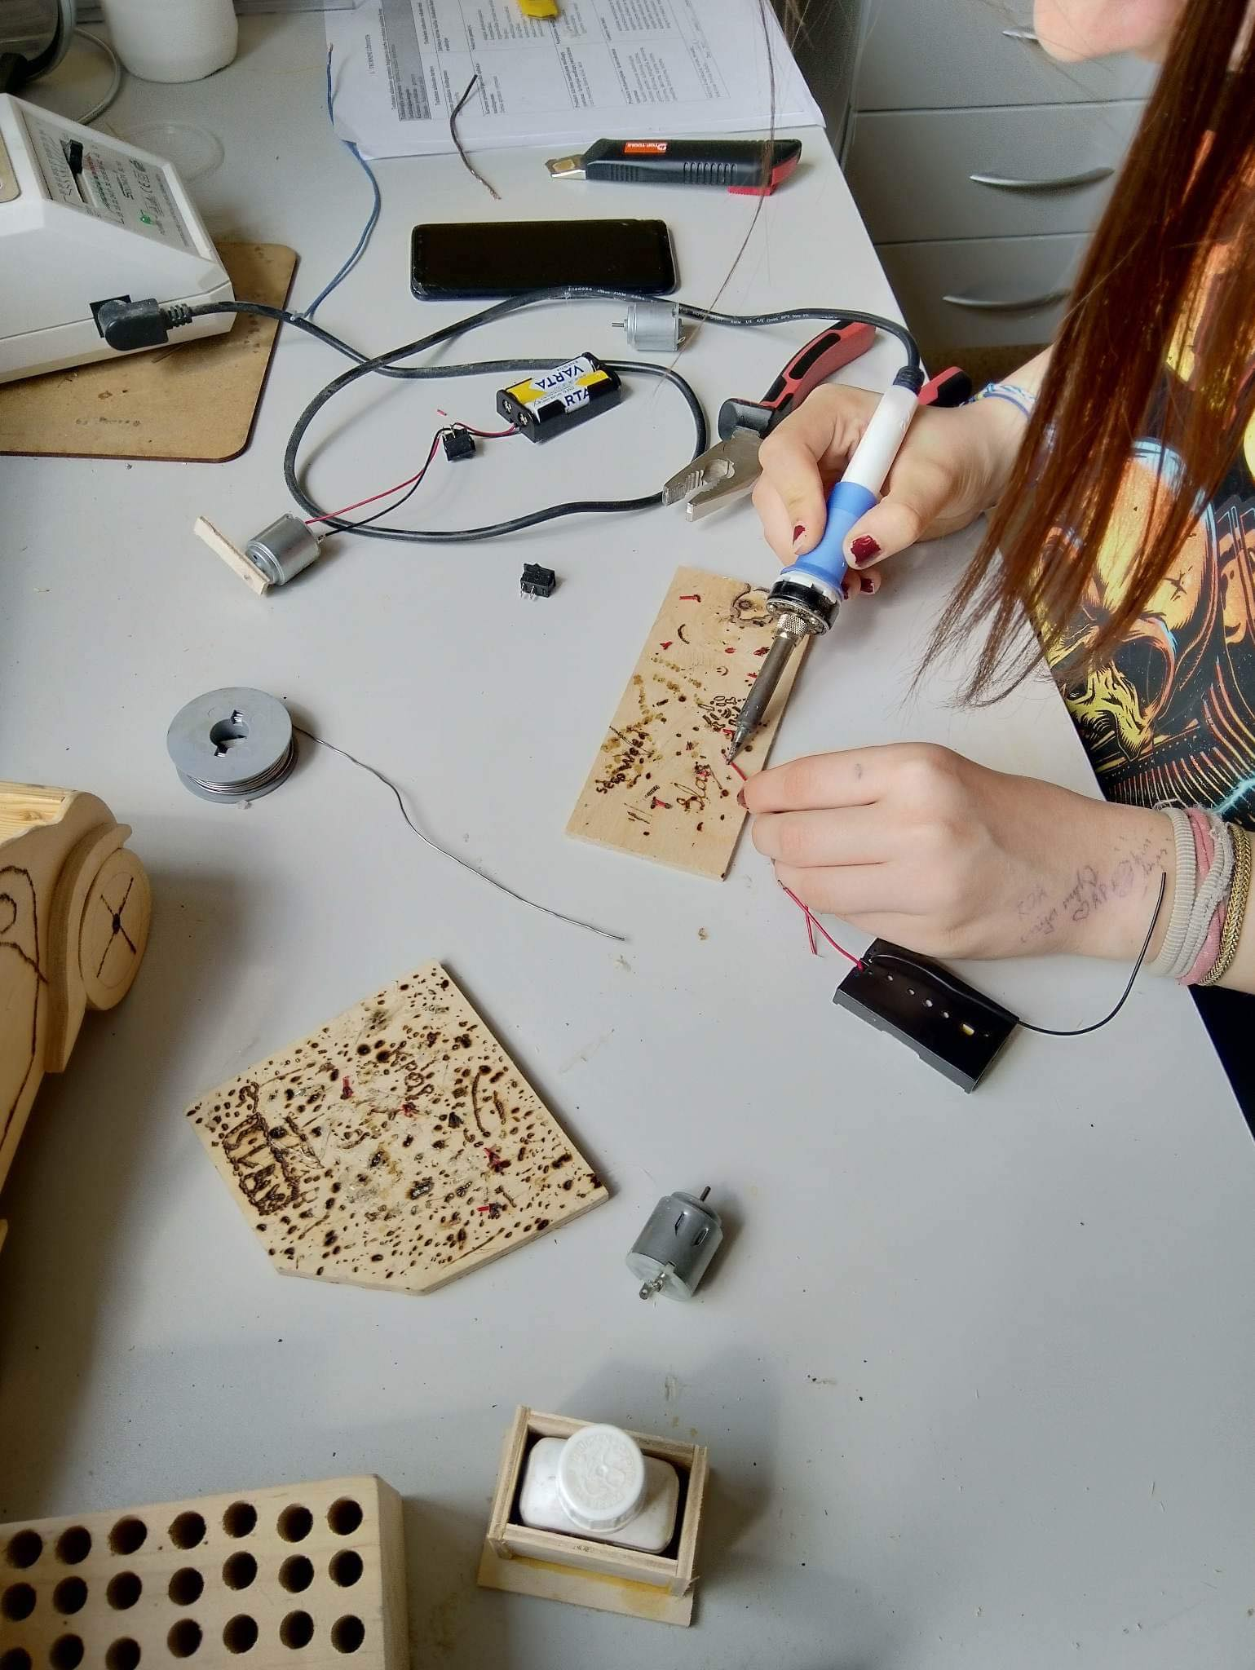

Slide 8
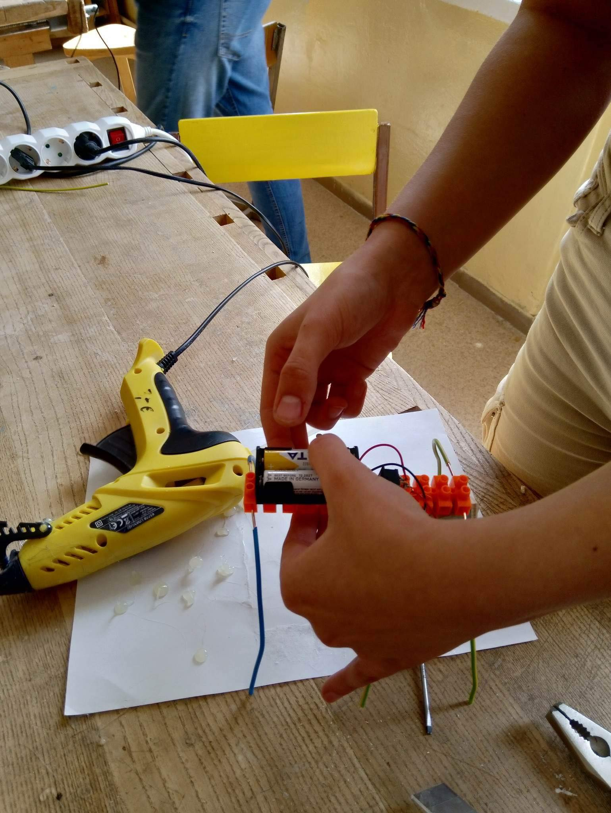
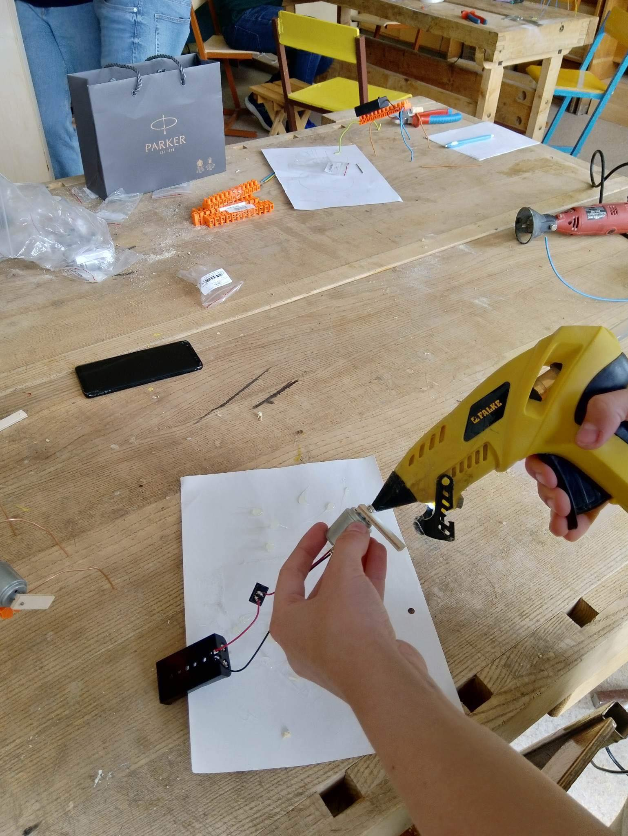

Slide 9
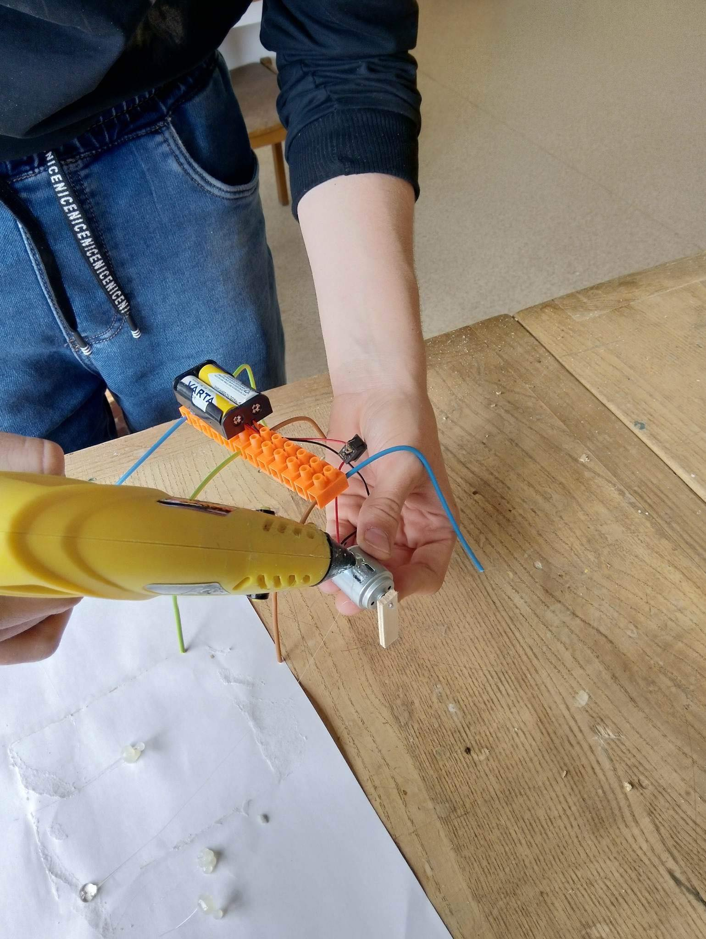
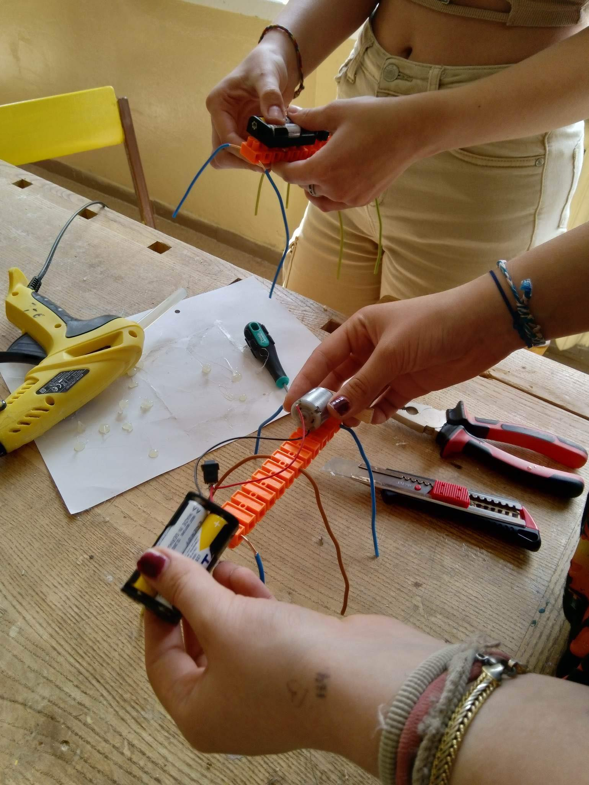

Slide 10



Thank you for your attention
Presentiation was made by:
Mija Petrauskytė
Saida Petrauskytė
Lukas Dargužas
Justinas Stagys
Gustas Gedžius

