Slide 1
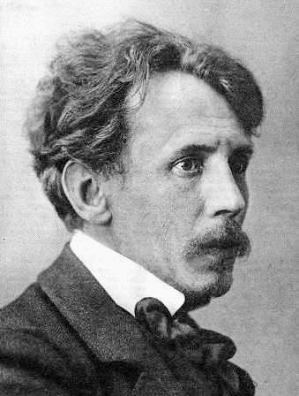
Mikalojus Konstantinas Čiurlionis
(1875-1911)
Lithuanian composer
painter and artist

Slide 2
Mikalojus Konstantinas Čiurlionis
Mikalojus Konstantinas Čiurlionis was born in 1875, September 22nd, in Lithuania, in the organist's family (the oldest child of 9 children in the family).
At the age of 14, he started playing in a school orchestra in Lithuania.
At the age of 19, he started attending Warsaw Conservatory.
In 1901-1902, at the age of 26, M. K. Čiurlionis studied at Leipzig Conservatory, in Germany.
At the age of 27, he enters a drawing school in Warsaw.
In 1904-1906, at the age of 29 he studied at Warsaw School of Art.
M. K. Čiurlionis lived in Vilnius in 1907-1908.
The composer and painter lived in St. Petersburg, Russia in 1908-1909.
At the age of 35, he died of pneumonia in 1911.

Slide 3
Music and art
First music and later art appeared in M. K. Čiurlionis' life.
In just ten years, M. K. Čiurlionis composed about 400 pieces of music, including two major symphonic poems, an overture, a cantata for choir and orchestra, two sonatas and several variation cycles for piano and a string quartet and works for choir.
M. K. Čiurlionis became an artist when he was a mature composer. He dedicated to painting and art only 6 years. In 1904-1909 M. K. Čiurlionis created about 400 paintings and graphics. M. K. Čiurlionis liked to work with tempera, pastel, mixed technique, ink, and he tested the fluorophore as well. The artist belongs to the styles of late romanticism, symbolism and modernism. Some of his works are abstract.
In addition to his works of music and art that were recognized in Europe, Čiurlionis alos created some works in literature and poetry. M. K. Čiurlionis also expressed himself as a journalist, experimented artistic photography and was an active public figure.

Slide 4
Inspiration
M. K. Čiurlionis was interested in geology and history, chemistry and geometry, physics and astronomy, astrology and ancient mythology, ancient and modern languages, classical and new philosophy, Eastern and Western religions.
M. K. Composer, painter was interested in his origin, Lithuanian folk art fairy tales, legends, stories, as well as small architecture.
The artist was also interested in human being, human anatomy, human psychological state, other objects of creation and inspiration such as nature, architecture, interior and exterior decoration elements.
M. K. Čiurlionis was influenced by music to create mature paintings. Some of his works are particularly musical. Inspired by music, he created a series of paintings "Sonata".
M. K. Čiurlionis often combined several themes such as man, music, geometry, astronomy, mythology, philosophy in one picture. He created paintings in cycles, diptychs, triptychs.

Slide 5
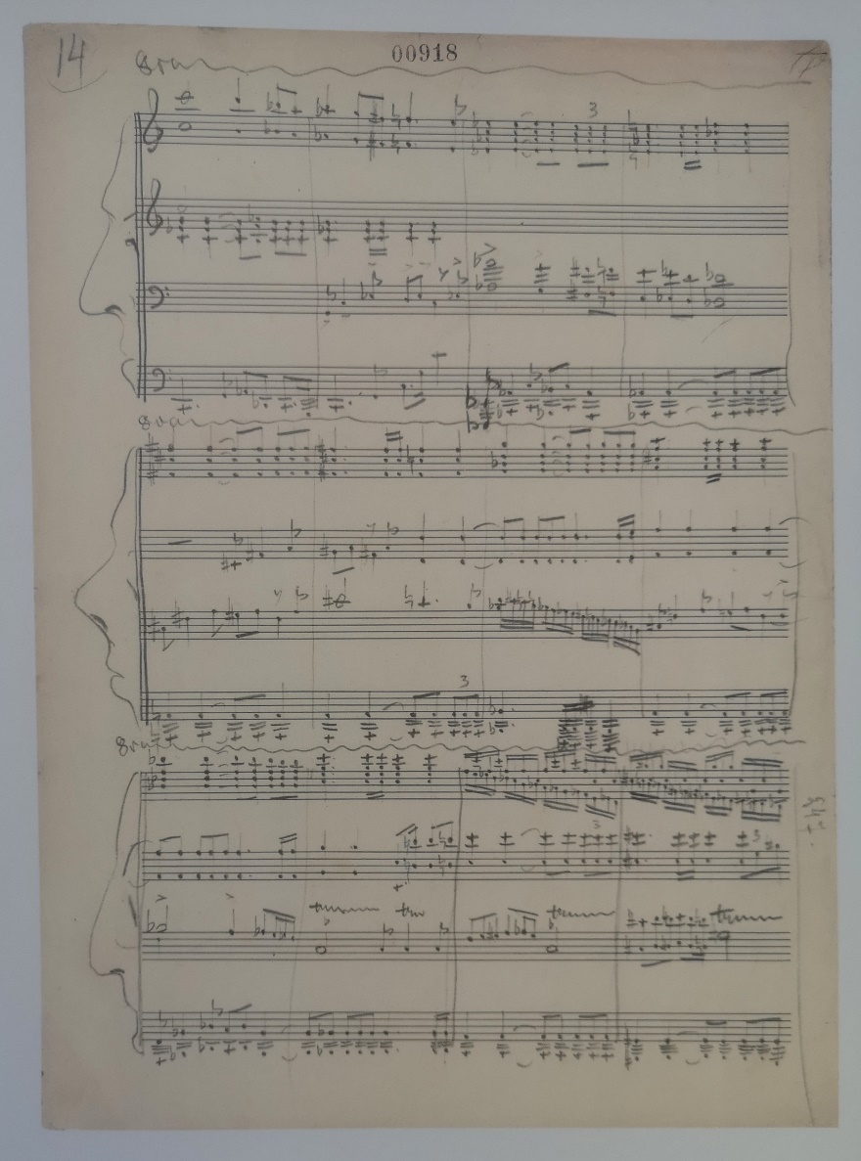
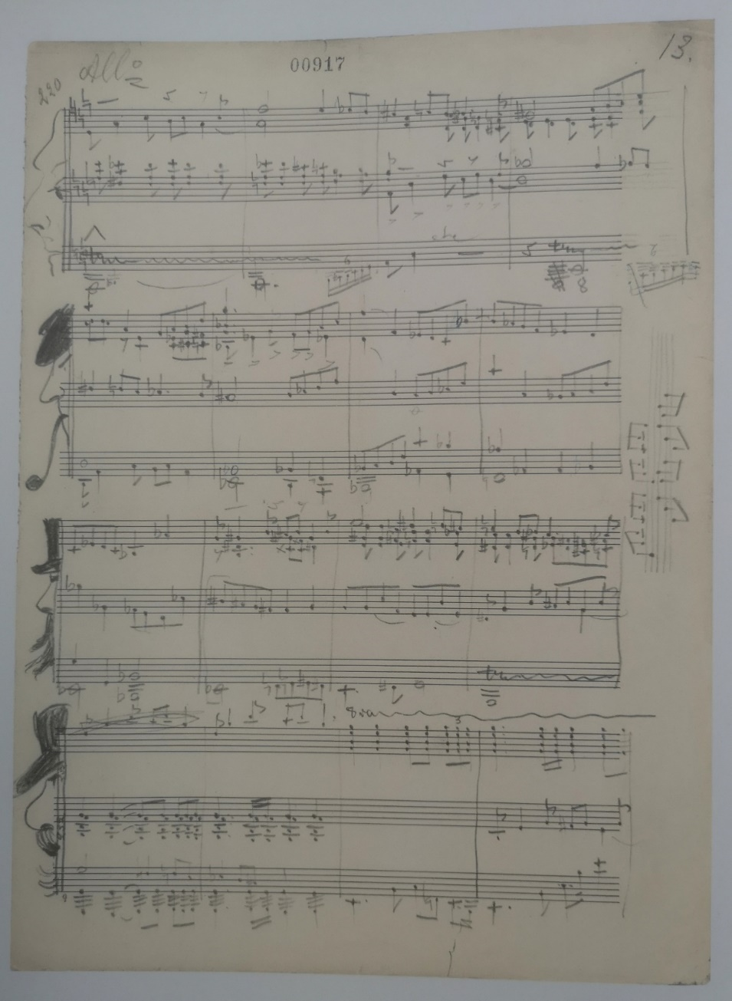
A Portrait in the score

Slide 6
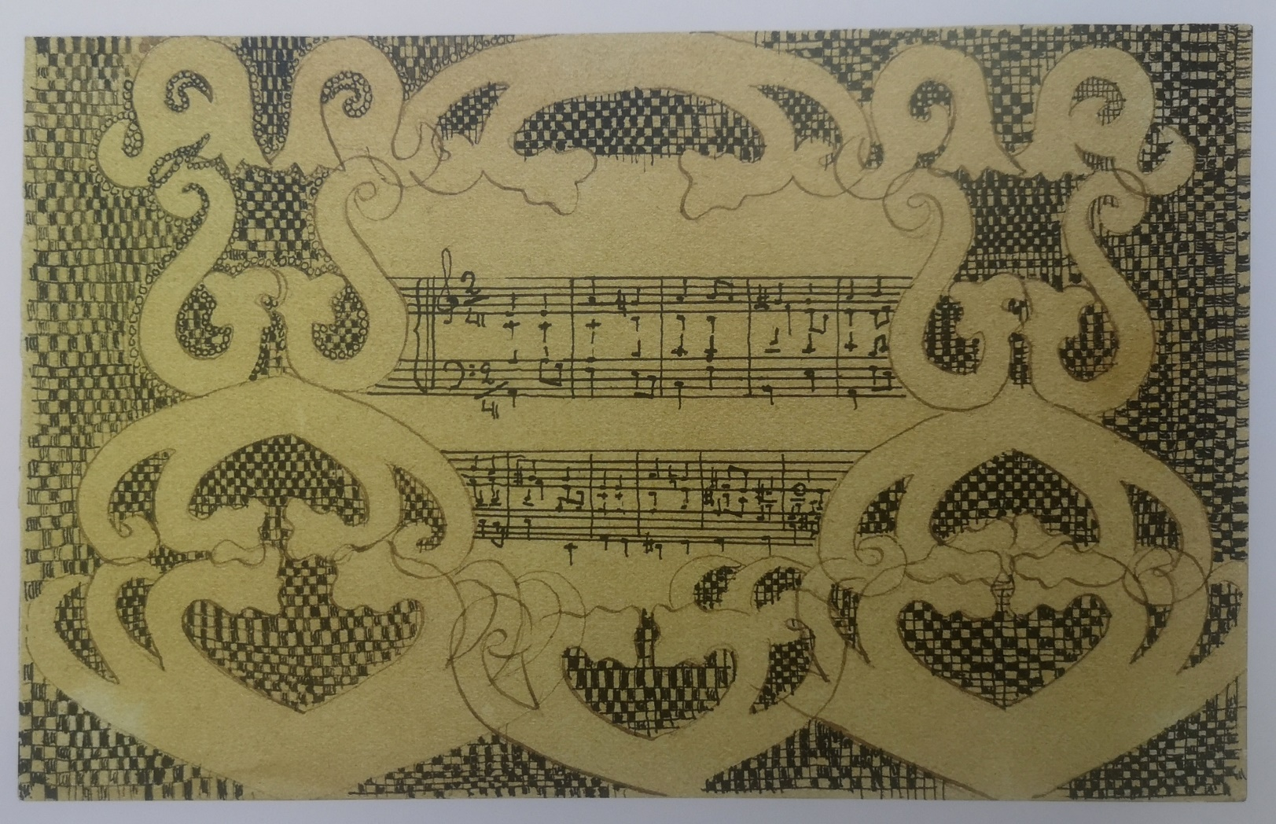
Vignette for Lithuanian folk song 10.4x16.6cm. Paper, pencil, ink, pen.

Slide 7
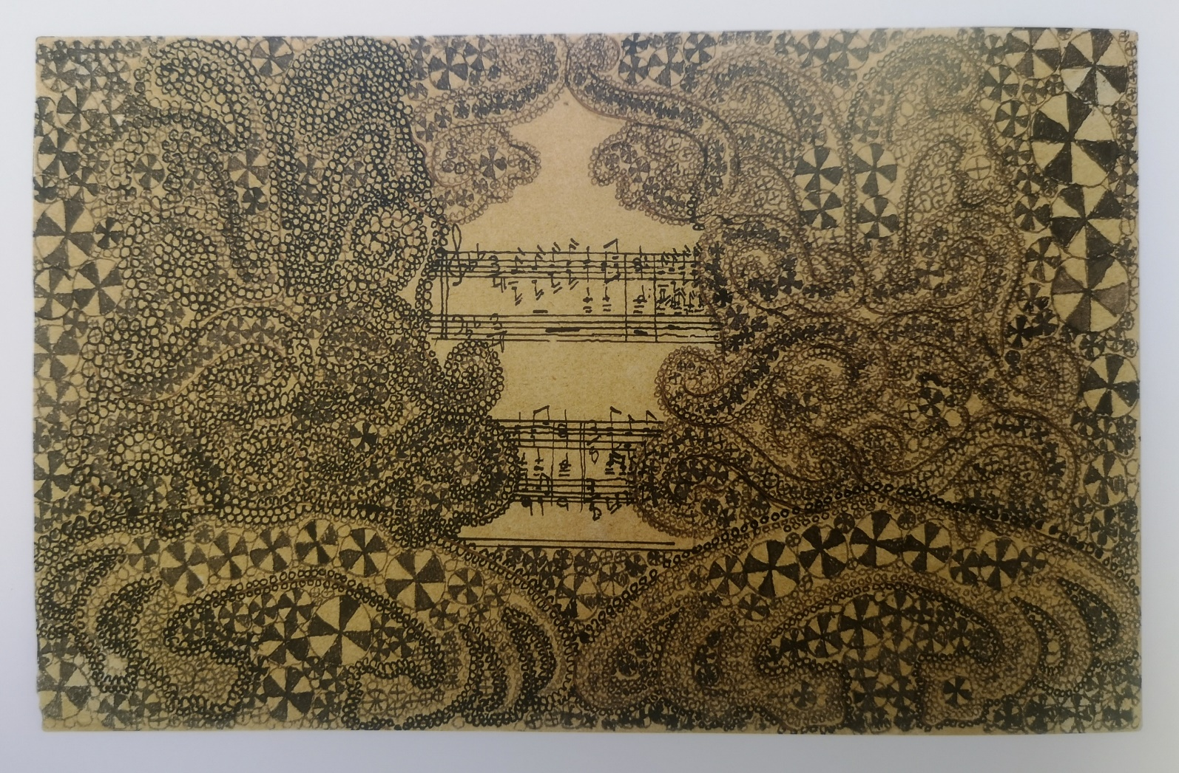
Vignette for Lithuanian folk song 10.4x16.6cm. The artist used paper, pencil, ink, pen to paint the painting.

Slide 8
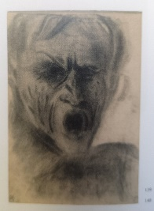
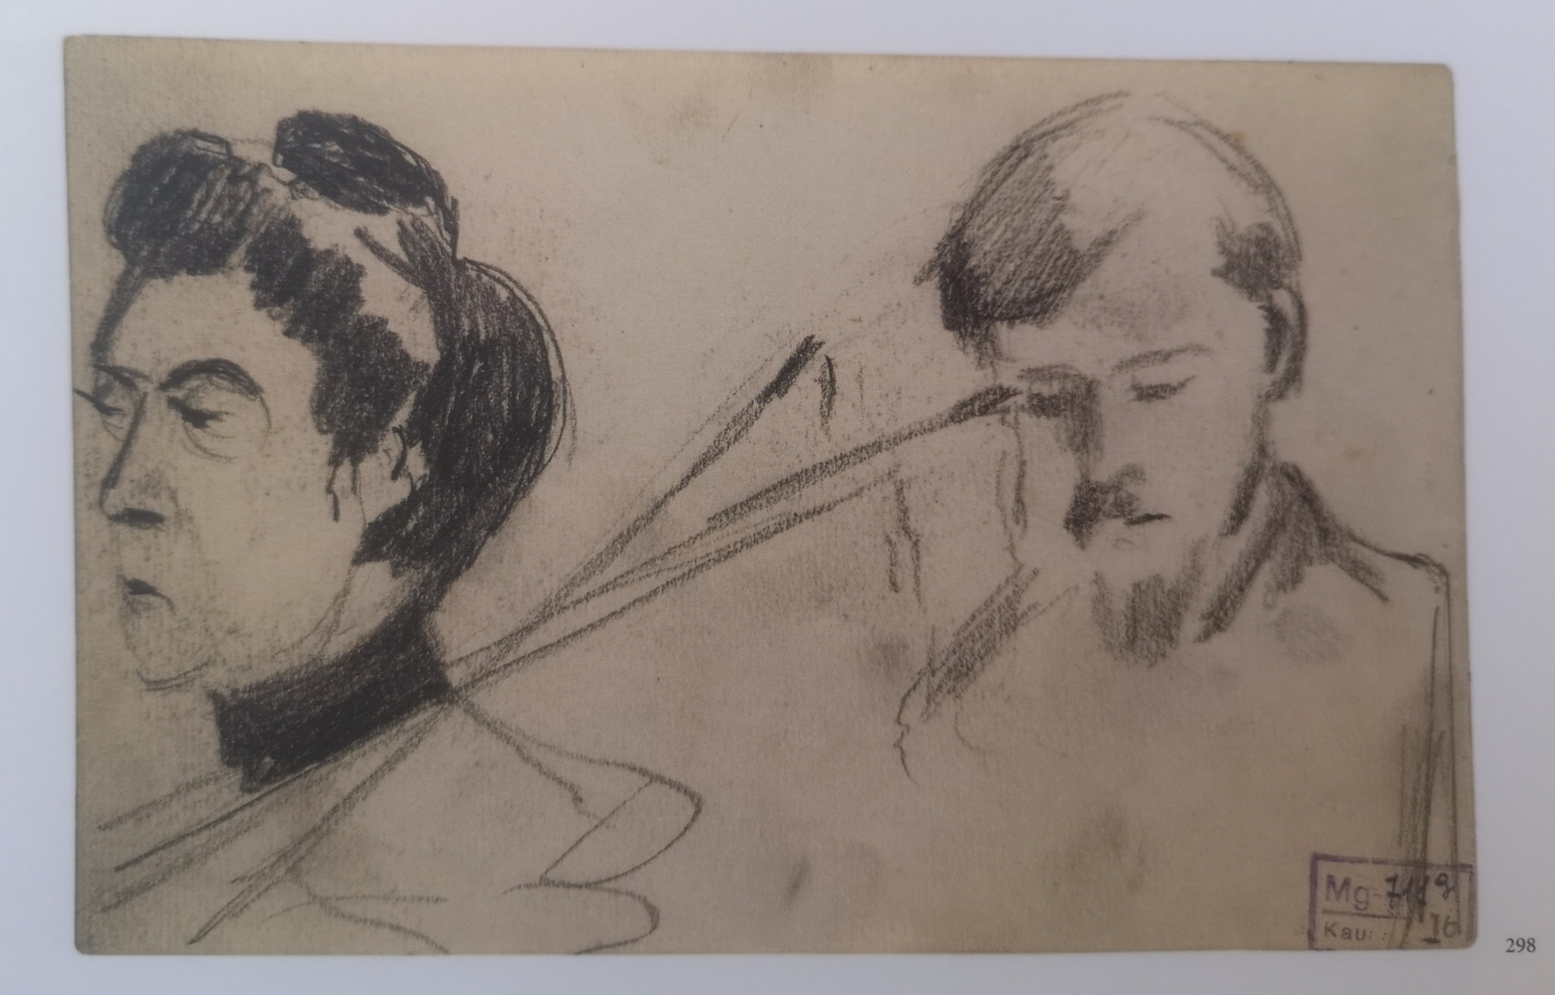
Portrait sketches. Paper, pencil.

Slide 9
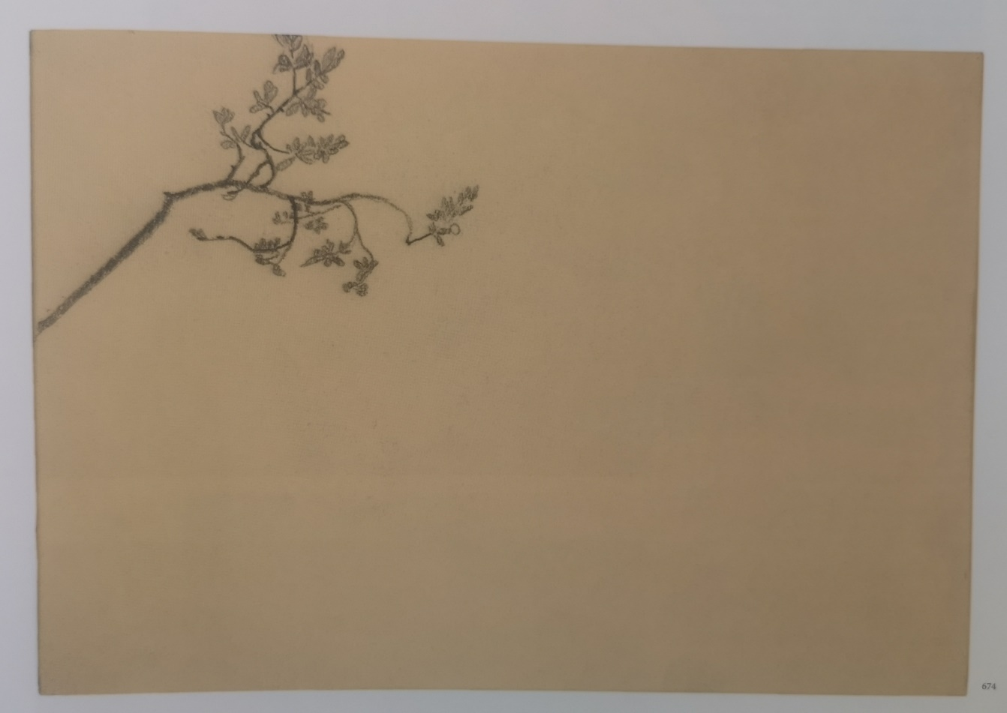
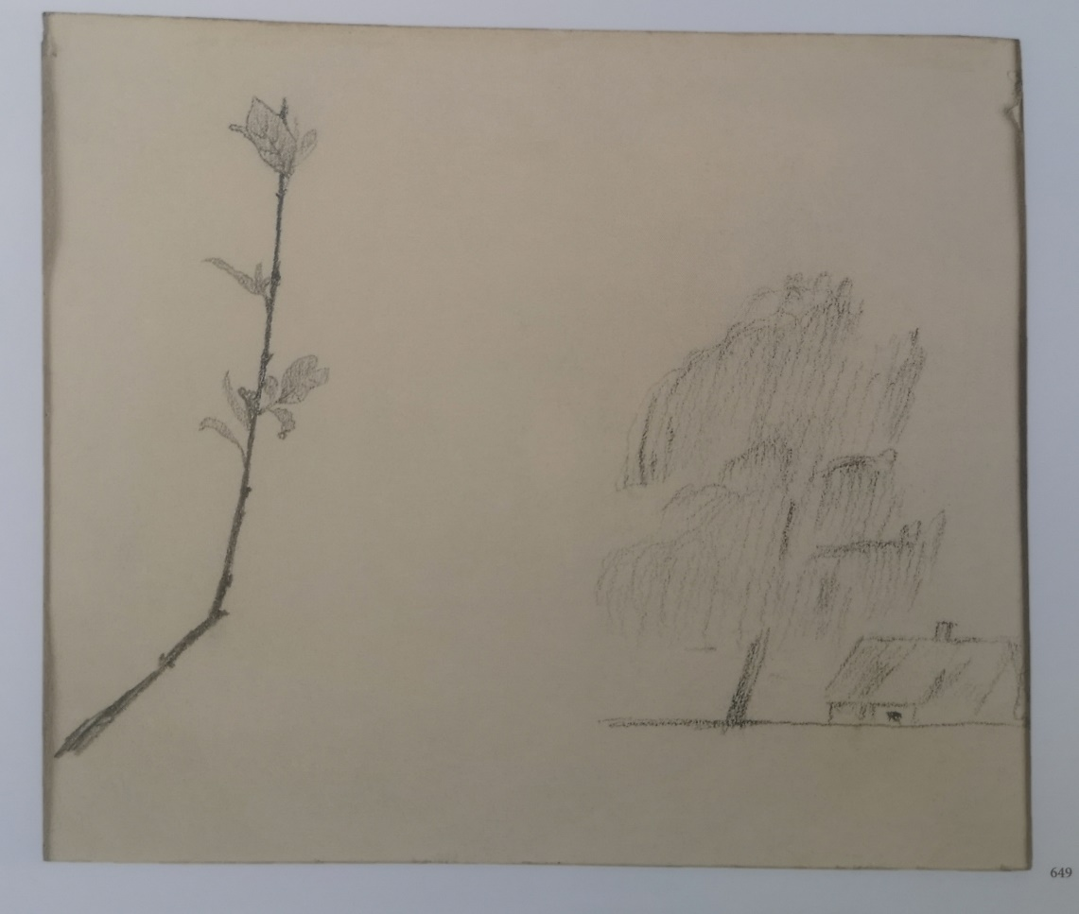
Minimalism in landscape sketches. Paper, pencil.

Slide 10
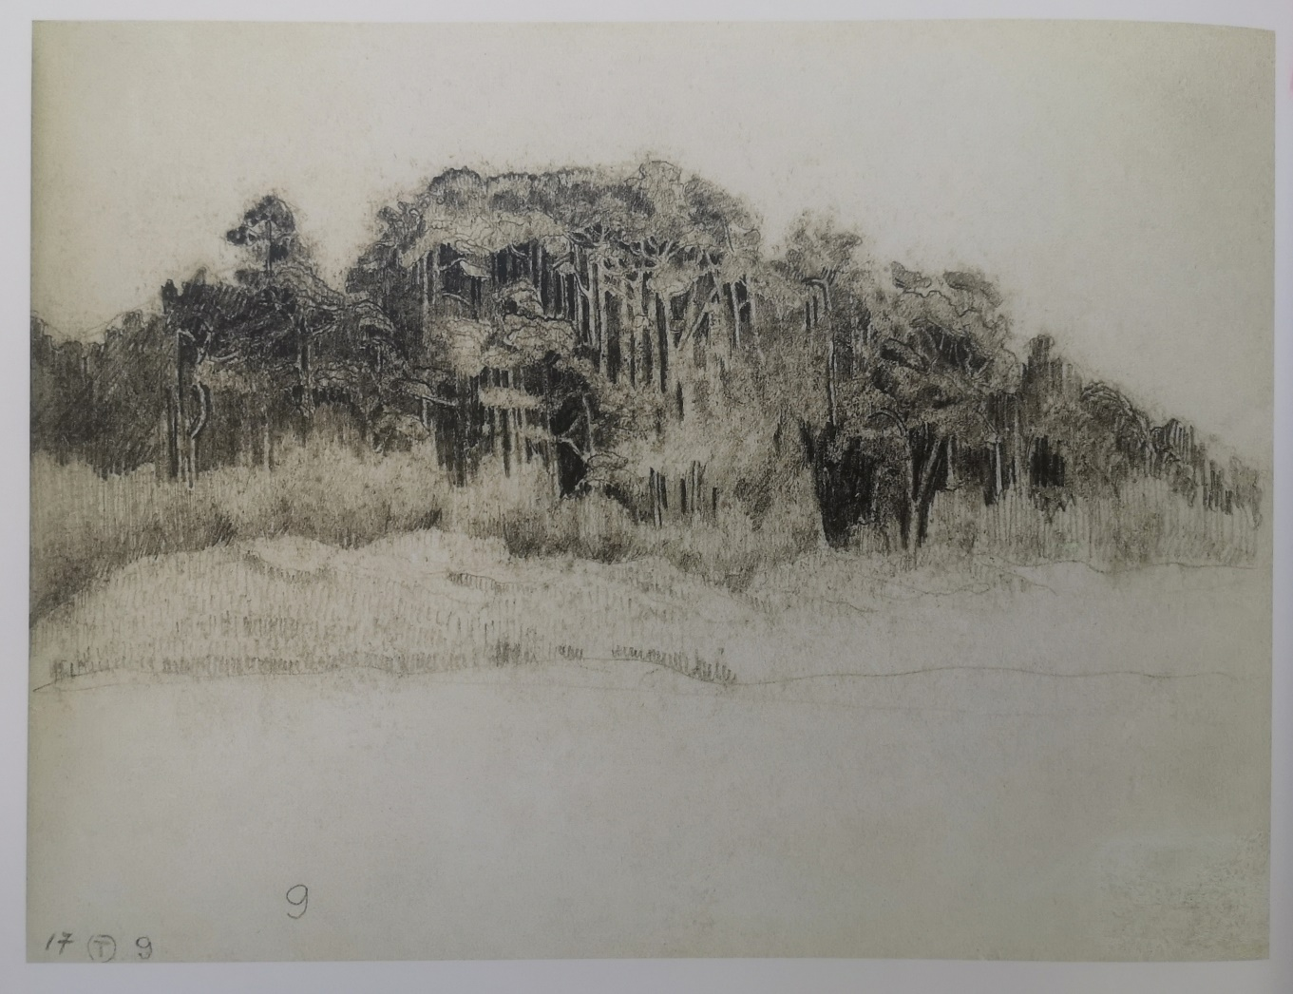
Sketch, landscape. Paper, pencil.

Slide 11
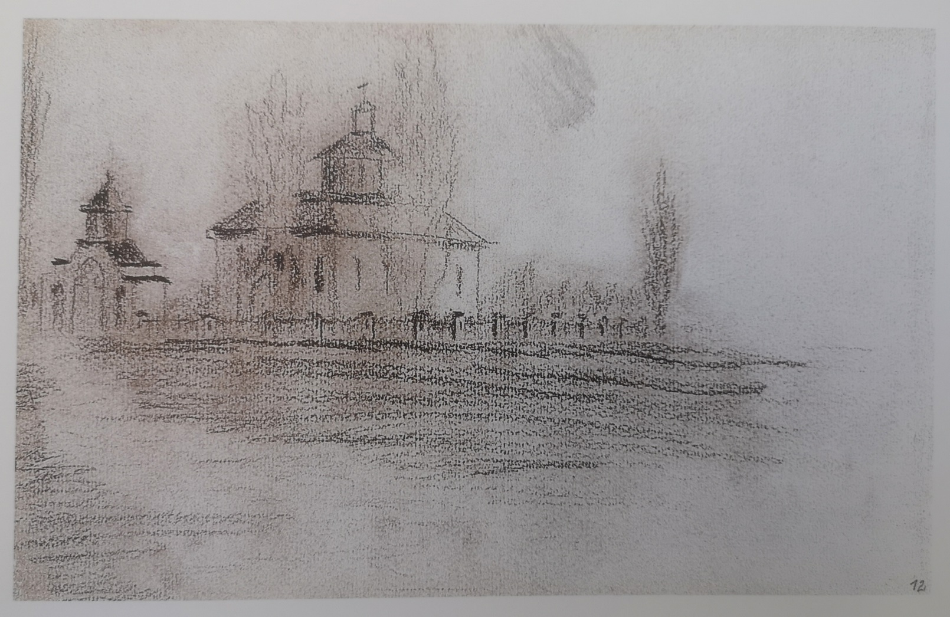
Architecture and nature sketch. Paper, pencil

Slide 12
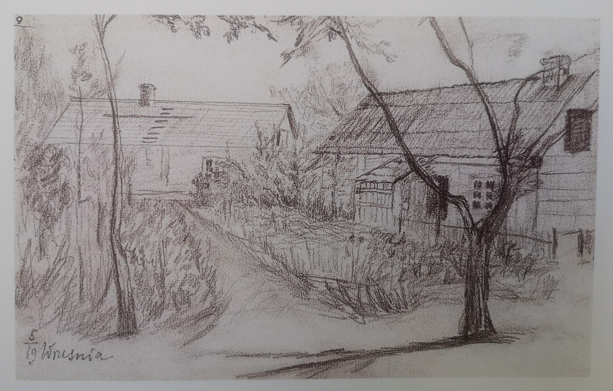
Architecture and nature sketch. Paper, pencil

Slide 13
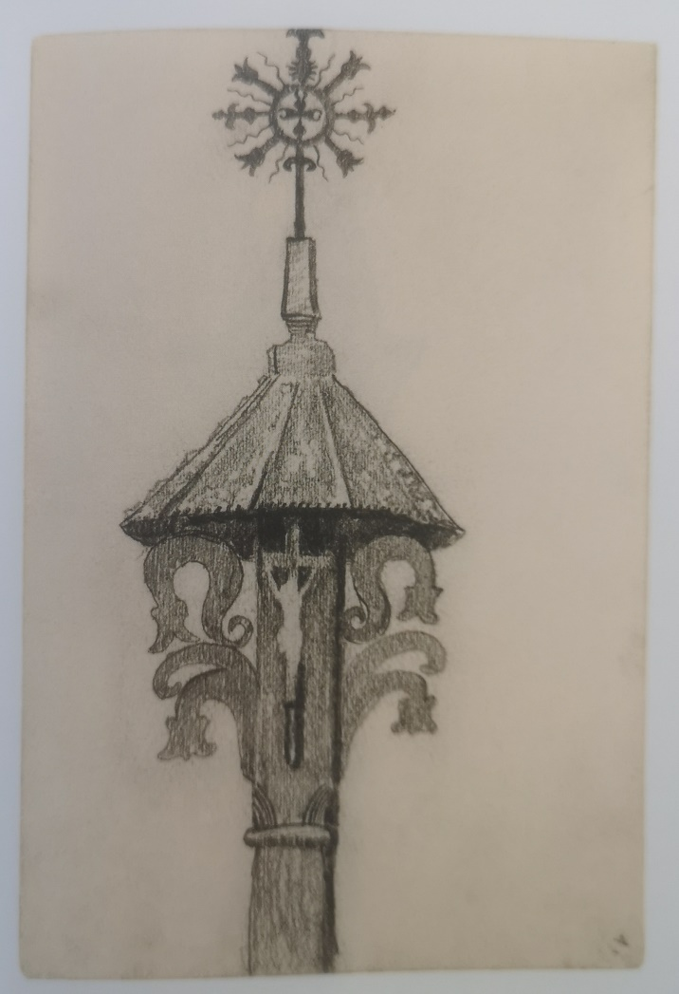
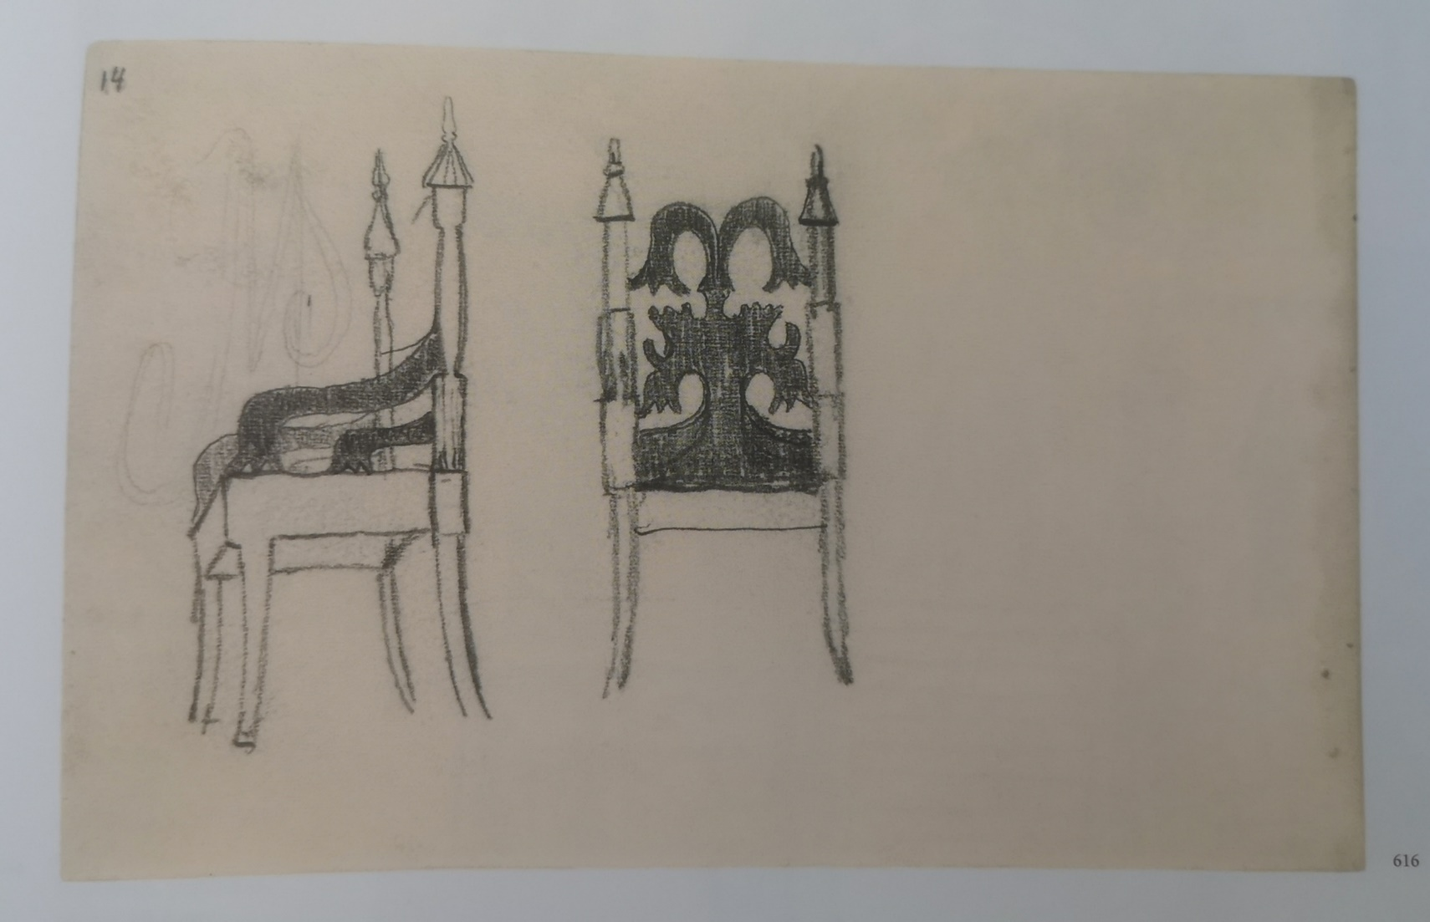
Lithuanian folk art “Chapel“ sketch. Paper, pencil.
Lithuanian folk art, interior element-chair sketch. Paper, pencil.

Slide 14
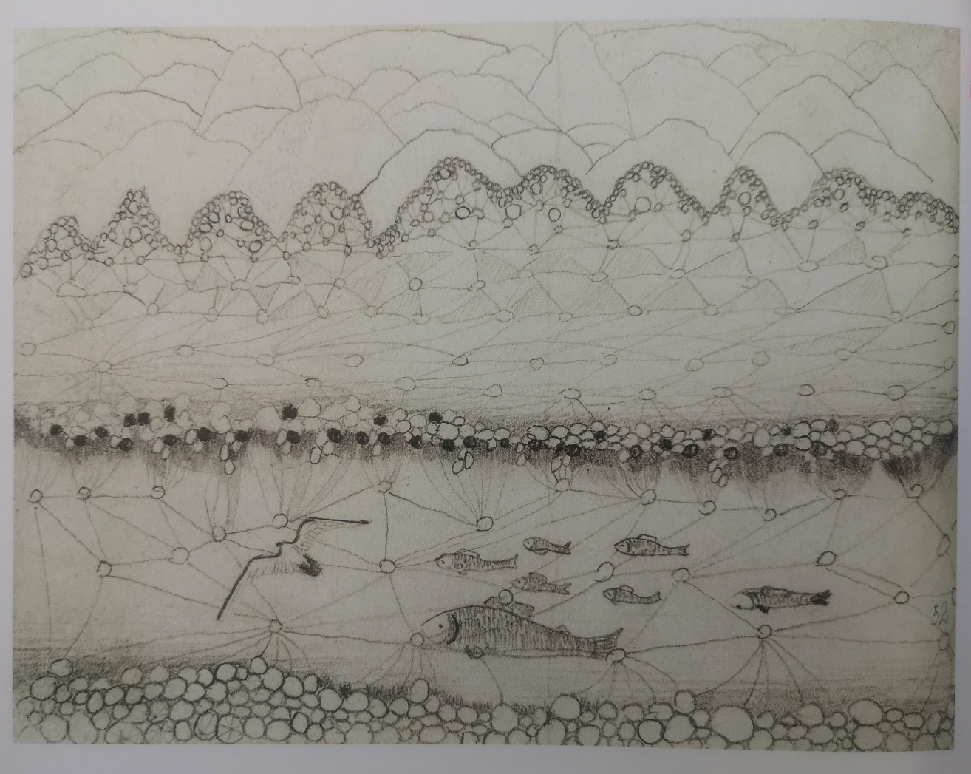
Allegro sketch dedicated to Sonata no. 5 (Sea Sonata), 1908. Paper, pencil. 11.8x16.0 cm. The work combines music, biology, chemistry and physics.

Slide 15
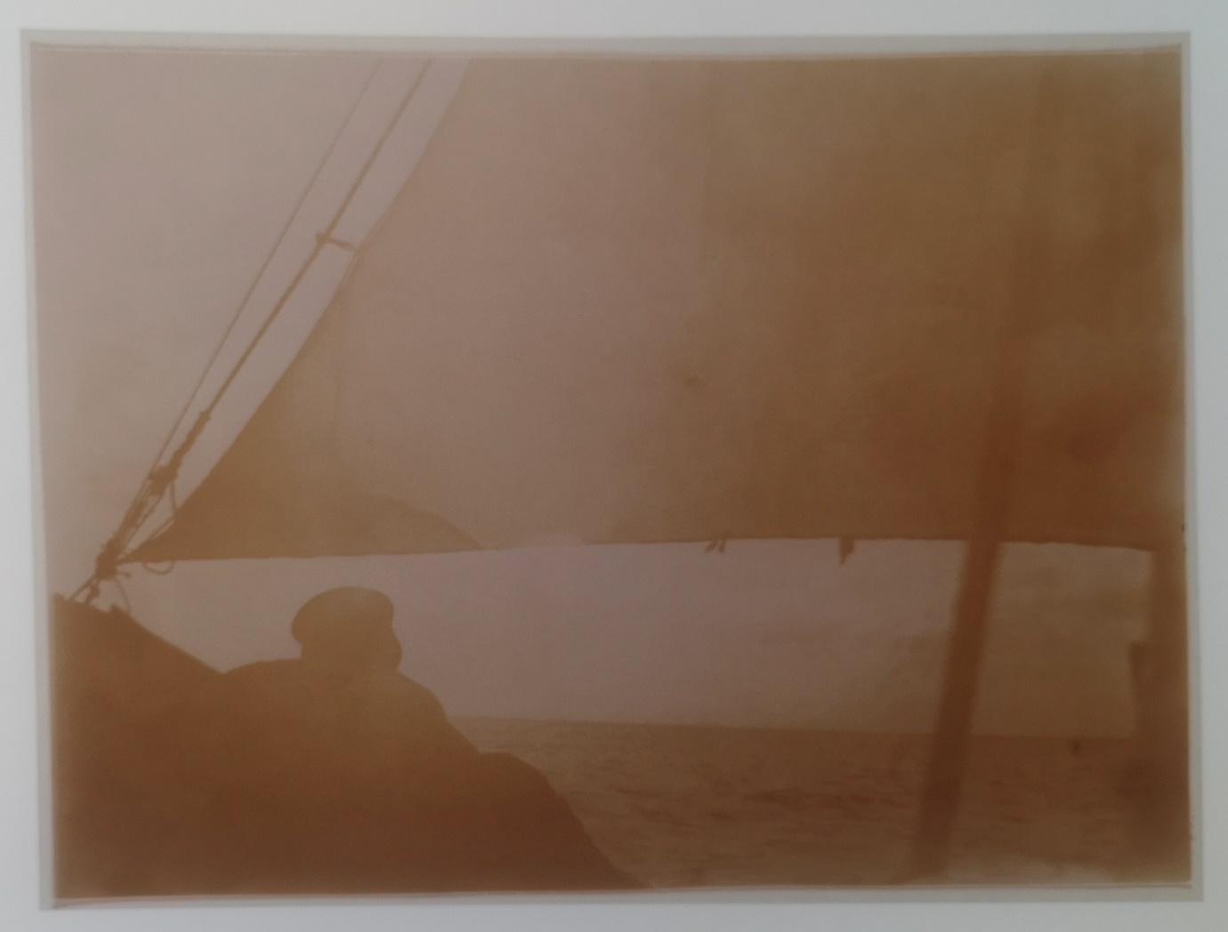
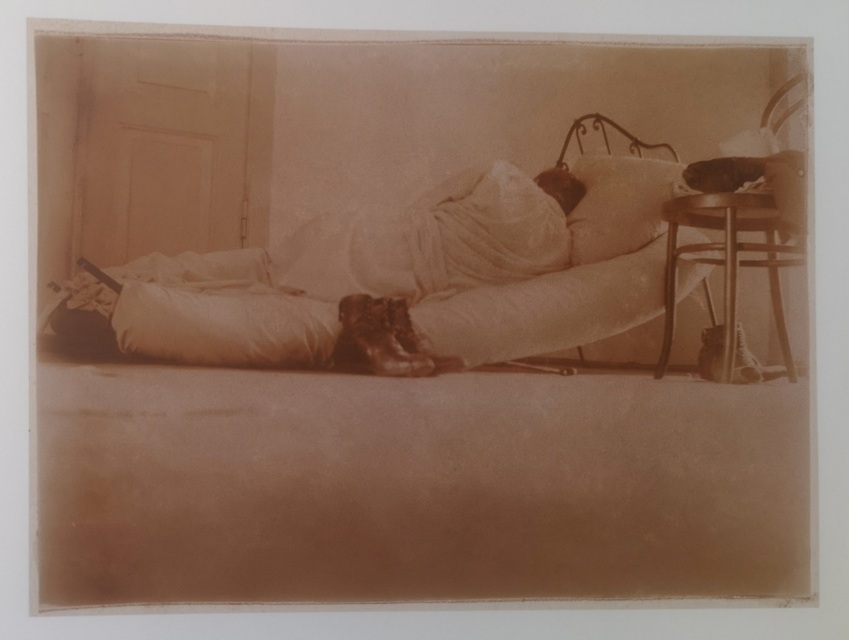
Photography

Slide 16
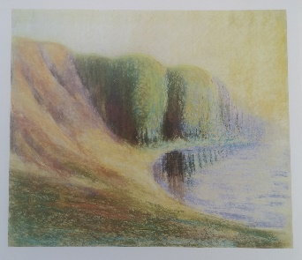
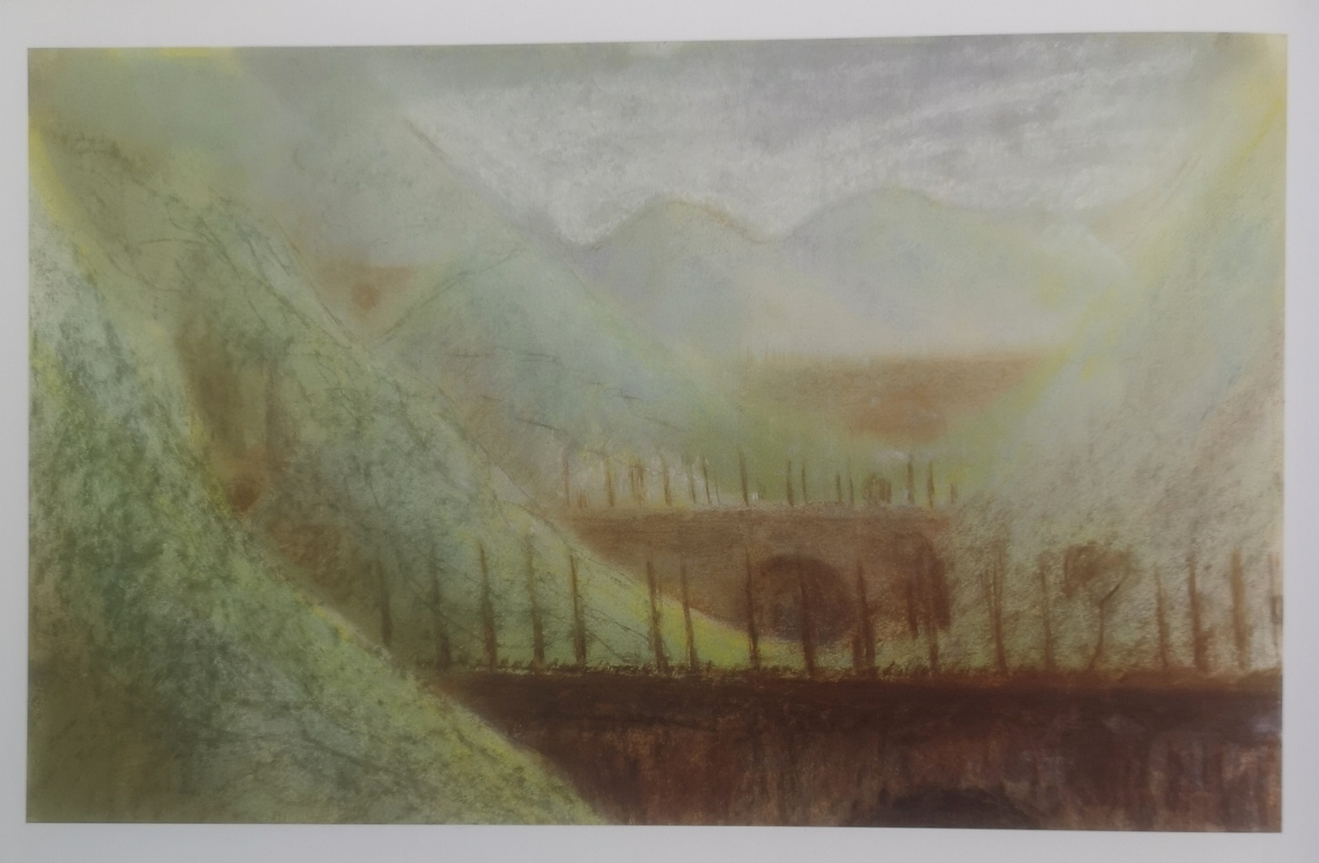
Pastel

Slide 17
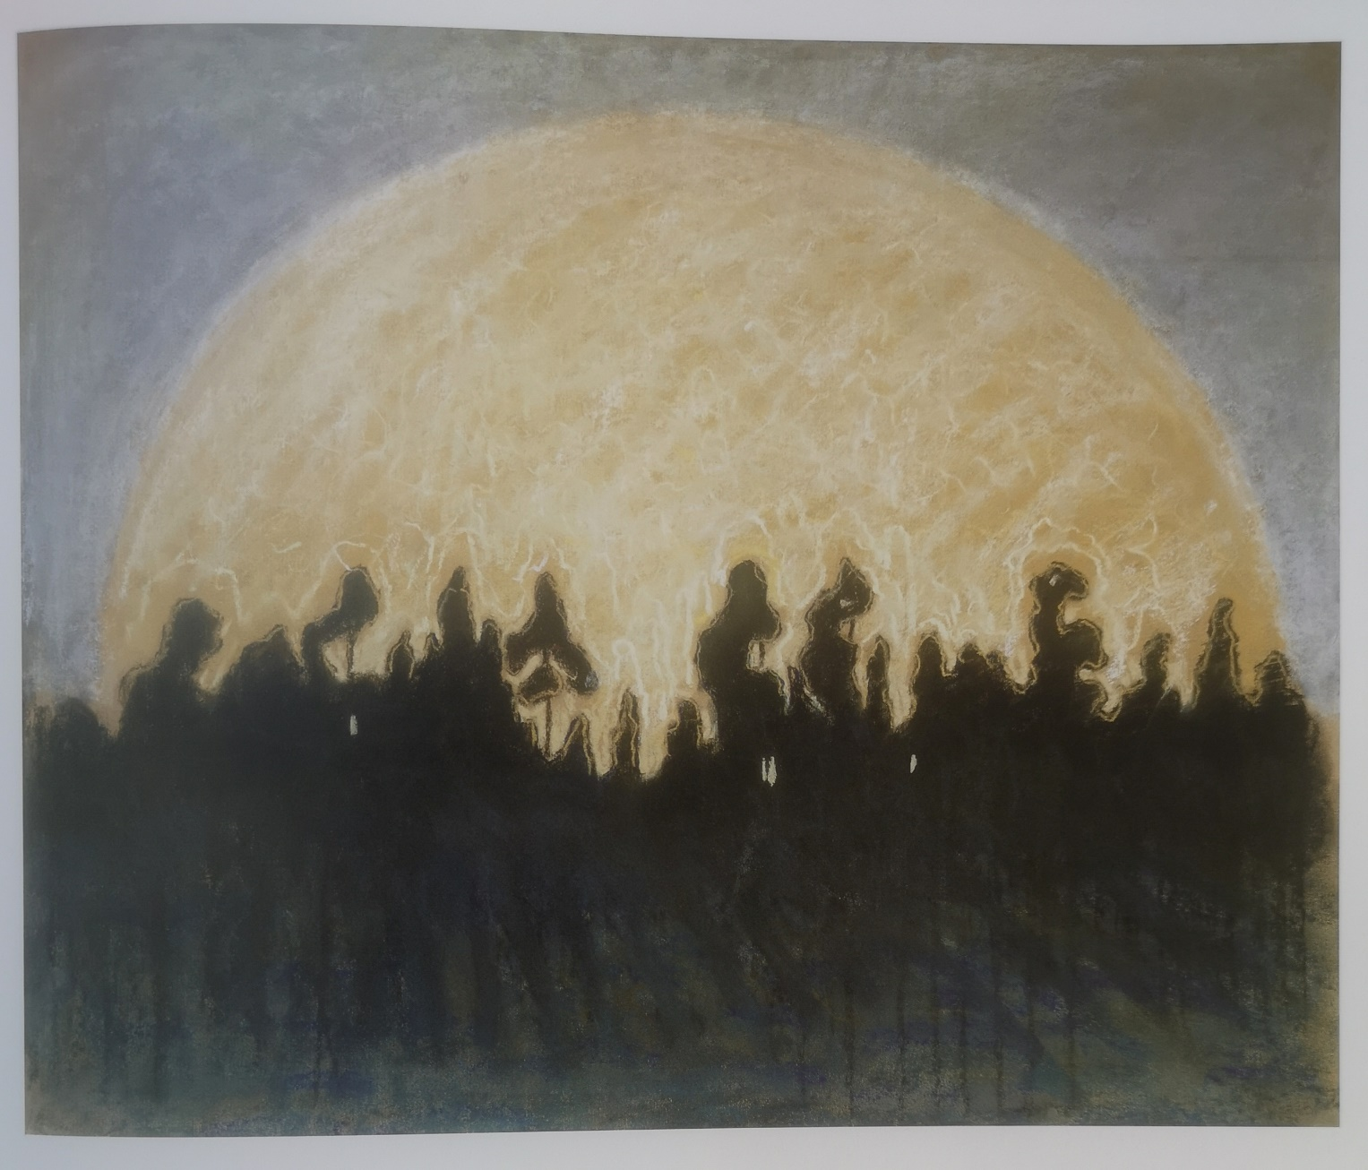
Pastel

Slide 18
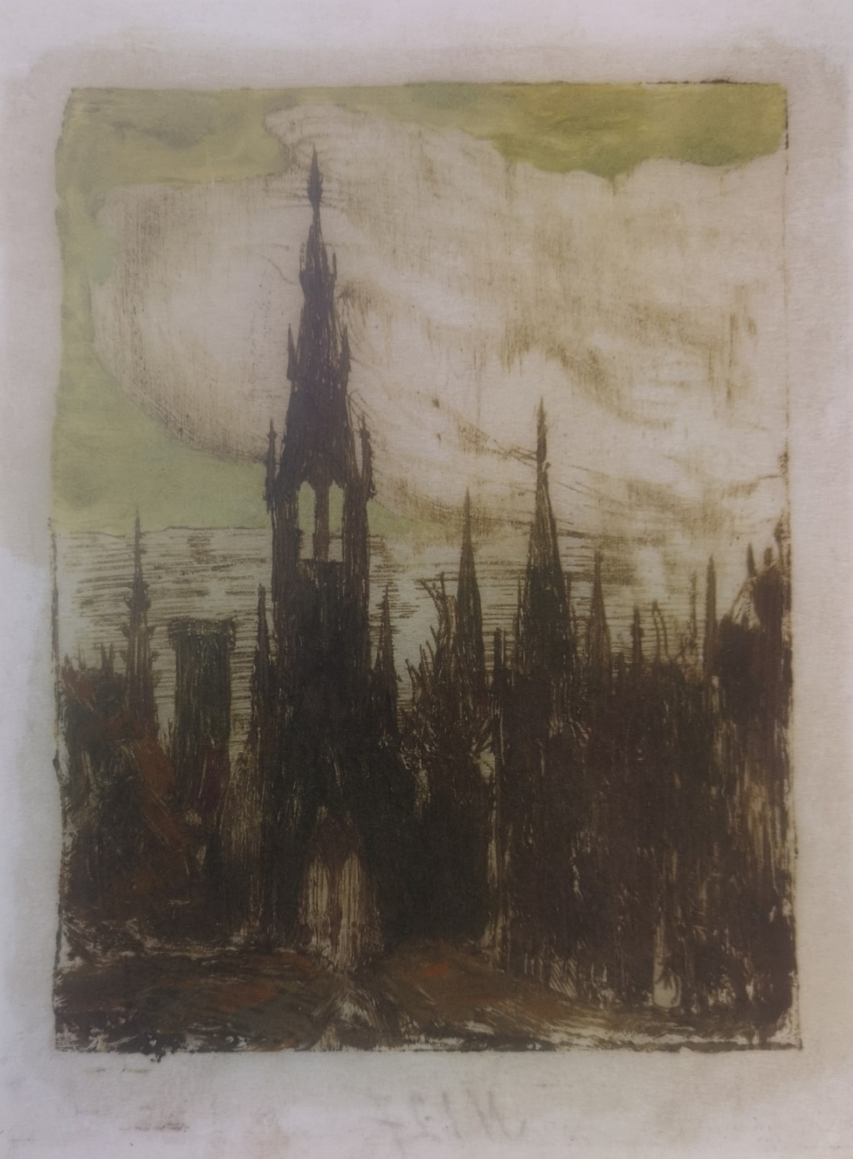
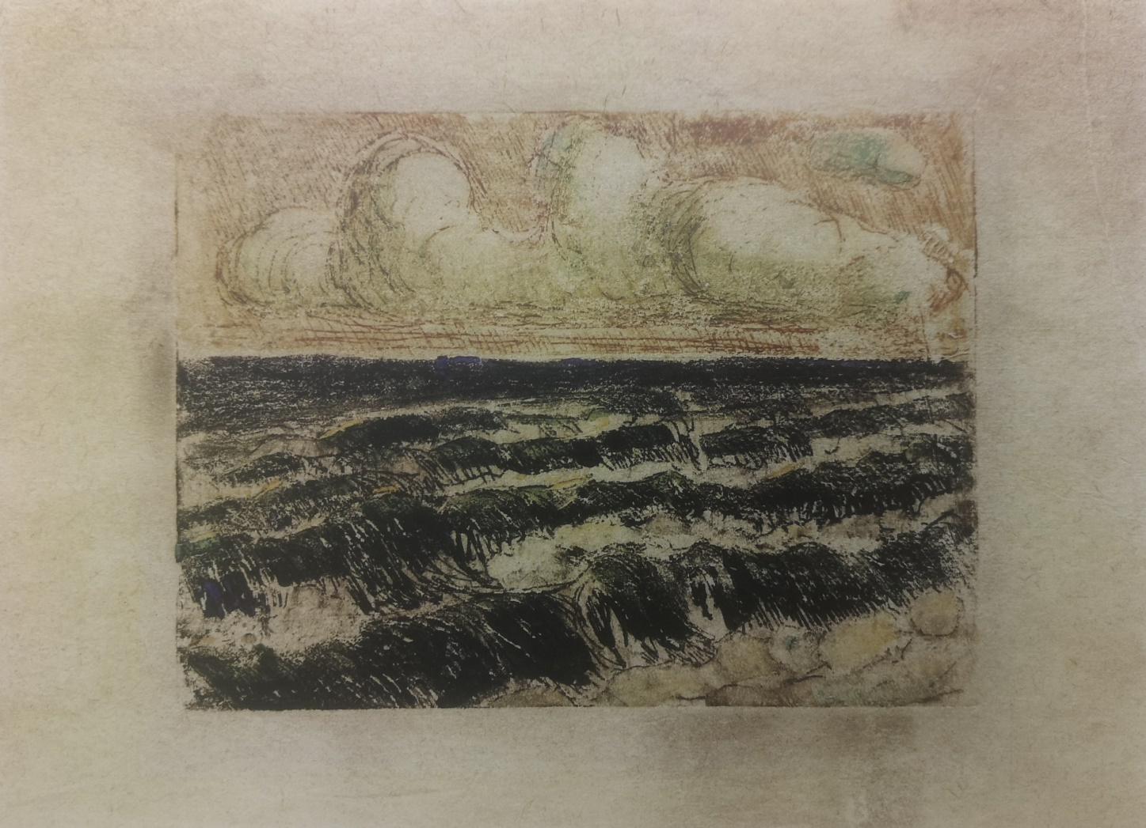
Fluorophore

Slide 19
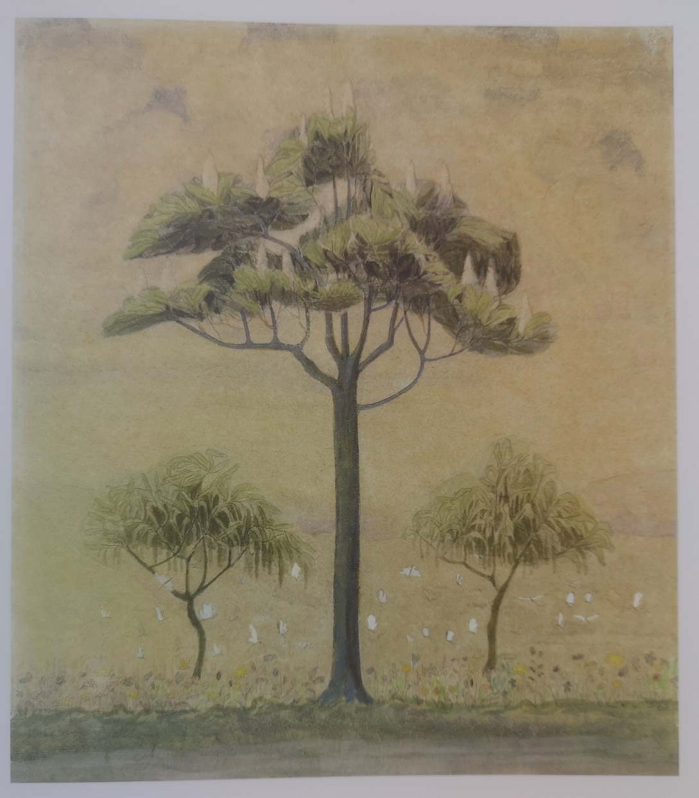
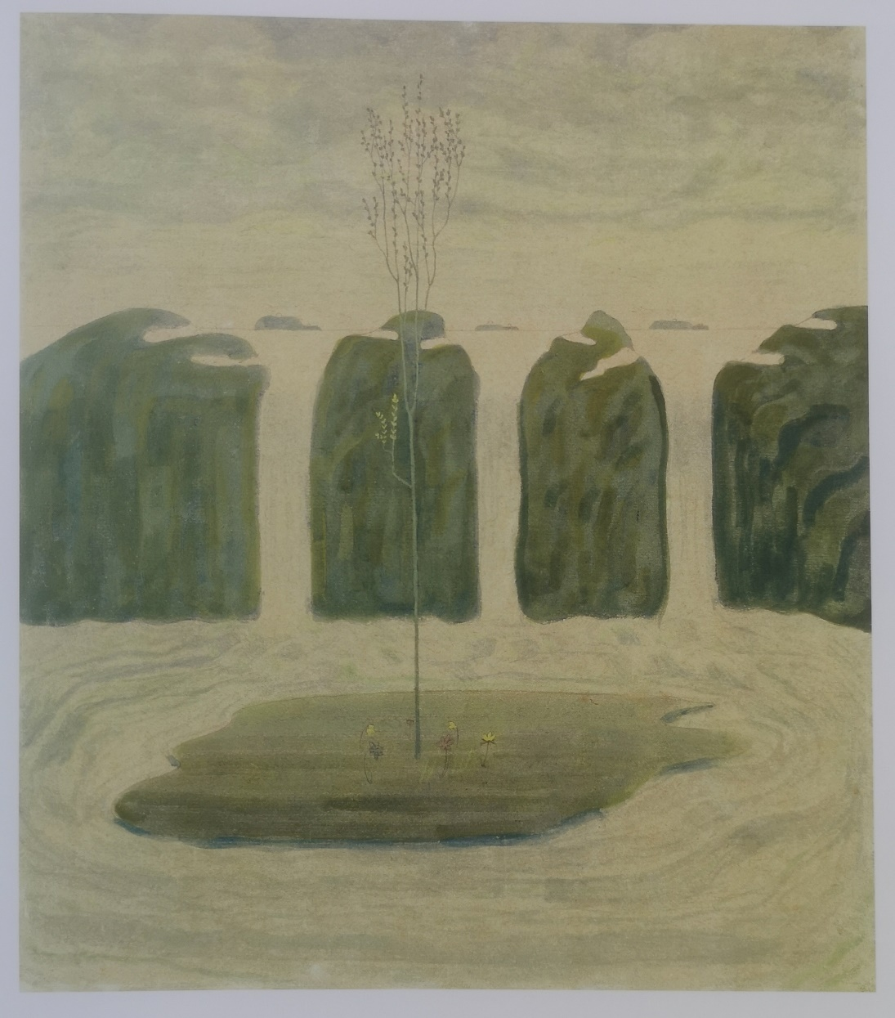
Tempera

Slide 20
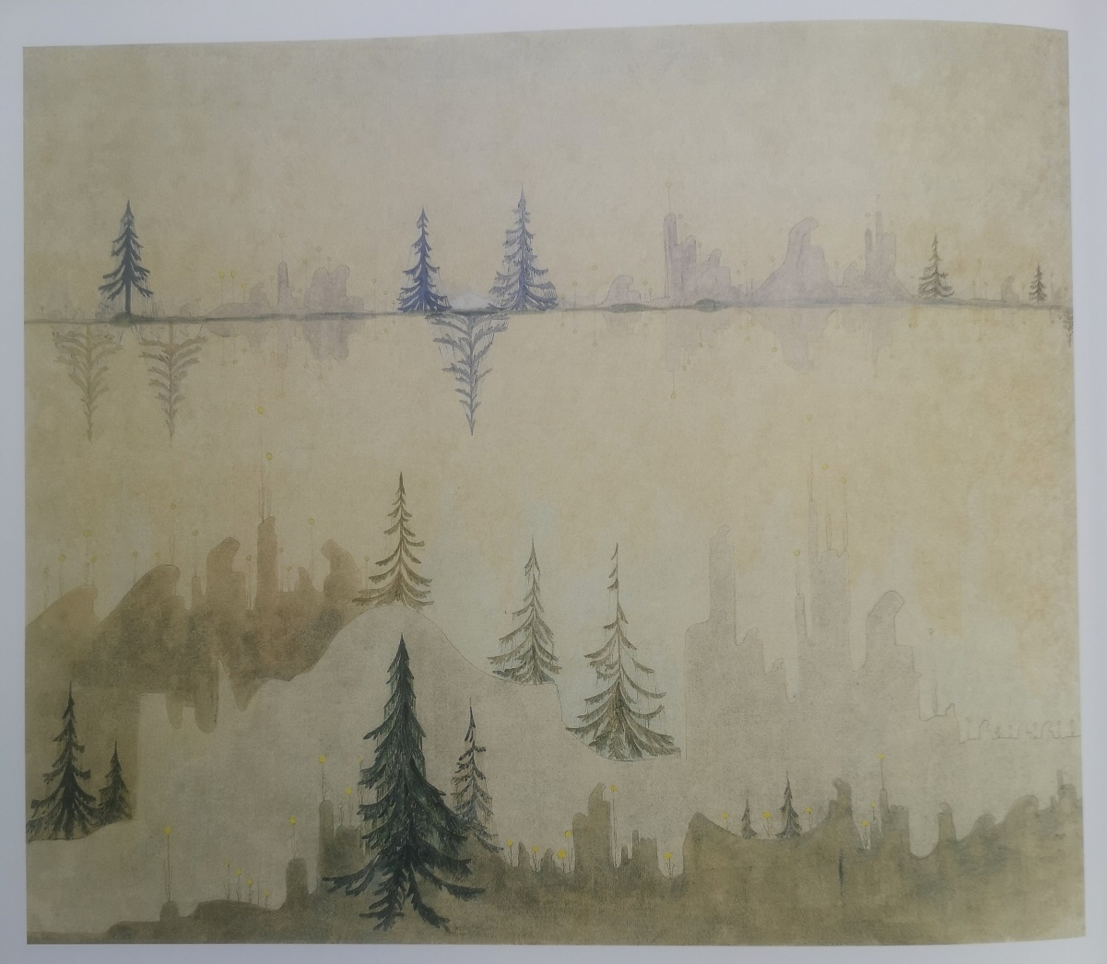
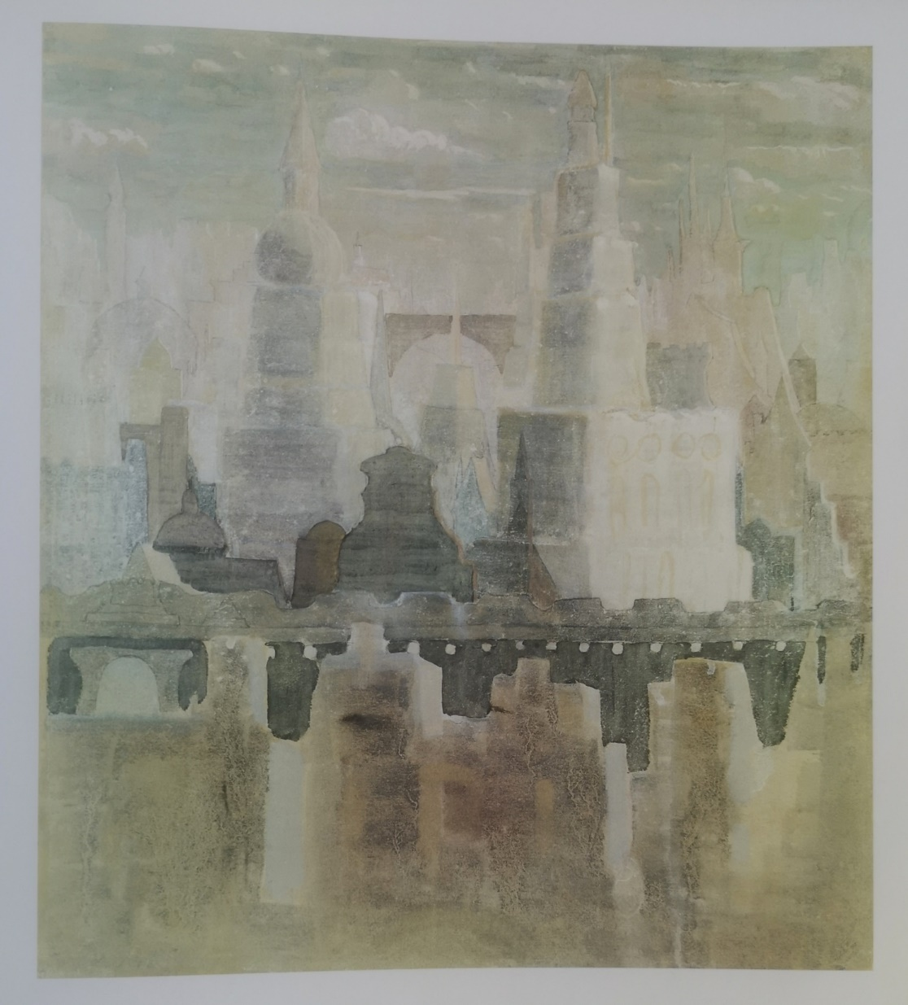
Fugue from the diptych “Prelude. Fuga ”. 1908. Paper, tempera. 62.2x72.6
“City” from the cycle “City”. 1908. Paper, tempera, gouache. 36.2x31.5

Slide 21
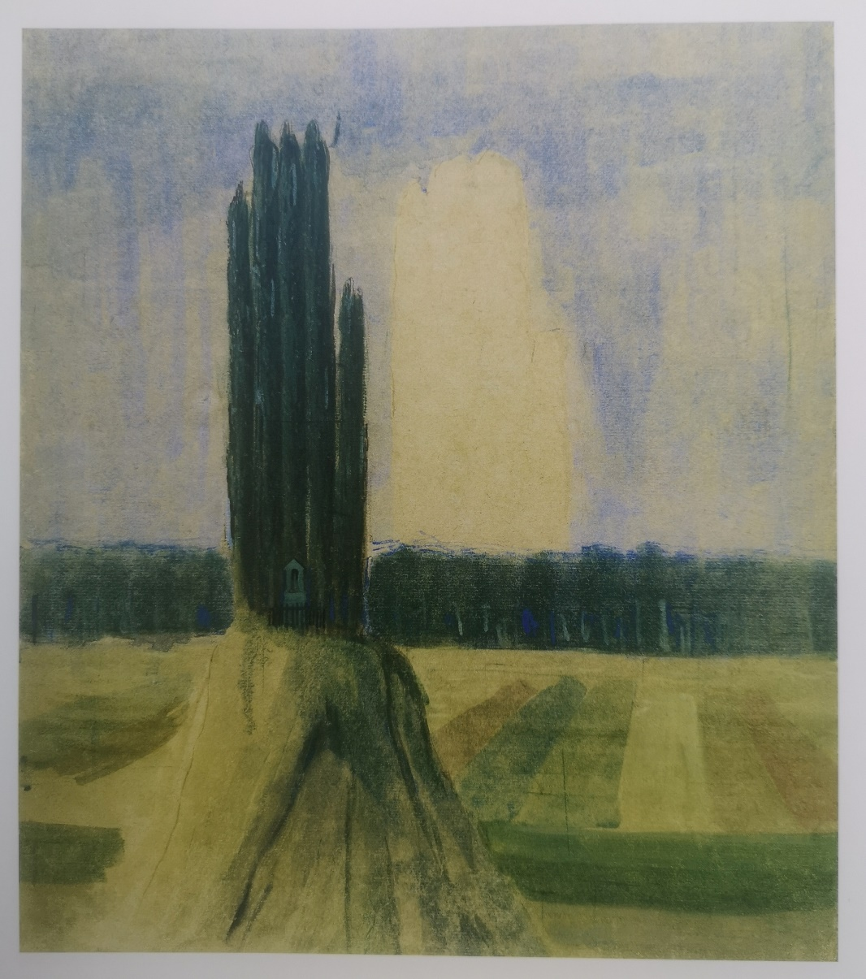
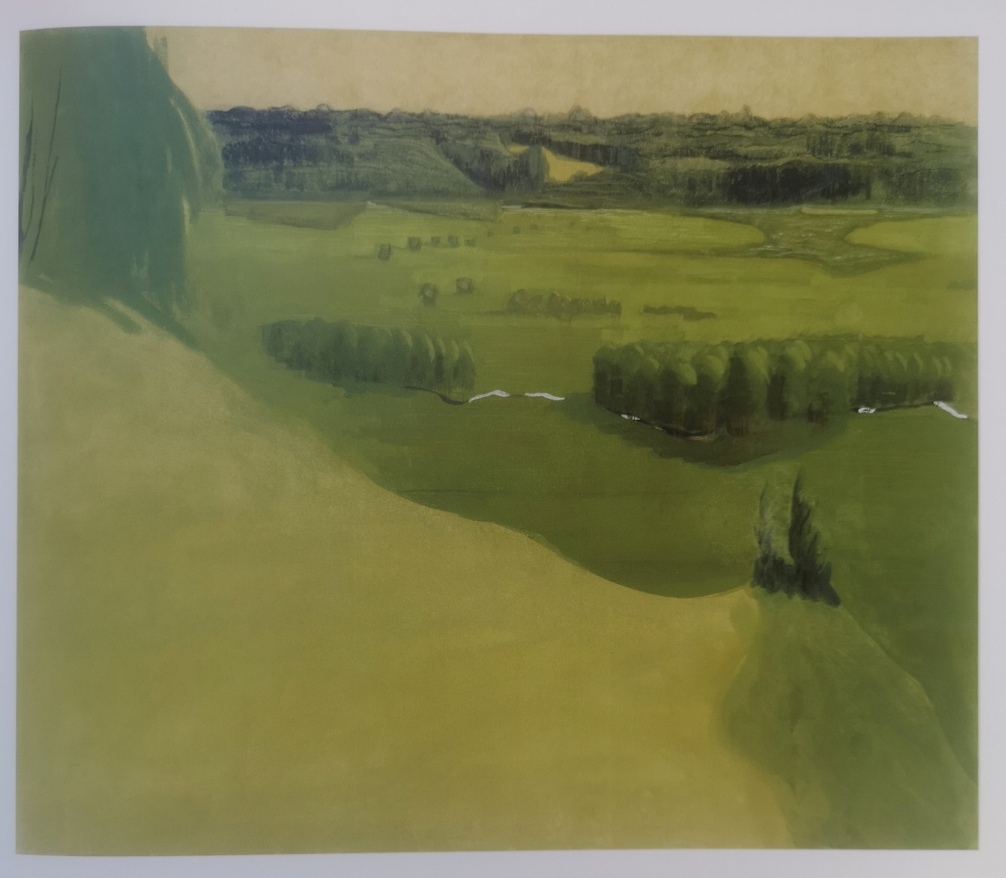
“Summer” Picture II from a triptych. 1907. Paper, tempera, watercolor, gouache. 36.1x31
Raigardas picture I from a triptych. 1907. Paper, tempera. 61.6x71.8

Slide 22
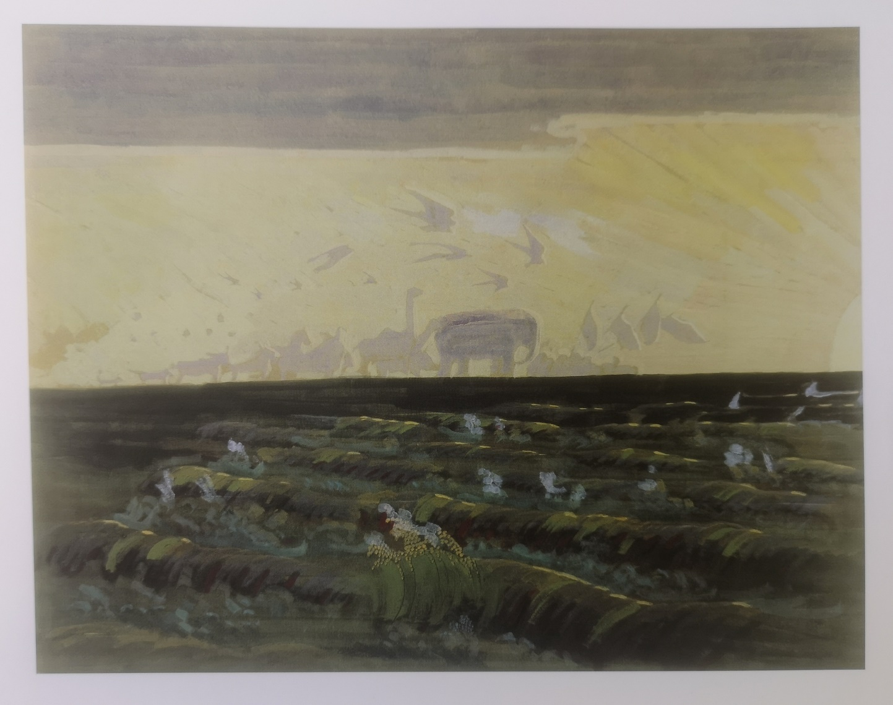
“Worship of the Sun“, 1909. Cardboard, tempera. 55.7x70.7. The work deals with evolution, geology, and history.

Slide 23
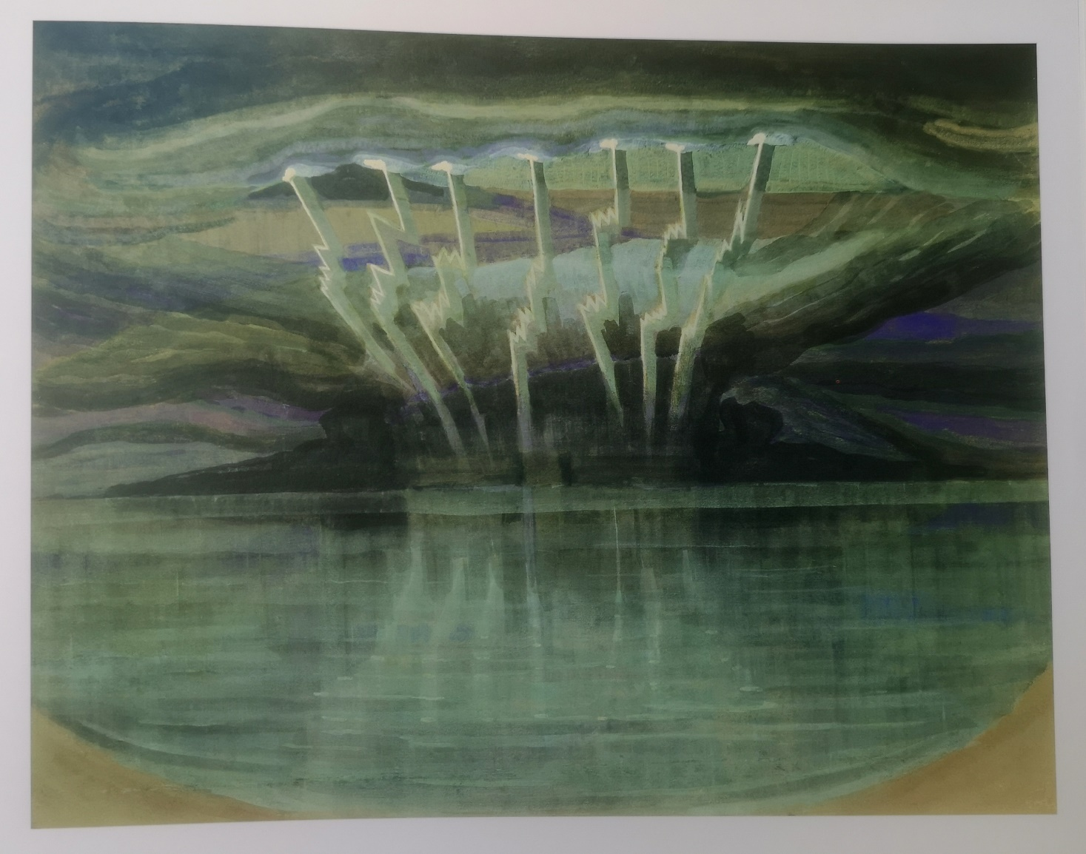
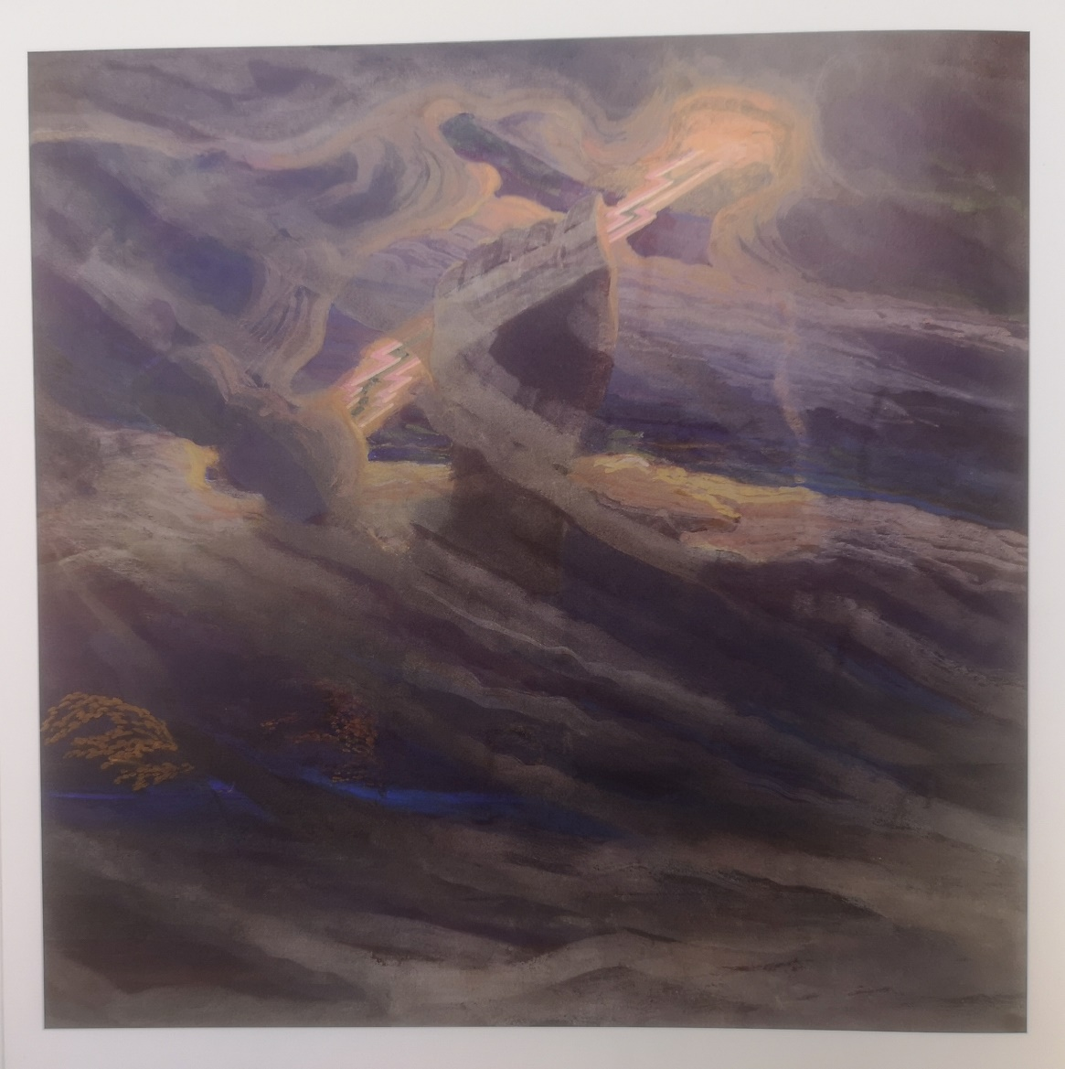
“Lightning ”1909. Cardboard, tempera. 59.8x76.6 "Thunder" 1909. Cardboard, tempera.60.9x61
The works in which manifestations of physics and chemistry can be found.

Slide 24
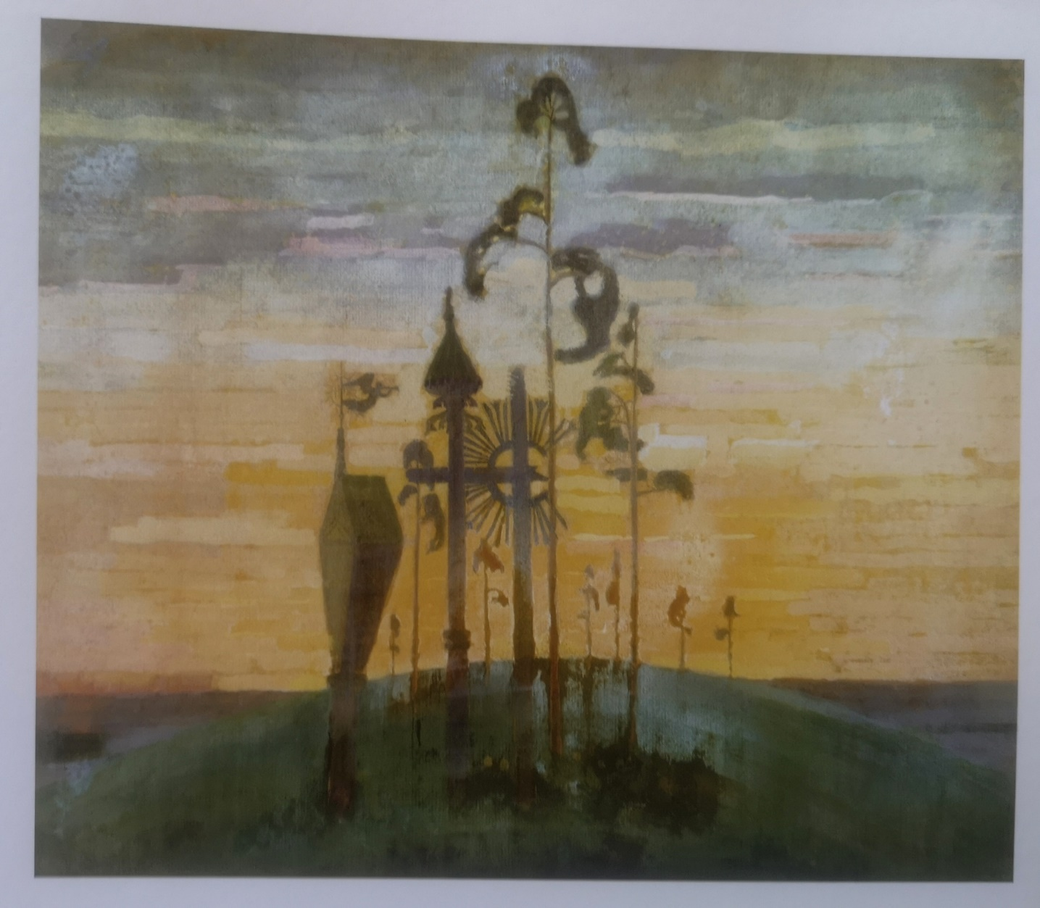
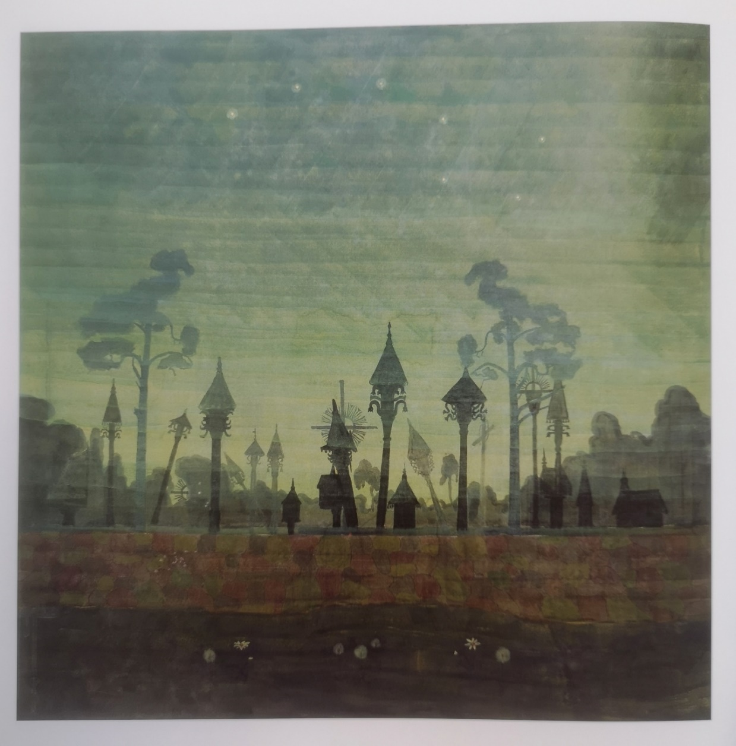
"Cemetery" 1909. Cardboard, tempera, "Lithuanian Cemetery" 1909. Cardboard, watercolor 30.4x35.6 tempera. 61,5x62
The works which show small Lithuanian folk architecture.

Slide 25
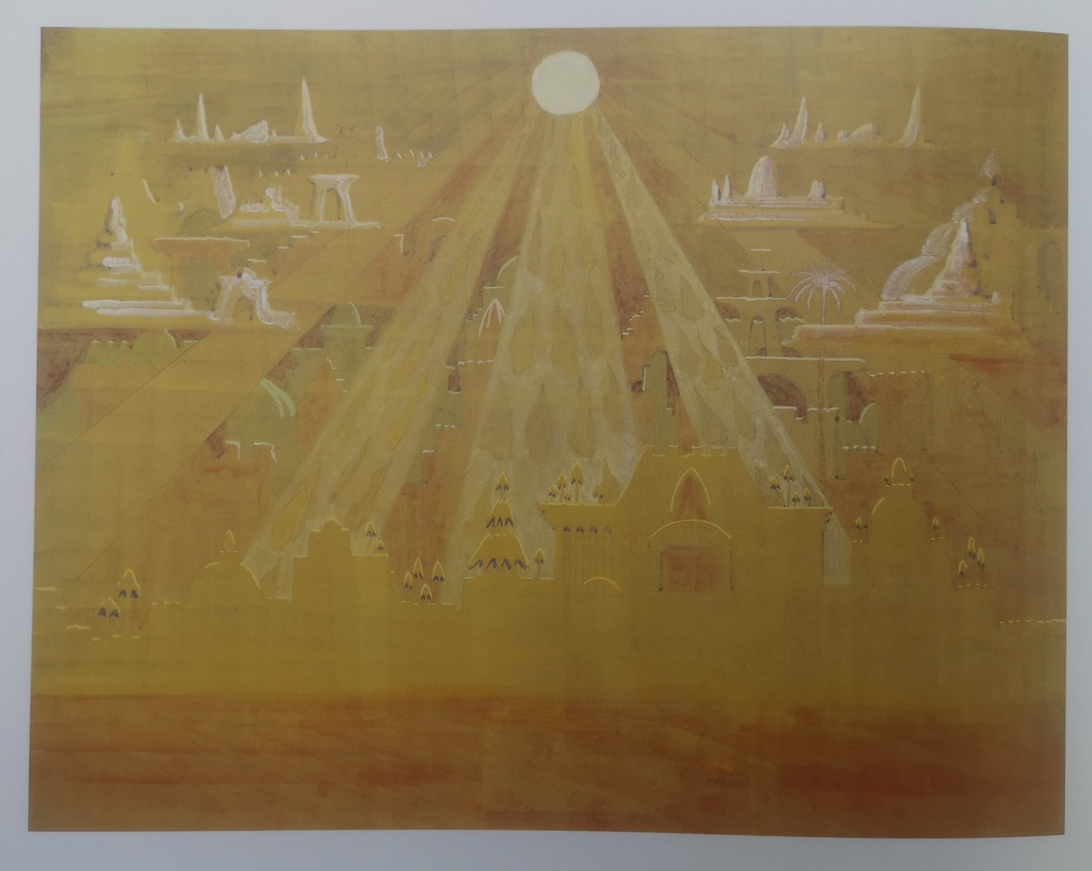
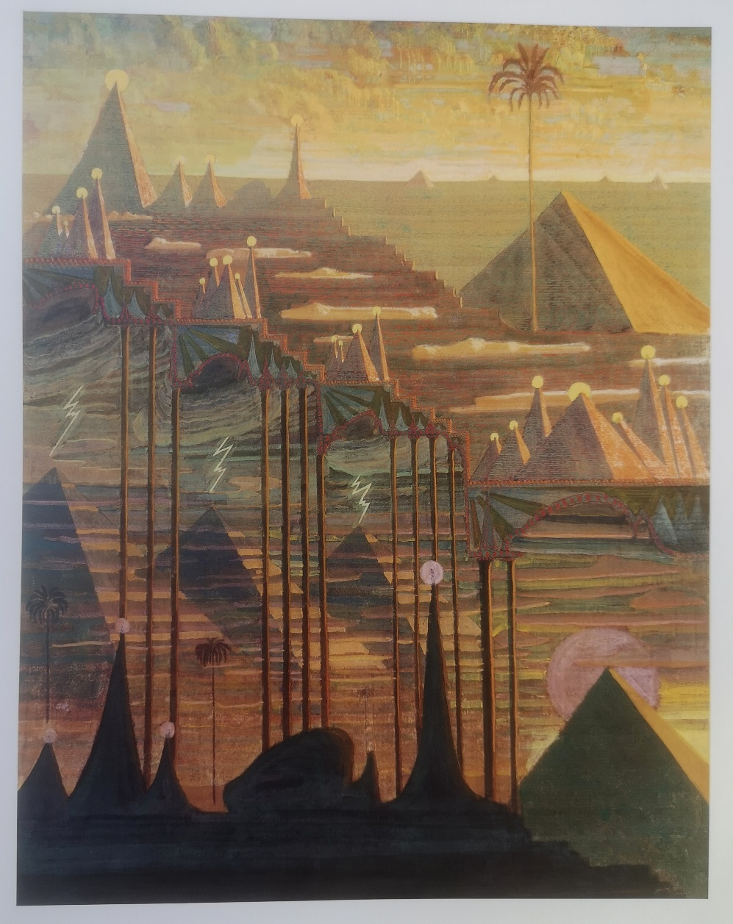
“Sonata no. 7 (Sonata of the Pyramids). Scherzo“ 1909. Paper, tempera. 53.8x69.4
“Sonata no. 7 (Sonata of the Pyramids). Allegro“. 1909. Paper, tempera. 76.6x59.7

Slide 26
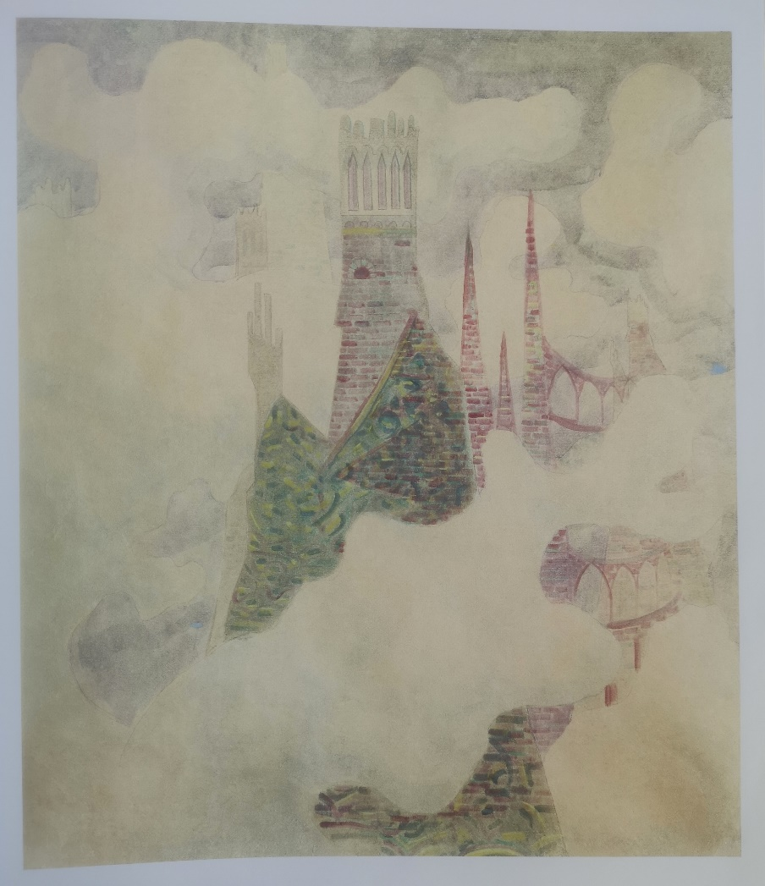
„Sonata no. 4 (Summer Sonata). Finale ”. 1908. Paper, tempera. 72.5x62
The work in which we see the illusion of nature, architecture and a man.

Slide 27
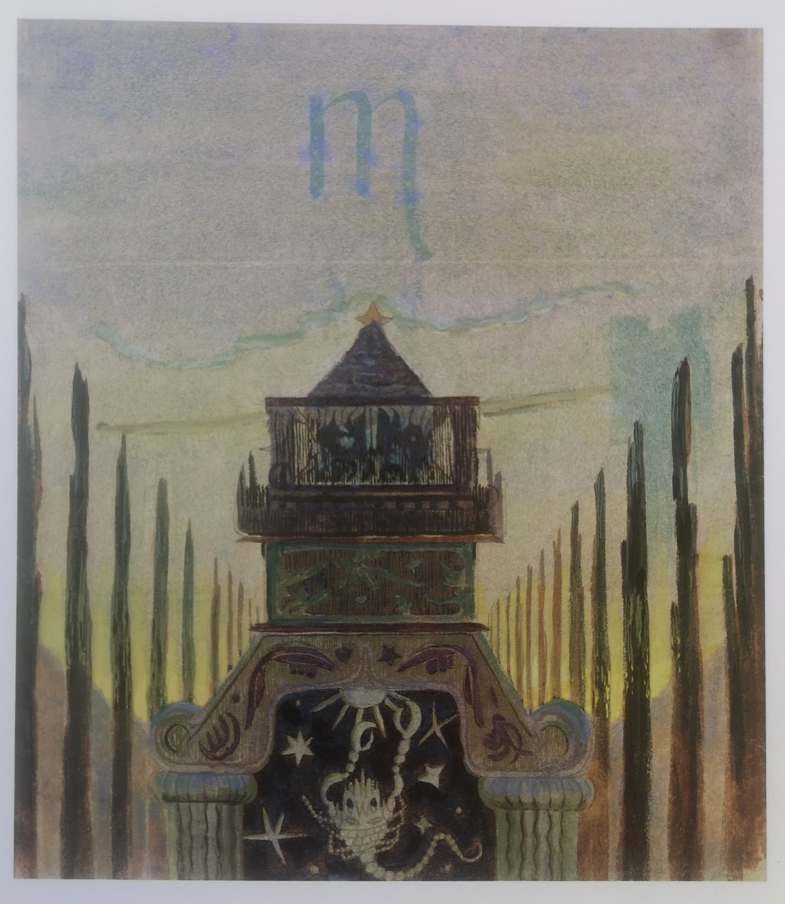
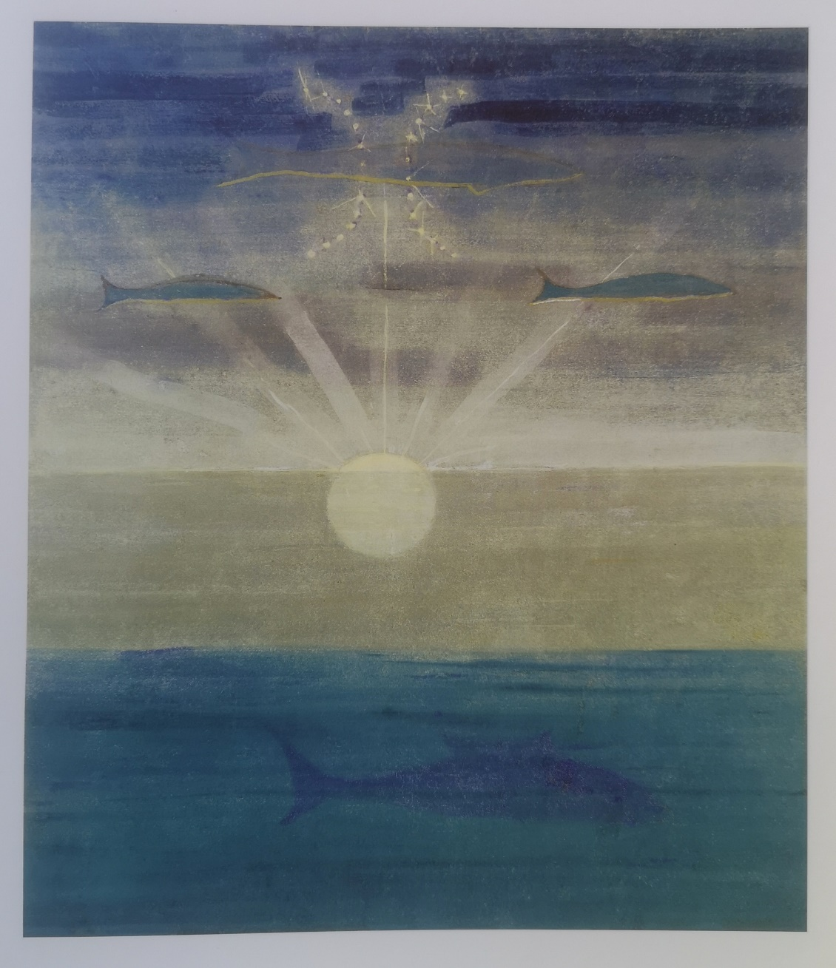
The Sun Goes in the Sign of Scorpio ” “ The Sun Goes in the Sign of Pisces” Works from the cycle of 12 paintings “ Zodiac ”. 1906/1907. Paper, tempera. 35.7x30.6

Slide 28
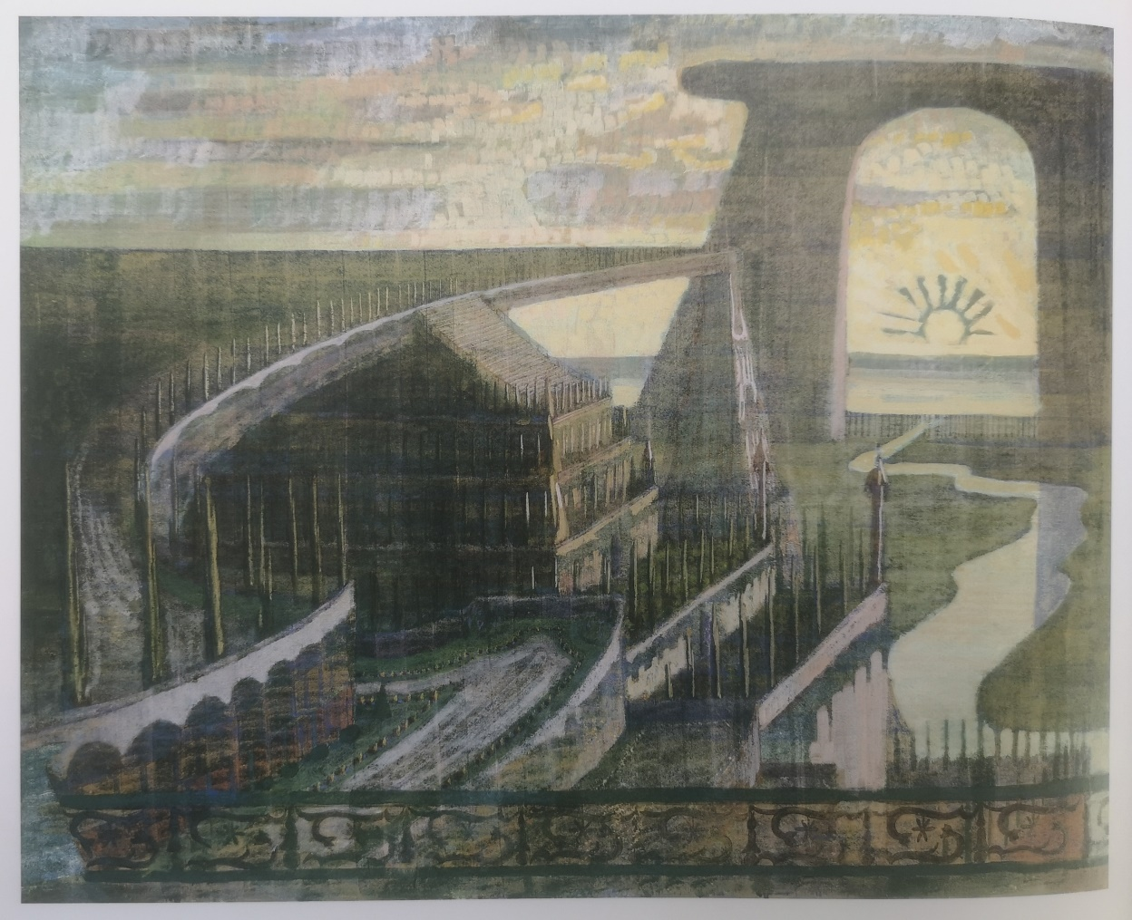
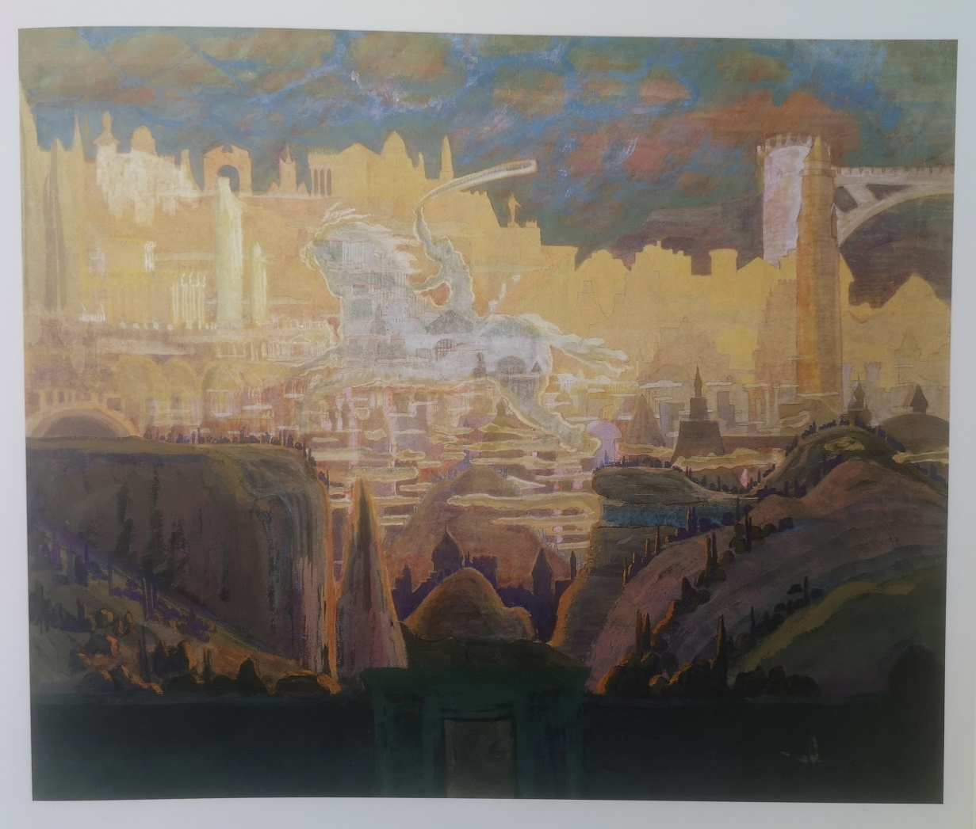
Other M. K. Čiurlionis’ works

Slide 29
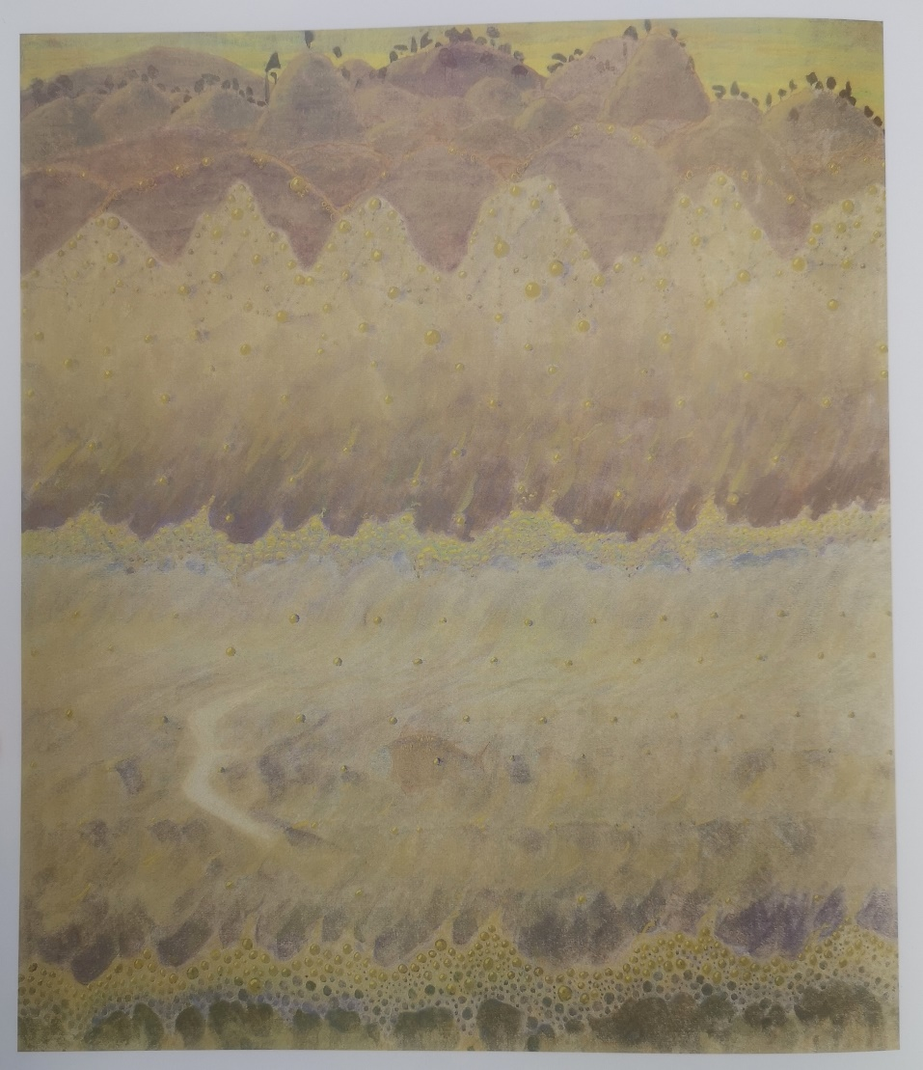
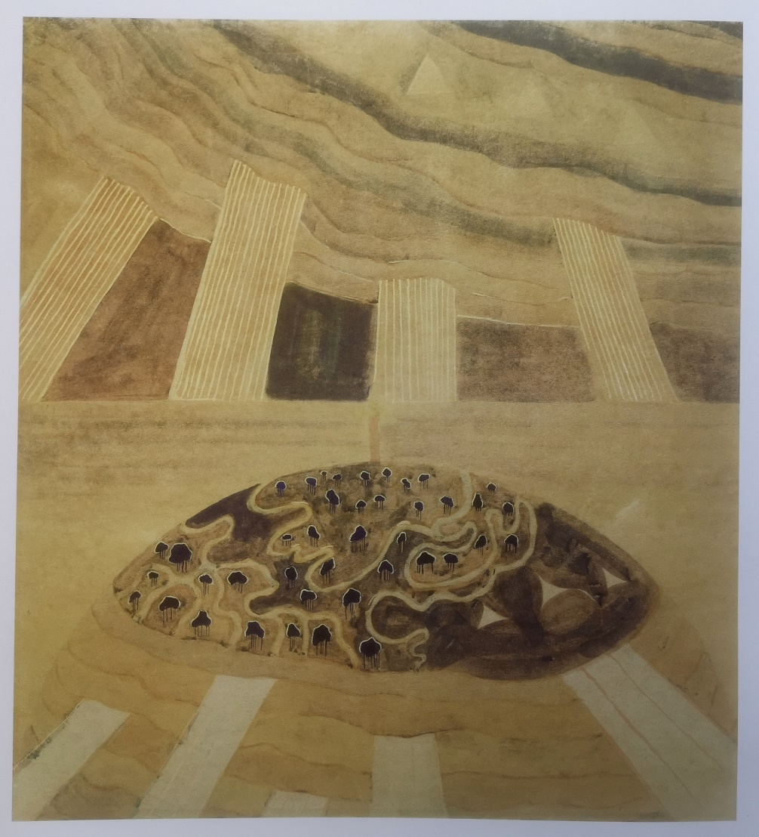

Slide 30
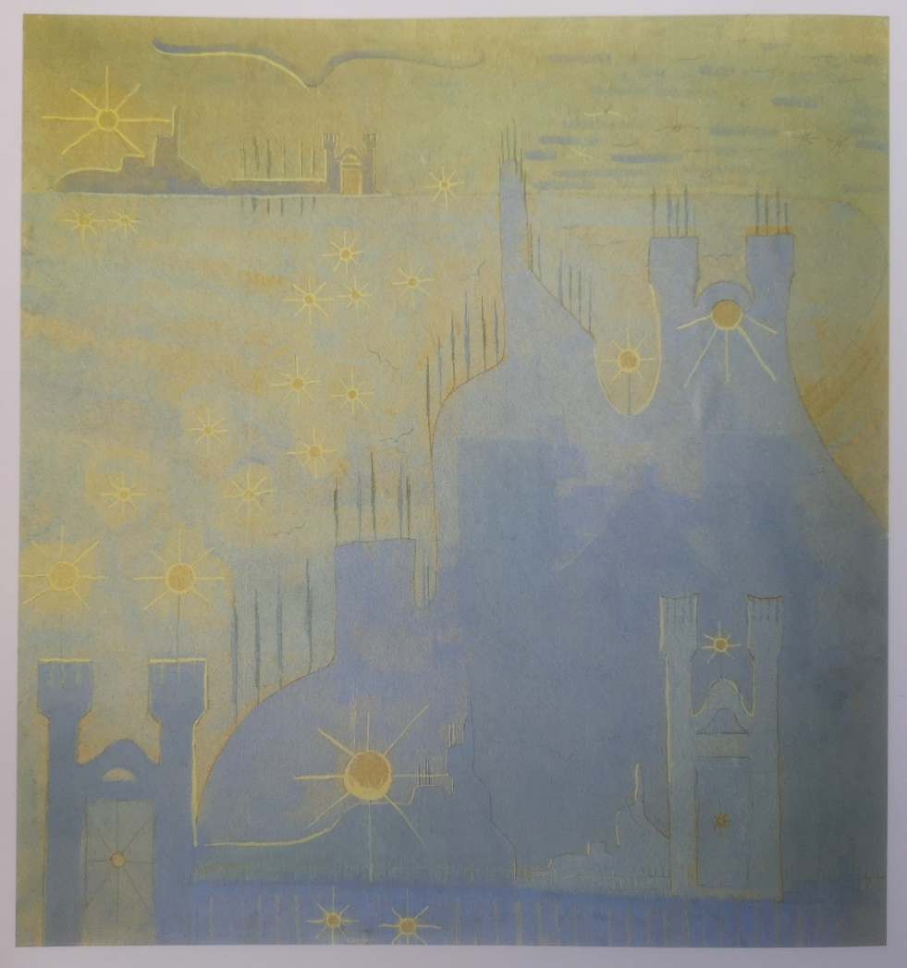
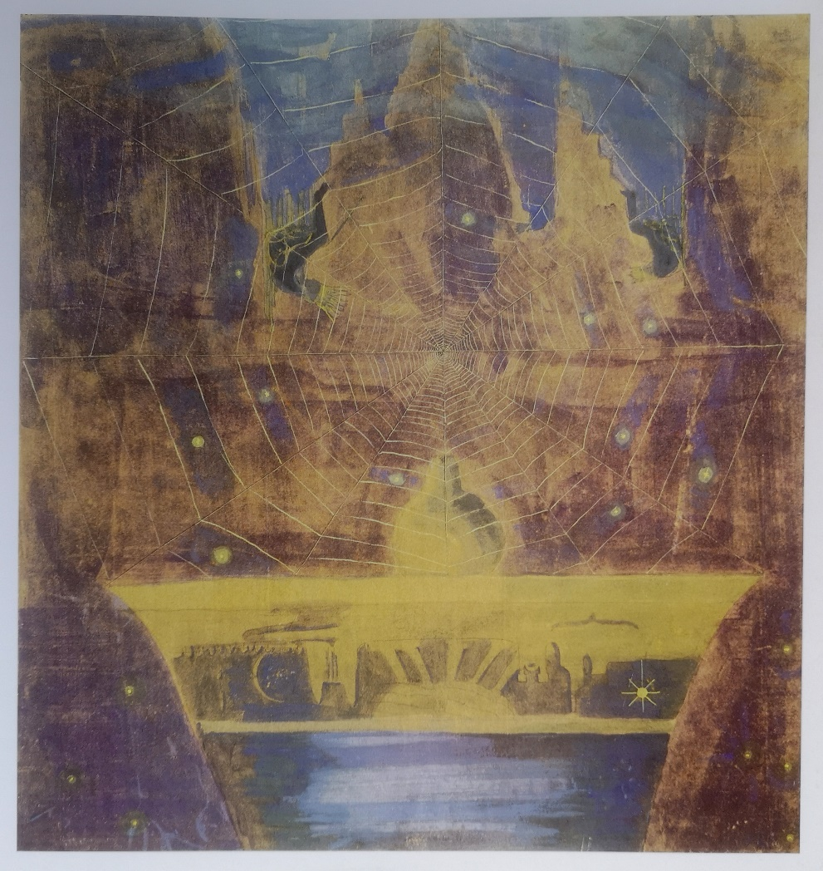

Slide 31
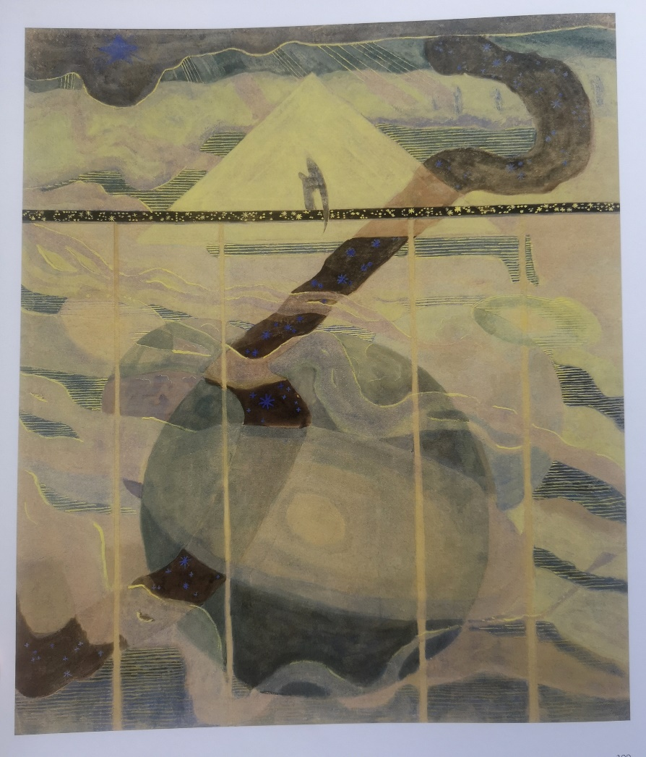
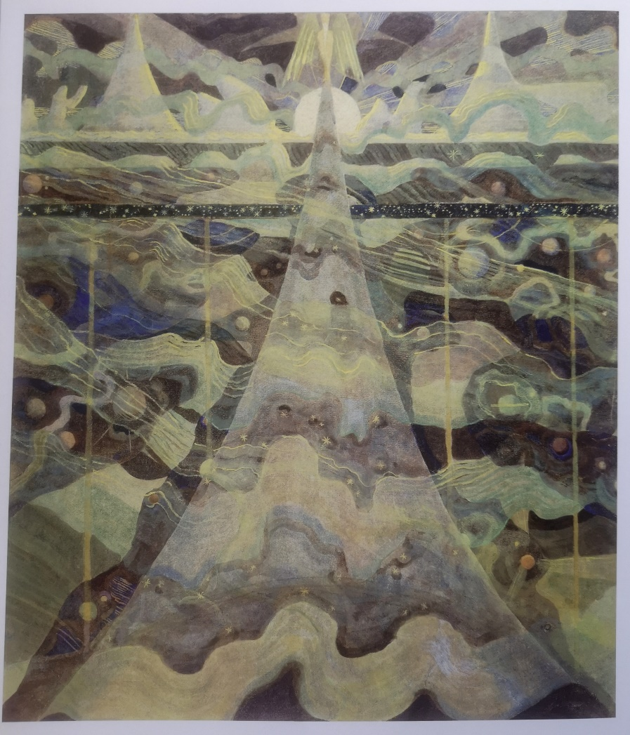

Slide 32
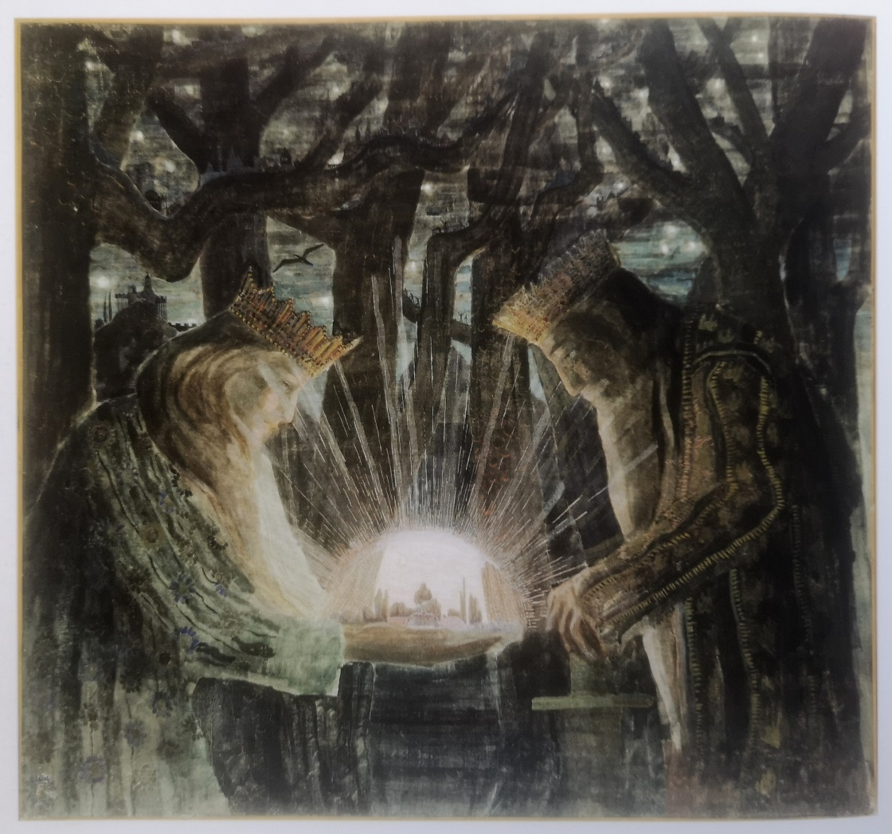
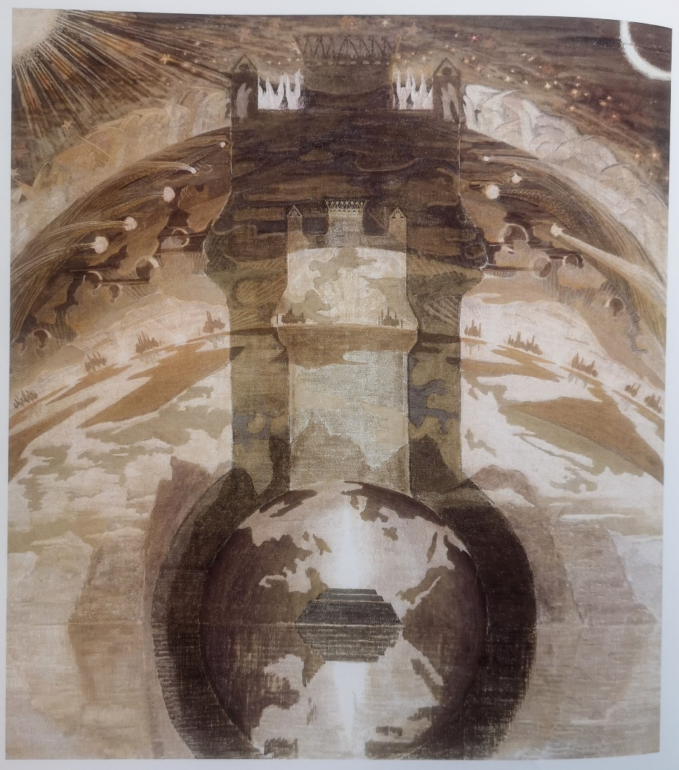

Slide 33
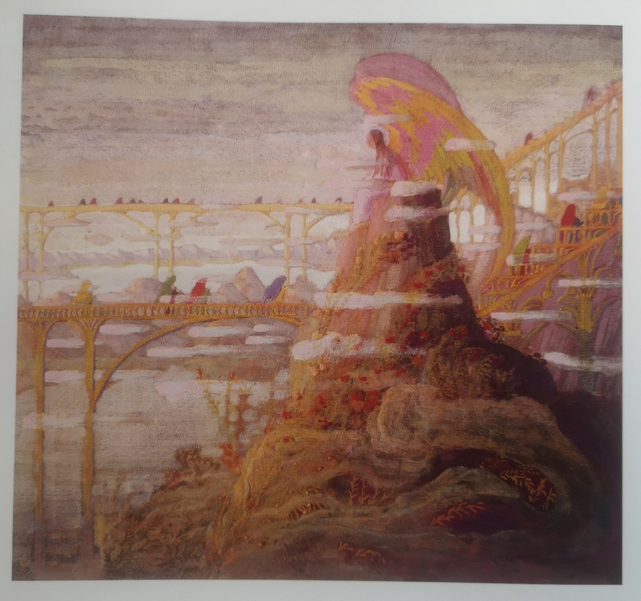
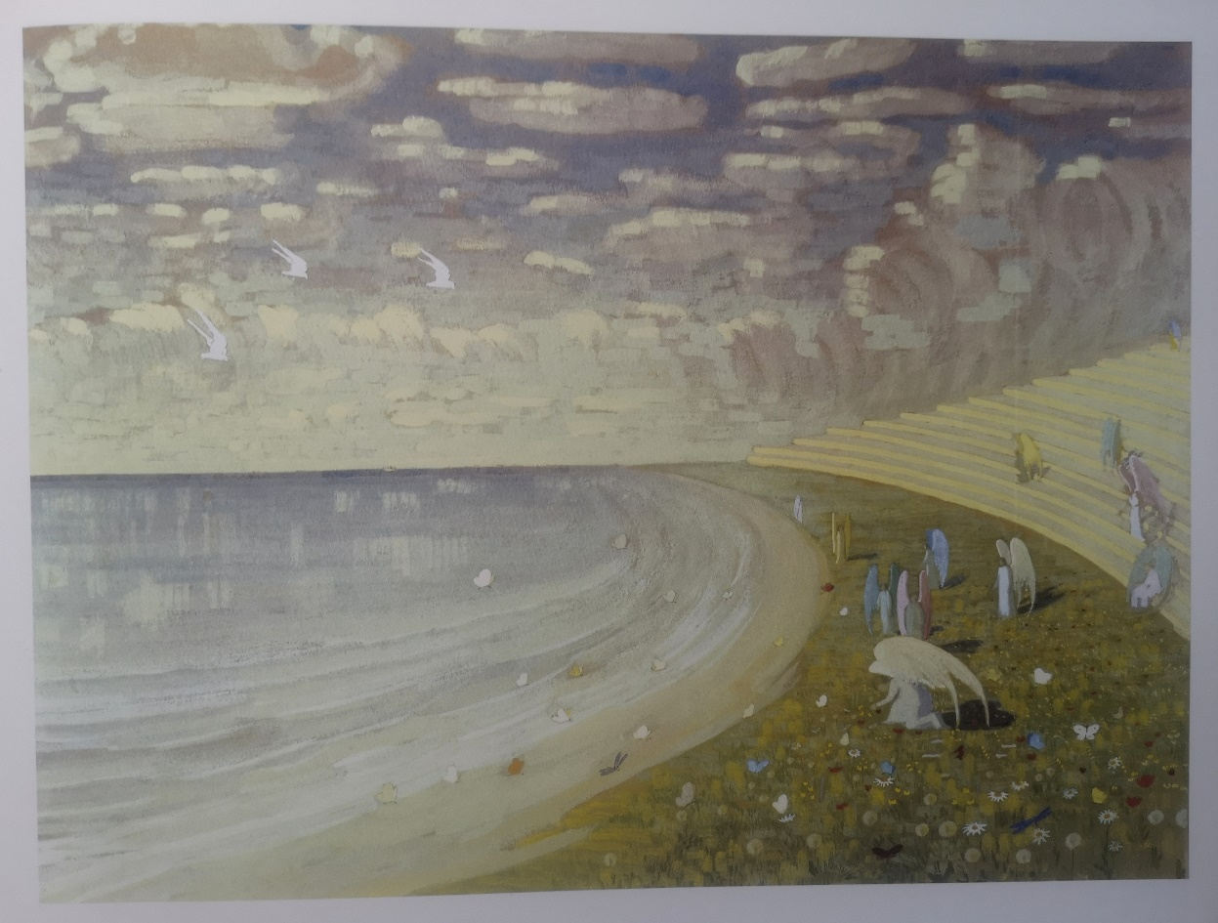

Slide 34


One of the major (437 pages) M. K. Čiurlionis’ publications is named “Drawings, sketches of compositions, graphics ”.
Another 382 page publication is "Mikalojus Konstantinas Čiurlionis’ Album".

Slide 35
M. K. Čiurlionis VR film "Paths of Angels"
In 2018, a 25-minute artistic VR film about M. K. Čiurlionis' works called "Paths of Angels“ was created by a large team of Lithuanian and foreign creators led by the director Kristina Buožytė. The virtual reality film invites us to get acquainted with 60 well-known and easily recognizable and less visible paintings by the Lithuanian artist M.K. Čiurlionis in the VR space.
You can find the film reviews by pressing the following link:
https://www.youtube.com/watch?v=lgXnB_umKnE
You can watch the film in the following YouTube channel:
https://www.youtube.com/watch?v=hqgvbJAqe70

Slide 36
You can get acquainted with the works of M. K. Čiurlionis:
In the National M. K. Čiurlionis‘ Art Museum, Kaunas, Lithuania.
M. K. Čiurlionis House - Museum, Druskininkai, Lithuania
165 Paintings by M. K. Čiurlionis on YouTube:
https://www.youtube.com/watch?v=a1YUX21knEk
Music by M.K. Čiurlionis on YouTube:
https://www.youtube.com/watch?v=TQeub39T-9c

