Slide 1
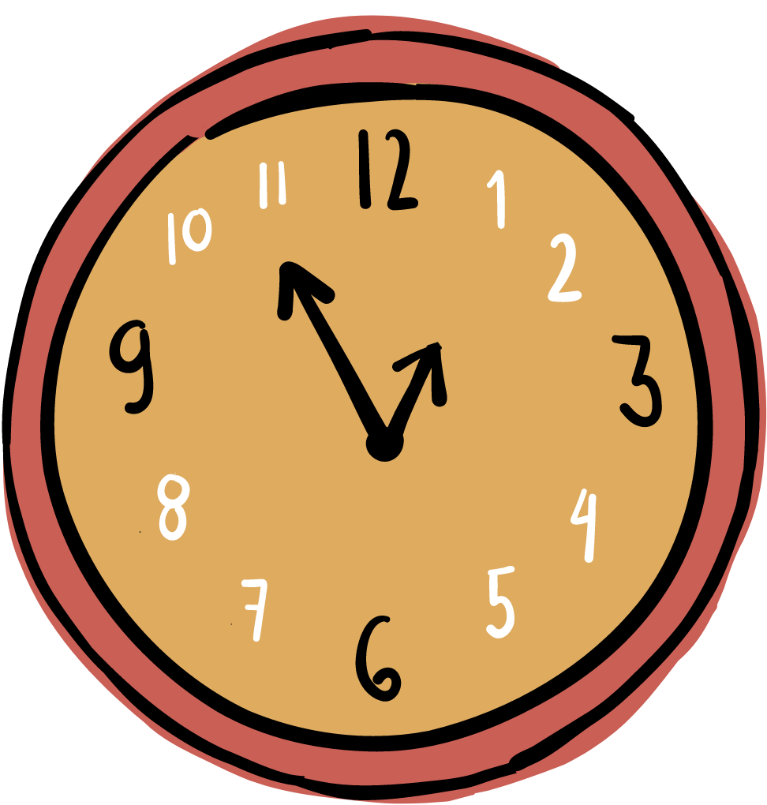
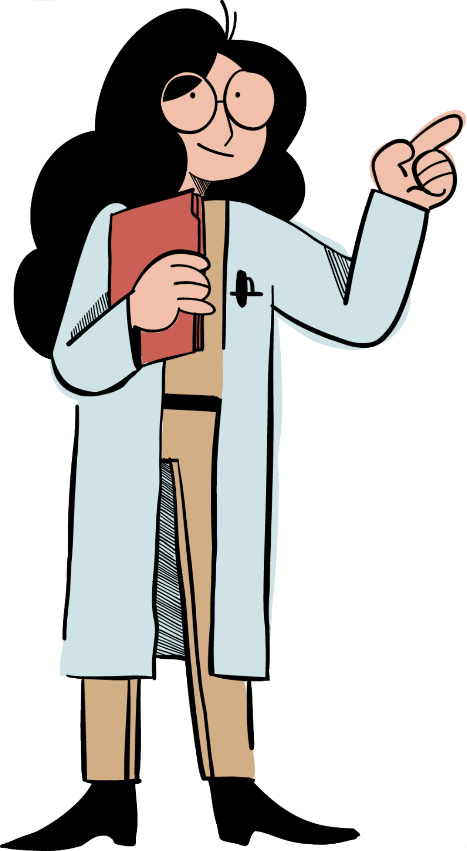

GYMNASIUM ,,KIRIL PEJÇINOVIQ’’
WOMEN IN STEAM

Slide 2
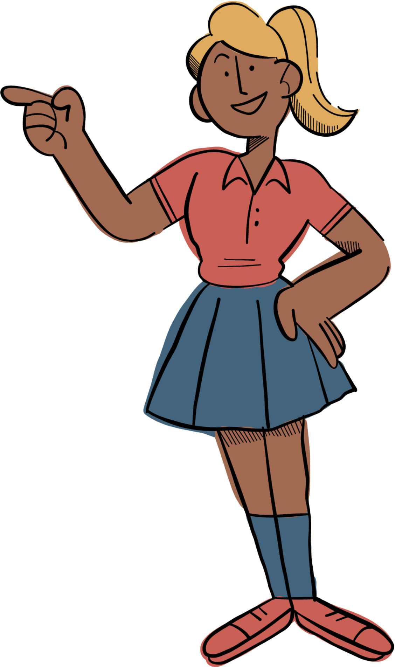

CONTENTS:
Statistics about women scientists
Maria the Jewess, an inventor of alchemy
Ida Noddack, scientist for the future
Why women scientists “didn’t exist” and Rosalind Franklin
The relentless Sabiha Kasimati
Katie Bouman, the face of modern science

Slide 3

Old ages
Statistics about women scientists
Prior to the great civilizations of early Greece and Rome, women are known to have practiced medicine in ancient Egypt. In ancient Greece pondering the nature of reality and of health and disease became male endeavours. But by the time that the Roman Empire reached its dying days, a woman, Hypatia of Alexandria, had emerged as a symbol of learning and science. Hypatia, who lived from 370 to 415 CE, was a mathematician who rose to be head of her city’s Neoplatonist school of philosophy.
Middle ages
Women fared little better in the Middle Ages, being excluded from the universities that began to be founded in Europe from the late 11th century onward. During this period, convents provided havens where women could become considerable scholars.
Modern times
In the early 21st century in the United Kingdom and the United States, nearly 50 percent of medical degrees and doctorate degrees in the biomedical sciences were awarded to women. Undergraduate numbers in mathematics and in the physical sciences were approaching similar levels, and only in computing and engineering were women students still significantly underrepresented.

Slide 4
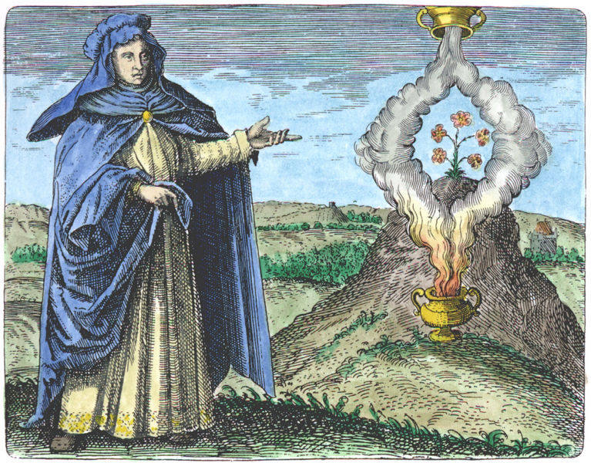
Maria the Jewess, an inventor of alchemy
Alchemists from the mythic Hermes to Isaac Newton desired to transmute lead into gold. It was believed that through the transformation of the material, they could attain wisdom beyond the limitations of man and create great works that would transmute themselves closer towards divinity through the Philosopher's Stone and the Elixir of life. None of that could be done without an ancient alchemist name Maria.
She is credited with inventing an alchemical apparatus' that copied the process of distillation in nature, what the alchemists believed provided the bedrock for the creation of gold in nature. This apparatus would become a staple in modern chemistry labs.

Slide 5
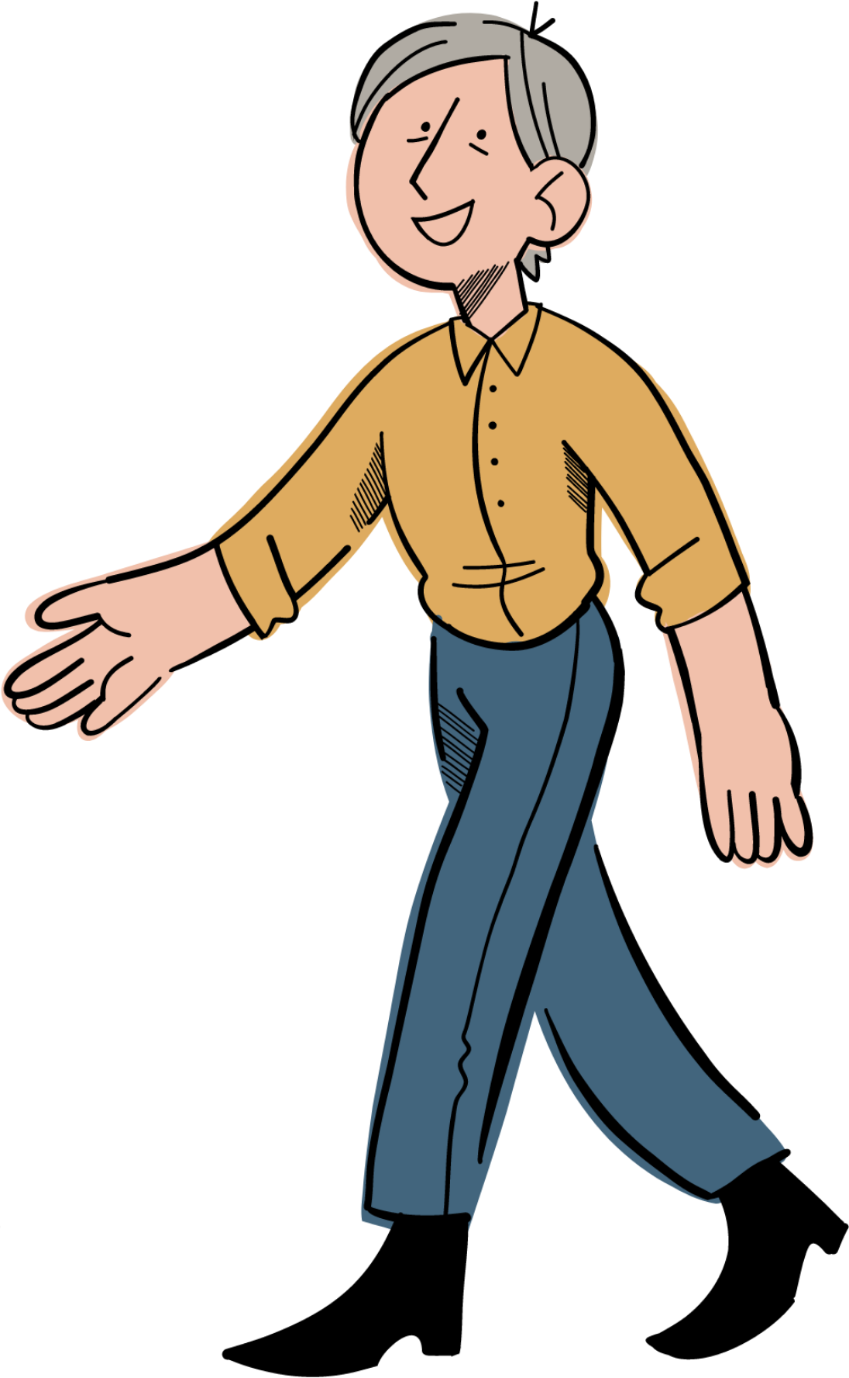
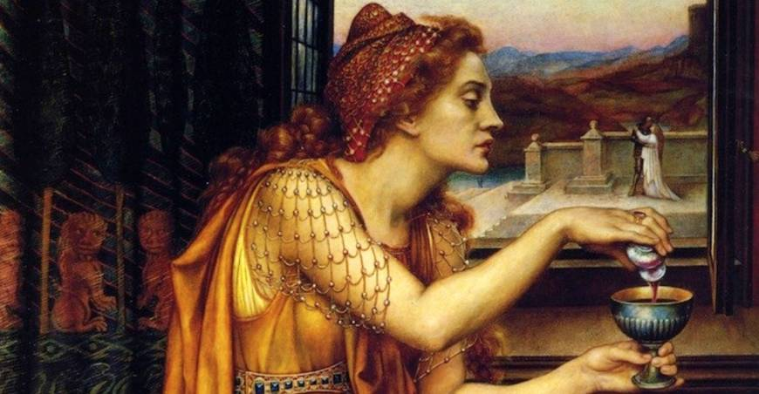
The “chemist” who set women free
Giulia Tofana was an Italian saleswoman who made her profit from selling a poison called aqua tofana (supposedly invented by Teofania di Adamo who may have been Giulia's mother). The liquid, who’s contents are still not known, made Giulia and her smartness confusing to historians. Information about Giulia Tofana's background is sparse. She was thought to have been born in Palermo and speculation by historians that she may have taken the first name of her mother as her last name (a common practice at the time) led them to believe that she was the daughter of another Palermo poisoner, According to one version of events, Giulia Tofana fled to Rome and set up a business that began to sell this poison to women who wanted to escape abusive spouses.

Slide 6
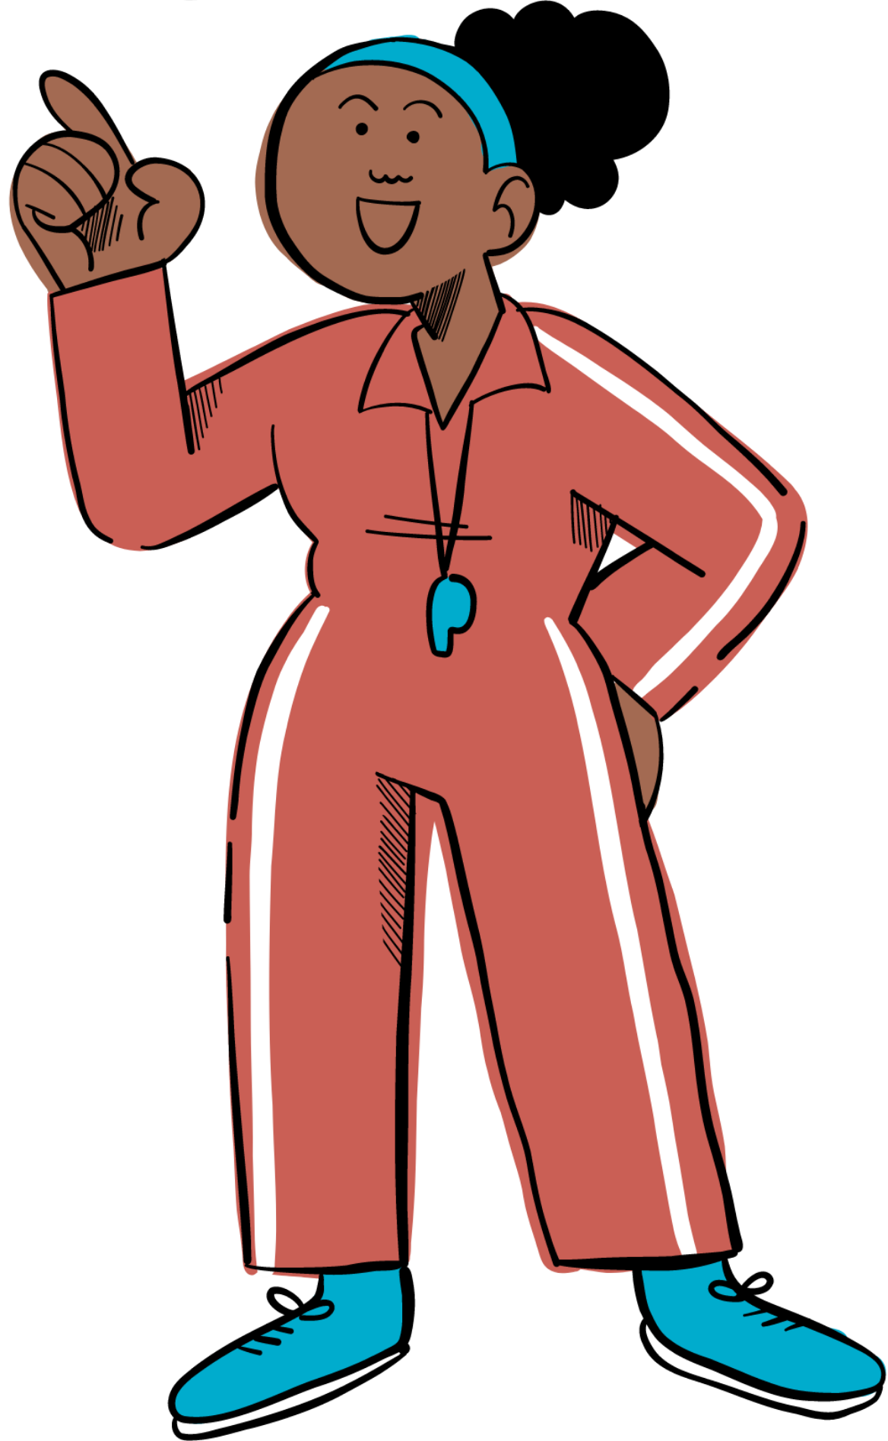

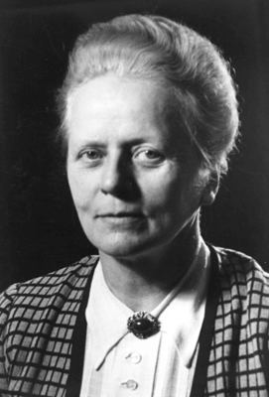
Ida Noddack, scientist for the future
Ida Noddack, a German chemist, codiscovered the chemical element rhenium and first proposed the idea of nuclear fission.
In 1934 Italian physicist Enrico Fermi claimed possible production of atomic elements heavier than uranium (or transuranium elements) after bombardment of uranium with neutrons. However, in a paper on Fermi’s discovery, Noddack noted in passing that the bombardment of uranium could have actually produced smaller nuclei. Her suggestion was the first proposal of the concept of nuclear fission.

Slide 7
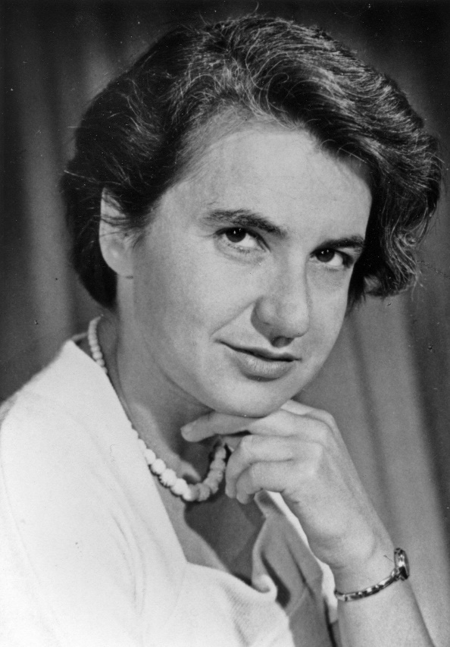

Why women scientists “didn’t exist” and Rosalind Franklin
Rosalind Franklin is a British scientist best known for her contributions to the discovery of the molecular structure of deoxyribonucleic acid (DNA), a constituent of chromosomes that serves to encode genetic information. Franklin also contributed new insight on the structure of viruses, helping to lay the foundation for the field of structural virology. In 1951 Franklin joined the Biophysical Laboratory at King’s College, London, as a research fellow. There she applied X-ray diffraction methods to the study of DNA. When she began her research at King’s College, very little was known about the chemical makeup or structure of DNA. However, she soon discovered the density of DNA and, more importantly, established that the molecule existed in a helical conformation. Even if today we learn that it was Watson and Crick that deserve all the credit for the discovery of DNA they somehow forgot to give credit to the person who deserved it most.

Slide 8
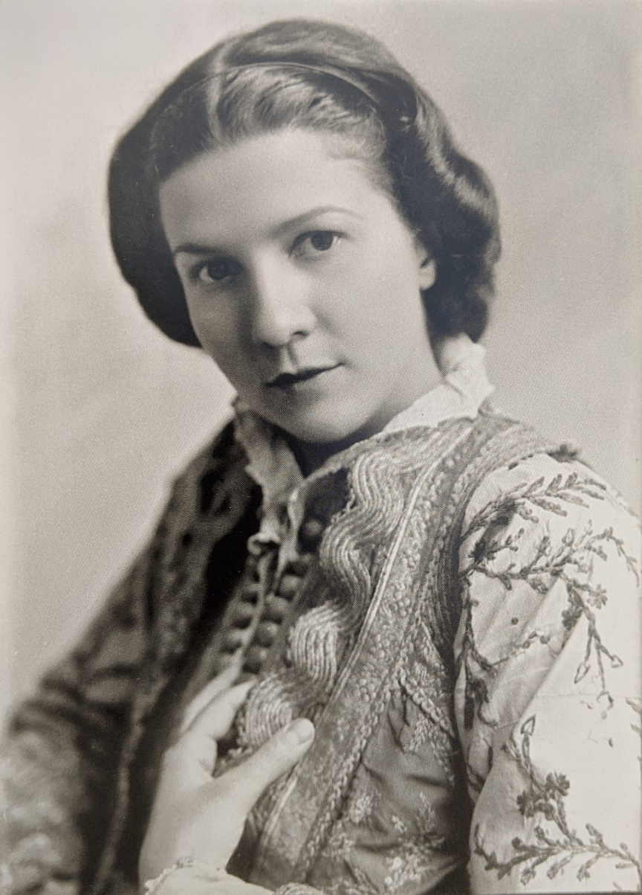
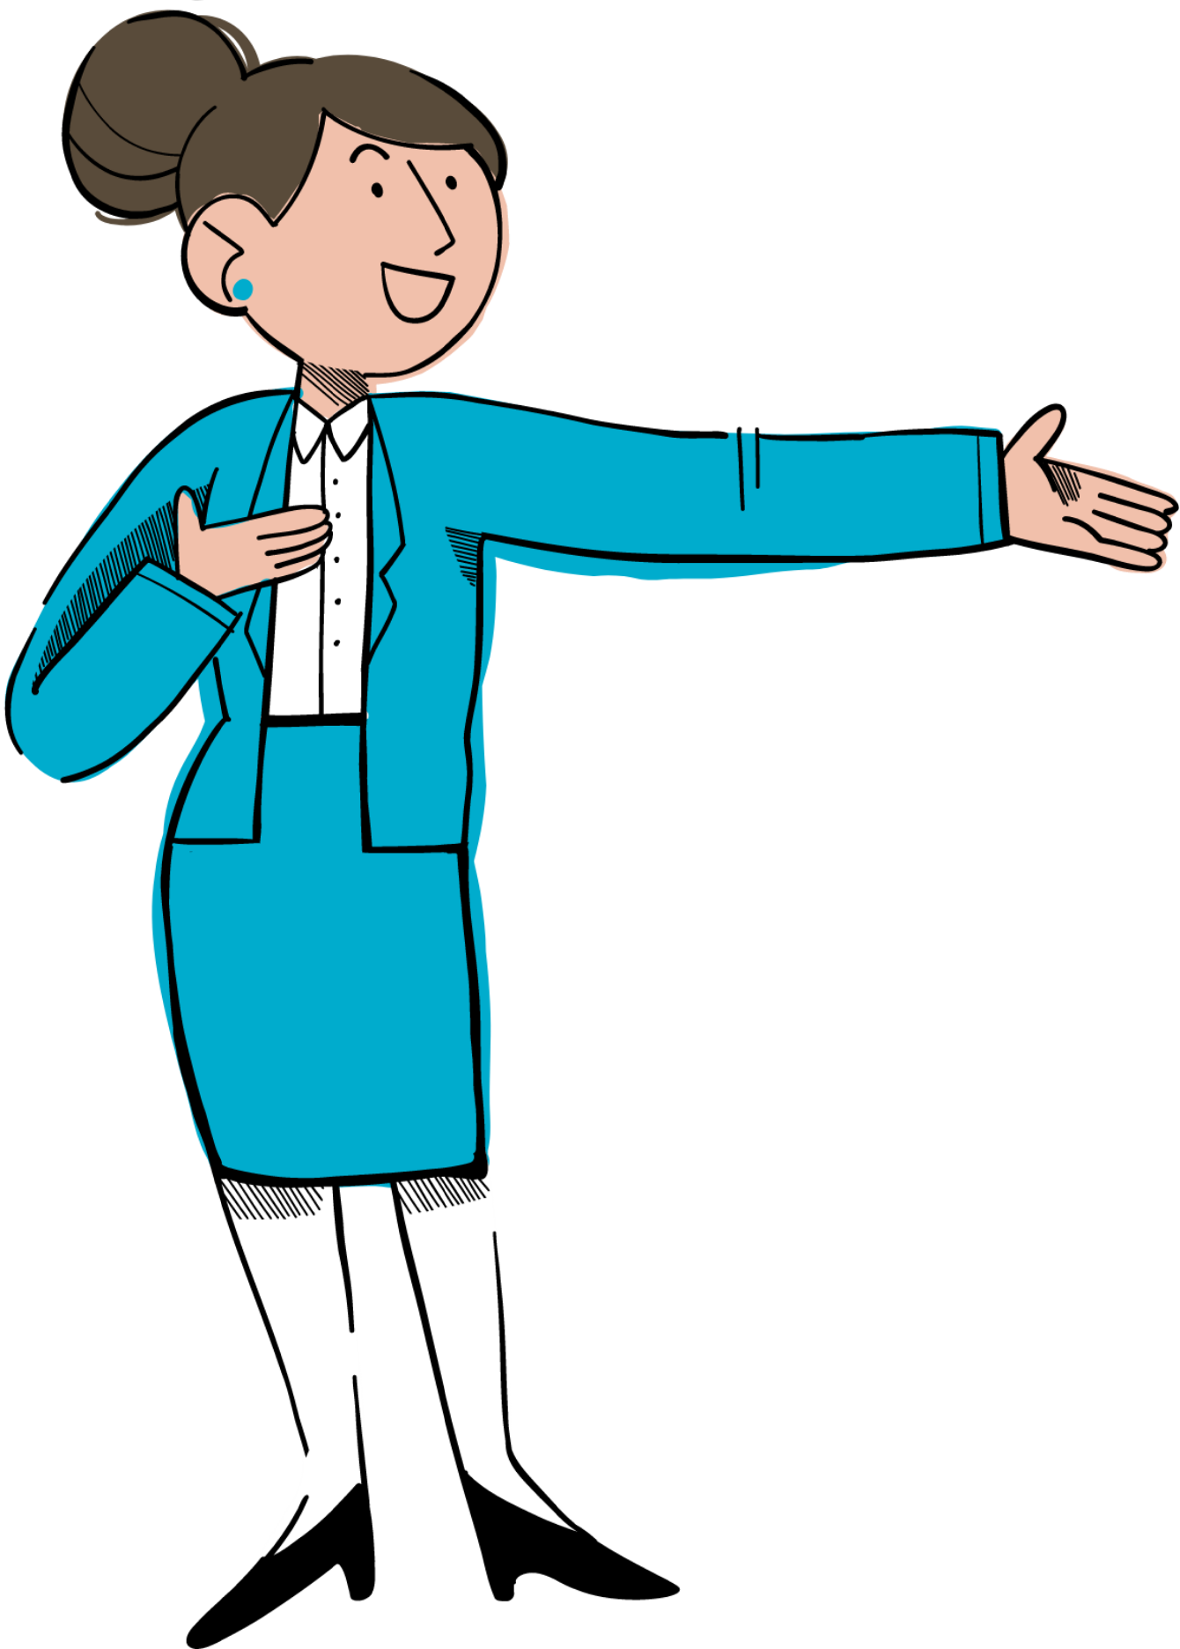
Sabiha Kasimati was an Albanian professor of biology and ichthyologist, cited as one of the first women scientists in Albania. She was arrested by the communist regime on 20 February 1951, after the bombing of the Soviet embassy, and a few days later was executed without trial along with 21 other intellectuals. She was born on 15 September 1912 in Edirne, In parallel with her pedagogical work, she gave an important place in her life and in her scientific activity to the study of the biology of sea fish that live in lagoons, swamps, collecting materials for the preparation of the major work of the future, the monograph: "Fishes of Albania". "Fishes of Albania" documented the fish of Albanian lakes, rivers and the seas and it was publicised under the name of the Russian scientist Anatoly Poliakov and two Albanian researchers in 1955. After the end of the Second World War, she decided to return to her homeland in 1947, while the communists had just come to power in the country. Kasimati is credited with creating the idea of an Albania's National Museum of Science. In October 2018 it was announced that the Albanian National Museum of Science would be named for and that an area of the museum would be set aside for her life story and sacrifice.
The relentless Sabiha Kasimati
.

Slide 9
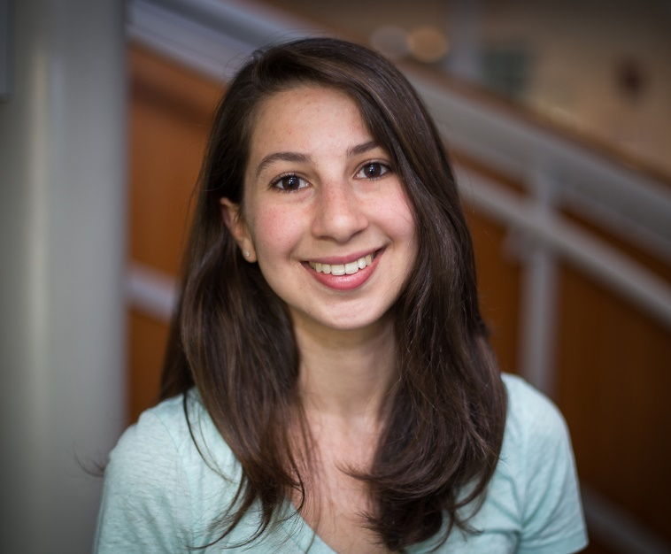
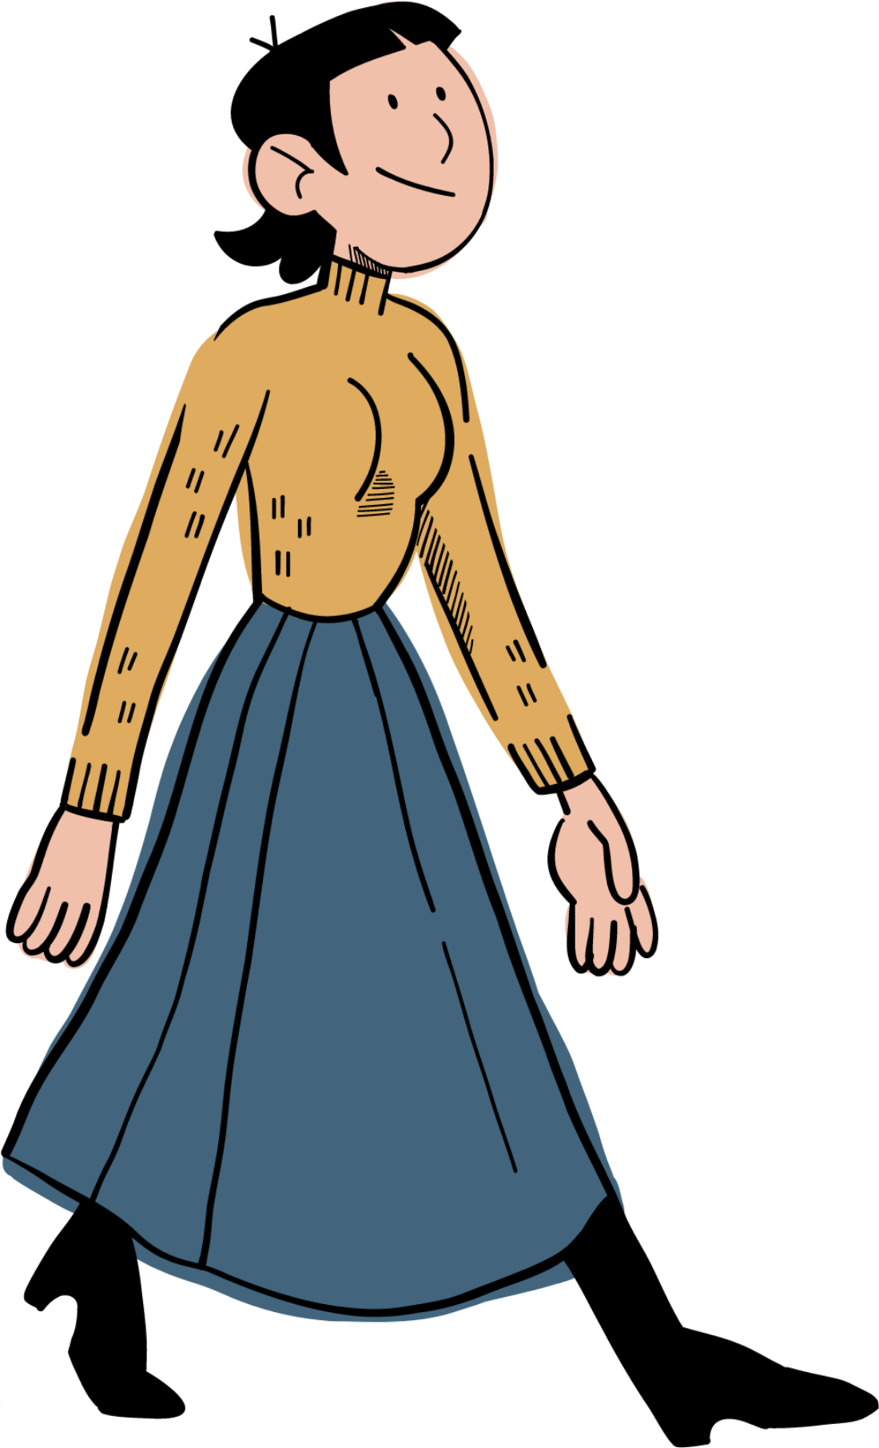
Katie Bouman, the face of modern science
Katie Bouman led development of a computer program that made the breakthrough image possible.
The remarkable photo, showing a halo of dust and gas 500 million trillion km from Earth, was released on Wednesday.
For Dr Bouman, its creation was the realisation of an endeavour previously thought impossible.
Excitedly bracing herself for the groundbreaking moment, Dr Bouman was pictured loading the image on her laptop. She started making the algorithm three years ago while she was a graduate student at the Massachusetts Institute of Technology (MIT).
There, she led the project, assisted by a team from MIT's Computer Science and Artificial Intelligence Laboratory, the Harvard-Smithsonian Center for Astrophysics and the MIT Haystack Observatory.

Slide 10
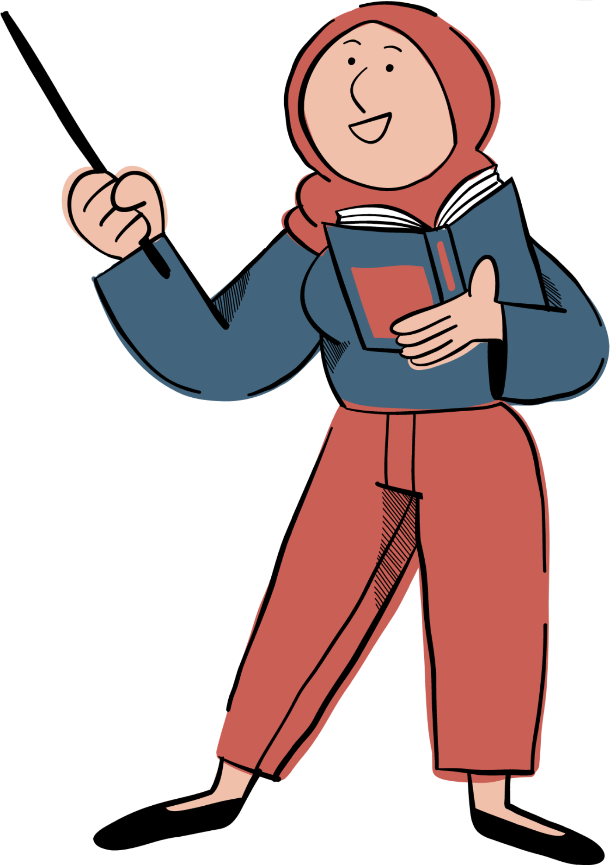
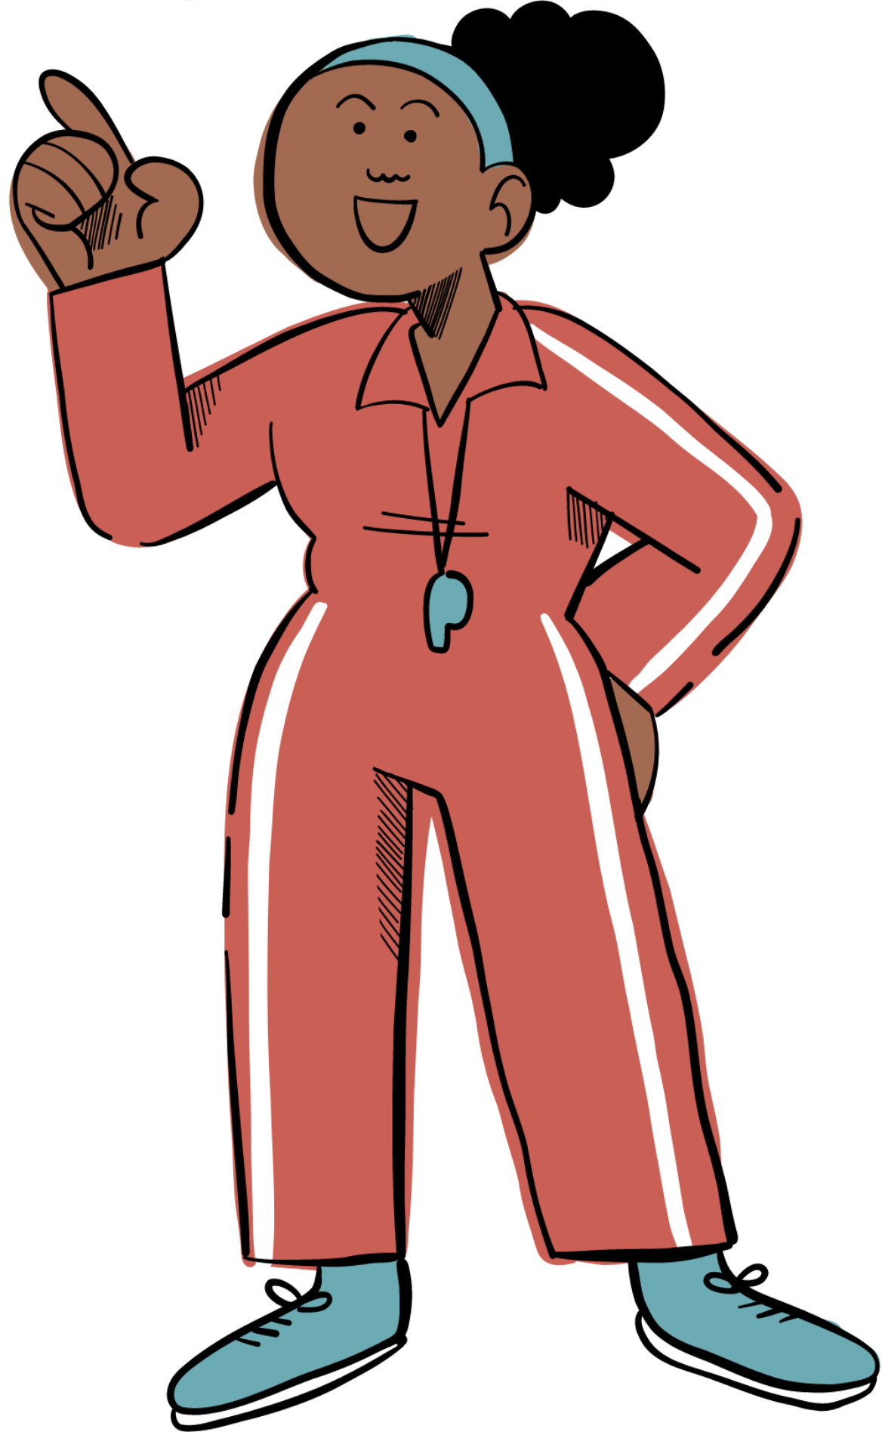
Along the ages women have had to fight their way to the top, always opening doors that were shut to their faces. Today, as we look at all the smart women in science we cannot deny the effort that it took previous generations to bring us here. Determined, powerful and effortlessly genial women and young girls today continue to prove that the unfairness done to them in the past never showed the truth of what actually is, that women are just as smart as men.
and maybe even more😉

