Slide 1
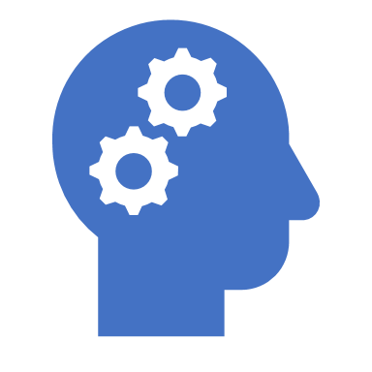
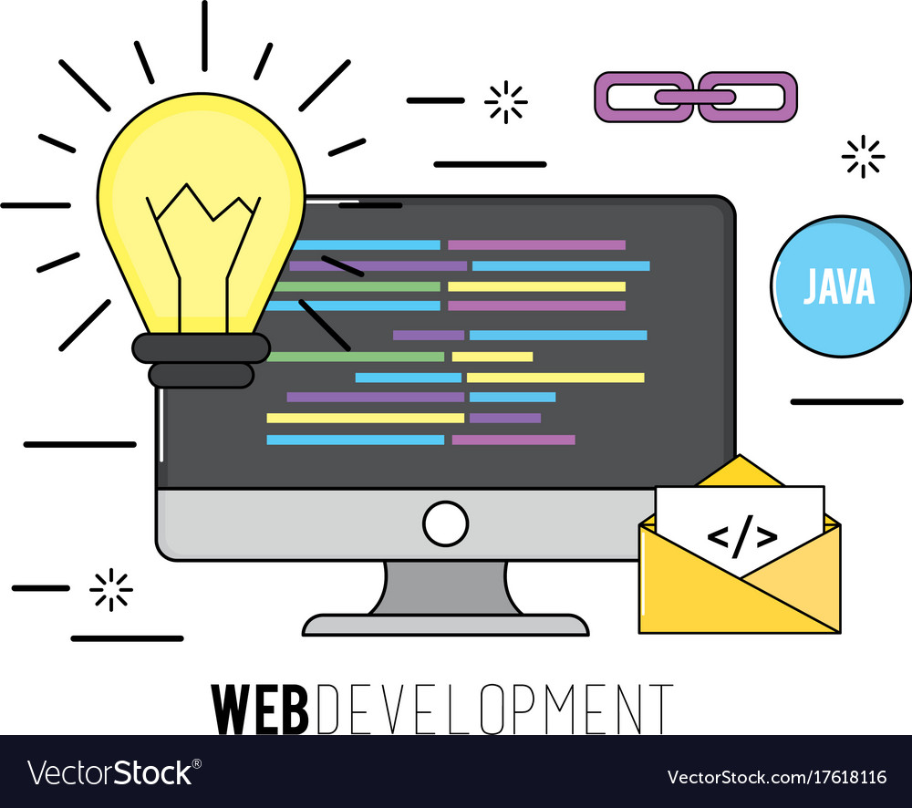
Computational thinking
Coding and Programing

Slide 2
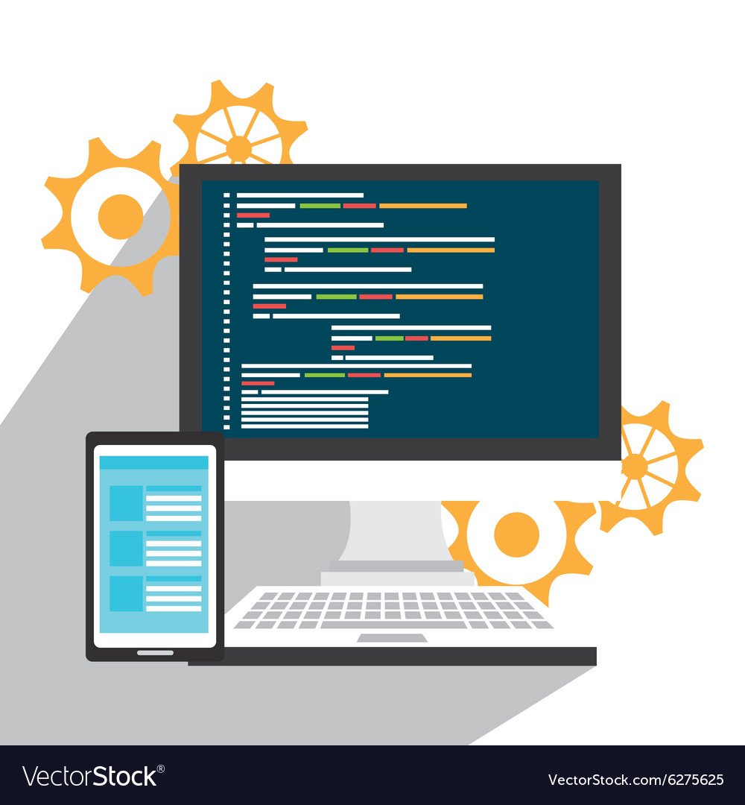
Computational
1.what is computational thinking
2.For what we can use computational thinking
3.Example of computational thinking

Slide 3
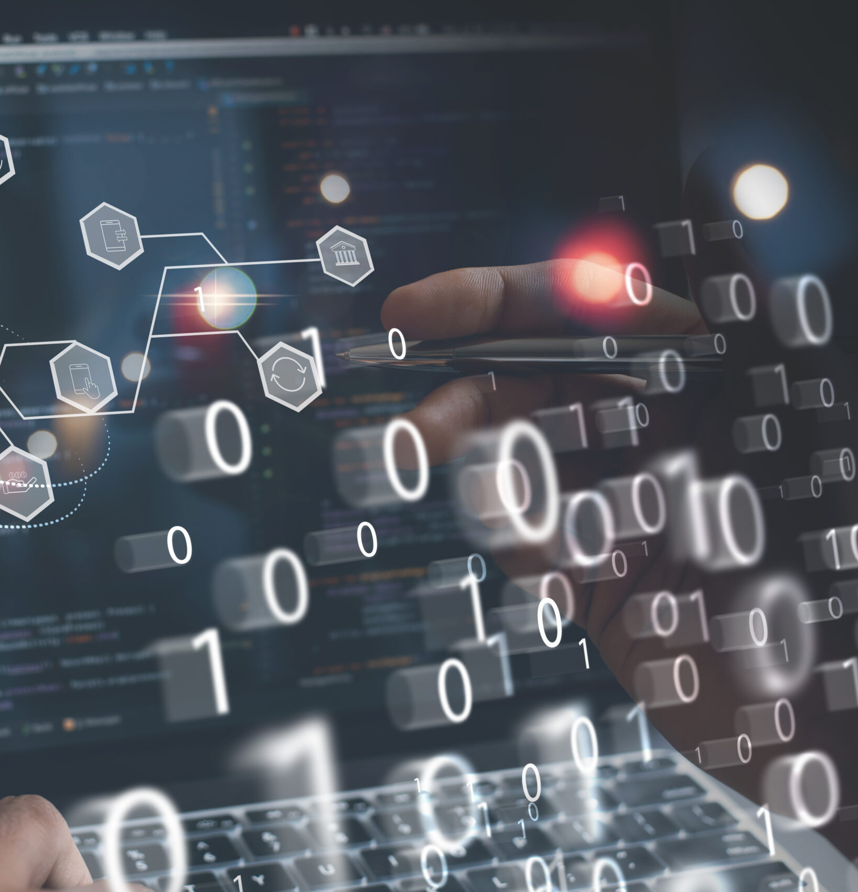
What is computational thinking
Computational thinking is a problem-solving method that involves breaking down complex problems into smaller, more manageable parts and then using algorithms and logical reasoning to develop solutions. It is a way of thinking that is fundamental to computer science, but can be applied to a wide range of fields and everyday tasks.
At its core, computational thinking involves four key concepts: decomposition, pattern recognition, abstraction, and algorithmic thinking. Decomposition involves breaking down complex problems into smaller, more manageable parts. Pattern recognition involves identifying patterns and trends within these smaller parts. Abstraction involves focusing on the important details while ignoring irrelevant information. Algorithmic thinking involves developing a step-by-step plan for solving a problem.
Computational thinking is a valuable skill because it helps people to approach complex problems in a logical, organized way. It is particularly important in fields such as computer science, data science, and engineering, but can be applied in many other areas as well.

Slide 4
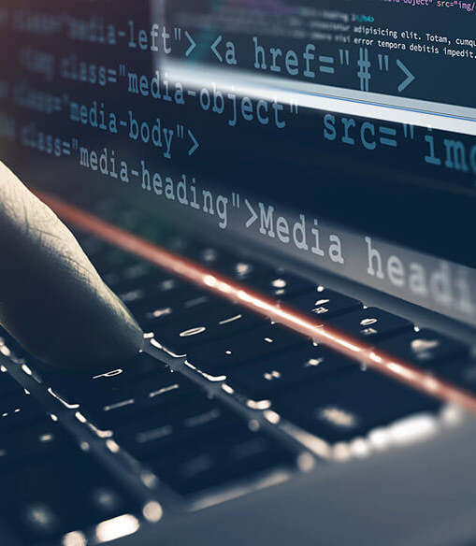
2.For what we can use computational thinking
1. Solving complex problems: Computational thinking can be used to solve complex problems in fields such as science, engineering, and medicine. By breaking down a problem into smaller parts and analyzing each part individually, it becomes easier to identify patterns and relationships that can help lead to a solutio
.
2. Designing systems: Computational thinking can be used to design and develop complex systems, such as software applications, websites, and databases. By breaking down a system into its constituent parts and analyzing how they interact with each other, it becomes easier to design and build a system that meets the desired specifications
3. Data analysis: Computational thinking can be used to analyze and interpret large data sets, such as those found in scientific research, business, and finance. By using algorithms and statistical models, it is possible to identify patterns and trends in data that can help inform decision-making.
4. Automation: Computational thinking can be used to automate repetitive tasks, such as data entry or report generation. By breaking down a task into its constituent parts and developing algorithms to complete each part, it is possible to automate the task and save time and resources.
Overall, computational thinking is a valuable tool for anyone who needs to solve complex problems, design systems, analyze data, or automate tasks.

Slide 5
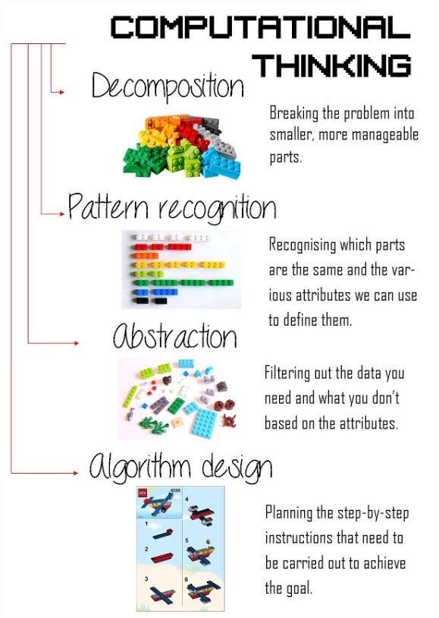
3.Example of computational thinking

Slide 6
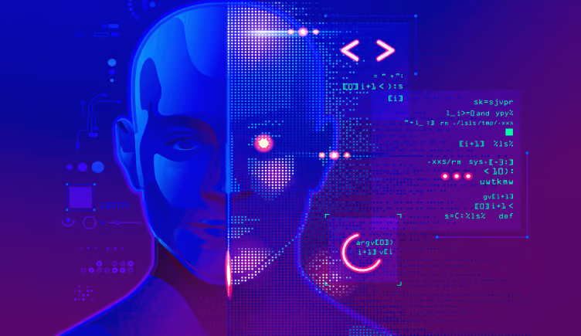
Programing
1 What is programing
2 For what we can use programing

Slide 7

1.What is Programing
Programming is the process of creating software, applications, or other computer-based systems by writing, testing, and maintaining source code. It involves designing and implementing algorithms, data structures, and other instructions that a computer can execute to perform a specific task or set of tasks.
Programming is typically done using a programming language, such as Java, Python, C++, or JavaScript, among many others. Each programming language has its own syntax, rules, and features that programmers use to create their programs.
The programming process typically involves several steps, including:
1. Understanding the problem or task that the program is intended to solve.
2. Designing a solution to the problem, including selecting appropriate algorithms and data structures.
3. Writing the code using a programming language and appropriate tools, such as an Integrated Development Environment (IDE).
4. Testing the code to ensure that it works correctly and meets the desired specifications.
5. Debugging and refining the code as needed to fix any errors or improve performance.
6. Maintaining the code over time, including making updates or modifications as needed to address changing requirements or fix bugs.
Overall, programming is a critical skill in today's technology-driven world, and is used to create everything from simple scripts to complex software applications that power businesses, organizations, and governments around the world.

Slide 8
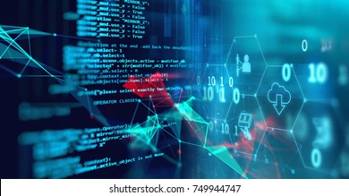
2.For what we can use programing
Programming can be used for a wide variety of tasks and applications. Here are some examples:
1. Creating software applications: Programming is used to create software applications for a variety of purposes, such as productivity tools, financial software, video games, and mobile apps.
2. Building websites and web applications: Programming is used to build websites and web applications using technologies such as HTML, CSS, and JavaScript.
3. Developing artificial intelligence and machine learning: Programming is used to develop artificial intelligence and machine learning systems that can perform tasks such as image recognition, natural language processing, and predictive analytics.
4. Automating tasks: Programming is used to automate repetitive tasks such as data entry or report generation, which can save time and improve efficiency.
5. Controlling hardware devices: Programming is used to control hardware devices such as robots, drones, and smart home devices, enabling them to perform specific tasks or respond to user input.
6. Analyzing data: Programming is used to analyze large data sets and extract insights using techniques such as data mining, data visualization, and statistical analysis.
7. Creating games: Programming is used to create video games, which are a popular form of entertainment enjoyed by millions of people around the world.
Overall, programming is a versatile tool that can be used in many different fields and applications, and is a valuable skill for anyone who wants to work in technology, science, engineering, or other related fields.

Slide 9
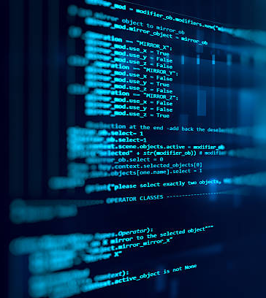

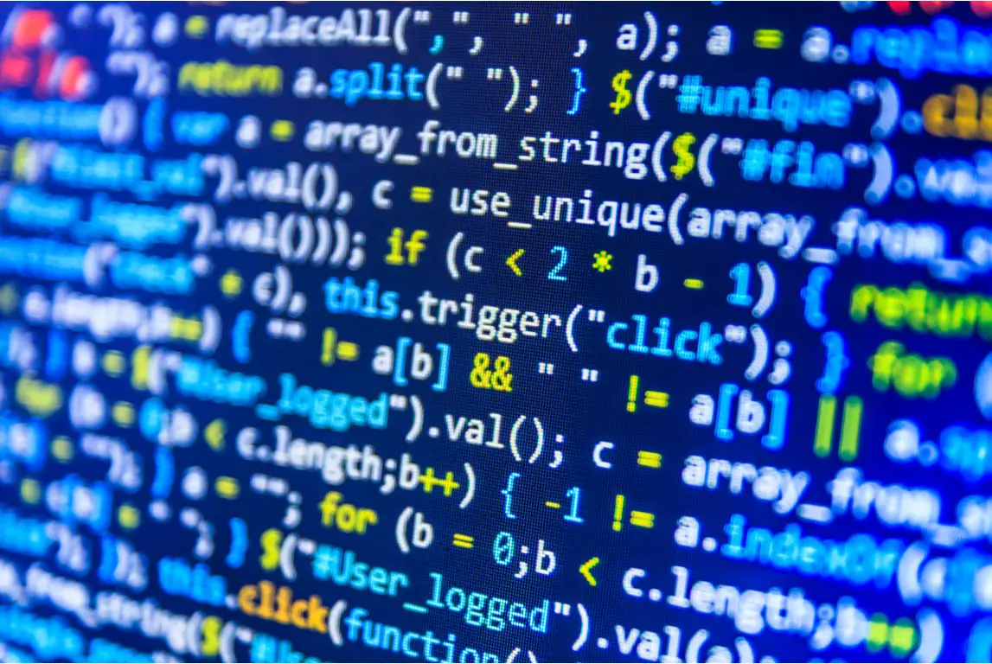
Coding
1.What is coding
2.For what we can use coding

Slide 10


1.What is Coding
Coding, also known as programming, is the process of creating software, websites, and other computer applications by writing instructions in a programming language that a computer can understand and execute. These instructions are typically written in text files using a code editor, and can range from simple commands to complex algorithms.
Coding involves designing, writing, testing, debugging, and maintaining the source code of a program or application. It requires a deep understanding of programming languages, algorithms, data structures, and computer architecture, as well as problem-solving and critical thinking skills.
The resulting software or application can be used for a wide range of purposes, such as automating tasks, analyzing data, creating games, building websites, and much more.

Slide 11

2.For what we can use coding
Coding, or computer programming, is a valuable skill with numerous applications in today's world. Here are some examples of what coding can be used for:
1. Software development: Coding is essential for creating software applications, whether it's a mobile app, a web app, or a desktop app.
2. Web development: Coding is crucial for building websites, from creating the layout and design to developing the functionality and features.
3. Game development: Coding is critical for creating video games, from the game mechanics to the graphics and sound effects.
4. Data analysis and visualization: Coding is necessary for data analysis and visualization, as it allows you to manipulate and analyze large datasets and create visual representations of the data.
5. Automation: Coding can be used for automating repetitive tasks, such as generating reports or performing backups.
6. Machine learning and artificial intelligence: Coding is essential for developing machine learning and artificial intelligence algorithms and models.
7. Internet of Things (IoT): Coding is crucial in developing and programming devices that are part of the IoT, such as smart home devices, wearables, and industrial sensors.
These are just a few examples of what coding can be used for. In general, coding is a versatile skill that can be applied to many different domains and industries, making it a valuable skill to have in today's job market.

