Slide 1
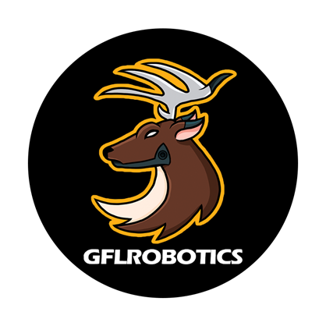
GFL ROBOTİCS
OTONOM

Slide 2
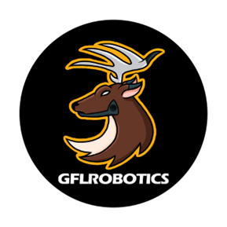
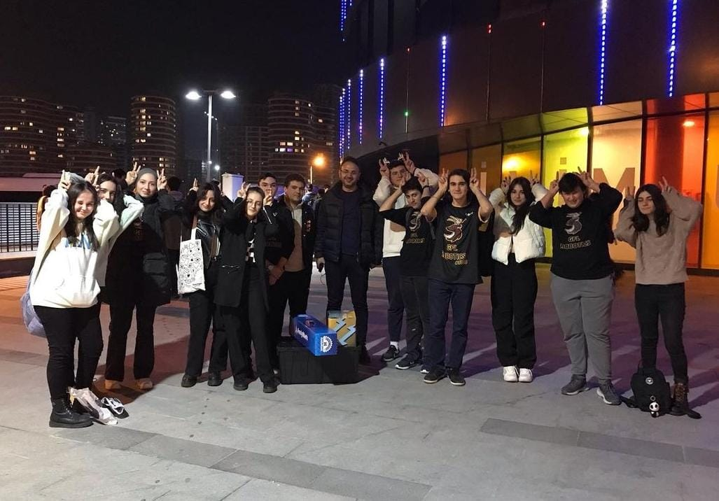
GFL ROBOTICS AND ITS MISSION
GFL ROBOTICS was established in Gölcük Science High School in 2019 by 12 students and 2 teachers. Our team continues its journey by constantly improving, both with our cooperation and with our strong ties to each other.

Slide 3
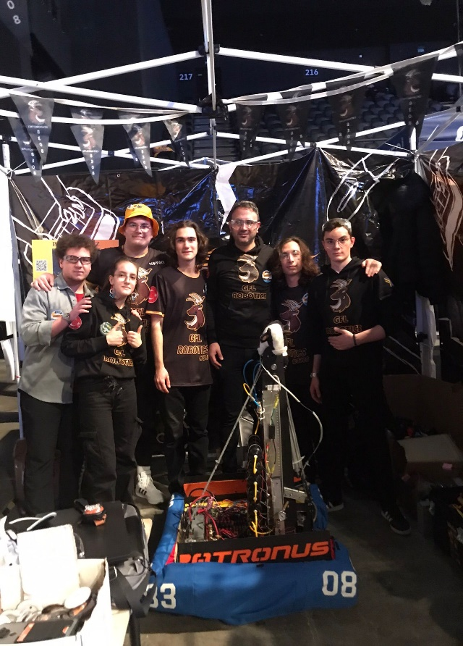
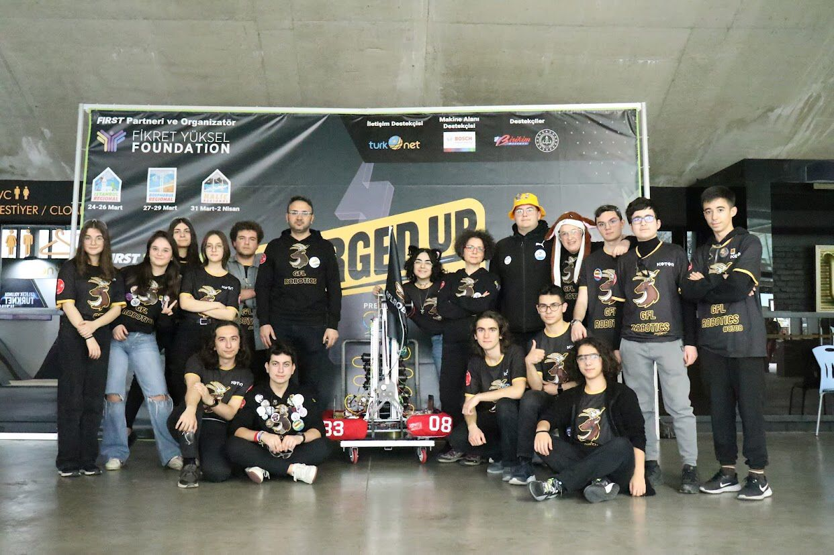
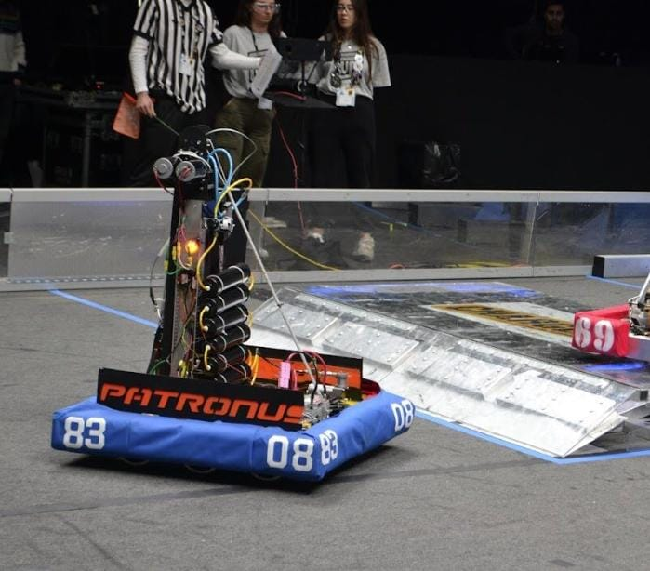

Slide 4
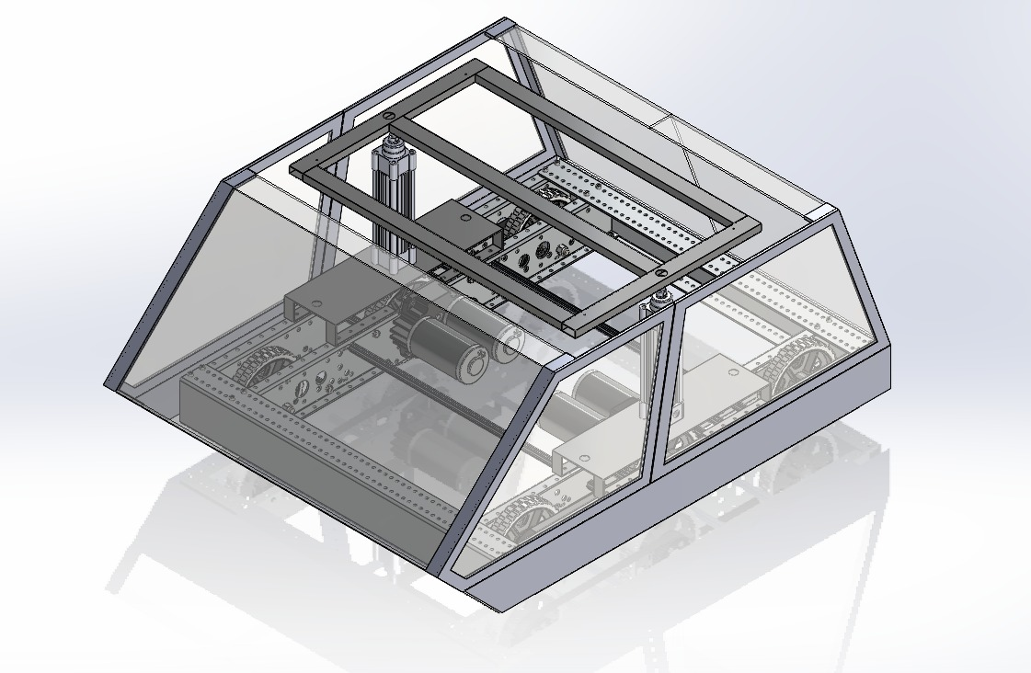
THE PROJECT SUMMARY
Our robot moves autonomously according to the scenarios determined in order to ensure the transportation of the material in the factories both safely and in the most efficient way. Our robot moves in the right direction by reading QR codes and picks up the loads at the designated places and leaves them where they are needed.

Slide 5
JUSTIFICATION OF THE PROJECT
The use of such robots in factories has many advantages for us:
They can work in heavy and big jobs that force people's physical characteristics,
They maintain product quality standards thanks to their high precision and repeatability
They can work together smoothly and quickly in the same environment

Slide 6
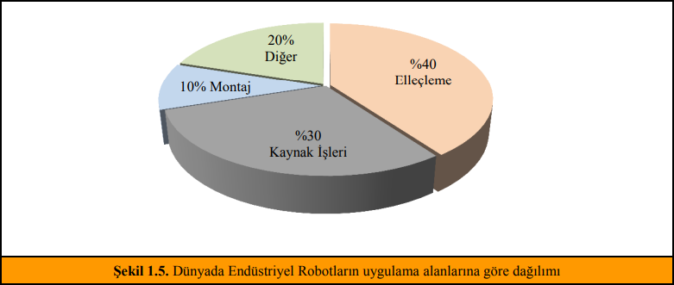
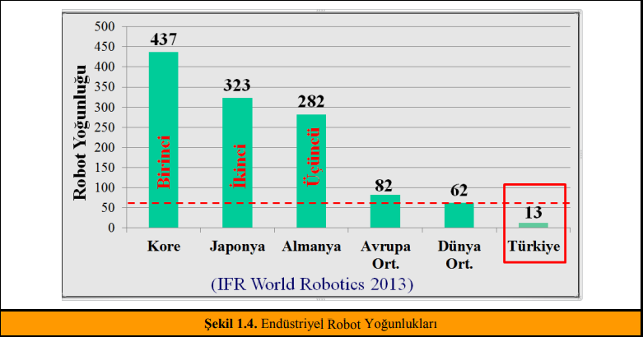
REQUIREMENTS OF THE PROJECT
Our project has been designed for the internal logistics needs of warehouse, material handling and e-commerce operation centers in factories engaged in production or logistics.
In addition, when we look at the industrial robot densities, we see that Turkey is below the world and European averages. We should raise Turkey above the standards by developing and supporting projects like this one.

Slide 7
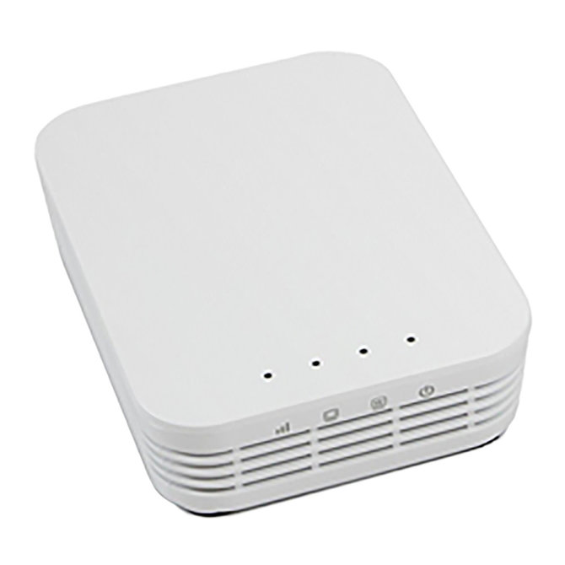
ALGORITHM AND SYSTEM ARCHITECTURE
Solidworks program was used in the design phase of the project. All drawings were designed in Solidworks.
System Used:
Open-Mesh OM5P-AC Router

Slide 8
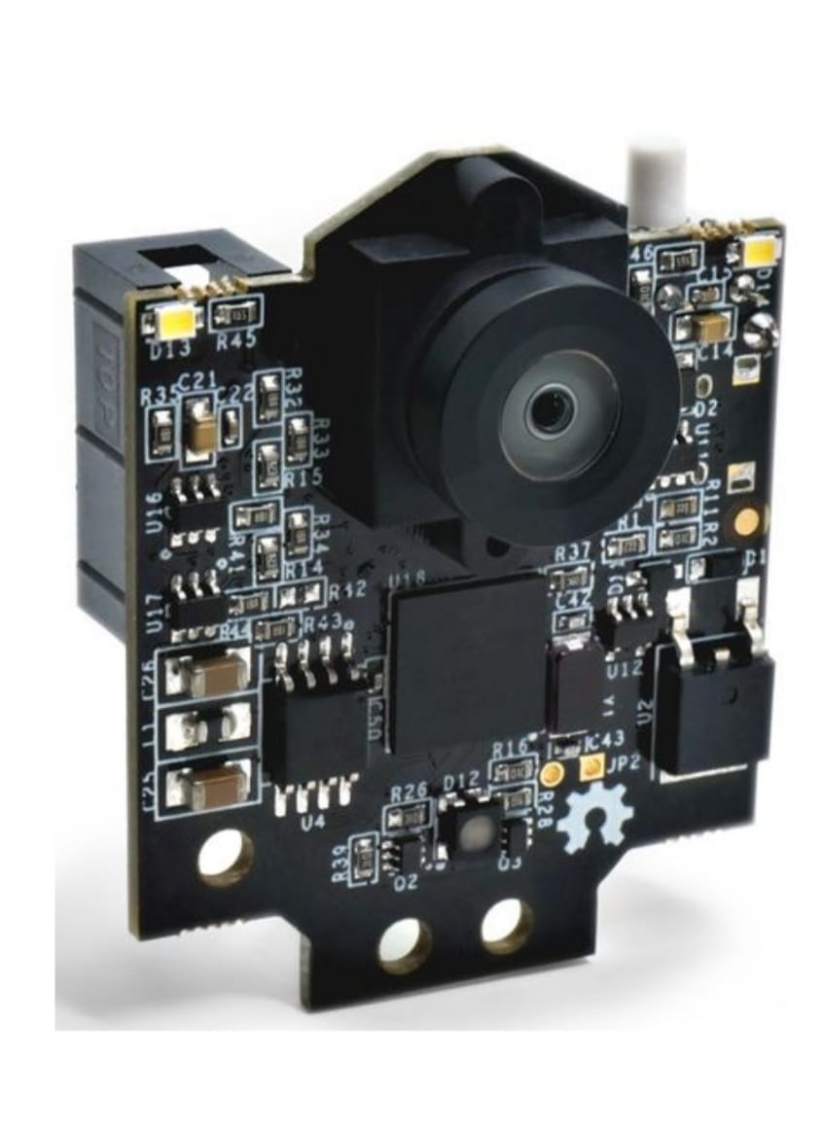
Lane Tracking
After assigning a task to our robot, it will continue to follow the lane thanks to the Pixy 2 Camera on it, as long as it does not encounter any obstacles and does not carry out the loading / unloading operations. Pixy 2 is placed in a position where you can see the floor comfortably.
System Used: Pixy 2 Camera

Slide 9
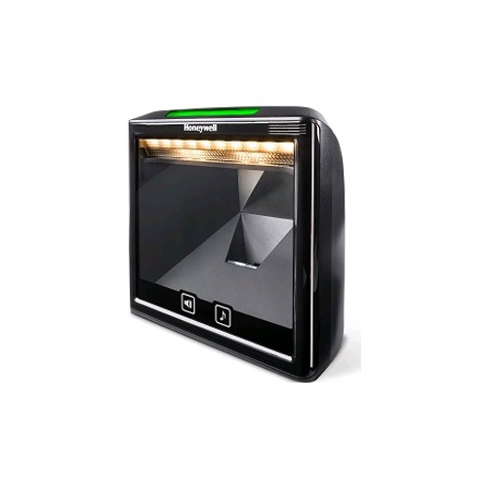
Direction Determination with QR Code
Thanks to the Honeywell Solaris 7980, which we will position in front of our vehicle close to the ground, we will be able to read the data from the QR code. According to the data read, it will either continue straight or if an intersection is detected, it will proceed in the specified direction.
System Used:
Honeywell Solaris 7980

Slide 10
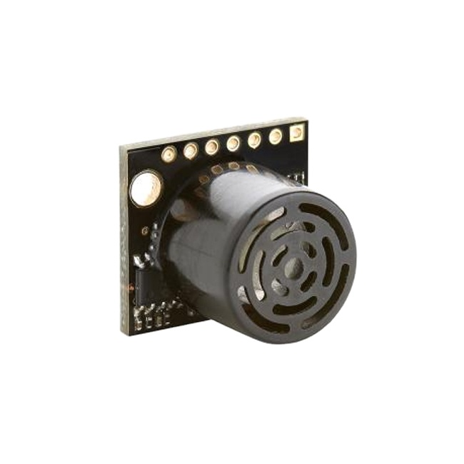
Obstacle Avoidance Algorithm
Obstacles are detected by the MB1013 ultrasonic sensor located in front of our vehicle. If obstacles are detected, our robot will signal and wait for the obstacle to be removed for 15 seconds. If the obstacle does not move from its current position, it will go around the obstacle and continue to follow the lane.
System Used:
MB1013 Ultrasonik Sensor

Slide 11
THANK YOU FOR LISTENING TO ME

