Slide 1
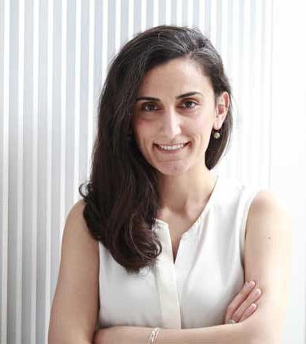
A scientist from Kocaeli
CANAN DAGDEVİREN

Slide 2
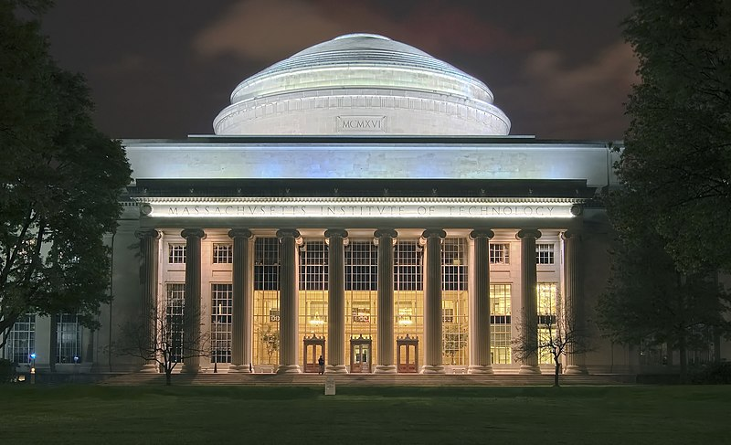
Who is Canan DaGdeviren?
She is a Turkish academic, physicist, material scientist, and assistant professor at MIT.
‘Massachusetts Institute of Technology’

Slide 3
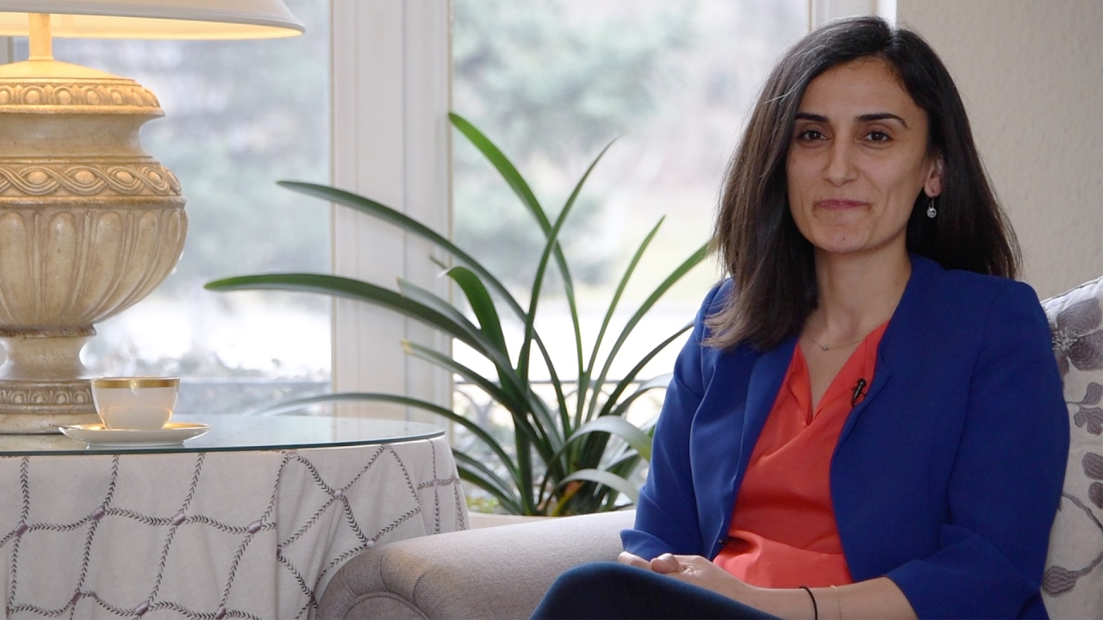
She was born on May 4, 1985.

Slide 4
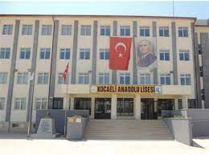
She completed her primary and secondary education in Kocaeli.

Slide 5
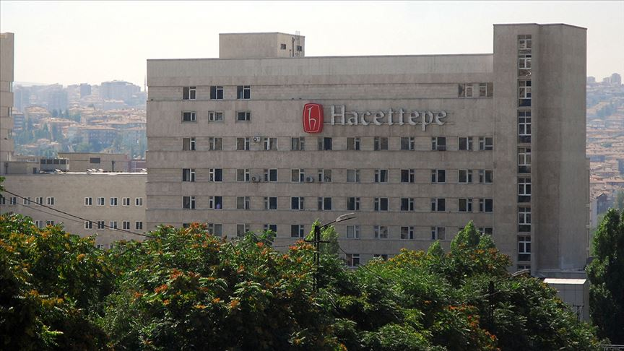
She graduated from Hacettepe University in Ankara Physics Engineering Department in 2007.

Slide 6
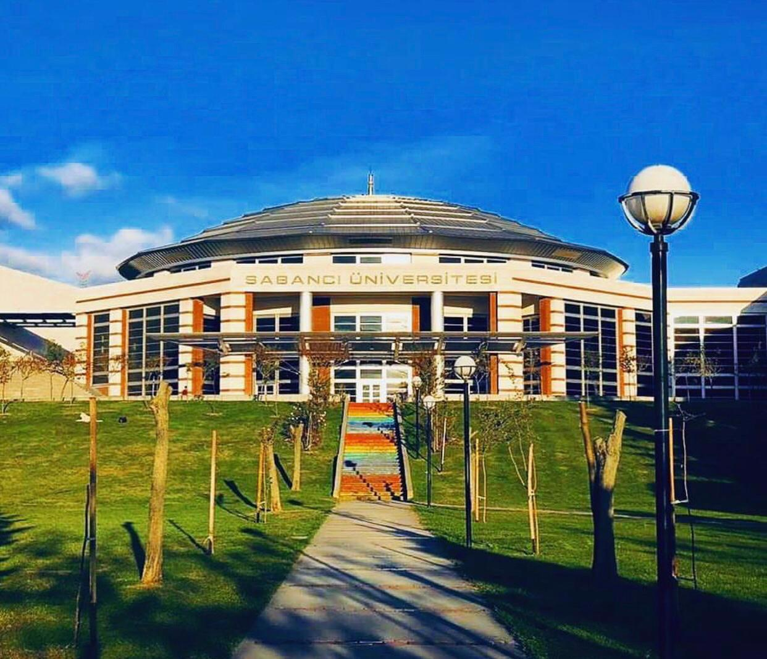
She completed her master's degree in Sabancı University Materials Science and Engineering program in 2009.

Slide 7
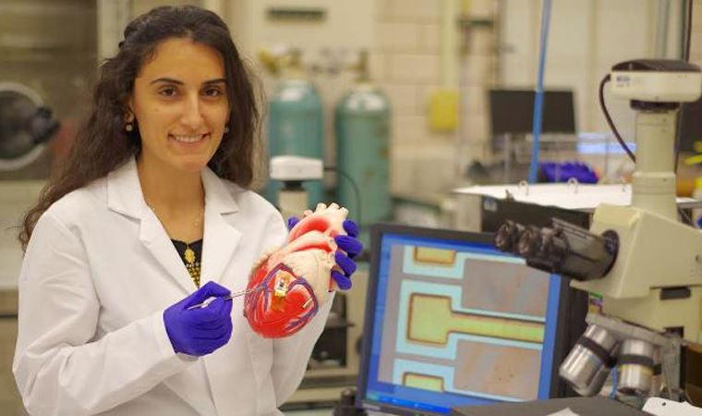
Working in the field of medical technology, she developed a battery-free wearable heart chip and a device for diagnosing skin cancer.

Slide 8
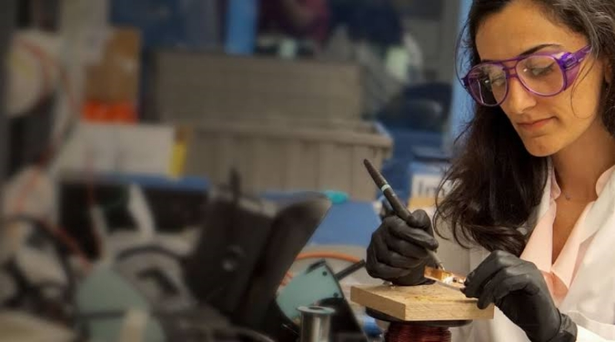
When she first came to America, she was the only female researcher in her research group.

Slide 9
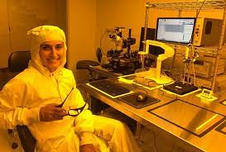
And she wanted a female physicist scientist to be seen by everyone, especially students, for inspiration.

Slide 10
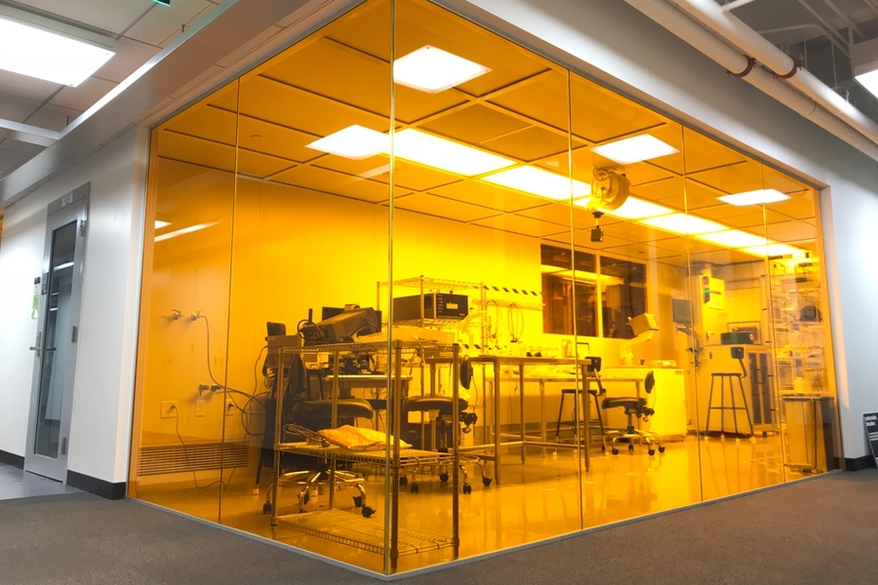
Therefore, her lab is transparent. So when you look from the outside, you can see what is being done inside.

Slide 11
She wants everyone to see how a scientist works in a laboratory, especially for young girls visiting or studying at the university.

Slide 12
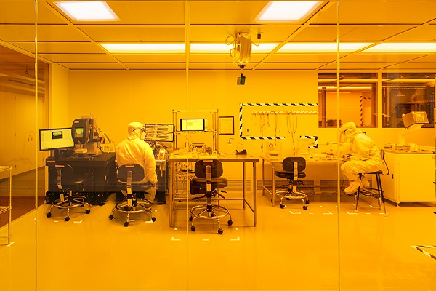
She designed the Yellow Box by herself from the ground.

Slide 13
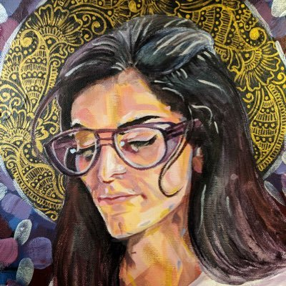
FACTS aBOUT HER
1) In 2015, she was named one of the top Innovaters Under 35.

Slide 14
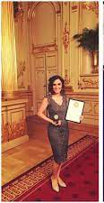
2) She is the first Turkish citizen to be elected as a Harvard Young Academy Fellow.

Slide 15
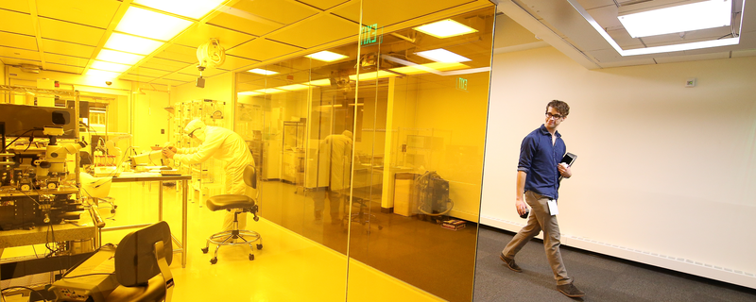
3) The YellowBox is a cleanroom used at the MIT Media Lab, which Dagdeviren designed and constructed from the ground up in 2017.

Slide 16

In 2018, she was invited to speak at the United Nations about women in science.

Slide 17
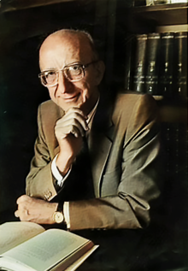
5) In an interview, Dagdeviren said that she was inspired by a book written by Turkish theoretical physicist Erdal İnönü.

Slide 18
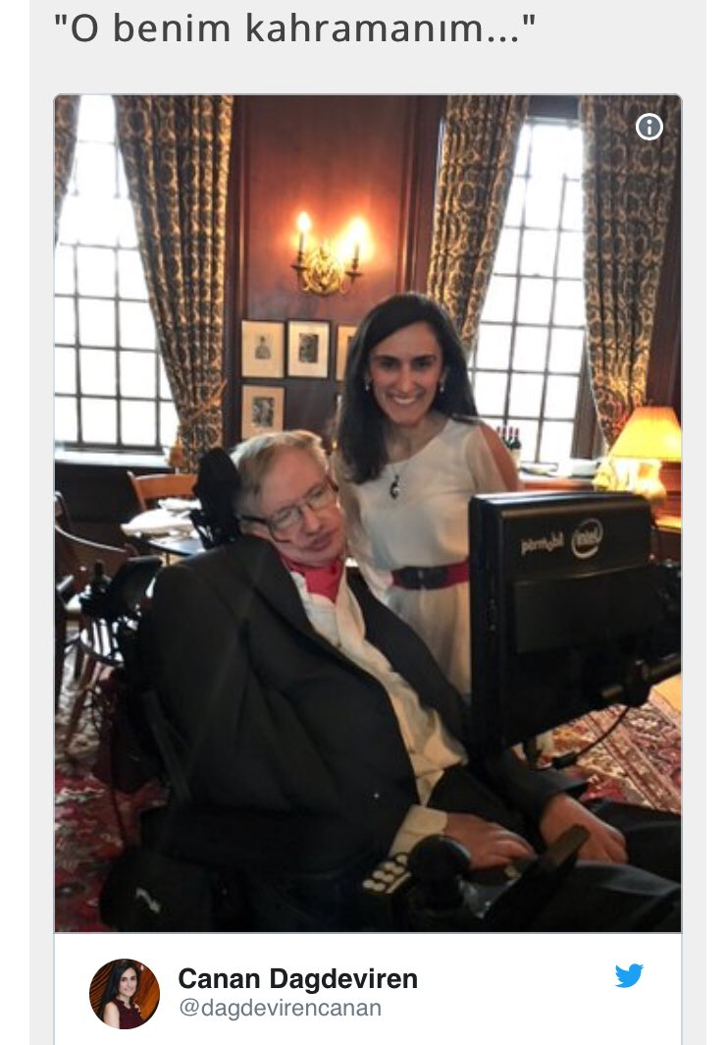
FOLLOW HER ON SOCIAL MEDIa!!!
‘’ He is my hero…’’
Her twitter acc :
@dagdevirencanan
Her facebook acc : canandagdeviren28
Her gmail : canand[at]mit.edu
Her instagram acc :
@canandagdeviren
‘Canan Dagdeviren & Stephen Hawking on Twitter’

Slide 19
Thank you for listening to me :)
Miray A. YILDIZ

