Slide 1
HISTORY OF ROBOTICS IN THE WORLD

Slide 2
The history of robotics dates back to 350 BC, when Archytas, a brilliant Greek mathematician, managed to build a mechanical bird that used steam to move itself. This was the first documented human attempt to build an automaton.
The first use of the word "robot" appeared in a play about mechanical men, built to work on factory assembly lines, rebelling against their human masters. These machines in RUR (Rossum's Universal Robots), written by Czech playwright Karl Capek in 1921, were named after the Czech word for slave
The word "robotics" was also invented by a writer. The Russian-born American science fiction writer Isaac Asimov first used the word in 1942 in his short story "Runabout".

Slide 3
Asimov also proposed three "Laws of Robotics" that his robots and the sci-fi robotic characters of many other stories follow:
Law One
A robot cannot injure a human being or allow a human being to be harmed by remaining inactive.
Second Law
A robot must obey the commands given to it by humans, as long as they do not contradict the First Law.
Third Law
A robot must preserve its own existence as long as it does not contradict the First and Second Laws.

Slide 4
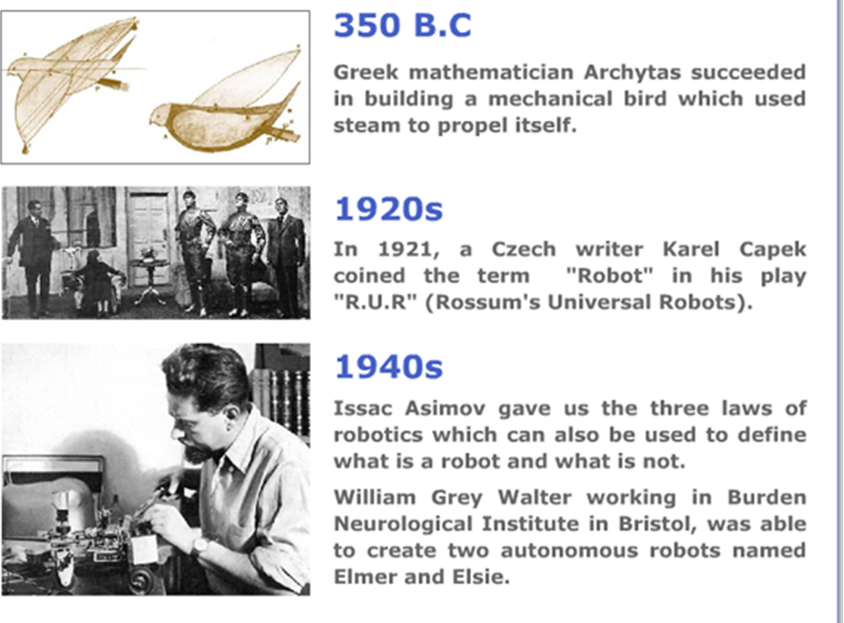

Slide 5
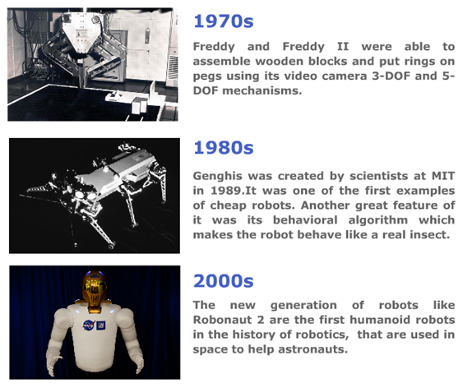

Slide 6
ROBOTICS IN TURKEY

Slide 7
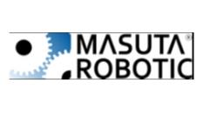
Provider of collaborative robotic automation for industries. It offers solutions for building, configuring, and testing robots. These robots are used for production in factories.
Company Overview
Founded Year 2015
Location Cayirova (Turkey)

Slide 8

Andropack provides a packaging robot that has inventive and dependable case configurations with product handling and case packing. It has the functionality of a quick changeover, which is flexible and has high speed. It provides its services in snacks, pharma, beverages, foods, technical equipment, and Tobacco Industries.
Company Overview
Founded Year 2019 Location Izmir (Turkey)

Slide 9
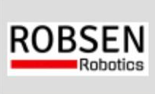
Robsen Robotics provides robots for welding. It provides iRoCube Plus which offers modules, through which robots can be configured. The company provides technology that supports foundries in digitalization to monitor the die-casting process in real-time and increases the performance of the die-casting cell.
Company Overview
Founded Year 2013
Location Gebze (Turkey)

Slide 10
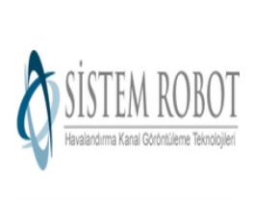
Sistem Robot has developed robotic crawlers with CCTV cameras attached at one end of their body which help in remote drain inspection and maintenance activities. The company has robots of two kinds: ones that have camera attached with the core body, and others that have camera at the end of an extendable arm. The robot's camera can have endless movement in 360 degrees that helps in better inspection.
Company Overview
Founded Year 2013
Location Ankara (Turkey)

Slide 11
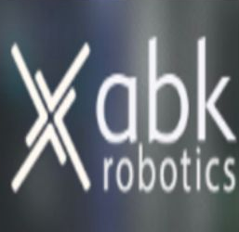
ABK Robotics develops robots for industrial material handling needs. The company primarily provides delta robots can be effectively used for packaging and sorting operations. The robots have a cycle time as low as 0.3s with a rated load capacity of up to 2 kilo.
Company Overview
Founded Year 2015
Location Istanbul (Turkey)

Slide 12
FAMOUS SCIENTISTS AND COMPANIES IN
ROBOTICS IN TURKEY

Slide 13
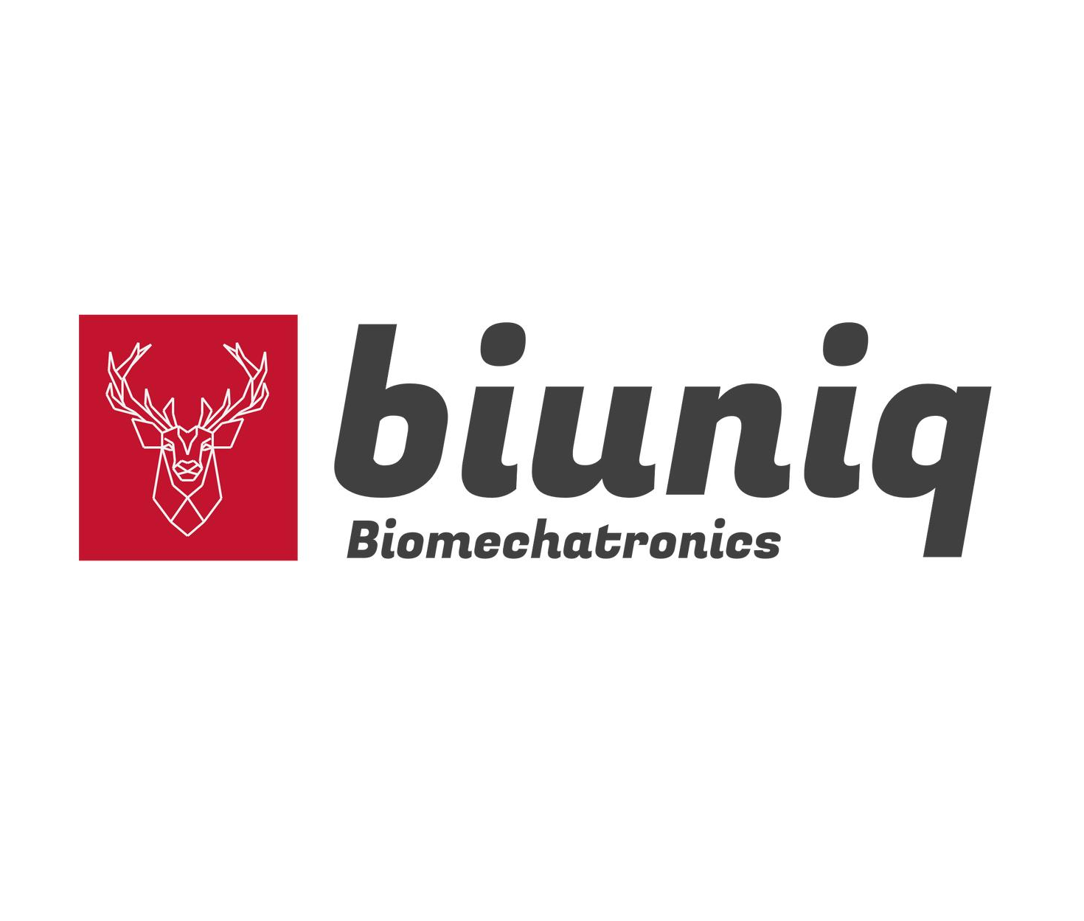
Biuniq Technology
Biuniq technology was founded in 2019 in İstanbul-Turkey to create solutions in the fields of rehabilitative robots and human robot interfaces based on Biomechatronic technology.

Slide 14

Bama Technology
BAMA Technology was founded in 2010 in Ankara to develop robotic rehabilitation systems that would serve in the medical field.
It’s the first producer company in the field of rehabilitation in Turkey.

Slide 15
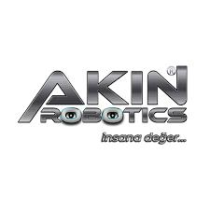
Akın Robotics
Akın robotics was founded in 2017 in Konya by Özgür Akın. It’s the first humanoid robot factory to mass produce in the world.

Slide 16
SCIENTISTS

Slide 17
El Cezeri
El Cezeri is a Turkish scientist who lived in the golden age of Islam. He has laid the foundations of cybernetics and has made the first robot in history and he’s considered that he has inspired leonardo da vinci. When he made the first robot ever in 1203 he wanted to point out Islam’s universlatiy so he put many symbols in it. He defines it as "The elephant represents the Indian and African cultures, the two dragons represent Chinese culture, the phoenix represents Persian culture, the water work represents Greek culture, and the turban represents Islamic culture.

Slide 18
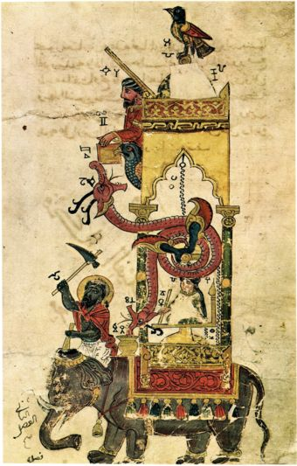
The elephant's body conceals a water tank containing a bowl with a hole in the bottom. As the bowl slowly sinks, it pulls ropes that move the scribe and his pen to indicate the number of minutes past the hour.

Slide 19
Prof. Karaboga
Having previously studied the learning, reasoning, and interpretation abilities of humans and the immune system with ants, Karaboğa became interested in honeybees based on her experiences. Karaboğa, who started his studies on the artificial intelligence method inspired by the behavior of honey bees in the early 2000s, named her method Artifical Bee Colony (ABC). He defines this thinkibg with this quote: "The ability of the robot to solve its own problem like a human is done by using certain algorithms and certain approaches.

Slide 20
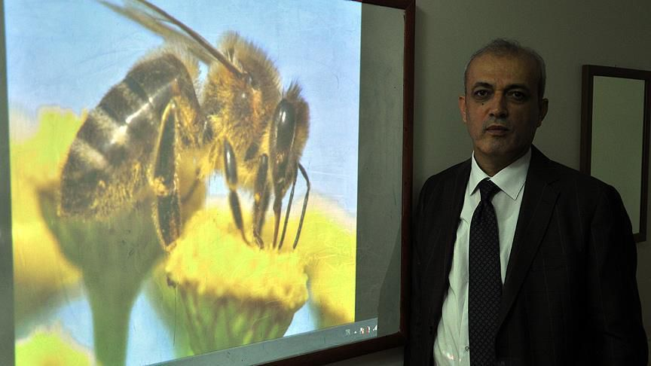
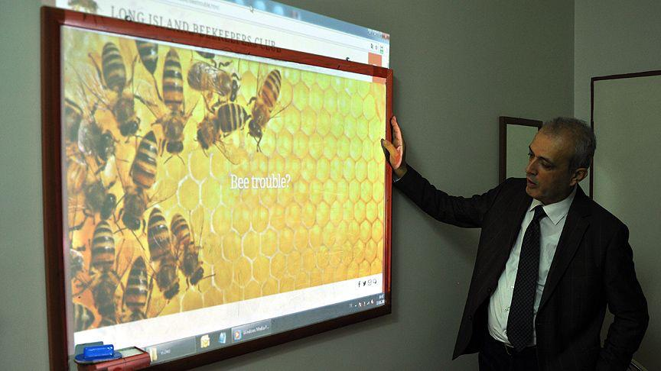
The Artificial Bee Colony approach is an approach that can be used easily. Robots can solve this problem by being inspired by this approach, just as bees can solve the problem"He managed to get his name written on the list of "The most influential scientists in the world" for 2 years in a row.

