Slide 1
METE ATATÜRE

Slide 2
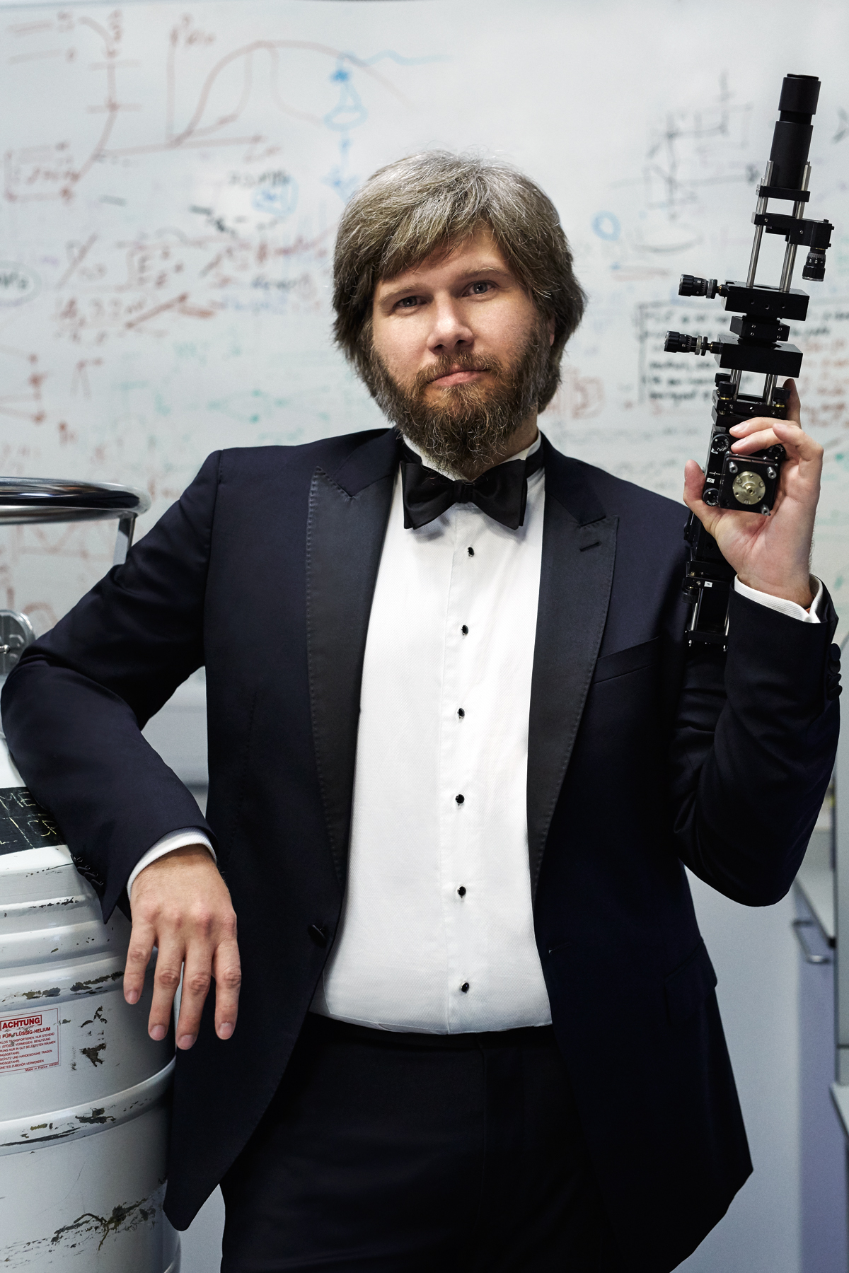
Who is Mete Atatüre?
He is a quantum physics professor at Cambridge Univesity.

Slide 3
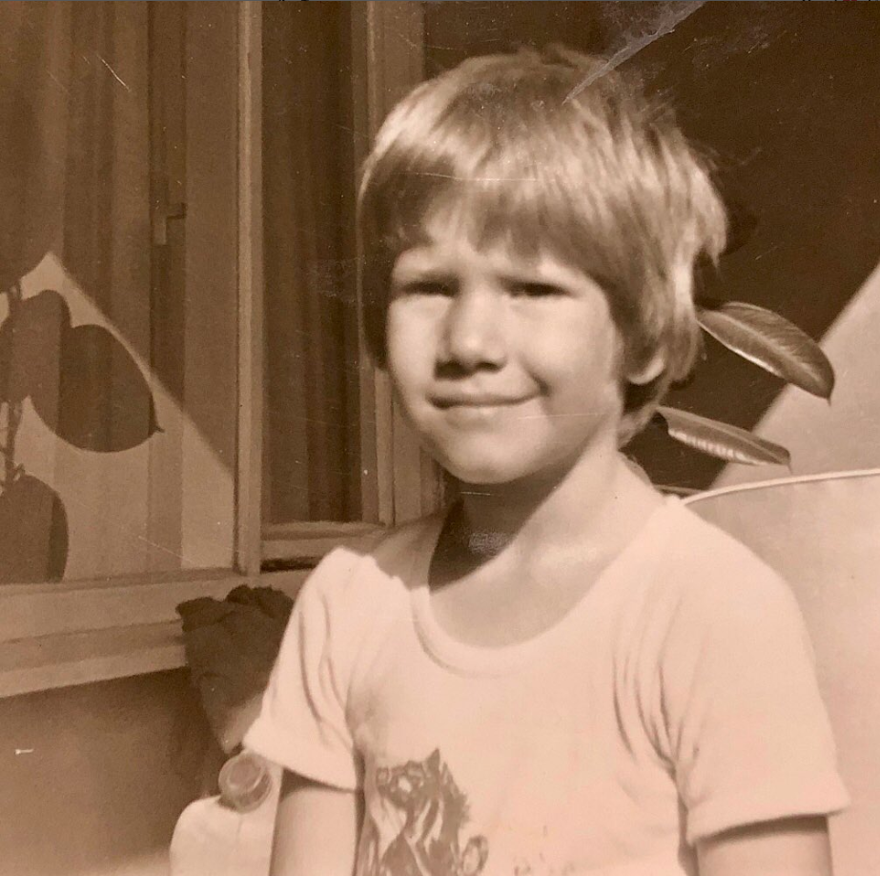
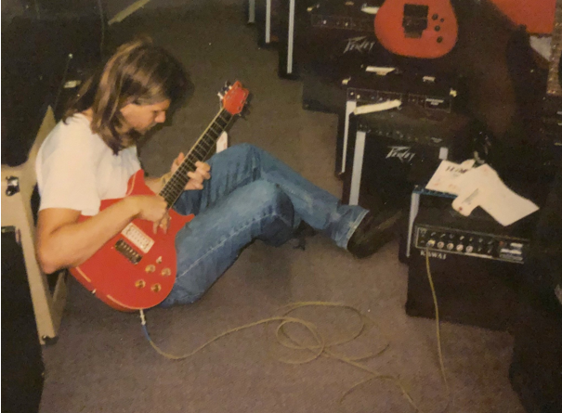
His life
He was born in 1975 at Kayseri, Turkey.

Slide 4
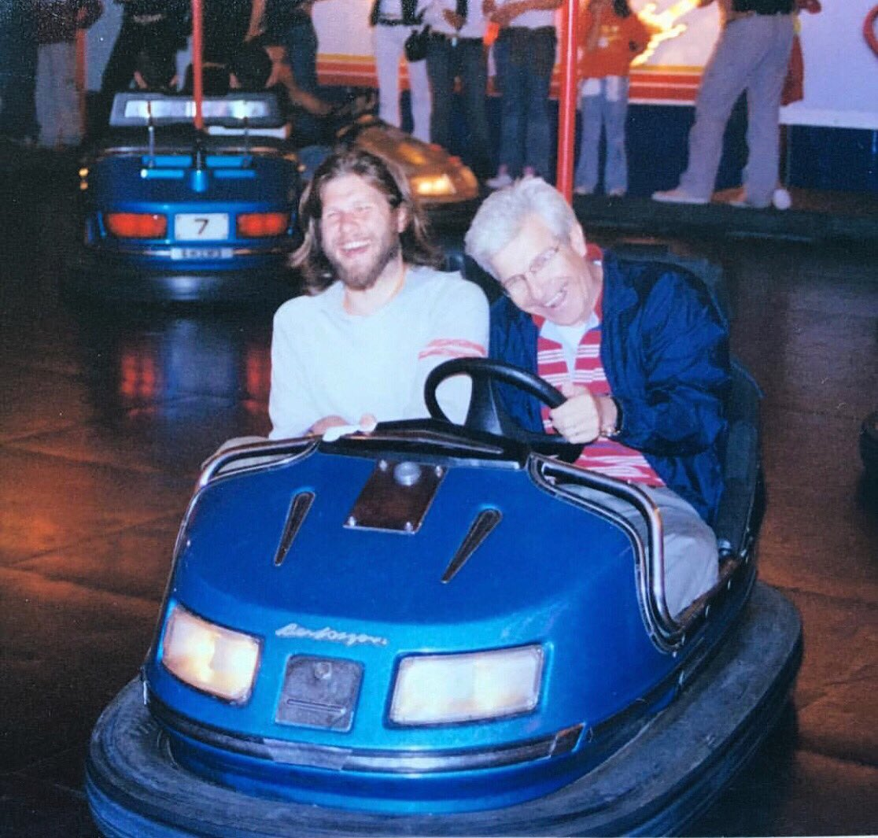
His father was a politician and his mother was an artist.
They moved to United States when he was in middle school.

Slide 5
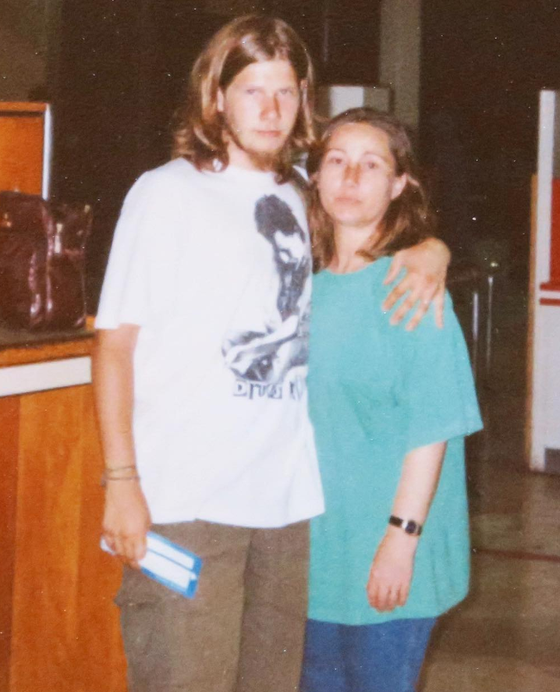
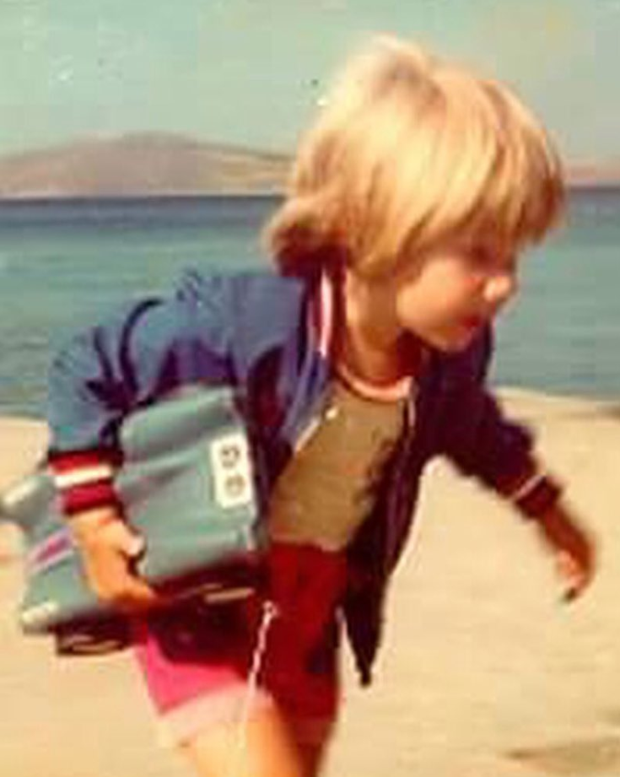
He moved to too many cities when he was a child therefore he changed to many schools. Becasue of his fathers job.

Slide 6

He graduated from Gazi Anadolu High School.

Slide 7
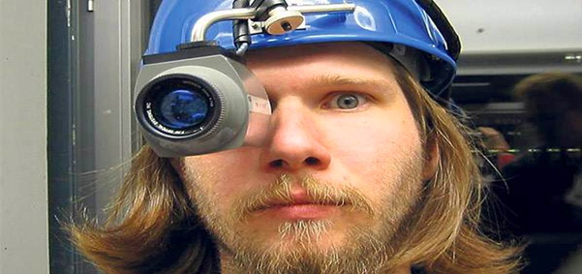
Actually he didn’t like physics in high school.
However he had a physics teacher who touched Mete Atatüre’s heart .

Slide 8
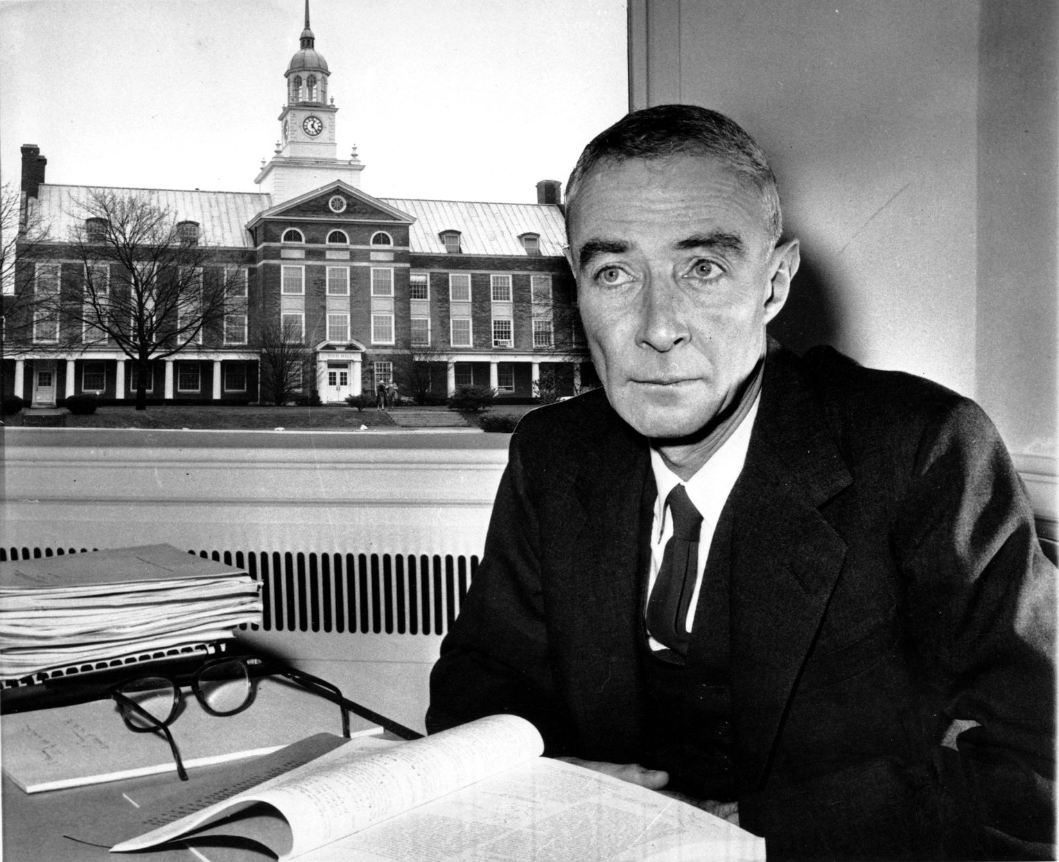
How?
His teacher gave him a book about Robert Oppenheimer.
That book changed his vision for physics.

Slide 9
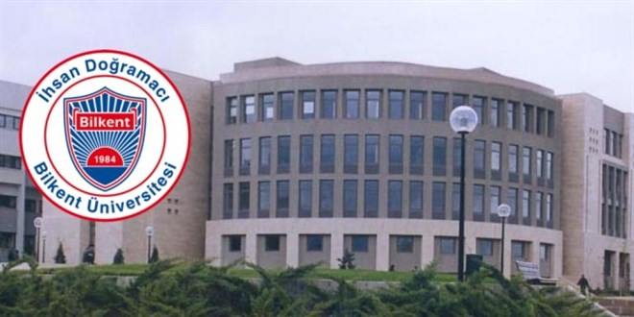
He studied in Bilkent University Physics Department till 1996.

Slide 10
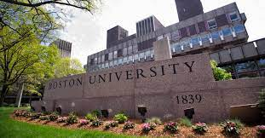
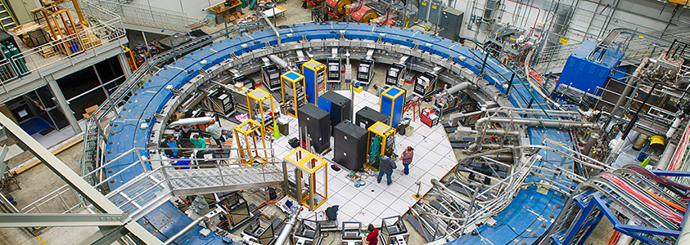
Then, he joined the Quantum Imaging Laboratory
at Boston University for his PhD studies.

Slide 11
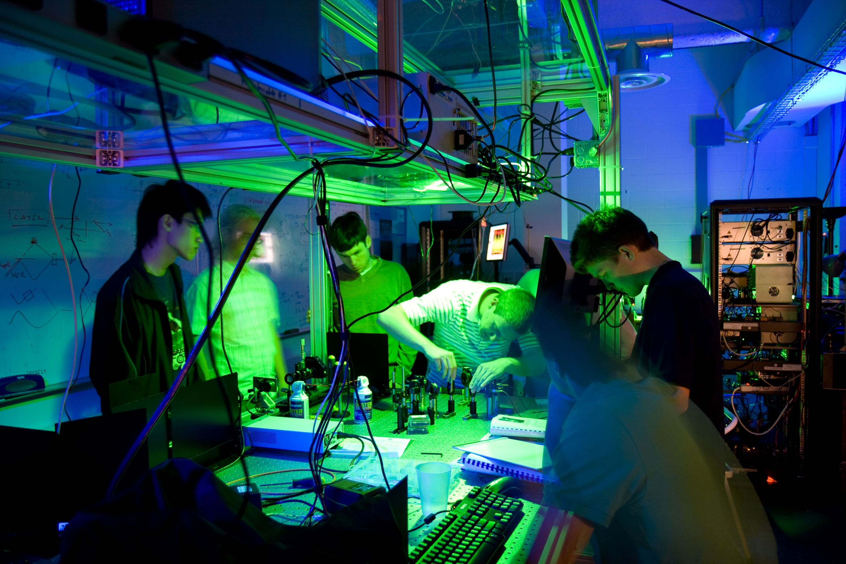
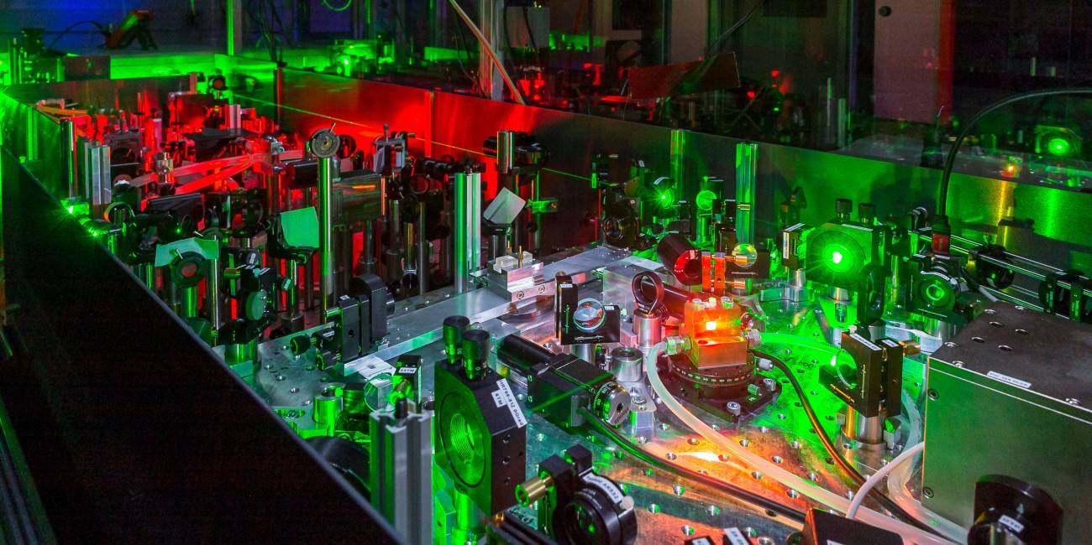
From 2002 to 2007,
he worked as a Postdoctoral Fellow in the Quantum Photonics Group at ETH Zurich.

Slide 12
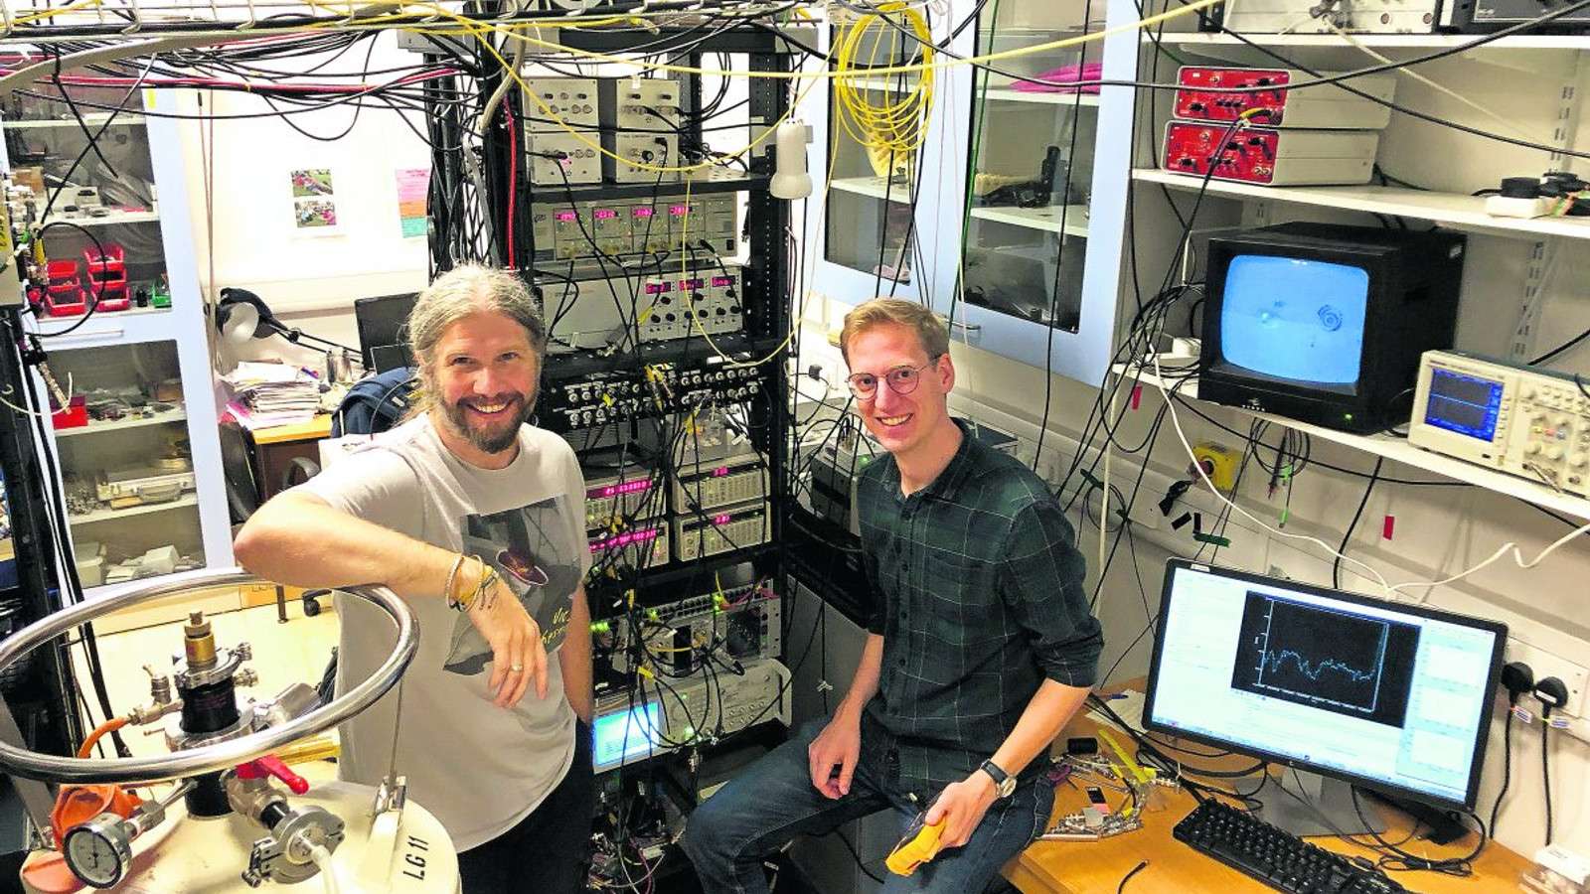
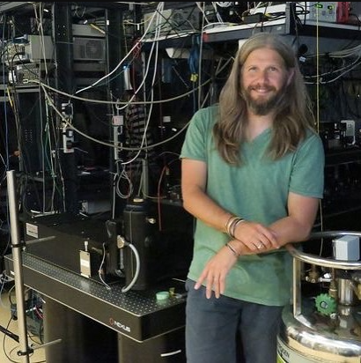
He joined the famous Cavendish Laboratory in 2007 as a University Lecturer.
He was promoted to a Readership in 2011 and to a Professorship in 2015.

Slide 13
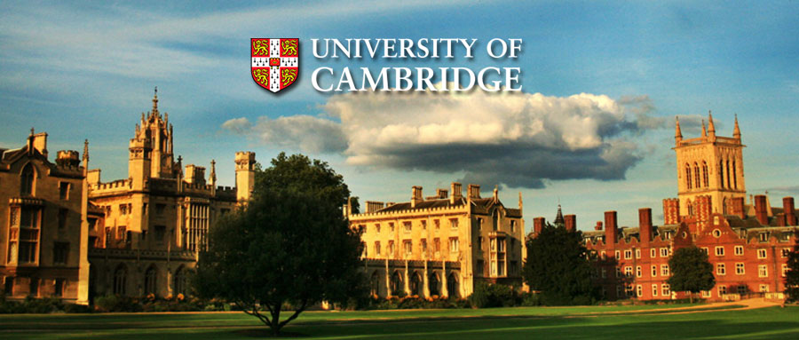
He is now Professor of Physics at St. John’s College Cambridge University.

Slide 14
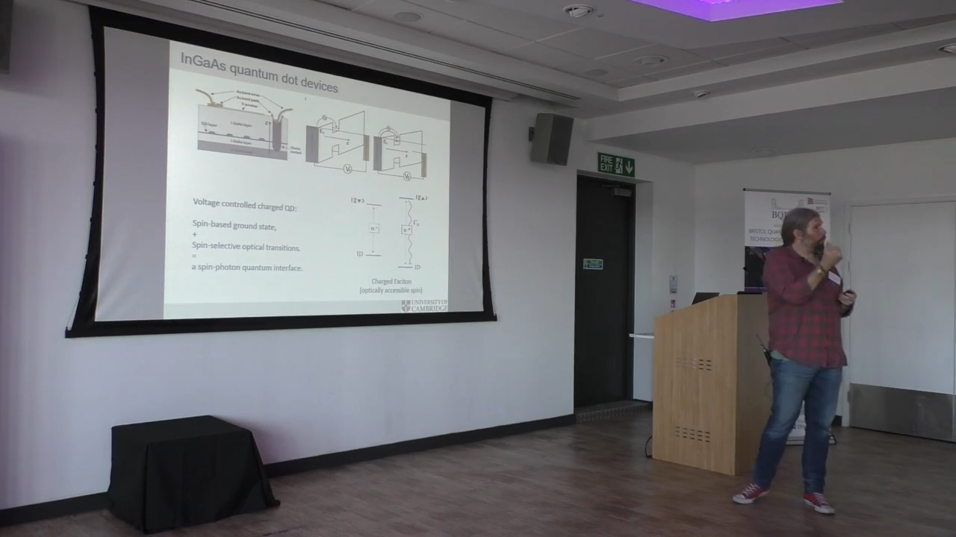

Slide 15
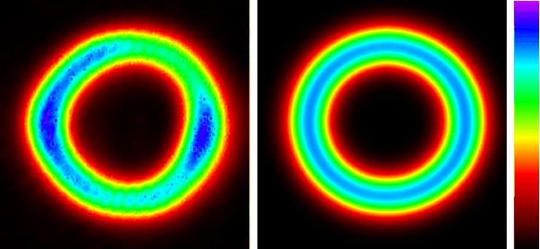
What did he find?
Mete Atatüre made the 'noise measurement of the light level', which is considered impossible to measure.

Slide 16
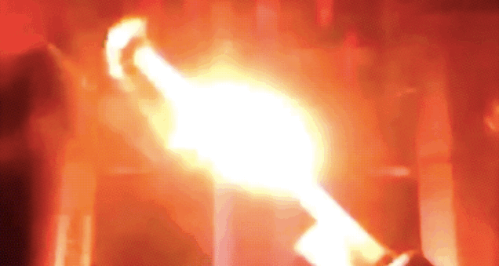
How did he find it?
He and his team had squeezed the light by a firing laser beam towards a matearial.

Slide 17
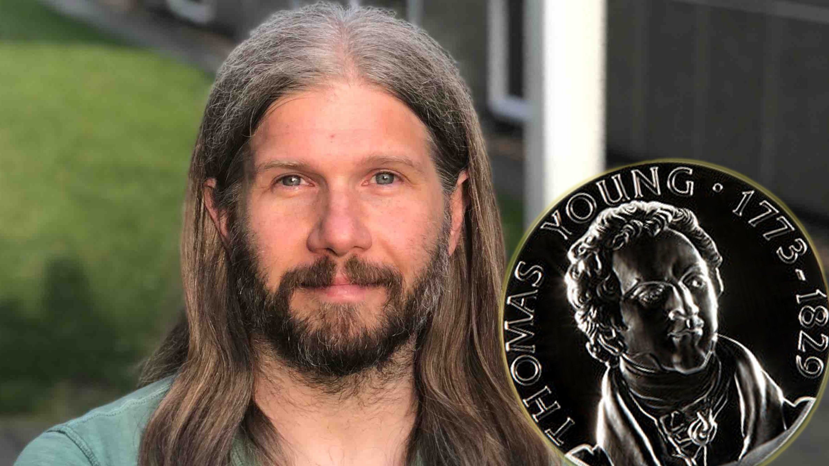
He won 2020 Thomas Young medal for his contributions of physics outside the visible region.

Slide 18
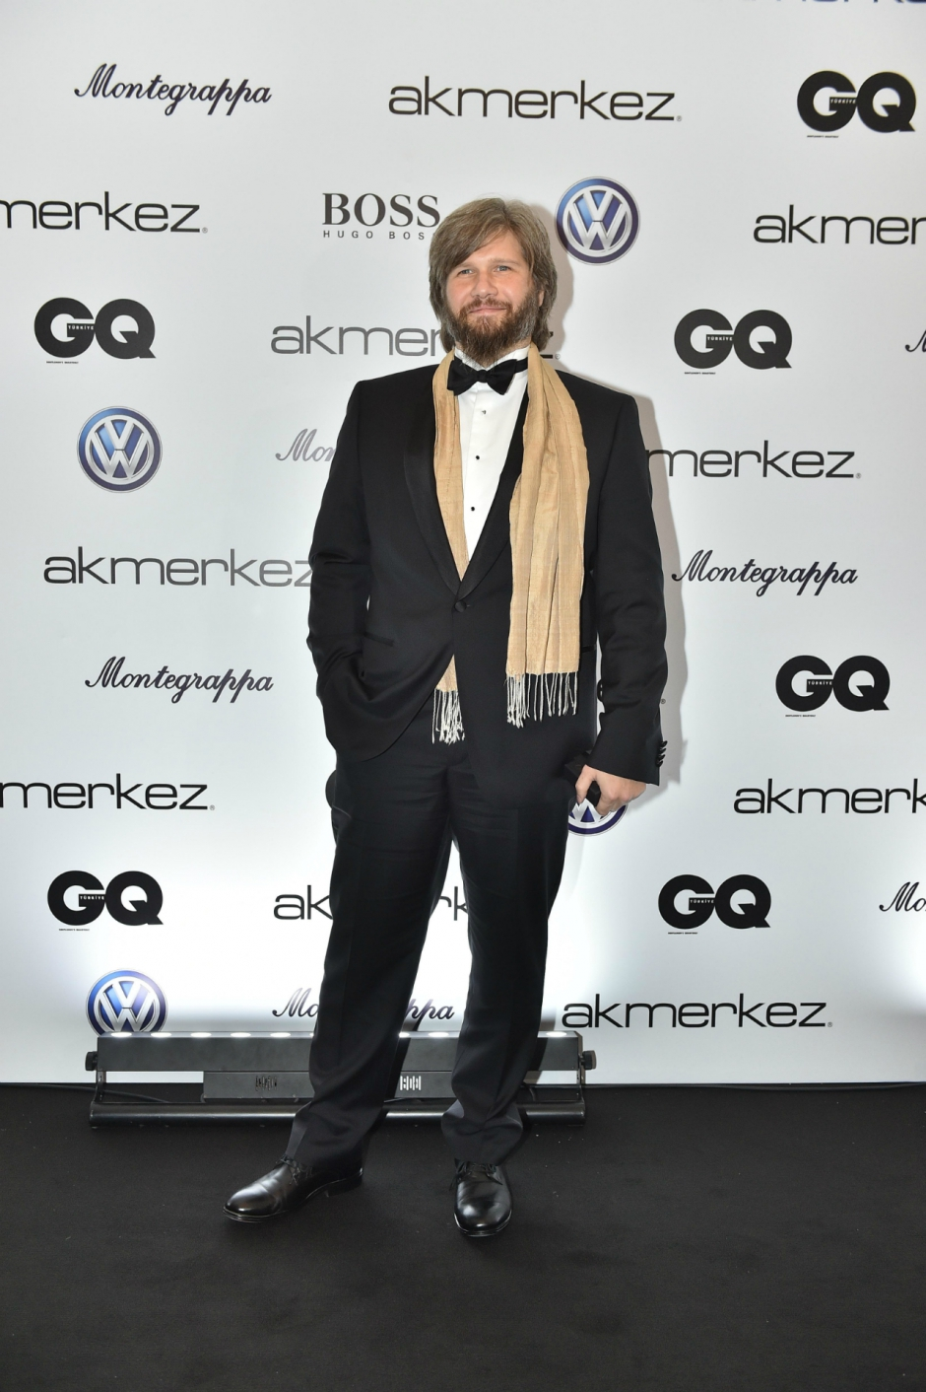
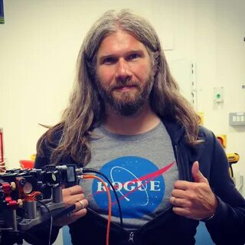
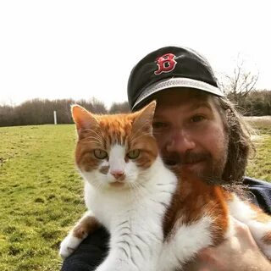

Slide 19
You can reach him from
Instagram
Twitter
Cambridge
https://www.instagram.com/meteatature/
https://twitter.com/MeteAtature
https://www.amop.phy.cam.ac.uk/Research/QOMS

Slide 20
Thank you for listening me
Burak A. MENDİ

