Slide 1
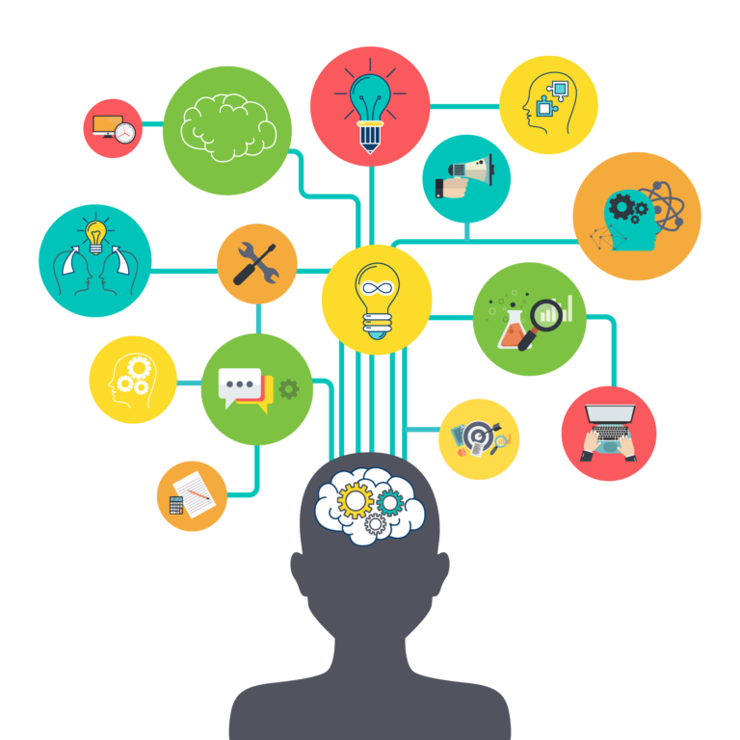
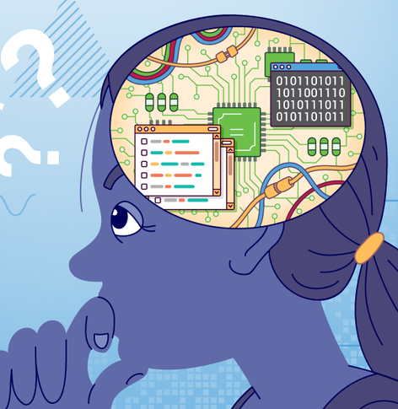
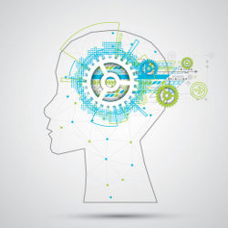
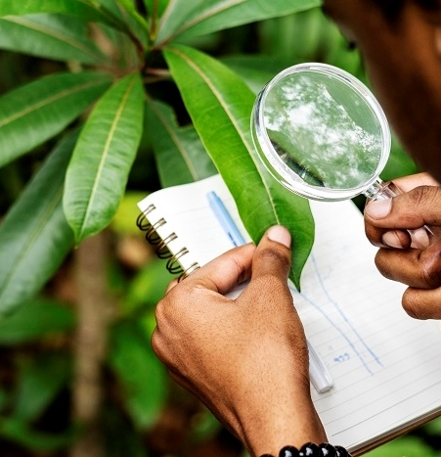


COMPUTATIONAL THINKING

Slide 2
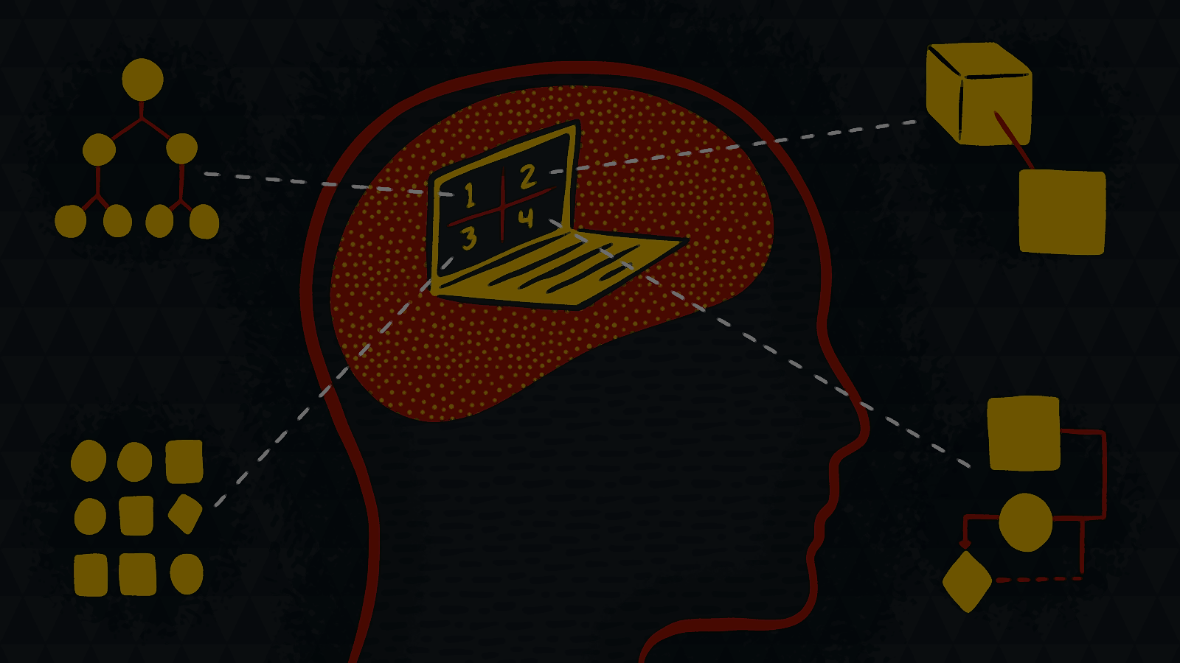
What is Computational Thinking?
Computational thinking is a technique that eases the process of solving a complex problem by breaking down the main problem into subtitles. This process Leads people to fully analyze and understand the problem and to develop comprehensive solutions that effects every part of the problem.

Slide 3
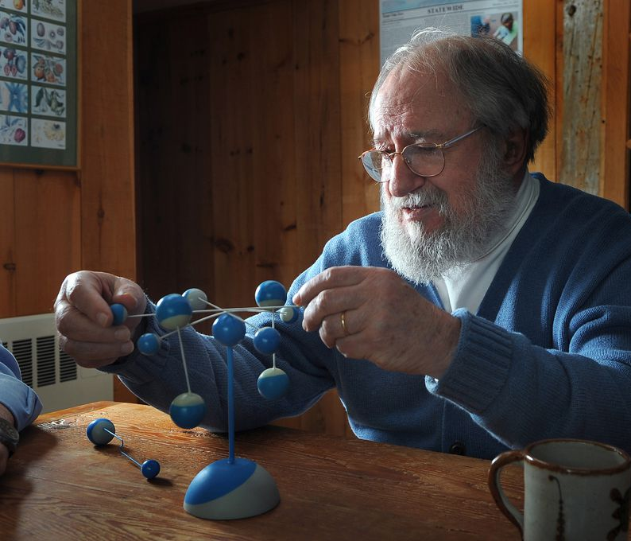
The History
The first reference of computational thinking as “procedural thinking”
by the mathematician Seymour Papert in 1980-and again in 1996-
The efforts of Seymour Papert to bring Computational thinking to
K-12 education in the Massachusetts Institute of Technology.
The occurrence of the phrase “computational thinking” by
Jeannette Wing in the 2006 Association for Computing
Machinery (ACM) essay
Photo of Seymour Papert

Slide 4
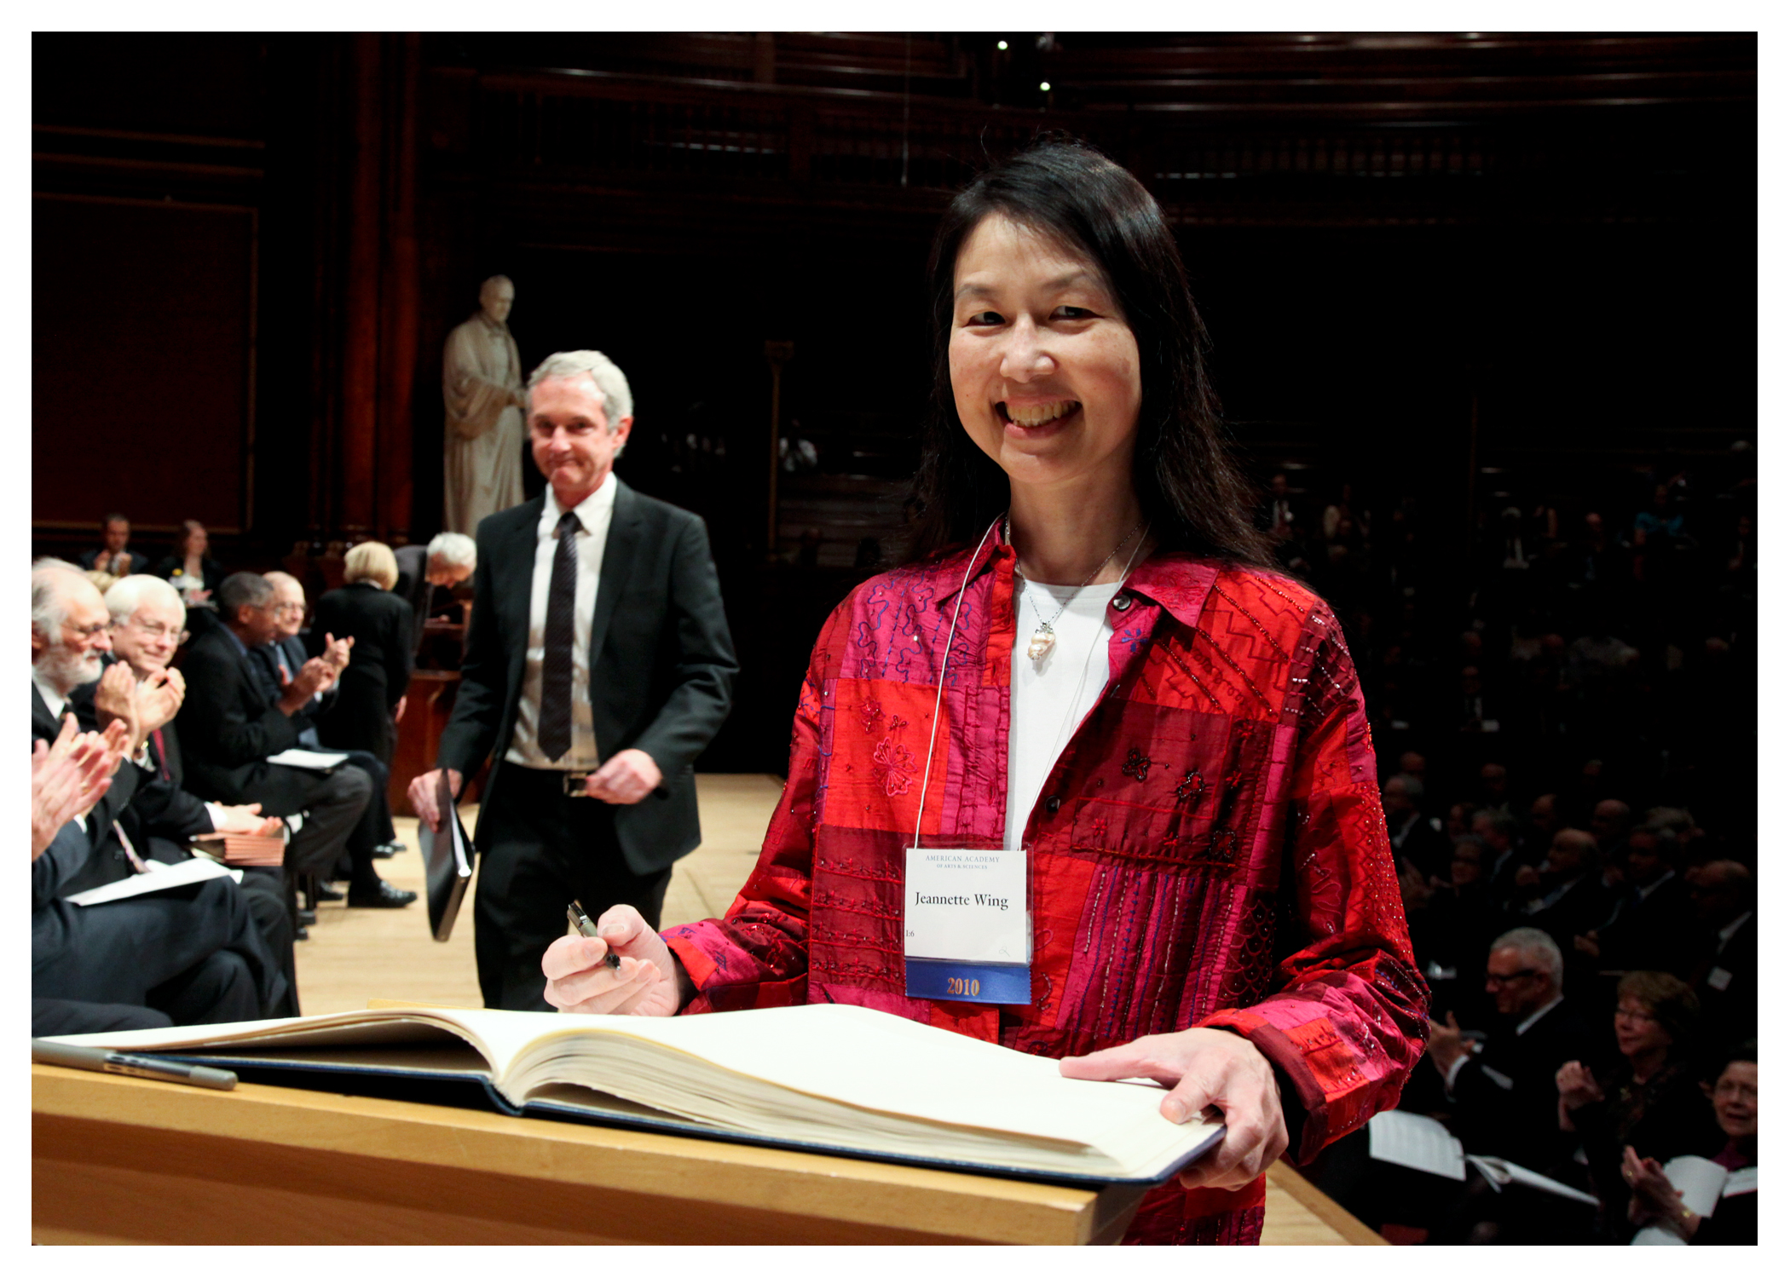
Photo of Jeannette Wing
The History
The evolution of Jeannette Wing’s definition of computational thinking in 2008
The establishment of Computer Science Teachers Association’s (CSTA)
own computational thinking frameworks in 2011
The articles that are written by Stephen and Conrad Wolfram
brothers about Computational thinking in 2016

Slide 5
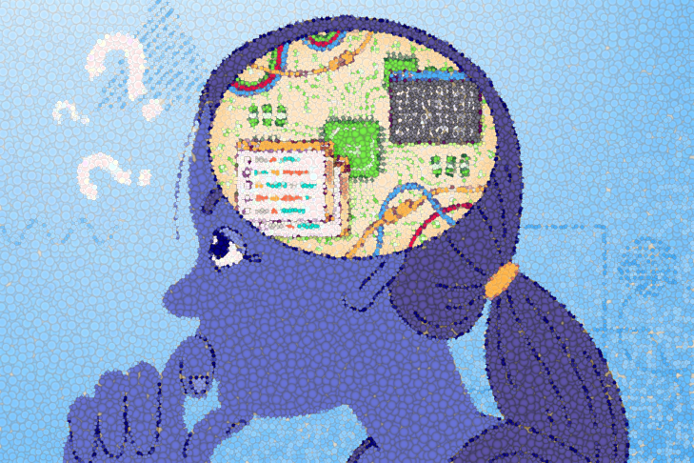
Four Key Elements of
Computational Thinking
Decomposition
Pattern Recognition
Abstraction
Algorithmic Thinking

Slide 6
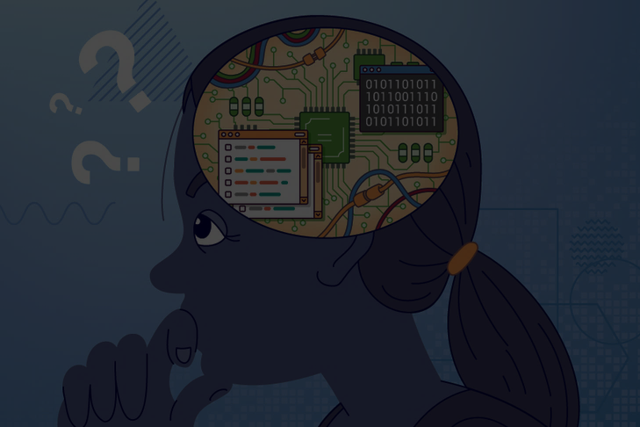
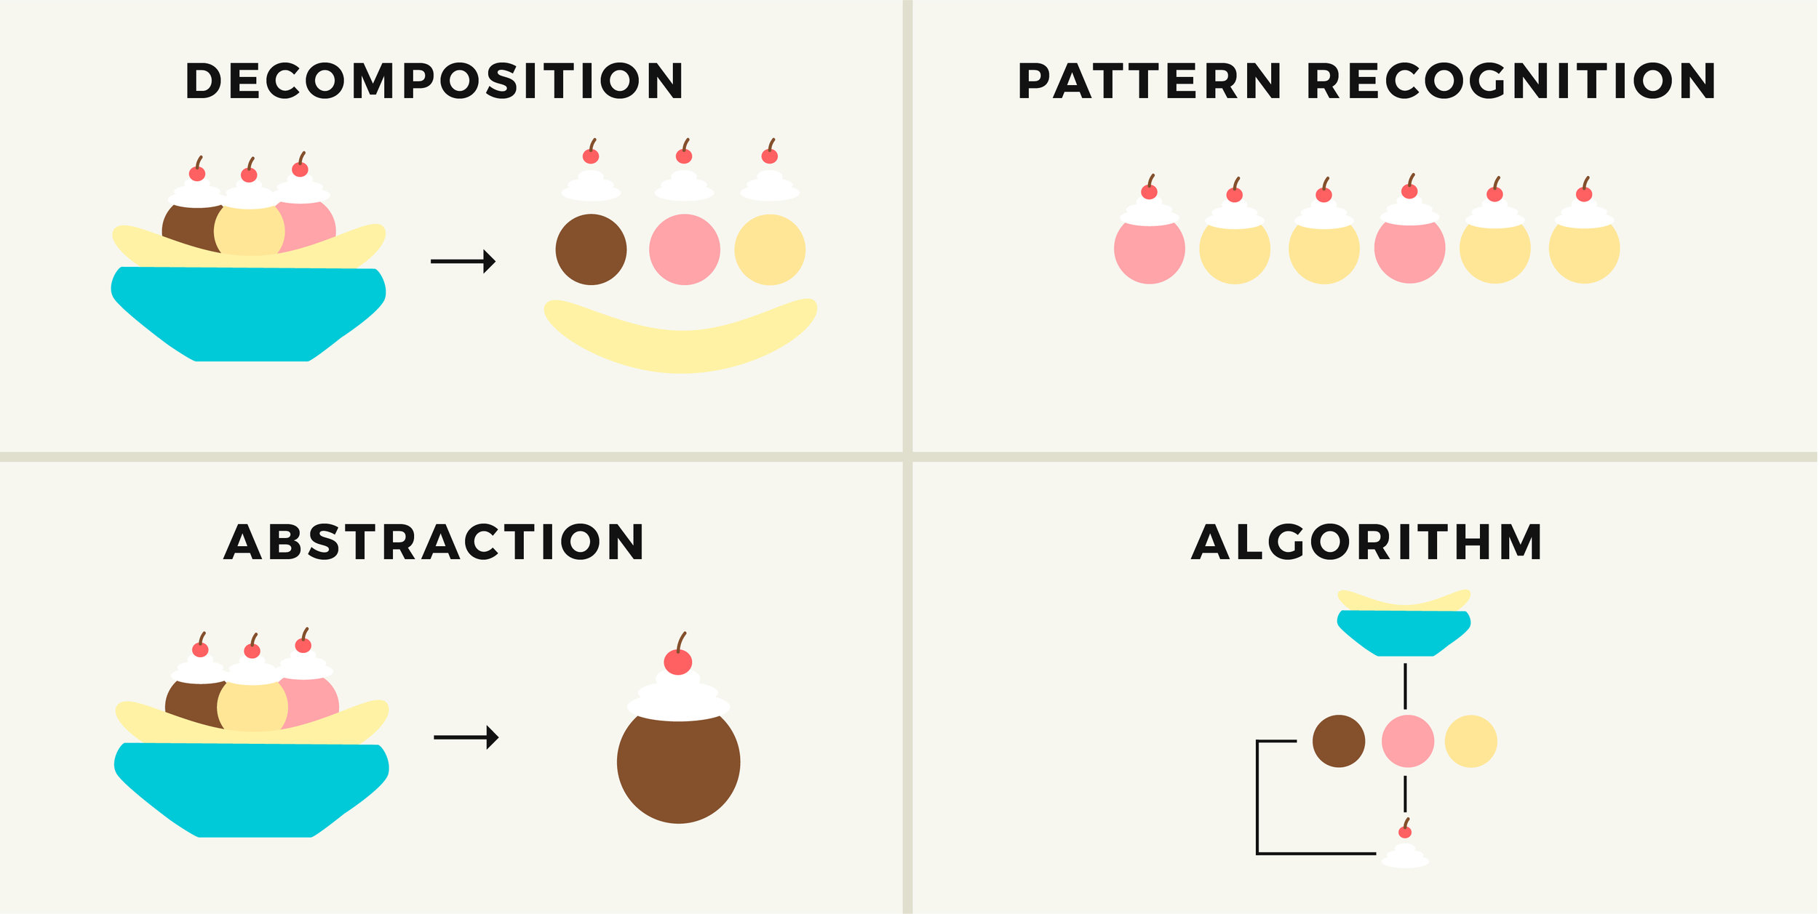
Four Key Elements of Computational Thinking
Breaking down the problem into smaller, more manageable parts
Focusing on the important information only, ignoring irrelevant details
Looking for similarities within problems
Developing a step-by-step solution to the problem

Slide 7

Examples of Computational Thinking
In Everyday Life
#1 PLANNING A VACATION

Slide 8
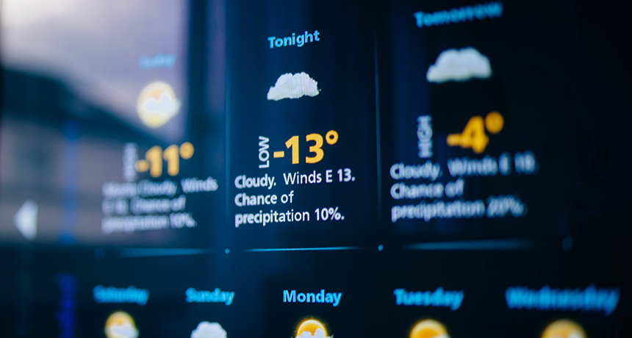
Examples of Computational Thinking
In Everyday Life
#2 WEATHER PREDICTING

Slide 9

Examples of Computational Thinking
In Everyday Life
#3 DATA ANALYZING AND PERSONALIZED RECCOMMODATIONS

Slide 10
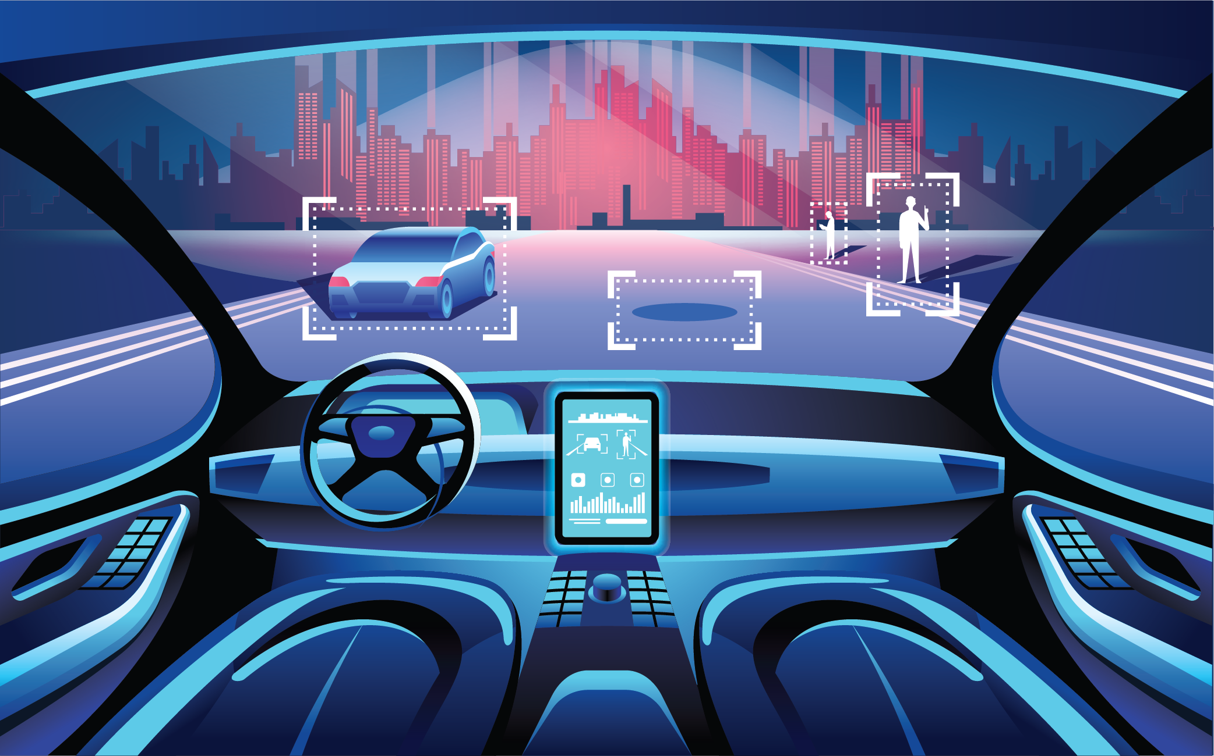
Examples of Computational Thinking
In Everyday Life
#4 SELF-DRIVING CARS

Slide 11
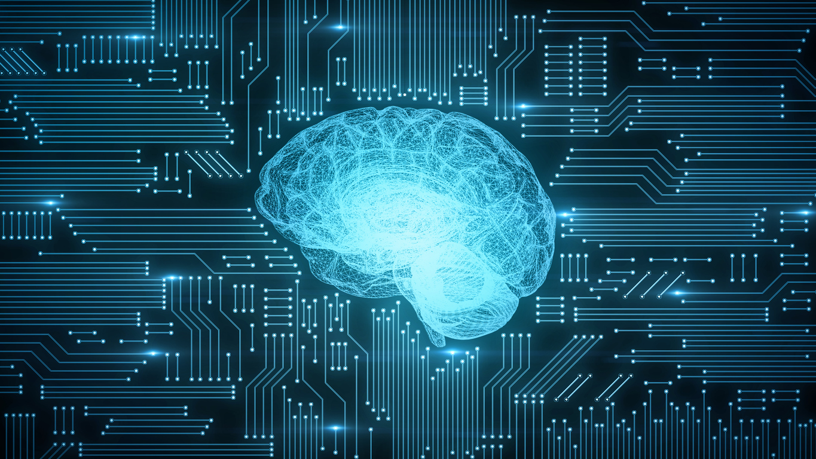
Thinking Like
A Computer Scientist
Thinking like a computer scientist means thinking on multiple levels of abstraction.

Slide 12
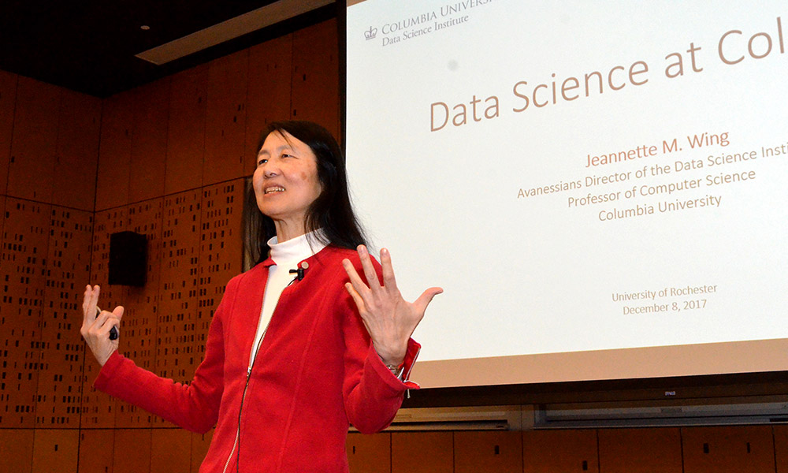
Jeanette M. Wing suggested including Coputational thinking to the education system in order for students to gain future skilllsets.
Jeanette M. Wing

Slide 13
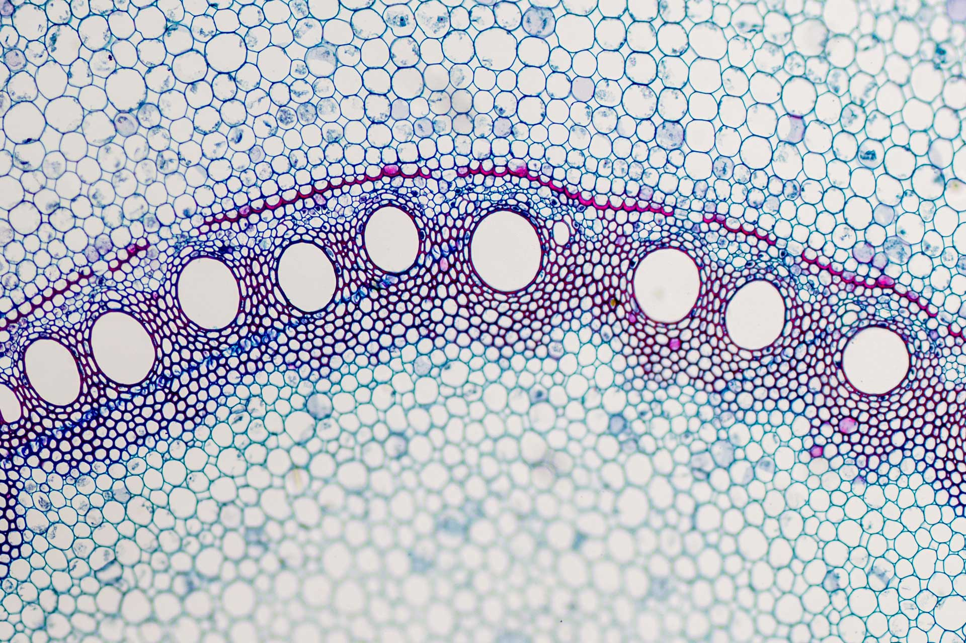
Computational thinking changed the way biologists and other scientists think.

Slide 14

Skillsets evolve to be different in digital age such as,
Coding skills
Analytical thinking
Security
Mobility

Slide 15
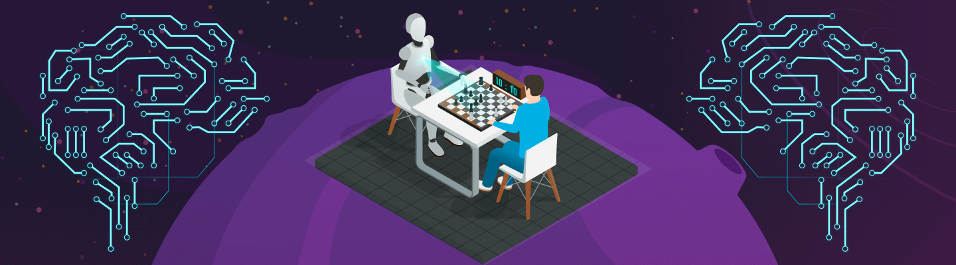
A Small Summary About Computational Thinking;

Slide 16

Thanks For Listening to Us
Bibliography
https://www.k12blueprint.com/sites/default/files/Computational_Thinking_Definition.pdf
https://online.york.ac.uk/what-is-computational-thinking/
https://files.eric.ed.gov/fulltext/EJ1214682.pdf
https://www.cs.cmu.edu/link/research-notebook-computational-thinking-what-and-why
https://isaaccomputerscience.org/concepts/dsa_ctm_logical_thinking?examBoard=all&stage=all&topic=computational_thinking
https://www.symmetrymagazine.org/article/think-like-a-computer?language_content_entity=und
https://www.futurelearn.com/info/courses/secondary-programming-pedagogy/0/steps/68413
https://bsd.education/l/computational-thinking/
https://cacm.acm.org/magazines/2017/6/217742-remaining-trouble-spots-with-computational-thinking/abstract
https://www.cs.cmu.edu/news/2010/bryant-wing-inducted-american-academy-arts-and-sciences
https://www.learningarchitects.com
https://forward.com/culture/346666/remembering-seymour-papert-revolutionary-socialist-and-father-of-ai/
https://busites-www.s3.amazonaws.com/blog-margaritaville/2018/11/ThinkstockPhotos-891573112.jpg
https://www.snexplores.org/article/explainer-weather-and-weather-prediction
https://www.altexsoft.com/blog/recommender-system-personalization/
https://dda.ndus.edu/ddreview/are-self-driving-cars-safe/
https://www.paperhelp.org/blog/what-is-computational-thinking.html
https://numberdyslexia.com/real-life-computational-thinking-examples/

